Slide 1

Unlocking the Secrets of Angles: A Journey Through Trigonometric Equations

Slide 2



Introduction to Angles
the secrets of understanding
is essential for
. This
presentation will take you on a journey through the fascinating world of angles, exploring their properties and applications in various ﬁelds. Get ready to discover how angles shape our understanding of mathematics and beyond!

Slide 3




What are Angles?
An is formed when two lines meet at a point. Angles are measured in or . They play a crucial role in geometry and trigonometry, inﬂuencing everything from architecture to navigation.
Understanding angles is the ﬁrst step in mastering trigonometric equations.

Slide 4








Types of Angles
Angles can be classiﬁed into several types: , , , and .
Each type has unique properties and applications. For example,
are less than 90 degrees, while
exceed 90 degrees. Understanding these types is key to solving trigonometric problems.

Slide 5




Trigonometric Ratios
Trigonometric equations rely on between the sides of a triangle. The primary ratios are , , and
. These ratios allow us to relate angles to side lengths, making them fundamental in solving various mathematical and real-world problems.

Slide 6
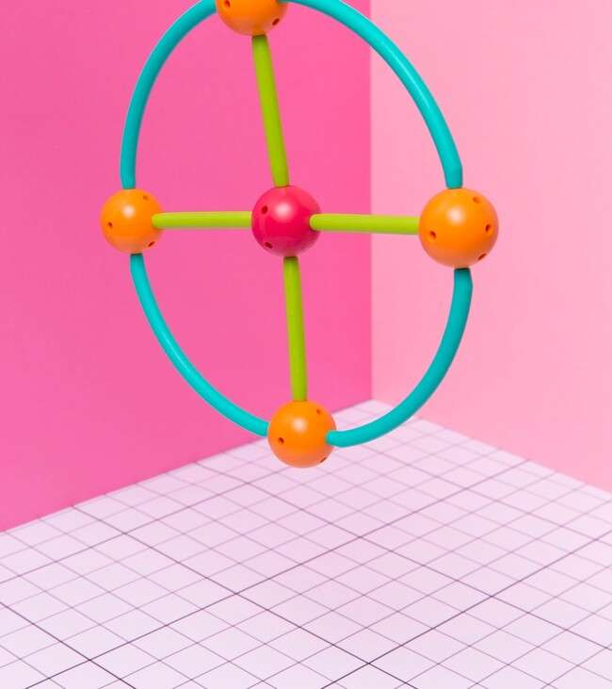

The Unit Circle
The is a powerful tool in trigonometry. It helps visualize the relationship between angles and their corresponding . By
understanding the unit circle, you can easily determine the sine, cosine, and tangent of any angle, enhancing your
problem-solving skills.

Slide 7





Solving Trigonometric Equations
To solve , one
must understand the properties of angles and their relationships.
Techniques such as ,
, and can simplify the process. Mastering these methods will empower you to tackle complex problems with conﬁdence.

Slide 8



Applications of Angles
Angles and trigonometry are not just theoretical; they have real-world applications. From to
, angles help us design structures, navigate, and even create animations. Understanding these applications can inspire creativity and innovation in various ﬁelds.

Slide 9

Conclusion: The Angle's Impact
In conclusion, angles are the of trigonometric equations. By understanding their properties and applications, you unlock a world of possibilities in mathematics and beyond. Continue exploring angles, and let their secrets guide your journey in learning and creativity!

Slide 10
Thanks!
Do you have any questions? youremail@email.com
+91 620 421 838
www.yourwebsite.com @yourusername

