Slide 1

Asymptotes: Understanding the Limits of Functions
Asymptotes are lines that a function approaches as its input approaches certain values. They are crucial concepts in calculus and other areas of mathematics, providing a way to understand the behavior of functions as they approach infinity or specific points. This presentation will delve into the different types of asymptotes, their algebraic determination, and their real-world applications.
oi
by onyi ik

Slide 2
What are Asymptotes?
Definition
Key Concepts
An asymptote is a line that a function approaches as its input approaches either positive or negative infinity, or a specific value. The function can get arbitrarily close to the line, but never actually touches it. Asymptotes are visual representations of the limiting behavior of functions. They help us understand how a function behaves in the long run, as its input grows very large or very small.
Asymptotes are essential for understanding the behavior of functions. They represent the function's tendency to approach a particular line as its input increases or decreases indefinitely. Asymptotes can be horizontal, vertical, or oblique.

Slide 3
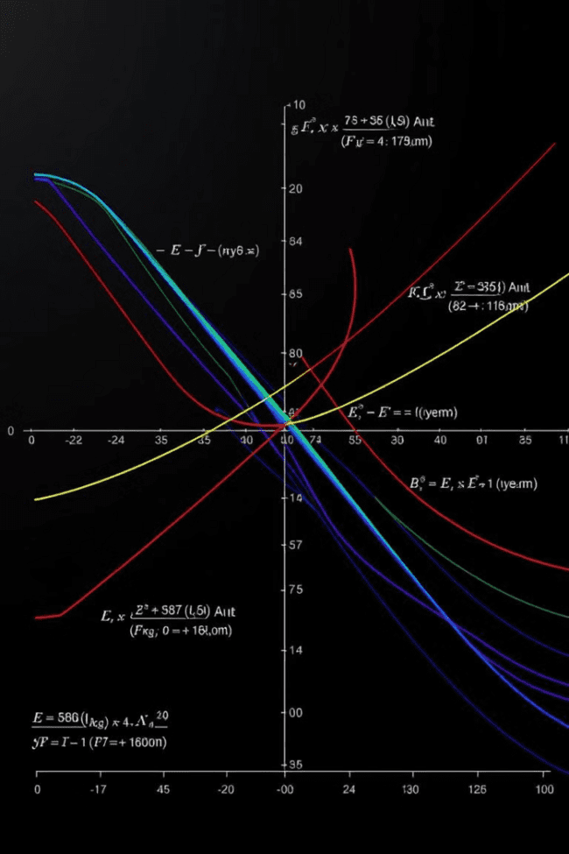
Types of Asymptotes
Vertical
Horizontal
Occur when the function approaches infinity or negative infinity as the input approaches a specific value. These asymptotes are vertical lines that the function gets closer and closer to.
Occur when the function approaches a specific value as the input approaches either positive or negative infinity. These asymptotes are horizontal lines that the function gets closer and closer to as the input grows larger or smaller.
Oblique
Occur when the function approaches a non-horizontal line as the input approaches either positive or negative infinity. These asymptotes are slanted lines that the function gets closer and closer to as the input grows larger or smaller.

Slide 4
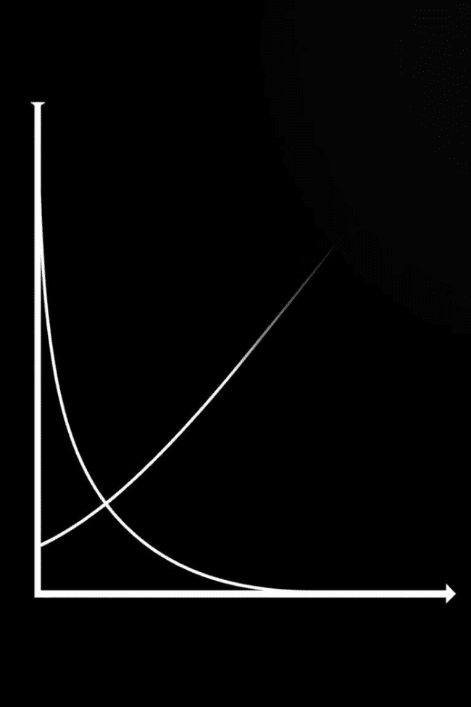


Vertical Asymptotes
Definition
A vertical asymptote is a vertical line that a function approaches as its input approaches a specific value. The function gets closer and closer to the line, but never actually touches it. The value at which the input approaches is where the vertical asymptote is located. It represents a point where the function becomes undefined.
Finding Vertical Asymptotes
To find vertical asymptotes, we usually check where the denominator of a rational function becomes zero, provided the numerator is not also zero at that point. The function will generally have a vertical asymptote where the denominator equals zero, but not where the numerator is also zero.

Slide 5


Horizontal Asymptotes
Definition
Finding Horizontal Asymptotes
A horizontal asymptote is a horizontal line that a function approaches as its input approaches either positive or negative infinity. The function gets closer and closer to the line, but never actually touches it. This asymptote represents the function's limiting behavior as its input grows very large or very small.
To find horizontal asymptotes, we analyze the degree of the numerator and the denominator of a rational function. If the degree of the numerator is less than the degree of the denominator, the horizontal asymptote is at y=0. If the degrees are equal, the horizontal asymptote is at y=the leading coefficient of the numerator divided by the leading coefficient of the denominator. If the degree of the numerator is greater than the degree of the denominator, there is no horizontal asymptote.

Slide 6
Oblique Asymptotes
Definition
An oblique asymptote is a non-horizontal line that a function approaches as its input approaches either positive or negative infinity. The function gets closer and closer to the line, but never actually touches it. These asymptotes are typically slanted lines and represent the function's asymptotic behavior in the long run.
1
Finding Oblique Asymptotes
To find oblique asymptotes, we perform polynomial long division of the numerator by the denominator of a rational function. If the degree of the numerator is one greater than the degree of the denominator, the quotient obtained from the division will be a linear equation, representing the oblique asymptote. If the degree of the numerator is more than one greater than the degree of the denominator, the quotient will be a higher-degree polynomial, and there will be no oblique asymptote.
2

Slide 7
Finding Asymptotes Algebraically
Vertical Asymptotes
Horizontal and Oblique Asymptotes
To find vertical asymptotes, factor the denominator of a rational function. Set the denominator equal to zero and solve for the variable. Any values that make the denominator zero and do not also make the numerator zero are vertical asymptotes.
To find horizontal and oblique asymptotes, consider the degrees of the numerator and denominator. If the degree of the numerator is less than the degree of the denominator, the horizontal asymptote is at y=0. If the degrees are equal, the horizontal asymptote is at y=the leading coefficient of the numerator divided by the leading coefficient of the denominator. If the degree of the numerator is greater than the degree of the denominator, there is no horizontal asymptote, but we can use polynomial long division to find an oblique asymptote.

Slide 8

Graphing Functions with Asymptotes
1
2
Identify Asymptotes
Plot Asymptotes
Use the methods discussed earlier to find the vertical, horizontal, and oblique asymptotes.
Draw the asymptotes as dotted lines on the coordinate plane.
3
4
Plot Points
Sketch the Curve
Choose a few input values and calculate the corresponding output values. Plot these points on the graph.
Connect the plotted points with a smooth curve, keeping in mind the asymptotic behavior. The function should get closer and closer to the asymptotes but never touch them. The shape of the curve near the asymptotes can be determined by analyzing the function's behavior as the input approaches the asymptotic values.

Slide 9



Applications of Asymptotes
Physics
Asymptotes are used to describe the behavior of physical systems, such as the velocity of an object falling under gravity or the temperature of a heated object cooling down. They are essential tools for understanding the limits of physical systems and predicting their behavior under different conditions.
1
Engineering
2
Engineers utilize asymptotes to design and analyze structures, circuits, and other systems. They help determine the limits of system performance and predict the behavior of systems under extreme conditions.
Economics
Asymptotes are employed to model economic phenomena, such as the growth of a company's profits or the supply and demand of a particular product. They provide a way to understand the long-term trends of economic systems and predict their behavior under different market conditions.
3

Slide 10
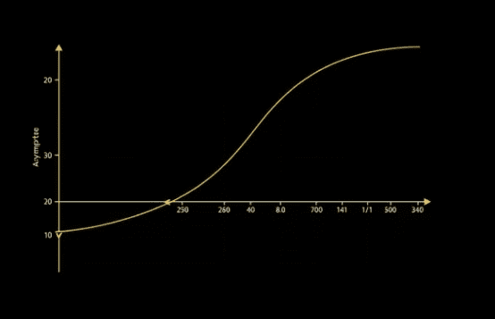

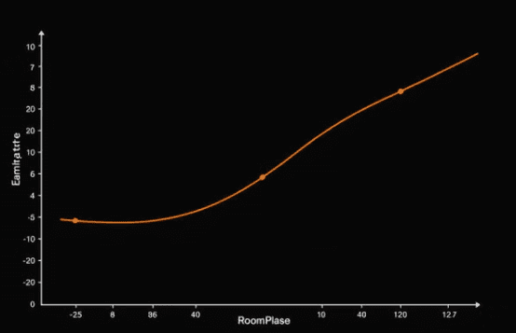
Importance of Asymptotes in Real-World Scenarios
Asymptotes are crucial for understanding the behavior of real-world systems. They provide a way to model and predict how these systems will behave as they approach their limits. Whether in physics, engineering, economics, or other fields, the concept of asymptotes is essential for understanding complex systems and making informed decisions about their design and operation.

