Slide 1
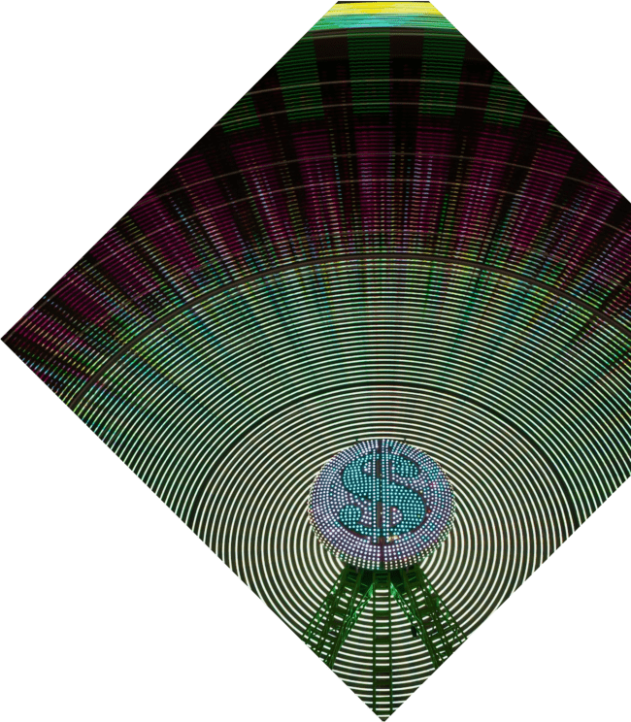

Rhythms of Repetition: Unveiling the Dance of Periodic Functions

Slide 2






Introduction to Periodic
Functions
Welcome to the world of
, where and create a beautiful dance.
In this presentation, we will explore the nature of these functions and their significance in mathematics and beyond. Get ready to unveil the that govern our universe!

Slide 3
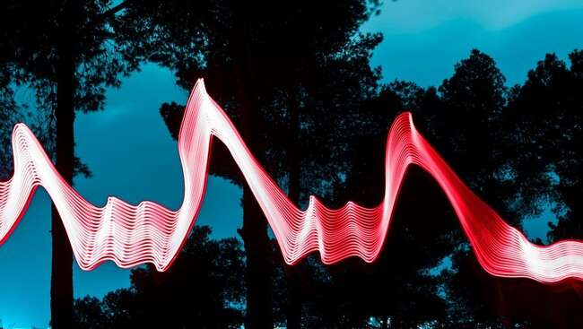


Understanding Periodicity
At the heart of periodic functions lies
. A function is periodic if it repeats its values at regular intervals, known as the . This concept is
crucial in understanding various phenomena, from sound waves to seasonal changes. Let’s delve deeper into its mathematical foundations.

Slide 4
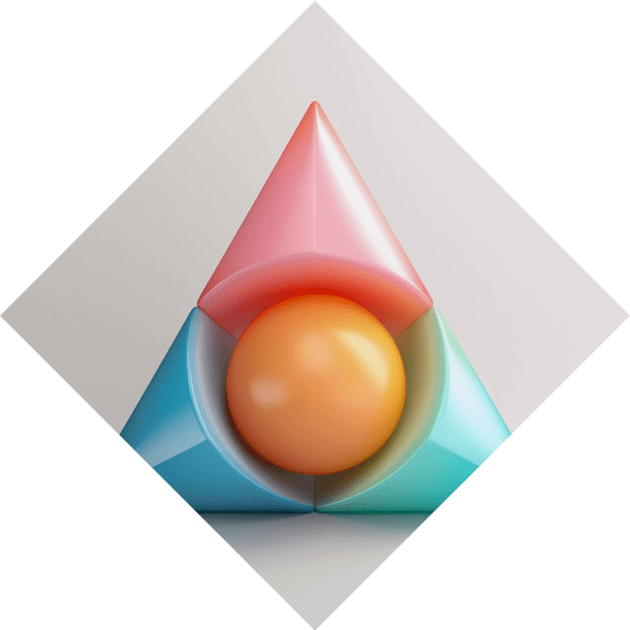




Common Periodic Functions
Some of the most common
include the and functions. These trigonometric
functions are not only fundamental in
mathematics but also essential in engineering, physics, and music. Their oscillating patterns create harmony in various applications.

Slide 5
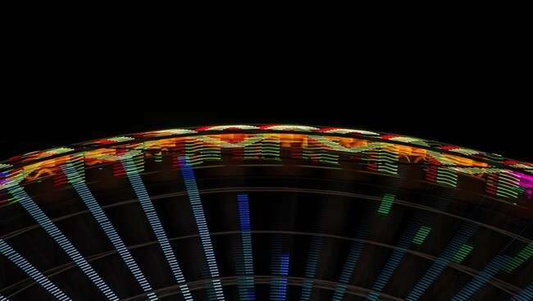


The Role of Frequency
Frequency plays a pivotal role in periodic functions. It defines how often a function repeats itself within a given time frame. The relationship between and is inverse, creating a fascinating interplay that governs oscillatory
motion in nature.

Slide 6
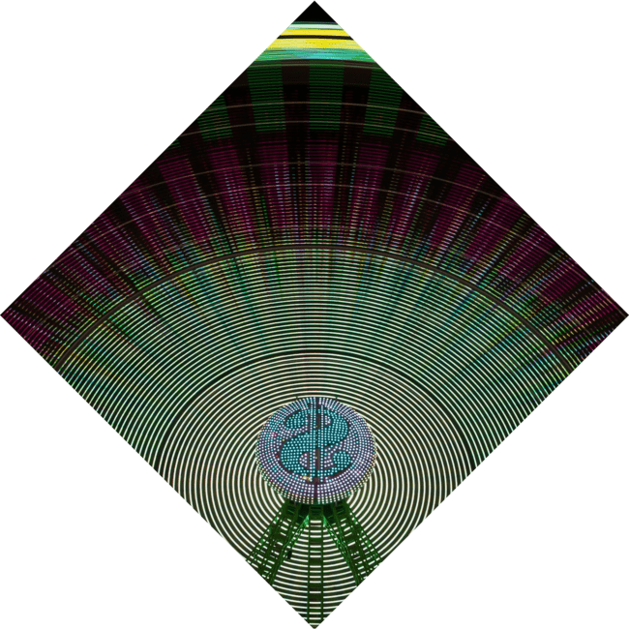



Applications in Real Life
Periodic functions find applications
in diverse fields, such as
, , and even
. From designing bridges to analyzing market trends, understanding these rhythms can lead to innovative solutions and insights. Let’s explore some intriguing examples.

Slide 7
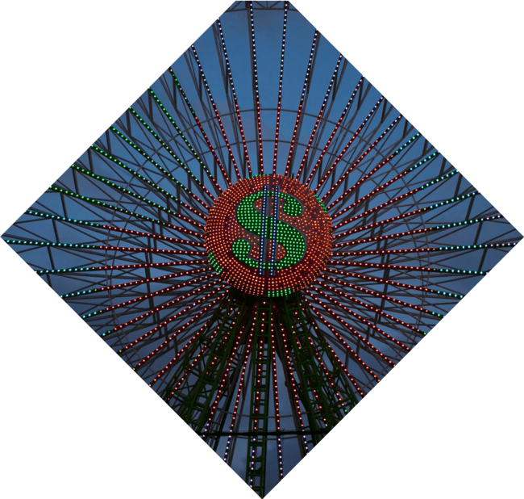

Fourier Series: Breaking it Down
The is a powerful tool that allows us to express periodic functions as a sum of sine and cosine functions. This decomposition reveals the underlying frequencies and harmonics, enabling deeper analysis and understanding of complex waveforms.

Slide 8
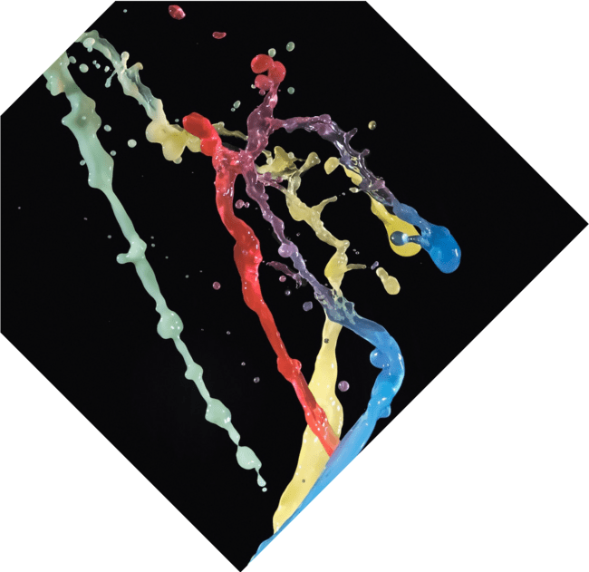

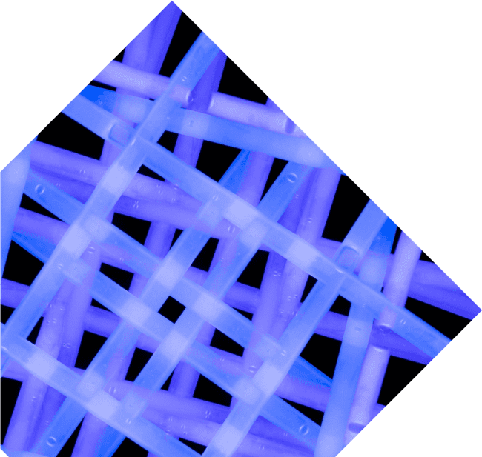
Exploring Chaos and Order
While periodic functions represent order, they can also lead to in certain conditions. Understanding the transition between order and chaos in periodic systems is a fascinating area of study, revealing the complexity of natural rhythms.

Slide 9
Conclusion: Embracing the Rhythm
In conclusion, the is
an essential aspect of our world. By embracing
these rhythms, we can unlock new insights and foster creativity in various disciplines. Let us continue to explore and celebrate the beauty of repetition in mathematics and nature!

Slide 10
Thanks!
Do you have any questions?
youremail@email.com
+91 620 000 838
www.yourwebsite.com @yourusername

