Slide 1

Linear Equations: A Comprehensive Overview
This presentation will explore the fundamentals of linear equations, including their definition, characteristics, and applications. We'll delve into methods for solving and graphing these equations, ultimately equipping you with a strong understanding of this crucial mathematical concept.
by Onyedikachi Ikenna Onwurah

Slide 2

Definition and Characteristics
Definition
Characteristics
Linear equations are mathematical expressions that represent a straight line when plotted on a graph. They consist of variables, constants, and coefficients, with the highest power of any variable being 1.
Key features of linear equations include a constant rate of change (slope) and a y-intercept, where the line intersects the y-axis. These characteristics determine the shape and position of the line on the graph.

Slide 3

Solving Linear Equations
1
1. Substitution Method
2
2. Elimination Method
This method involves solving one equation for one variable and substituting it into the other equation.
In this method, equations are manipulated to eliminate one variable, allowing you to solve for the other.

Slide 4
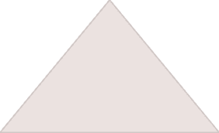
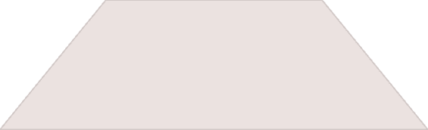
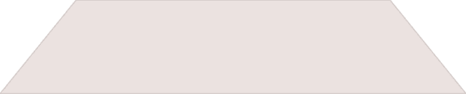
Graphing Linear Equations
Slope-Intercept Form
1
Use the slope and y-intercept to plot the line.
Point-Slope Form
2
Use a point and the slope to plot the line.
Two Points
3
Plot the two points and draw the line.

Slide 5
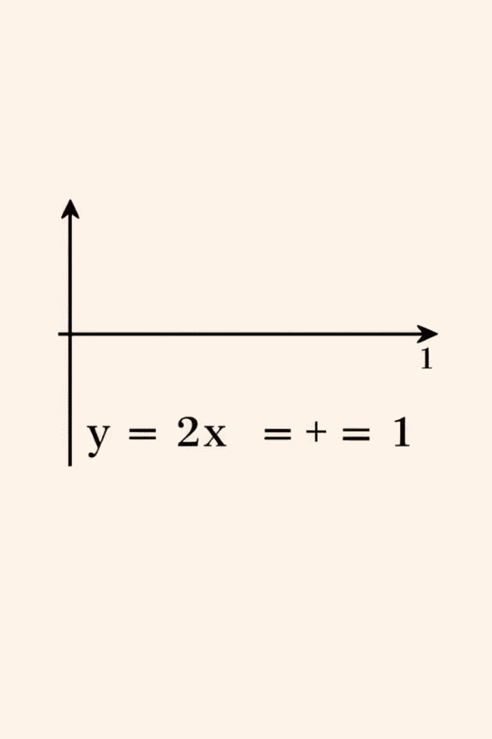



Slope-Intercept Form
y = mx + c
where m is the slope and c is the y-intercept.
Slope (m)
The rate of change of the line, indicating its steepness.
Y-intercept (c)
The point where the line intersects the y-axis.

Slide 6
Point-Slope Form
y - y1 = m(x - x1)
1
where m is the slope and (x1, y1) is a point on the line.
Slope (m)
2
Represents the rate of change of the line.
Point (x1, y1)
3
A specific point through which the line passes.

Slide 7

Applications of Linear Equations
Science
Business
Linear equations are used to model relationships between variables, such as velocity and time in physics.
They are used to analyze costs, revenue, and profits, enabling businesses to make informed decisions.

Slide 8
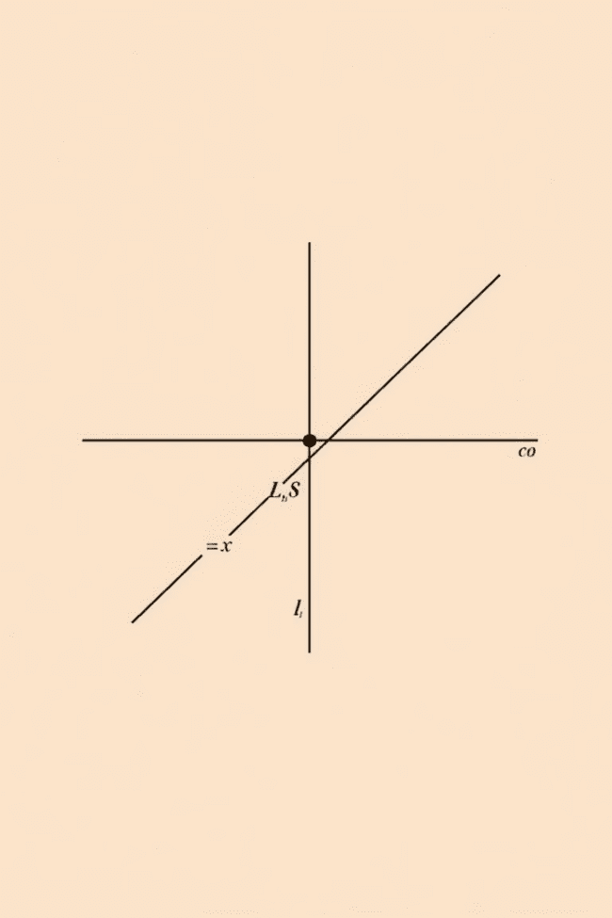


Solving Systems of Linear Equations
Graphical Method
Algebraic Method
The solution is the point where the lines intersect.
Use substitution or elimination to solve for the variables.

