Slide 1


Reflections of Balance: Unveiling the Beauty of Symmetry in Functions

Slide 2




Introduction to
Symmetry
is a captivating concept found in nature and mathematics. This presentation will explore the of symmetry in functions, revealing how it enhances our
understanding of the world around us. Join us as we delve into the of balance and harmony in mathematical expressions.

Slide 3

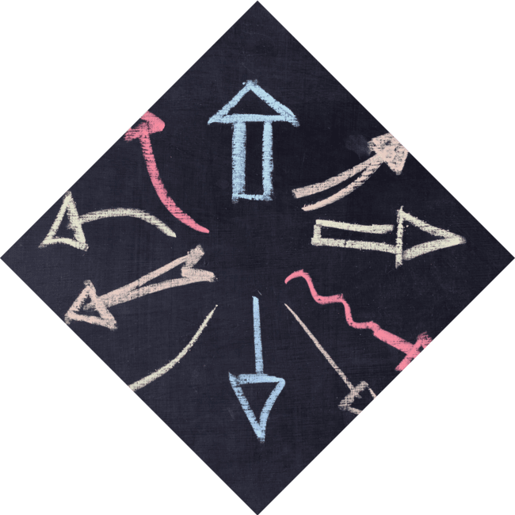



Defining Symmetry in
Functions
In mathematics, a function is said to be if it exhibits a balanced structure. This can manifest as or functions, where the graph mirrors itself across the y-axis or the origin, respectively. Understanding these properties is crucial in analyzing
their .

Slide 4

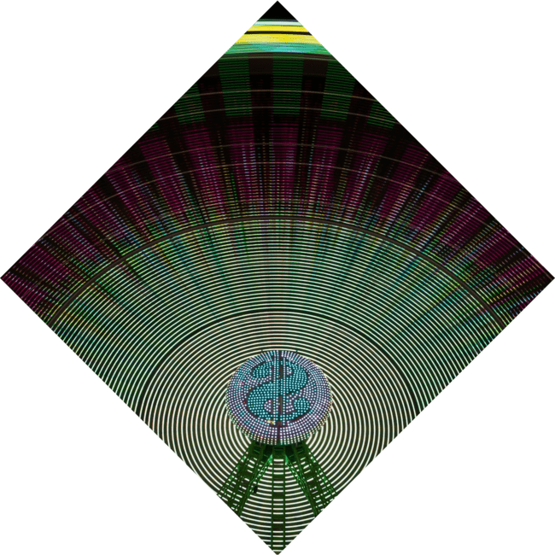


Even Functions
Explained
satisfy the condition f(x) = f(-x). This means their graphs are symmetric around the .
Common examples include quadratic functions like f(x) = x². Their behavior makes them essential in various fields such as physics and engineering.

Slide 5

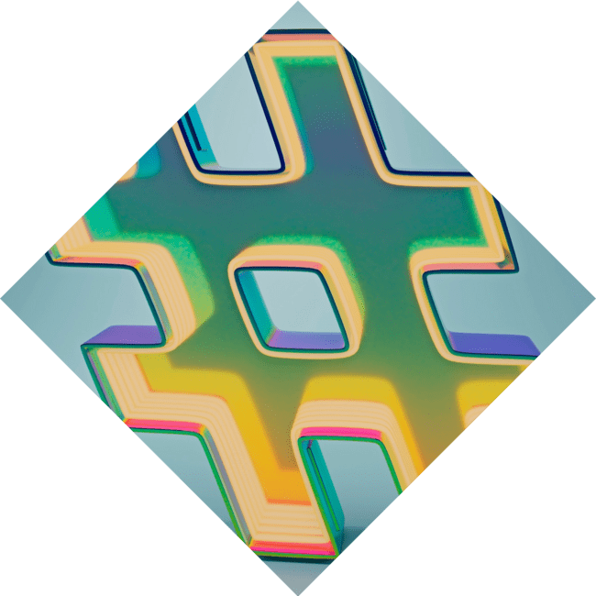


Odd Functions Unveiled
follow the rule f(-x) =
-f(x), showcasing symmetry about the . A classic example is f(x) = x³, which exhibits a unique rotational symmetry. Understanding these functions enables deeper insights into their in
real-world scenarios.

Slide 6






Applications of
Symmetry
Symmetry in functions is not just a
concept; it has practical applications in fields like ,
, and .
Recognizing symmetric properties can simplify complex problems and
enhance
, leading to more efficient solutions.

Slide 7
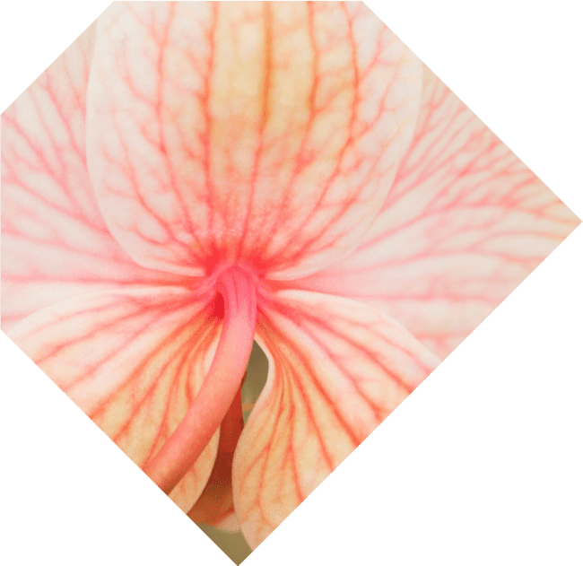



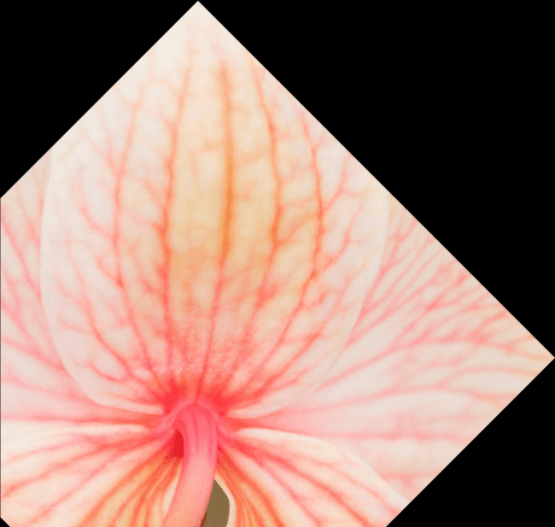
Exploring Symmetry in Nature
Nature is a of symmetry, with examples ranging from the of flowers to the structure of snowflakes. These natural forms inspire mathematical models, illustrating how and beauty are intertwined in the world around us.

Slide 8
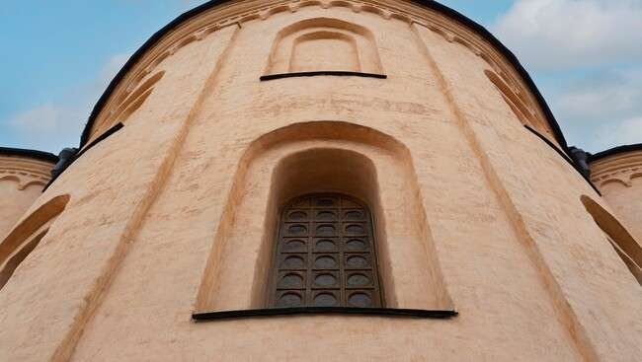


Art and Symmetry
Artists have long been fascinated by
, using it to create visually stunning works. From ancient architecture to modern designs, the
principles of symmetry evoke a sense of and balance, captivating audiences and enhancing aesthetic
appeal.

Slide 9


Conclusion: The Beauty of Balance
In conclusion, the exploration of in functions reveals a rich tapestry of balance and beauty. Understanding these concepts not only deepens our mathematical knowledge but also
enriches our appreciation for the present in both art and nature.

Slide 10
Thanks!
Do you have any questions?
youremail@email.com
+91 620 000 838
www.yourwebsite.com @yourusername

