Slide 1
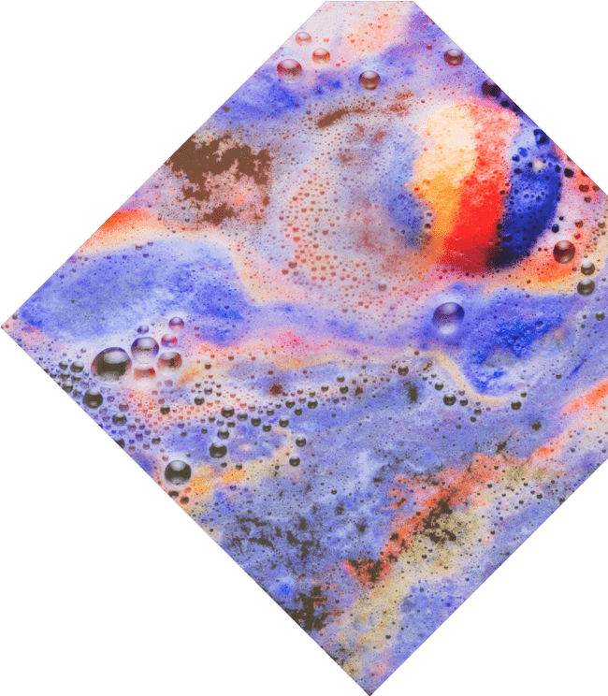
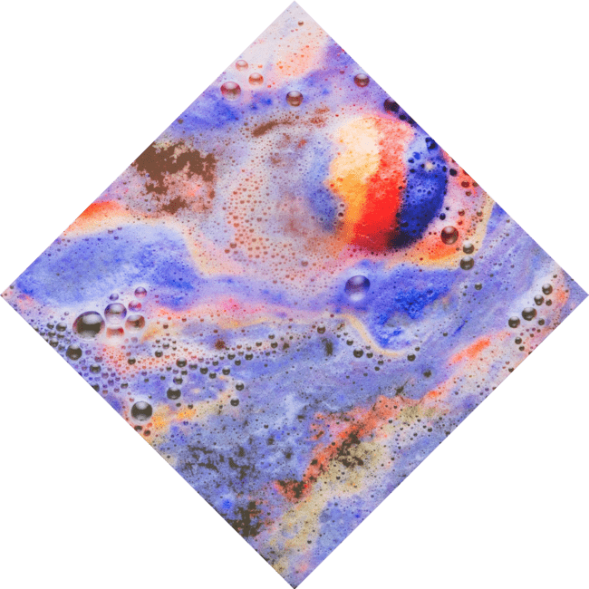
Unraveling the Magic: The Art of Function Composition

Slide 2
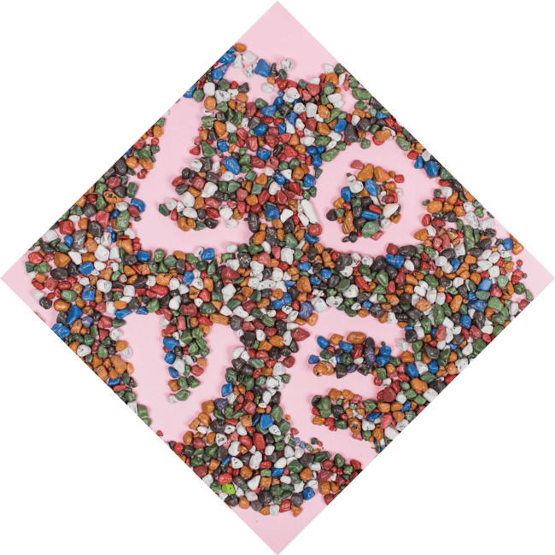




Introduction to Function
Composition
Welcome to our journey through
! Here, we will explore how combining functions can create and outcomes.
Prepare to unravel the behind this essential mathematical concept, which is not only powerful but also
remarkably .

Slide 3




What is Function Composition?
is the process of combining two or more functions to create a function. The output of one function becomes the input of another. This intriguing concept allows us to
and data in fascinating ways, leading to surprising results.

Slide 4
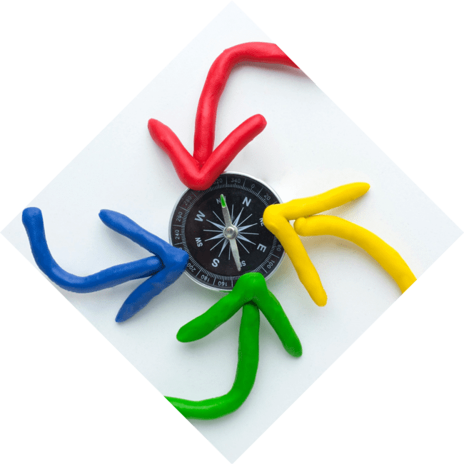



The Notation of Composition
In mathematics, function composition is denoted as , which means . This notation emphasizes the of operations,
showcasing how the inner function is applied first, followed by the outer function . Understanding this is key
to mastering function composition.

Slide 5
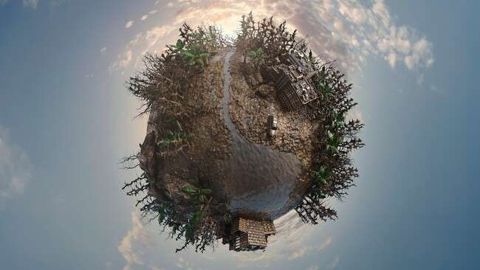





Visualizing Composition
Visualizing function composition can be . Imagine two
landscapes: one representing
and the other . The of g
creates a for f, illustrating how these functions interact and transform each other in a beautiful,
way.

Slide 6







Real-World Applications
Function composition is not just theoretical; it has
applications in various fields such as
, , and
. For instance, in programming, functions are composed to create complex
algorithms, showcasing the
and
of this mathematical
tool.

Slide 7

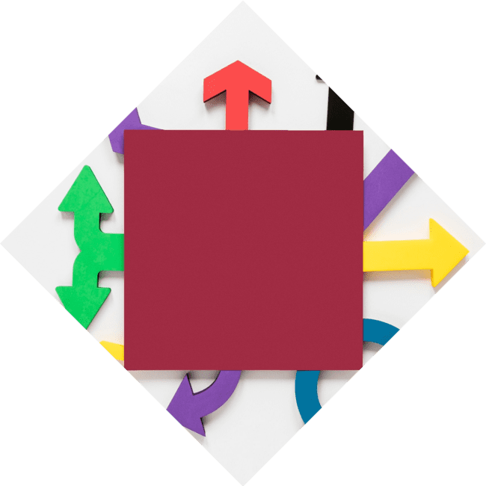


Properties of Composition
Understanding the of function composition is crucial. It is
, meaning (f ∘ g) ∘ h = f ∘ (g
∘ h). However, it is , as f ∘ g does not equal g ∘ f. These properties guide us in effectively using composition in problem-
solving.

Slide 8
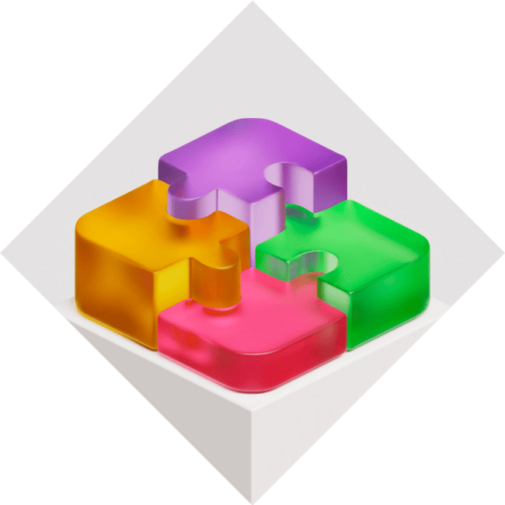


Challenges in Composition
While function composition is powerful, it can also present
. Identifying the correct order of functions and ensuring their compatibility can be tricky. Embracing these challenges can lead to deeper understanding and
mastery of this
mathematical technique.

Slide 9


Conclusion: The Art of Composition
In conclusion, is a magical blend of creativity and mathematics. It empowers us to create new functions, solve complex problems, and visualize relationships between variables. Embrace the art of composition, and let your imagination in the world of mathematics!

Slide 10
Thanks!
Do you have any questions?
youremail@email.com
+91 620 000 838
www.yourwebsite.com @yourusername

