Slide 1


Unlocking the Power of Linear Functions: The Straight Path to Understanding

Slide 2




Unlocking Linear
Functions
Welcome to our journey into the world of ! In this
presentation, we will explore the of these mathematical tools and how they pave the way for understanding complex
relationships in our daily lives. Let's
embark on this
adventure together!

Slide 3



What is a Linear Function?
A is a relationship where a change in one variable results in a consistent change in another.
Mathematically, it can be expressed as
, where is the slope and is the y- intercept. This simplicity makes it a powerful tool in .

Slide 4




The Slope: A Key Component
The of a linear function measures its steepness and direction. Positive slopes indicate an trend, while negative slopes indicate a trend.
Understanding slope is crucial for interpreting data trends and making predictions in various fields.

Slide 5
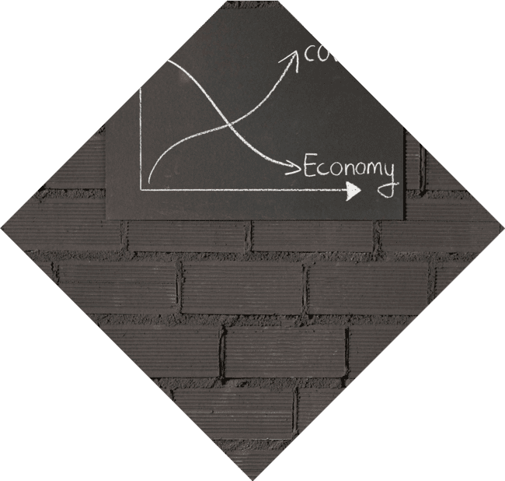



Y-Intercept: Where It Begins
The is the point where the line crosses the y-axis. It represents the value of when is zero. This point is essential
for graphing linear functions and understanding their
real-world scenarios.
in

Slide 6




Applications in Real Life
Linear functions are everywhere! From predicting sales in to calculating distance in , their applications are vast. By recognizing patterns through linear equations, we can make informed decisions and in everyday life.

Slide 7



Graphing Linear
Functions
Graphing linear functions allows us to visualize relationships between variables. By plotting points and connecting them, we can see trends
and make predictions. This
is a powerful tool in both mathematics and data
analysis.

Slide 8


Common Misconceptions
Many people assume that all
are linear, but that's not always the case. Understanding the limitations of linear functions is crucial. Not every situation can
be accurately modeled by a straight line, and recognizing this is key to effective analysis.

Slide 9

Conclusion: Embrace the Straight Path
In conclusion, linear functions are fundamental tools that help us understand the world around us. By mastering their principles, we unlock the potential for in problem-solving and analysis. Embrace the straight path to understanding and apply these concepts in your life!

Slide 10
Thanks!
Do you have any questions?
youremail@email.com
+91 620 421 838
www.yourwebsite.com @yourusername

