Slide 1
What do you need?
Keep Calm
&
Bring Your Materials Everyday
Stationery
Maths exercise book
Textbook 2A
Workbook 2A
Homework, WB 2A, Pg 1 - 4 (on teacher’s table)

Slide 2
Lesson 4
31 Aug 20

Slide 3
Lesson Objective
To explore Firefly subject pages
To solve simultaneous linear equations using graphical methods

Slide 4
Firefly
Subject Blog, Resources & Tasks
Click

Slide 5
Corrections: Worksheet 1.1
Common Mistakes
Pencil & ruler to plot
State equation of line on graph paper
Include x/ y in the equation of line
Extend the line till end of graph paper
Plot lines, not coordinates
Negative or Positive

Slide 6
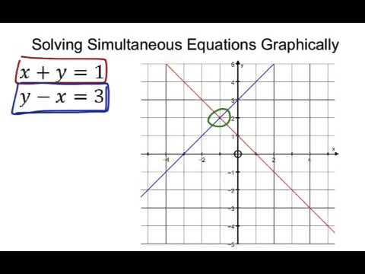
Solving simultaneous linear equations by graphical method

Slide 7
Guided Practice
TB 2A, Pg 11, WE 2 (WS)

Slide 9
What do you need?
Keep Calm
&
Bring Your Materials Everyday
Stationery
Maths exercise book
Textbook 2A
Workbook 2A
Worksheet (Guided Practice)

Slide 10
Lesson 5
1 Sep 20

Slide 11
Lesson Objective
To solve simultaneous linear equations using graphical methods

Slide 12
Guided Practice
TB 2A, Pg 11, WE 2 (WS)
Step 1: Plot line 1
Step 2: Plot line 2
Step 3: Find intersection point

Slide 13

Self Practice
TB 2A, Pg 12, PN 2
Individual/ pair work
Submit after completing
Step 1: Plot line 1
Step 2: Plot line 2
Step 3: Find intersection point

Slide 15
What do you need?
Keep Calm
&
Bring Your Materials Everyday
Stationery
Maths exercise book
Textbook 2A
Workbook 2A
Worksheet [Provided: Guided Practice 2]

Slide 16
Lesson 6
2 Sep 20

Slide 17
Lesson Objective
To solve simultaneous linear equations using graphical methods

Slide 18
Self Practice
TB 2A, Pg 12, PN 2 [WS: Guided Practice 2]
Individual/ pair work
Submit after completing
Step 1: Plot line 1
Step 2: Plot line 2
Step 3: Find intersection point

Slide 20
What do you need?
Keep Calm
&
Bring Your Materials Everyday
Stationery
Maths exercise book
Textbook 2A
Workbook 2A

Slide 21
Lesson 7
3 Sep 20, Thursday

Slide 22
Lesson Objective
To solve simultaneous linear equations using elimination

Slide 23
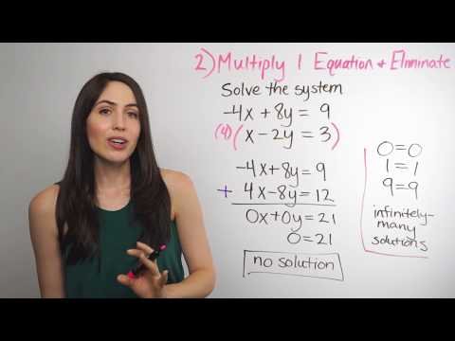
Solving Systems of Equations

Slide 24
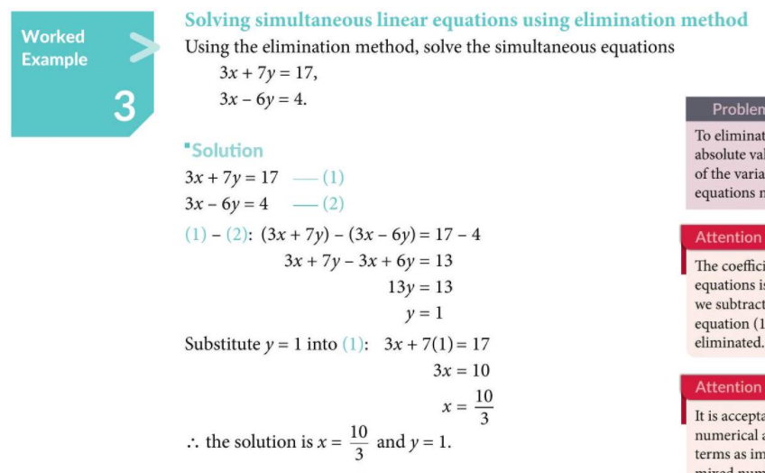
Guided Practice
TB 2A, Pg 15, WE 3

Slide 25
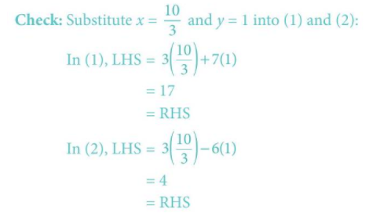
Guided Practice
TB 2A, Pg 15, WE 3

Slide 26
Guided Practice
WB 2A, Pg 13, Qn 1a
Solve each pair of simultaneous equations
1a) 2x + y = 5
x + y = 1

Slide 27

Self Practice
WB 2A, Pg 13
Qn 1b, c, d
Individual/ pair work

Slide 29
What do you need?
Keep Calm
&
Bring Your Materials Everyday
Stationery
Maths exercise book (Bring it home)
Textbook 2A (Bring it home)
Workbook 2A
E Teaching on Monday

Slide 30
Lesson 8
4 Sep 20, Friday

Slide 31
Lesson Objective
To solve simultaneous linear equations using elimination
To solve simultaneous linear equations using substitution

Slide 32
Google Meet Link
https://meet.google.com/tre-ntgh-puc
Firefly subject blog
Google calendar invite
Email
Hangouts

Slide 33
Self Practice
WB 2A, Pg 13
WB 2A, Pg 14, Qn 1g, 1h, 1i
Individual/ pair work

Slide 34
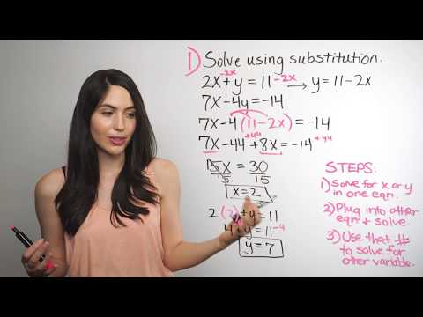
Solving Systems of Equations

Slide 35
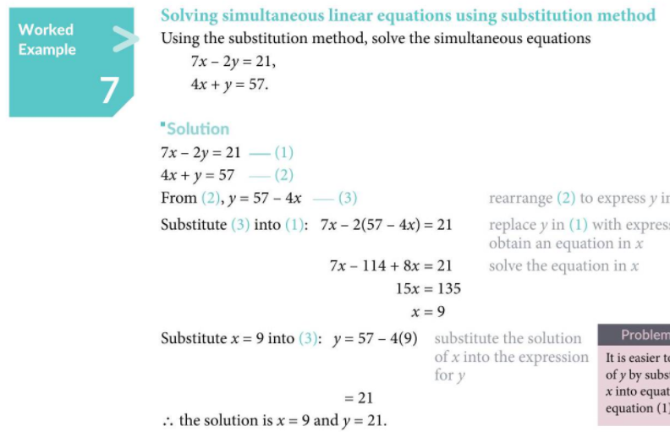
Guided Practice
TB 2A, Pg 18, WE 7

Slide 36
Guided Practice
WB 2A, Pg 14, Qn 1k

Slide 37
Self Practice
WB 2A, Pg 14, Qn 1j, 1l
Individual/ pair work

Slide 38

Homework
WB 2A, Pg 13 - 15
Due: Tuesday, 8 Sep 20

