Slide 1

Unraveling the Curves: The Art and Science of Parametric Equations

Slide 2
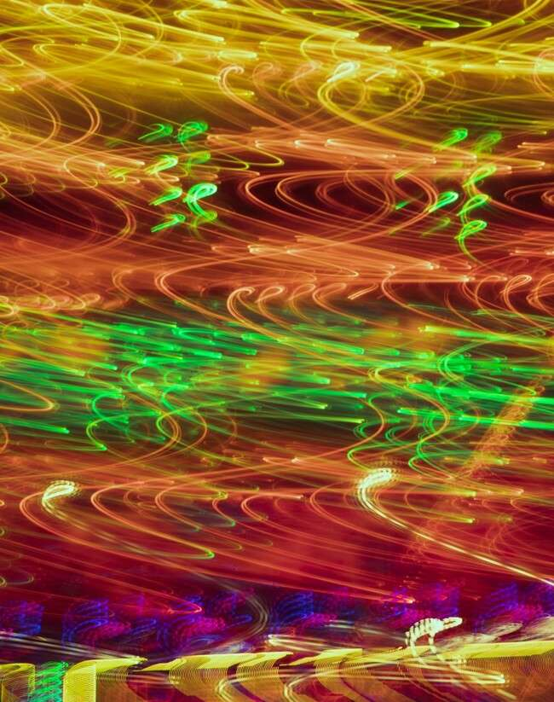



Introduction to Parametric Equations
Welcome to the fascinating world of
! In this presentation, we will explore the and behind these mathematical
tools, revealing their beauty and utility in various ﬁelds. Get ready to that deﬁne our universe!

Slide 3
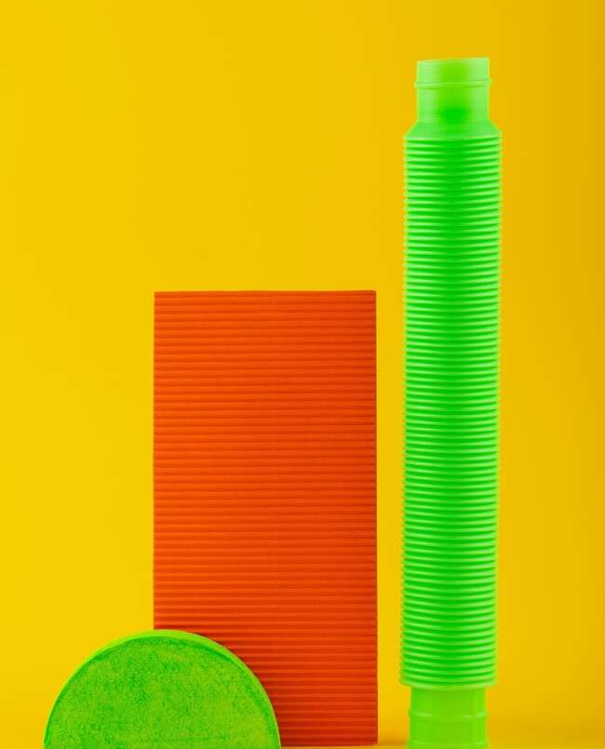
What are Parametric Equations?
deﬁne curves using one or more parameters. Unlike standard equations, they allow for a more dynamic representation of shapes. This ﬂexibility enables us to describe complex motions and relationships in and
spaces.

Slide 4
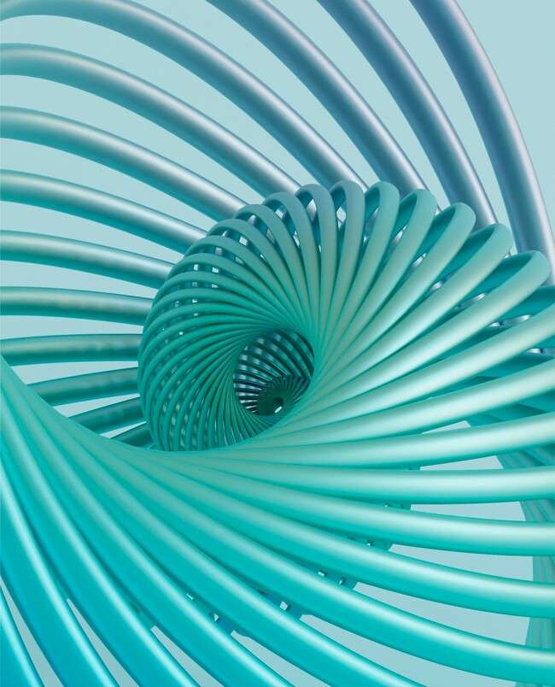

Applications in Art
and designers often use parametric equations to create stunning visual works. By manipulating parameters, they can generate intricate patterns and shapes, transforming mathematical concepts into
that captivate the viewer's imagination.

Slide 5
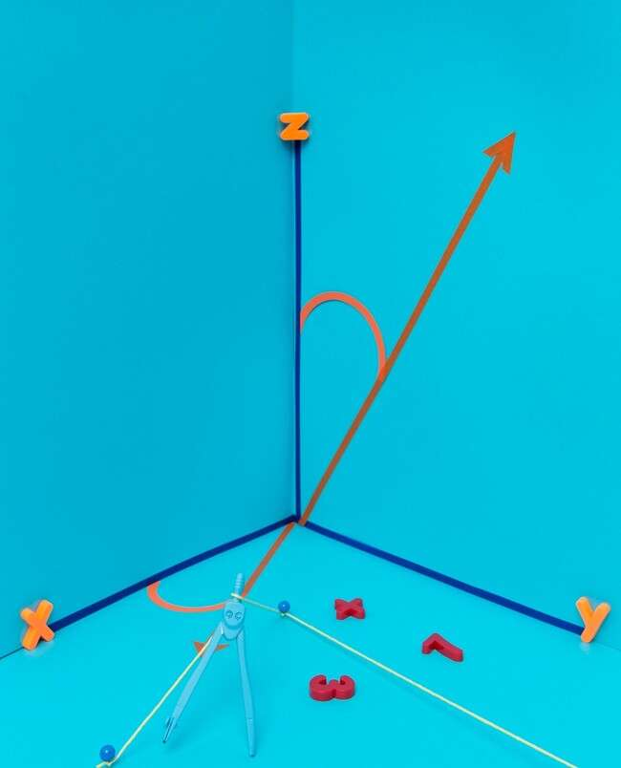





Applications in Science
play a crucial role in various scientiﬁc ﬁelds, including , , and
. They help model trajectories, simulate movements, and create realistic animations, bridging the gap between and
applications.

Slide 6
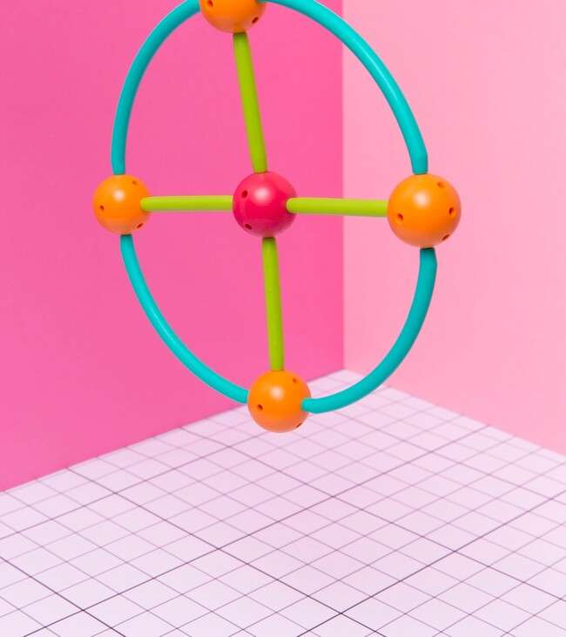

Creating Parametric
Curves
To create a , you need to express the x and y coordinates as functions of a parameter, usually denoted as . For example, the equations x(t) and y(t) can describe a circle, allowing us to visualize it dynamically as varies.

Slide 7





Exploring Famous Curves
Many can be
described using parametric equations, such as the
and the . Each curve offers unique insights into mathematical properties and can be visualized beautifully, showcasing the interplay of art and
science.

Slide 8
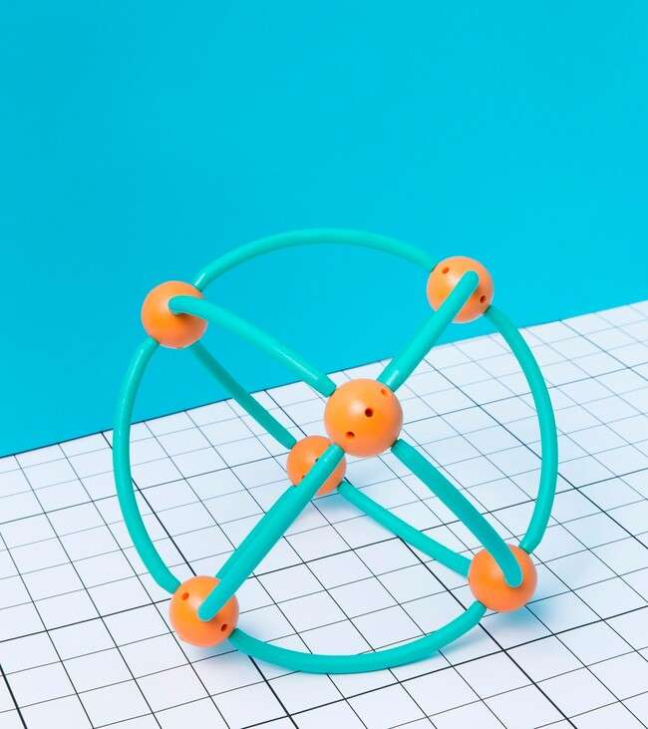


Challenges and Solutions
While working with parametric equations can be rewarding, it also presents challenges.
Understanding the curves, handling
of
, and
ensuring smooth transitions are critical. However, with practice and creativity, these challenges can be overcome.

Slide 9

Conclusion: The Beauty of Curves
In conclusion, beautifully blend and
. They not only help us understand complex phenomena but also inspire creativity in various ﬁelds.
Embracing these equations allows us to appreciate the elegance of curves that shape our world.

Slide 10
Thanks!
Do you have any questions? youremail@email.com
+91 620 421 838
www.yourwebsite.com @yourusername

