Slide 1

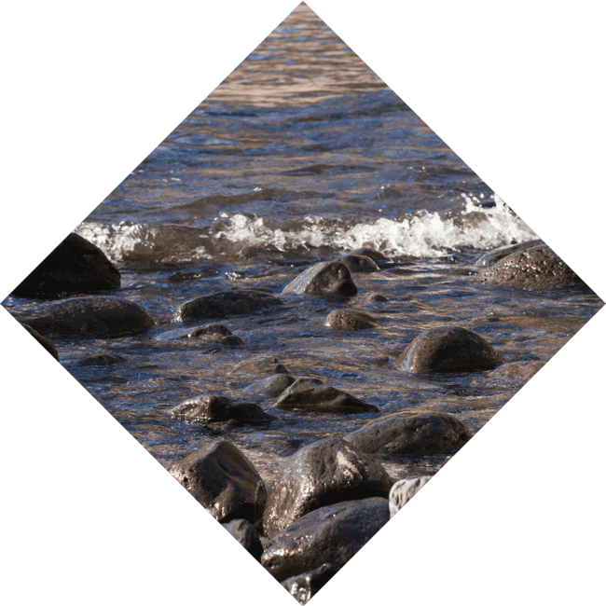
Trigonometry Unveiled: The Art of Angles and Waves

Slide 2
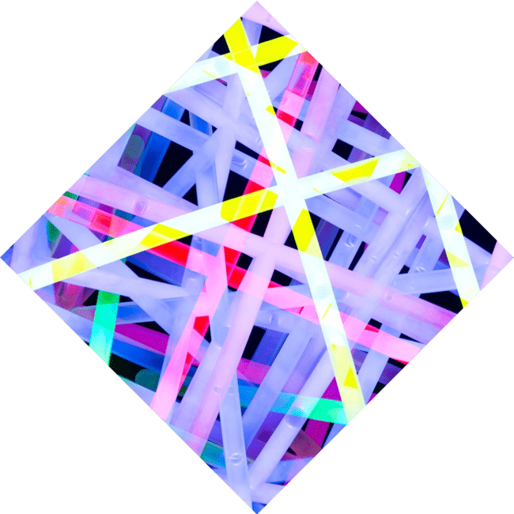



Introduction to Trigonometry
Welcome to !
Here, we will explore the of angles and waves. This fascinating branch of mathematics helps us understand
the relationships between and
in triangles, as well as the periodic nature of waves. Let's
embark on this
journey together!

Slide 3







The Basics of Angles
Angles are the
They are measured in
of trigonometry. or
and can describe various and
. Understanding how to measure
and manipulate angles is crucial for solving complex problems in mathematics and real-world applications.

Slide 4
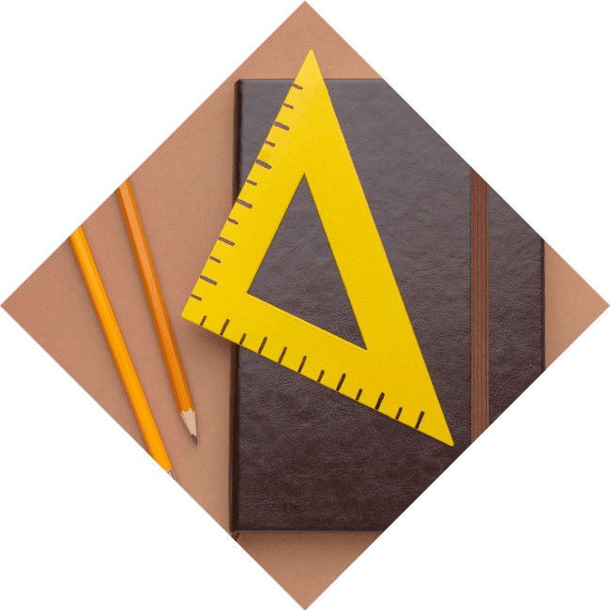




Sine, Cosine, and Tangent
The — ,
, and —are essential for relating angles to side lengths in right triangles. These functions help
us model and oscillations, making them vital in fields like physics, engineering, and music. Let's dive deeper into their meanings!

Slide 5
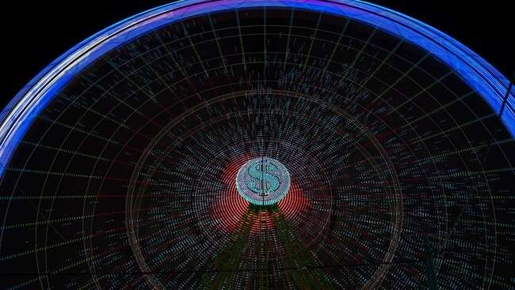

Unit Circle Exploration
The is a powerful tool in trigonometry. It allows us to visualize the values of sine and cosine for various angles. By understanding the unit circle, we can easily derive the
that simplify complex calculations and enhance
our mathematical skills.

Slide 6

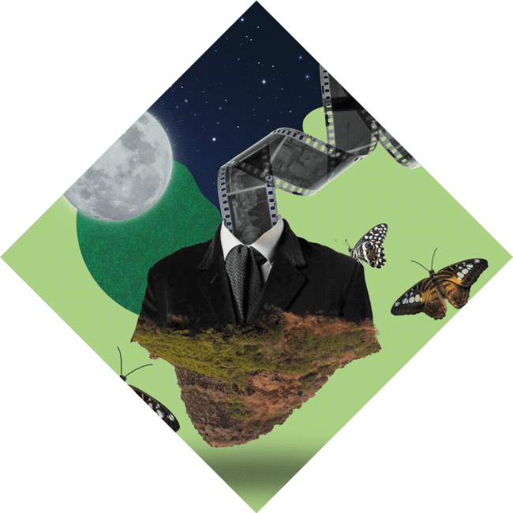
Applications in Real Life
Trigonometry is not just theoretical; it has in
everyday life! From architecture to navigation, and even in music, the principles of angles and waves help solve real-world problems. Let's discover how trigonometry shapes our world in unexpected ways.

Slide 7



Waves and Oscillations
Waves are everywhere, from sound to light, and they can be described using trigonometric functions. The and
functions model periodic behavior,
making them essential in physics and engineering. Understanding these concepts opens doors to new realms of knowledge and creativity.

Slide 8


Trigonometric Identities
Trigonometric identities are that hold true for all
angles. They simplify calculations and
are crucial for solving problems in
trigonometry. Familiarizing ourselves with these identities enhances our problem-solving abilities and deepens our understanding of mathematical relationships.

Slide 9



Conclusion: Embrace the Waves
In conclusion, trigonometry is a beautiful blend of and that enriches our understanding of the world. By mastering its concepts, we unlock new ways to and
. Embrace the art of trigonometry and let it inspire your journey in mathematics and
beyond!

Slide 10
Thanks!
Do you have any questions?
youremail@email.com
+91 620 000 838
www.yourwebsite.com @yourusername

