Slide 1
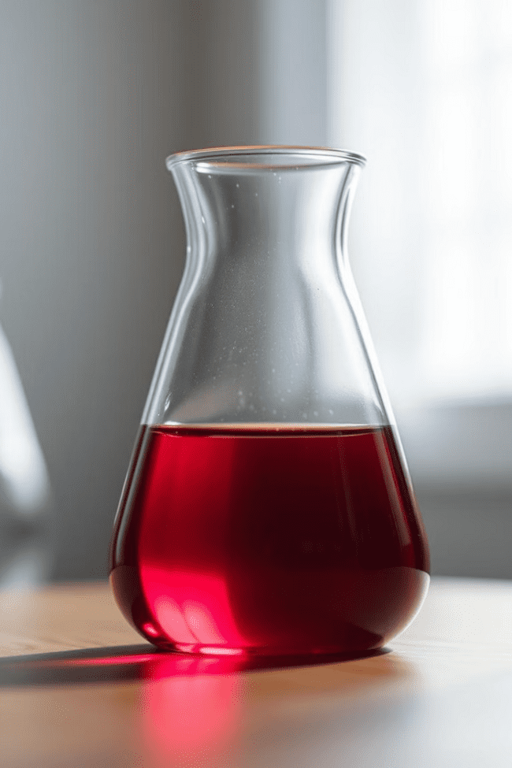
Volume and Capacity
Volume and capacity are fundamental concepts in science, engineering, and everyday life. Understanding these principles is crucial for a wide range of applications, from measuring and managing resources to designing efficient systems and products. In this presentation, we'll explore the definitions, measurements, and practical applications of volume and capacity, equipping you with the knowledge to better understand and utilize these essential properties.
by Onyedikachi Onwurah

Slide 2
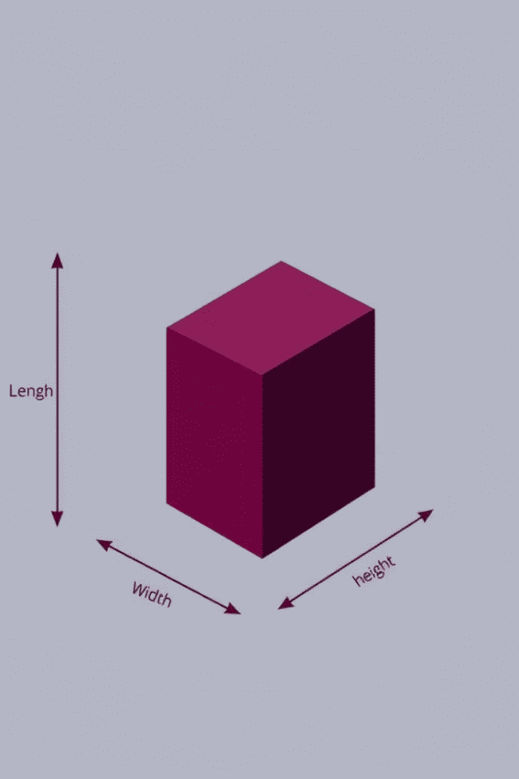

Defining Volume and Capacity
1
Volume
2
Capacity
Volume refers to the amount of three-dimensional space occupied by an object or substance. It is typically measured in units like cubic meters (m³), liters (L), or cubic feet (ft³).
Capacity is the maximum amount of a substance or object that a container or system can hold. It is often used to describe the maximum storage or holding capability of a given space or device.
3
Relationship
While related, volume and capacity are not the same. Volume is a property of the object itself, while capacity is a property of the container or system that holds the object.

Slide 3

Measuring Volume
Direct Measurement
Graduated Containers
For regular-shaped objects, volume can be directly calculated using the formula for the shape's geometry, such as the volume of a cube or a cylinder.
Graduated containers, such as beakers or cylinders, are commonly used to directly measure the volume of liquids by reading the markings on the container.
1
2
3
Displacement Method
The displacement method involves submerging an object in a container of water and measuring the volume of water displaced, which is equal to the object's volume.

Slide 4
Measuring Capacity
Direct Measurement
Markings and Labels
Inferring from Dimensions
The capacity of a container can be directly measured by filling it with a substance, such as water or sand, and then measuring the amount used to completely fill the container.
Many containers, such as bottles, cans, and boxes, have their capacity clearly marked on the label or printed directly on the container itself, making it easy to determine the maximum amount they can hold.
For regular-shaped containers, the capacity can be calculated by multiplying the length, width, and height dimensions, similar to how volume is calculated for objects.

Slide 5
Importance of Volume and Capacity
Resource Management
Efficient Design
Understanding volume and capacity is essential for efficiently managing resources, such as water, fuel, and raw materials, ensuring they are stored, transported, and used effectively.
Knowing the volume and capacity of objects and containers is crucial for designing products, systems, and structures that are optimized for their intended use, whether it's a storage tank, a shipping container, or a building.
Scientific Research
Everyday Applications
Precise measurements of volume and capacity are fundamental to many scientific disciplines, from chemistry and physics to biology and engineering, enabling accurate data collection and analysis.
Volume and capacity measurements are essential in everyday tasks, such as cooking, baking, and measuring the amount of medicine or fuel needed, ensuring accuracy and safety.

Slide 6
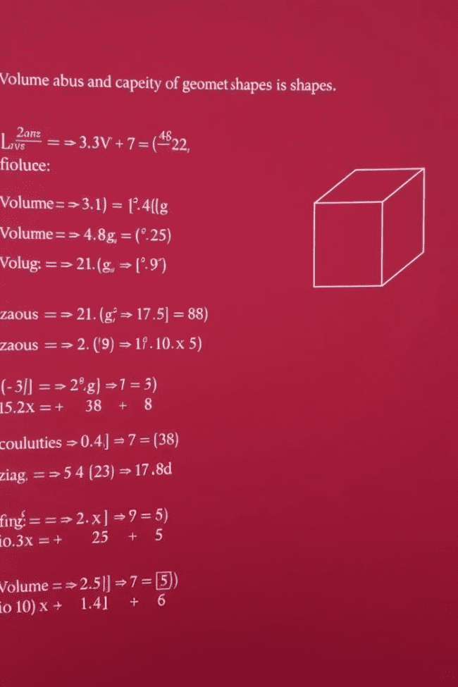



Calculating Volume and Capacity
Geometric Formulas
For regular-shaped objects and containers, volume and capacity can be calculated using geometric formulas, such as the volume of a cube (V = l x w x h) or the capacity of a cylinder (V = π x r² x h).
Irregular Shapes
For irregular-shaped objects or containers, more complex methods, such as the water displacement technique or numerical integration, may be required to determine their volume and capacity.
Practical Considerations
When calculating volume and capacity, it's important to consider factors like temperature, pressure, and unit conversions to ensure accurate and meaningful results.

Slide 7
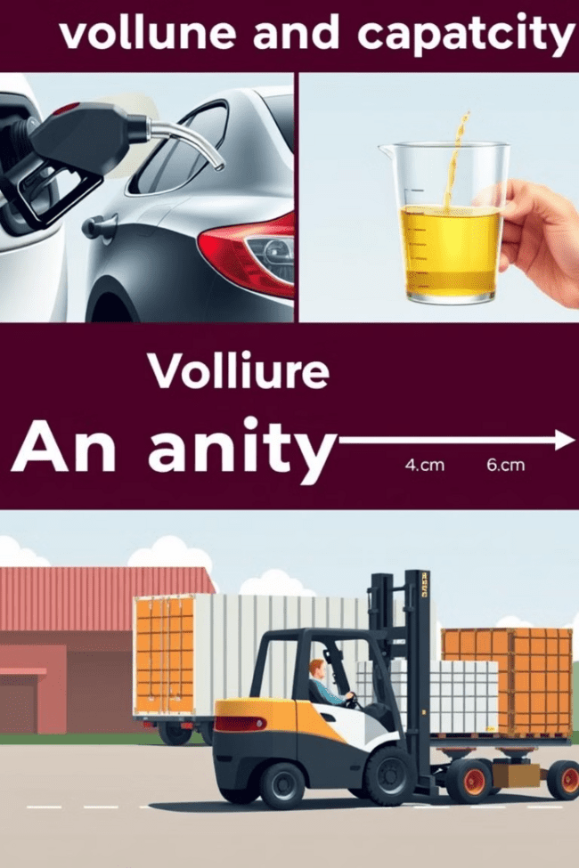




Applications of Volume and Capacity
Fuel Management
Cooking and Baking
Accurate measurements of fuel tank capacity and volume are essential for efficient transportation and energy management.
Precise volume and capacity measurements are crucial in the kitchen for successful recipe preparation and food storage.
Logistics and Shipping
Scientific Research
Understanding the volume and capacity of containers, vehicles, and storage spaces is vital for effective logistics and transportation planning.
Precise volume and capacity measurements are fundamental to many scientific experiments and processes, ensuring accurate data and results.

Slide 8
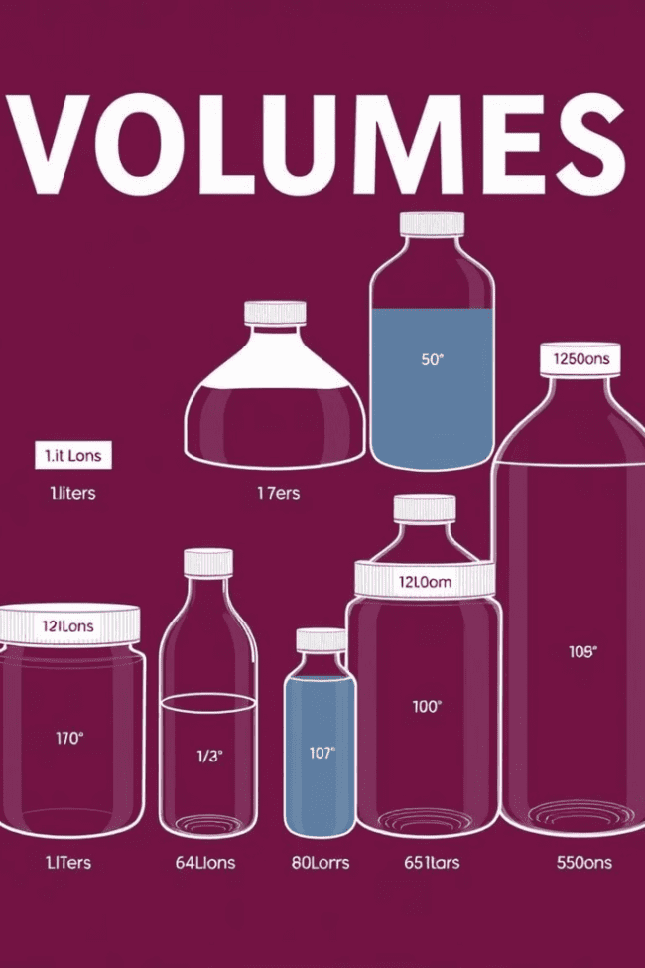
Common Units of Measurement
Unit
Description
Conversion
Liter (L)
A metric unit of volume, commonly used for liquids and gases
1 L = 1,000 mL
Gallon (gal)
A unit of volume, primarily used for measuring liquids in the United States
1 gal = 3.785 L
Cubic Foot (ft³)
A unit of volume, commonly used for measuring the volume of solids and gases
1 ft³ = 28.317 L
Milliliter (mL)
A metric unit of volume, commonly used for small measurements of liquids
1 mL = 0.001 L

Slide 9
Practical Examples and Exercises
Calculating Volume
Measuring Capacity
Unit Conversions
Determine the volume of a rectangular box with dimensions of 10 cm x 15 cm x 20 cm.
A cylindrical container has a diameter of 8 inches and a height of 12 inches. Calculate its capacity.
Convert 500 mL to gallons.
500 mL = 0.5 L, and 1 L = 0.264 gallons, so 500 mL = 0.132 gallons
Volume = Length x Width x Height = 10 cm x 15 cm x 20 cm = 3,000 cm³ or 3 L
Capacity = π x r² x h = 3.14 x (4 in)² x 12 in = 1,520 in³ or 24.8 gallons

