Slide 1

Q2 . Geometry Review on Reasoning

Slide 2

“The only way to learn mathematics is to do mathematics”

Slide 3
Pre-requisite skills needed
Know Axioms in Geometry
Know Building Blocks of Geometry

Slide 4
Objectives
To be able to identify definitions, postulates, theorems and axioms in geometry.
To be able to use axioms in geometry in reasoning
To be able to prove angle congruence
To be able to prove line congruence

Slide 5
Writing a Proof

Slide 6
Deductive Reasoning
This involves the formulation of statement or conclusion from a logical presentation of facts, definitions and accepted properties. In geometry, we intend to give proof before we can come up with a valid conclusion. The most common proof in High School Geometry is two – column proof
The given
The proposition
The statement Column
The reason Column
The diagram

Slide 7
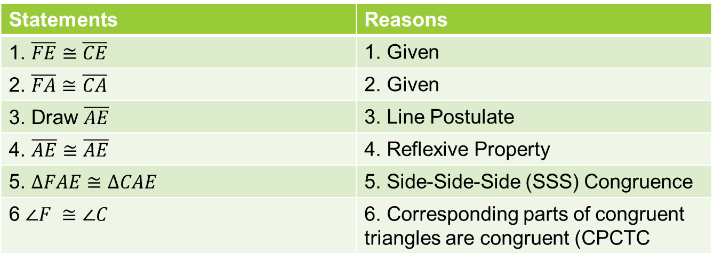
Geometric Proof
A method of determining whether a statement is True of False with the use of logic , facts and deductions
Statements | Reasons
1. $\overline{FE}≅\overline{CE}$ | 1. Given
2. $\overline{FA}≅\overline{CA}$ | 2. Given
3. Draw $\overline{AE}$ | 3. Line Postulate
4. $\overline{AE}≅\overline{AE}$ | 4. Reflexive Property
5. $∆FAE≅∆CAE$ | 5. Side-Side-Side (SSS) Congruence
6 $∠F ≅∠C$ | 6. Corresponding parts of congruent triangles are congruent (CPCTC

Slide 8
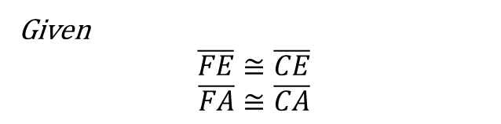
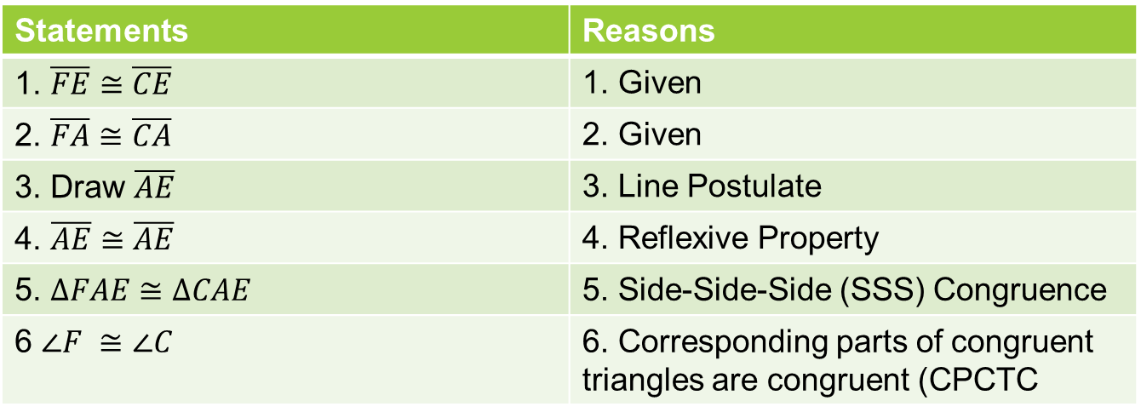
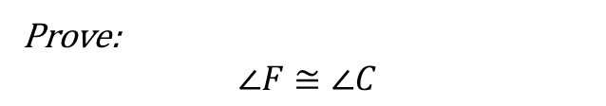
F
Given
$$\overline{FE}≅\overline{CE}$$
$$\overline{FA}≅\overline{CA}$$
A
E
Prove:
$$∠F≅∠C$$
C
Statements | Reasons
1. $\overline{FE}≅\overline{CE}$ | 1. Given
2. $\overline{FA}≅\overline{CA}$ | 2. Given
3. Draw $\overline{AE}$ | 3. Line Postulate
4. $\overline{AE}≅\overline{AE}$ | 4. Reflexive Property
5. $∆FAE≅∆CAE$ | 5. Side-Side-Side (SSS) Congruence
6 $∠F ≅∠C$ | 6. Corresponding parts of congruent triangles are congruent (CPCTC

Slide 9
The given
5. The diagram
F
Given
$$\overline{FE}≅\overline{CE}$$
$$\overline{FA}≅\overline{CA}$$
A
E
Prove:
$$∠F≅∠C$$
C
3. The statement Column
4. The reason Column
2. The proposition
Statements | Reasons
1. $\overline{FE}≅\overline{CE}$ | 1. Given
2. $\overline{FA}≅\overline{CA}$ | 2. Given
3. Draw $\overline{AE}$ | 3. Line Postulate
4. $\overline{AE}≅\overline{AE}$ | 4. Reflexive Property
5. $∆FAE≅∆CAE$ | 5. Side-Side-Side (SSS) Congruence
6 $∠F ≅∠C$ | 6. Corresponding parts of congruent triangles are congruent (CPCTC

Slide 10
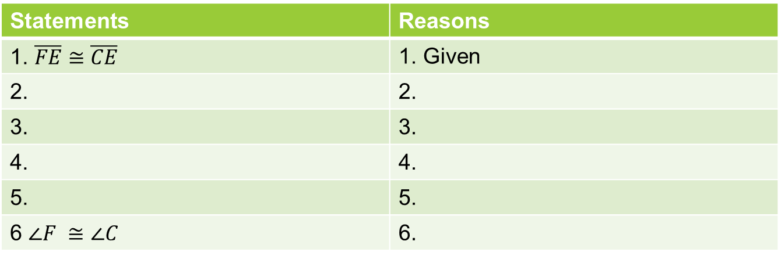
The given
5. The diagram
F
Given
$$\overline{FE}≅\overline{CE}$$
$$\overline{FA}≅\overline{CA}$$
A
E
Prove:
$$∠F≅∠C$$
C
3. The statement Column
4. The reason Column
2. The proposition
Statements | Reasons
1. $\overline{FE}≅\overline{CE}$ | 1. Given
2. | 2.
3. | 3.
4. | 4.
5. | 5.
6 $∠F ≅∠C$ | 6.

Slide 11


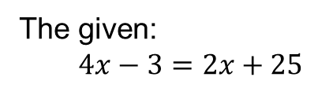



The given:
$4x−3=2x+25$
Solve for $x$:
Statements
Reasons
$$4x−3=2x+25$$
Given
$$4x−2x=25+3$$
$$2x=28$$
Transpose or APE
$$x=14$$
Divide both side by 2 or MPE

Slide 12
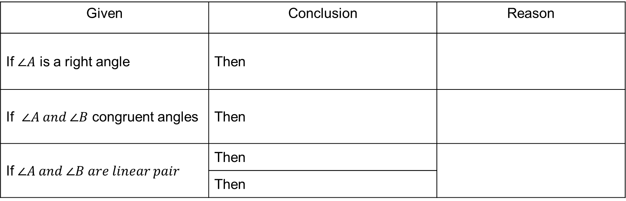
Given | Conclusion | Reason
If $∠A$ is a right angle | Then
If $∠A and ∠B$ congruent angles | Then
If $∠A and ∠B are linear pair$ | Then
 | Then

Slide 13
Guide #1 on Proving (Proving Algebra)

Slide 14
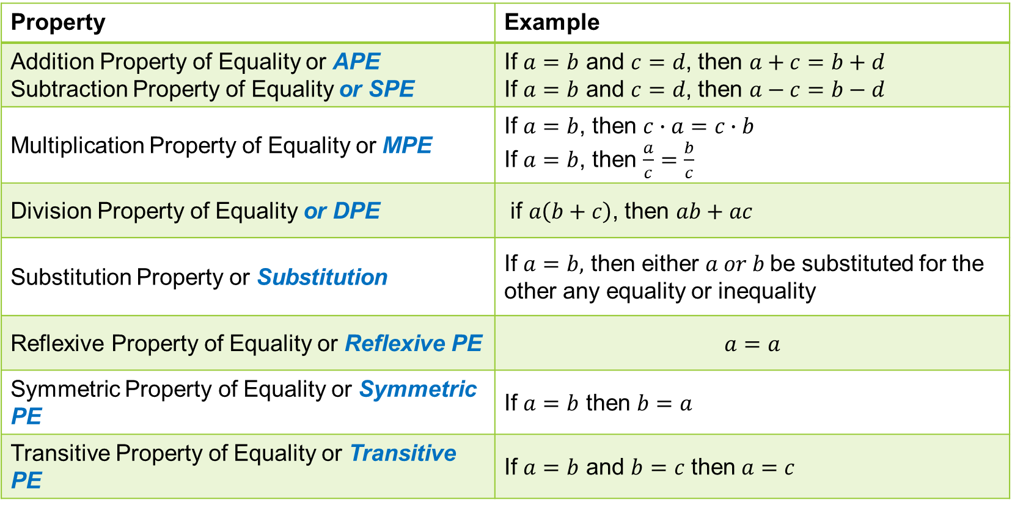
Properties of Equality
Property | Example
Addition Property of Equality or APE Subtraction Property of Equality or SPE | If $a=b$ and $c=d$, then $a+c=b+d$ If $a=b$ and $c=d$, then $a−c=b−d$
Multiplication Property of Equality or MPE | If $a=b$, then $c∙a=c∙b$ If $a=b$, then $\frac{a}{c}=\frac{b}{c}$
Division Property of Equality or DPE | if $a\left(b+c\right)$, then $ab+ac$
Substitution Property or Substitution | If $a=b,$ then either $a or b$be substituted for the other any equality or inequality
Reflexive Property of Equality or Reflexive PE | $$a=a$$
Symmetric Property of Equality or Symmetric PE | If $a=b$ then $b=a$
Transitive Property of Equality or Transitive PE | If $a=b$ and $b=c$ then $a=c$

Slide 15



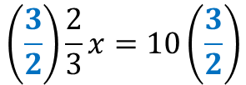







Addition Property of Equality or APE
Multiplication Property of Equality or MPE
Add or subtract same values on both side
Multiply or Divide same values on both side
Example 1
$$x=y$$
Example 1
$$5x=10$$
$$x+2=y+2$$
APE/Transpose
$$\frac{5x}{5}=\frac{10}{5}$$
Example 2
$$4x+5=20$$
$$x=2$$
MPE/ DPE
$$4x+5−5=20−5$$
Example 2
$$\frac{2}{3}x=10$$
$$4x=15$$
APE/SPE
Multiply by the reciprocal
$$\left(\frac{3}{2}\right)\frac{2}{3}x=10\left(\frac{3}{2}\right)$$
$$x=15$$
MPE

Slide 16








Substitution Property or Subtitution
Reflexive Property of Equality or Reflexive PE
Substituting values to the variables
Mirror of values
Example 1
$$2x+y=22$$
Example 1
$$2=2$$
Reflexive PE
Let $x=5$
$$2x+y=22$$
Given
$$2\left(5\right)+y=22$$
$$10+y=22$$
Substitution
$$y=22−10$$
$$y=12$$
APE

Slide 17












Symmetric Property of Equality or Symmetric
Transitive Property of Equality or Transitive
If $a=b$ then $b=a$
Example 1
$$2a=20$$
$$x=10 or 10=x$$
$$2a=b$$
$$b=20$$
Transitive property
Example 1
$$38=5−3x$$
Given
$$33=−3x$$
APE
Example 2
$$z=2x+y$$
$$−11=x$$
MPE
$$2x+y=30$$
$$z=30$$
Transitive property
$$x=−11$$
Symmetric Property

Slide 18
Property
Addition Property of Equality or APE
Multiplication Property of Equality or MPE Distribution
Substitution Property or Substitution
Reflexive Property of Equality or Reflexive PE
Symmetric Property of Equality or Symmetric PE
Transitive Property of Equality or Transitive PE

Slide 19
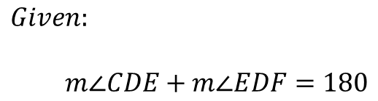
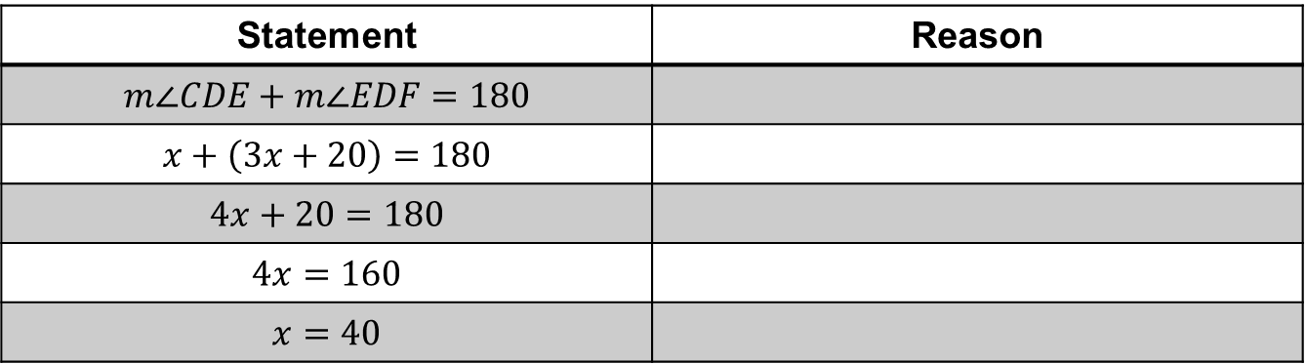


Exercise 1
E
$$Given:$$
$m∠CDE+m∠EDF=180$
$$x$$
$$3x+20$$
C
F
D
Statement | Reason
$$m∠CDE+m∠EDF=180$$
$$x+\left(3x+20\right)=180$$
$$4x+20=180$$
$$4x=160$$
$$x=40$$

Slide 20
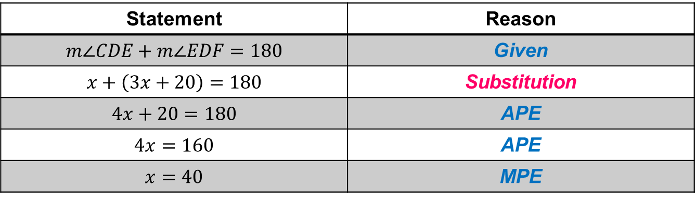
E
$$Given:$$
$m∠CDE+m∠EDF=180$
$$x$$
$$3x+20$$
C
F
D
Statement | Reason
$$m∠CDE+m∠EDF=180$$ | Given
$$x+\left(3x+20\right)=180$$ | Substitution
$$4x+20=180$$ | APE
$$4x=160$$ | APE
$$x=40$$ | MPE

Slide 21
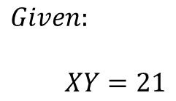
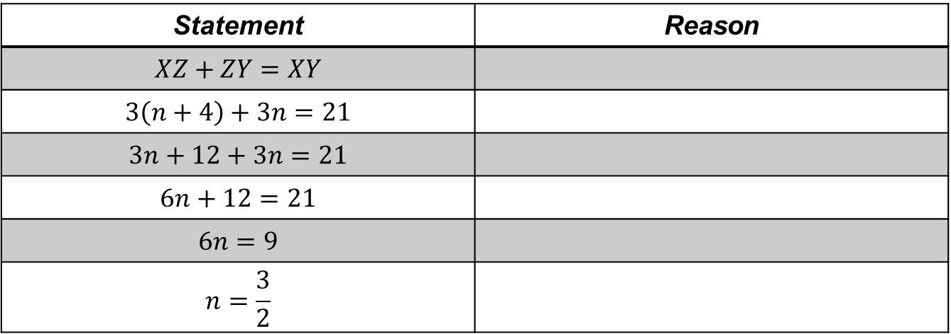


$$Given:$$
$XY=21$
$$3(n+4)$$
$$3n$$
X
z
Y
Statement | Reason
$$XZ+ZY=XY$$
$$3\left(n+4\right)+3n=21$$
$$3n+12+3n=21$$
$$6n+12=21$$
$$6n=9$$
$$n=\frac{3}{2}$$

Slide 22
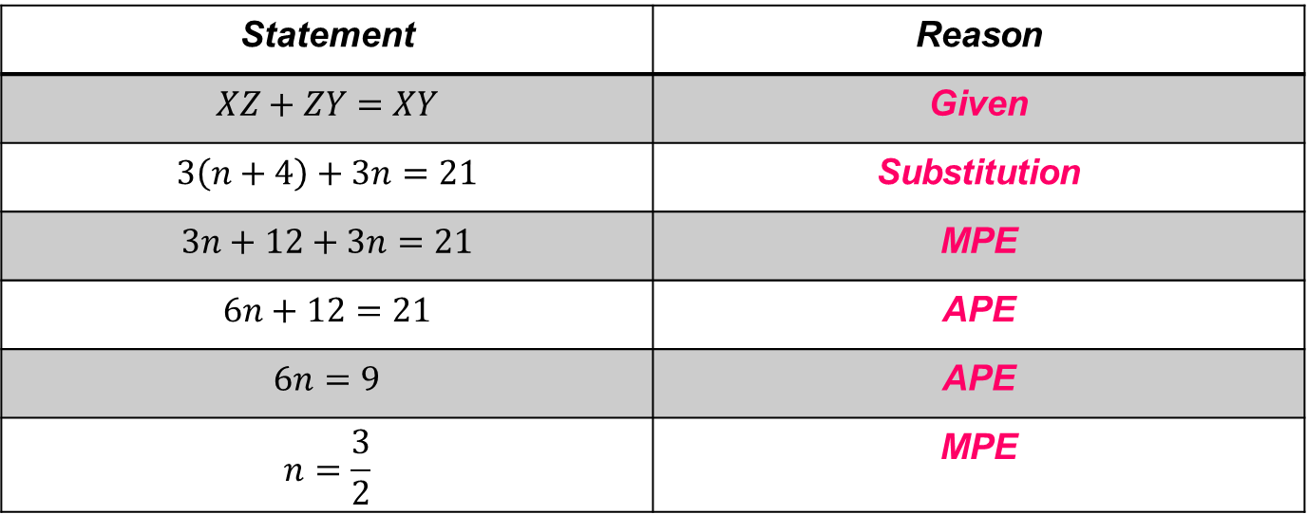
$$Given:$$
$XY=21$
$$3(n+4)$$
$$3n$$
X
Y
Y
Statement | Reason
$$XZ+ZY=XY$$ | Given
$$3\left(n+4\right)+3n=21$$ | Substitution
$$3n+12+3n=21$$ | MPE
$$6n+12=21$$ | APE
$$6n=9$$ | APE
$$n=\frac{3}{2}$$ | MPE

Slide 23
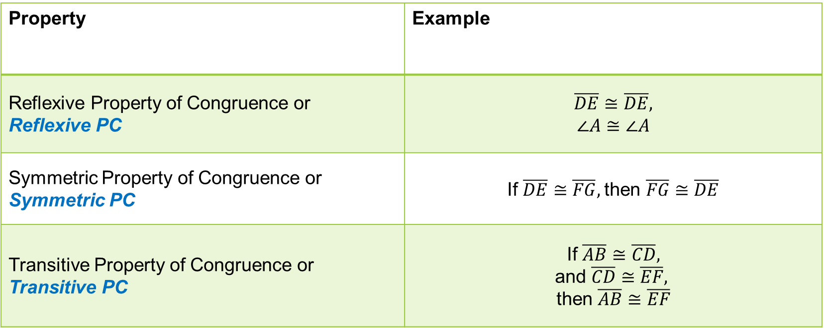

Properties of Congruence $≅$
Property | Example
Reflexive Property of Congruence or Reflexive PC | $$\overline{DE}≅\overline{DE},$$ $$∠A≅∠A$$
Symmetric Property of Congruence or Symmetric PC | If $\overline{DE}≅\overline{FG},$then $\overline{FG}$ $≅\overline{DE}$
Transitive Property of Congruence or Transitive PC | If $\overline{AB}≅\overline{CD},$ and $\overline{CD}≅\overline{EF},$ then $\overline{AB}≅\overline{EF}$

Slide 24
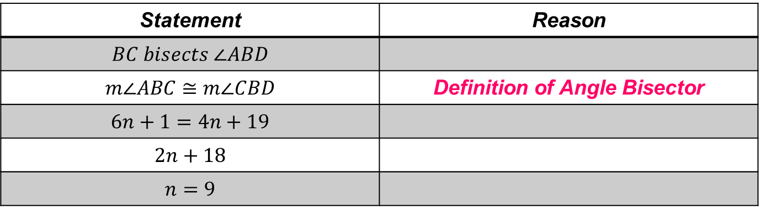


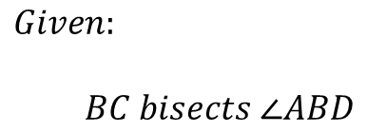
Point C is on the crease when you fold $\overline{BD}$onto $\overline{BA}$. Give the reason that justifies each step.
A
C
$$Given:$$
$BC bisects ∠ABD$
$$6n+1$$
$$4n+19$$
B
D
Statement | Reason
$$BC bisects ∠ABD$$
$$m∠ABC≅m∠CBD$$ | Definition of Angle Bisector
$$6n+1=4n+19$$
$$2n+18$$
$$n=9$$

Slide 25
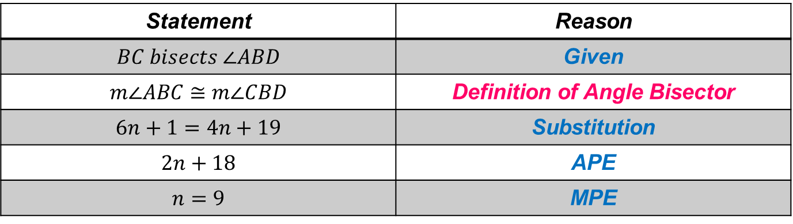
Point C is on the crease when you fold $\overline{BD}$onto $\overline{BA}$. Give the reason that justifies each step.
A
C
$$Given:$$
$BC bisects ∠ABD$
$$6n+1$$
$$4n+19$$
B
D
Statement | Reason
$$BC bisects ∠ABD$$ | Given
$$m∠ABC≅m∠CBD$$ | Definition of Angle Bisector
$$6n+1=4n+19$$ | Substitution
$$2n+18$$ | APE
$$n=9$$ | MPE

Slide 26
Postulates and Theorems Relating to Points, Lines and Planes

Slide 27
A Definition is a statement of meaning of a word, or term, or phrase which made use of previously defined terms
Ex. Definition of Midpoint
A postulate is a statement which is accepted as true without proof.
Ex. Angle Addition Postulate
A theorem is any statement that can be proven true.
Ex. Angle Bisector Theorem
A corollary to a theorem is a theorem that follows easily from a previously proved theorem.

Slide 28
Steps in Writing a Geometric Proof

Slide 29
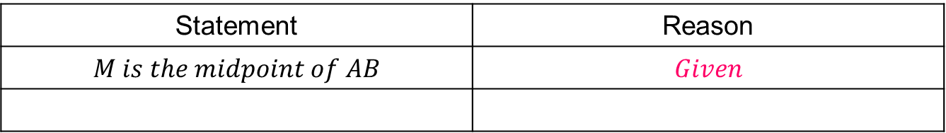
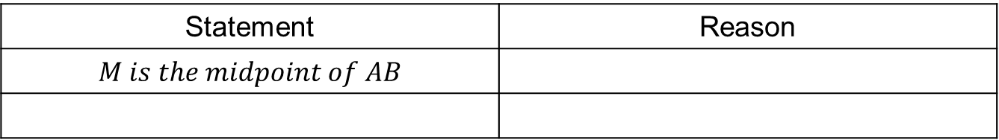
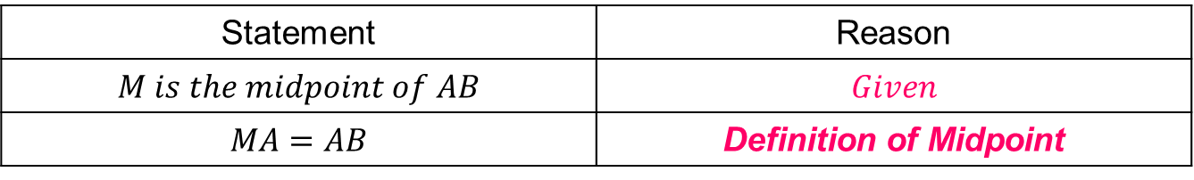
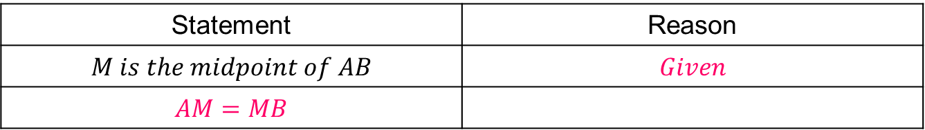
Step1: Write the given
Statement | Reason
$$M is the midpoint of AB$$
Step 2: Write the 1st Reason: Given
Statement | Reason
$$M is the midpoint of AB$$ | $$Given$$
Step 3: What can you conclude in the statement above( Your 1st IF). This is your then
Statement | Reason
$$M is the midpoint of AB$$ | $$Given$$
$$AM=MB$$
Step 4: Write your reason for your then part, it can be definition, postulates or theorems
Statement | Reason
$$M is the midpoint of AB$$ | $$Given$$
$$MA=AB$$ | Definition of Midpoint
Step 5: Continue the process until you’ve proven what's need to be proven

Slide 30
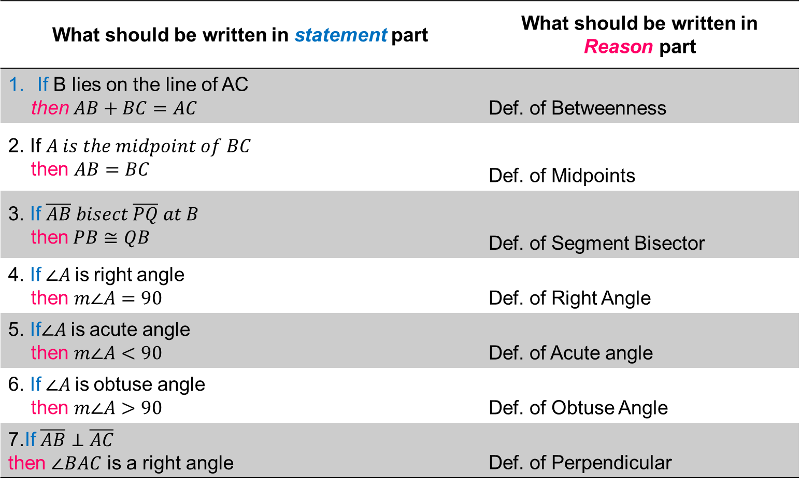
Some Definitions in Geometry:
What should be written in statement part | What should be written in Reason part
If B lies on the line of AC then$AB+BC=AC$ | Def. of Betweenness
2. If $A is the midpoint of BC$ then $AB=BC$ | Def. of Midpoints
3. If $\overline{AB} bisect \overline{PQ} at B$ then$PB≅QB$ | Def. of Segment Bisector
4. If$∠A$is right angle then $m∠A=90$ | Def. of Right Angle
5. If$∠A$is acute angle then $m∠A<90$ | Def. of Acute angle
6. If$∠A$is obtuse angle then $m∠A>90$ | Def. of Obtuse Angle
7.If$\overline{AB}⊥\overline{AC}$ then $∠BAC$ is a right angle | Def. of Perpendicular

Slide 31
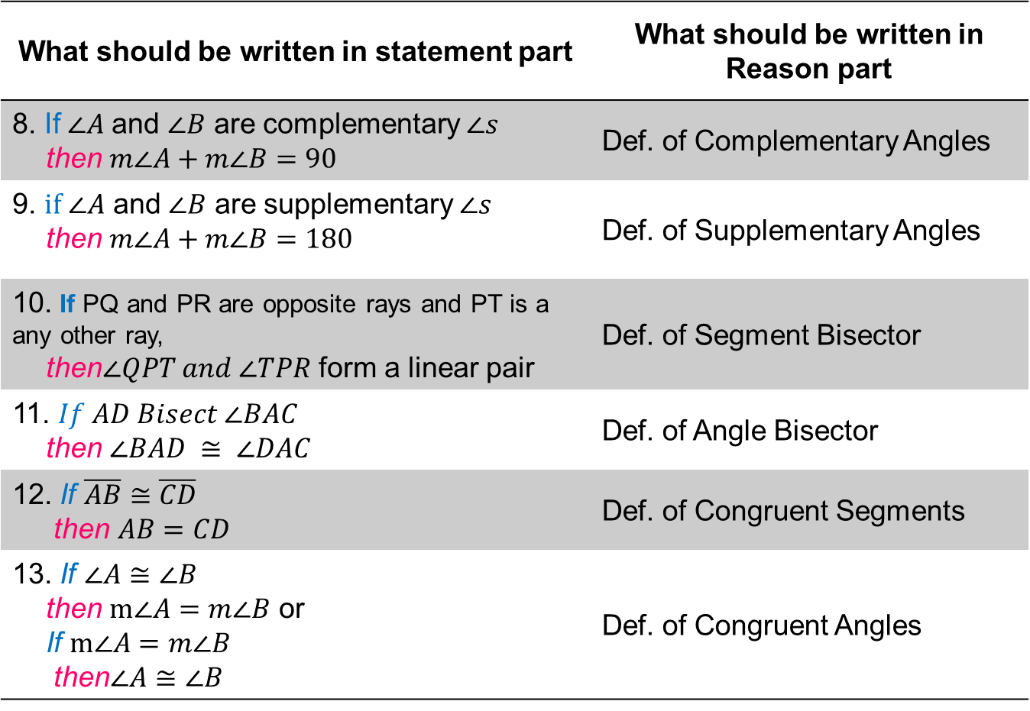
Some Definitions in Geometry:
What should be written in statement part | What should be written in Reason part
8. If$∠A$ and $∠B$ are complementary $∠s$ then $m∠A+m∠B=90$ | Def. of Complementary Angles
9. $if ∠A$ and $∠B$ are supplementary $∠s$ then $m∠A+m∠B=180$ | Def. of Supplementary Angles
10. If PQ and PR are opposite rays and PT is a any other ray, then$∠QPT and ∠TPR$ form a linear pair | Def. of Segment Bisector
11. $If AD Bisect ∠BAC$ then $∠BAD ≅ ∠DAC$ | Def. of Angle Bisector
12. If $\overline{AB}≅\overline{CD}$ then $AB=CD$ | Def. of Congruent Segments
13. If $∠A≅∠B$ then $m∠A=m∠B$ or If $m∠A=m∠B$ then$∠A≅∠B$ | Def. of Congruent Angles

Slide 32
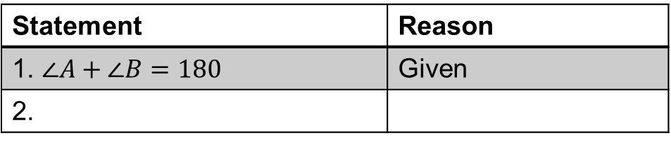
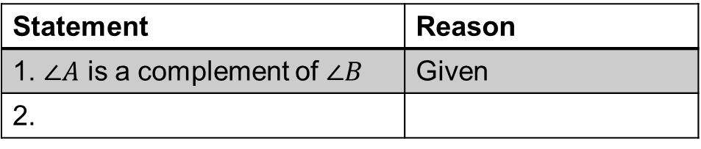
Practice: Determine any conclusion(s) that follow for each given statement. Give your reason.
Statement | Reason
1. B is a the midpoint of GF | Given
2.
Statement | Reason
1. $∠A$ is a complement of $∠B$ | Given
2.
Statement | Reason
1. $∠A+∠B=180$ | Given
2.

Slide 33
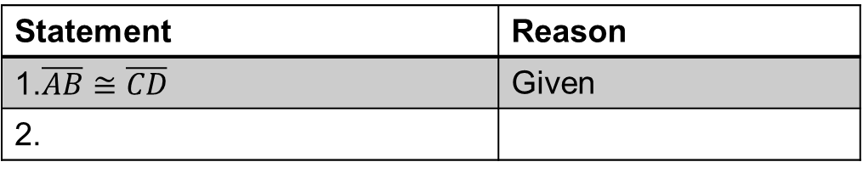
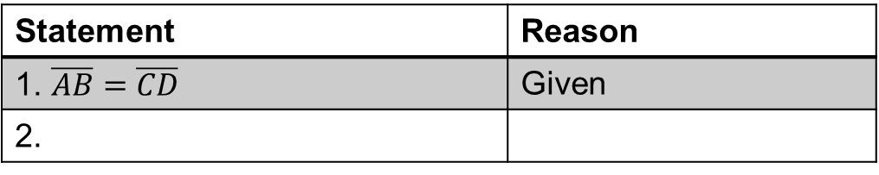
Practice: Determine any conclusion(s) that follow for each given statement. Give your reason.
Statement | Reason
1. Points A,Q and B are collinear in whole line AB | Given
2.
Statement | Reason
1. $\overline{AB}=\overline{CD}$ | Given
2.
Statement | Reason
1.$\overline{AB}≅\overline{CD}$ | Given
2.

Slide 34
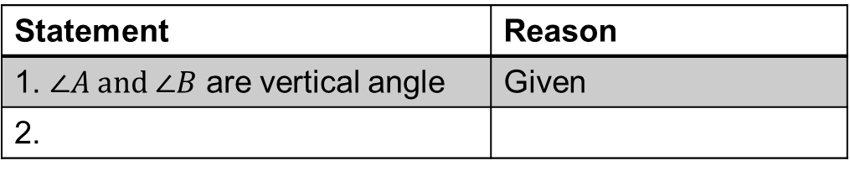
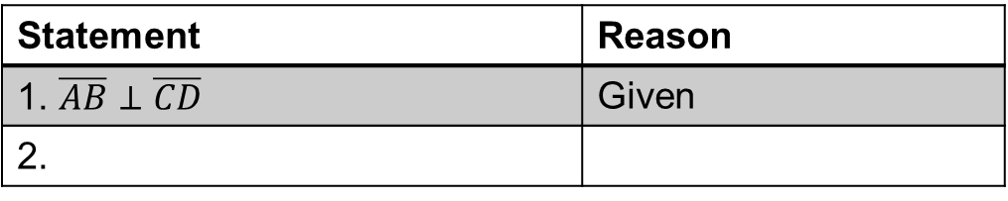
Practice: Determine any conclusion(s) that follow for each given statement. Give your reason.
Statement | Reason
1. Line AB Bisect the angle CAD | Given
2.
Statement | Reason
1. $\overline{AB}⊥\overline{CD}$ | Given
2.
Statement | Reason
1. $∠A and ∠B$ are vertical angle | Given
2.

Slide 35
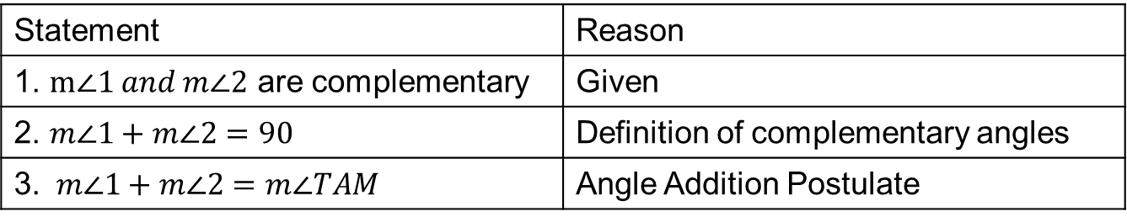
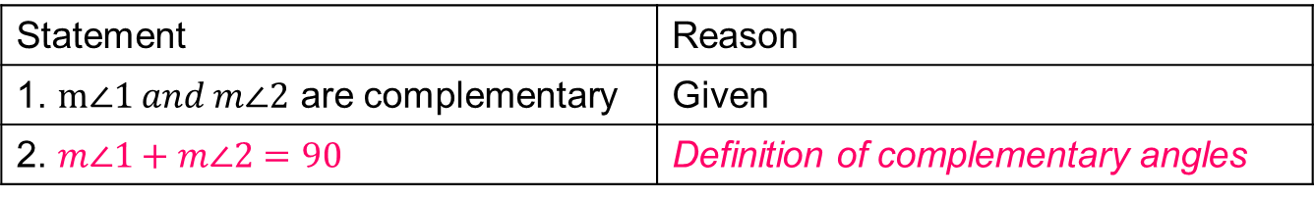
How to answer the Proof table
Statement | Reason
1. $m∠1 and m∠2$ are complementary | Given
2. $m∠1+m∠2=90$ | Definition of complementary angles
If
then
reason
Statement | Reason
1. $m∠1 and m∠2$ are complementary | Given
2. $m∠1+m∠2=90$ | Definition of complementary angles
3. $m∠1+m∠2=m∠TAM$ | Angle Addition Postulate
New If
New then
new reason
Statement | Reason
Write here the If part
Write here the then part | Write here the Def/Postulate/Properties or theorem used for if-then part.

Slide 36



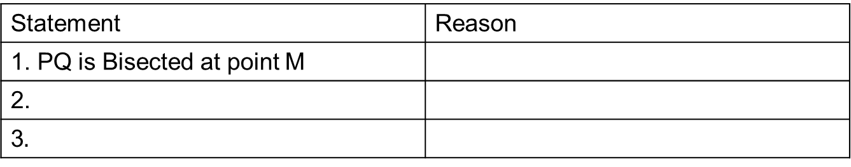



$$S$$
Given: PQ is bisected at point M
$$M$$
Prove: PM=MQ
$$P$$
$$Q$$
$$T$$
Statement | Reason
1. PQ is Bisected at point M
2.
3$.$
$$QED$$

Slide 37

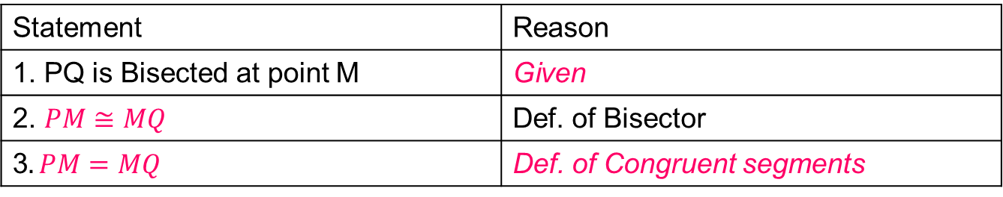
$$S$$
Given: PQ is bisected at point M
$$M$$
Prove: PM=MQ
$$P$$
$$Q$$
$$T$$
Statement | Reason
1. PQ is Bisected at point M | Given
2. $PM≅MQ$ | Def. of Bisector
3$. PM=MQ$ | Def. of Congruent segments
If (1) then (2)
$$QED$$
You can look at properties, definitions, postulates and theorems to know what must be written here

Slide 38
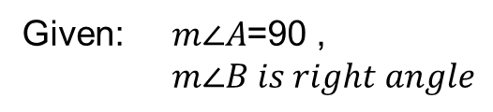

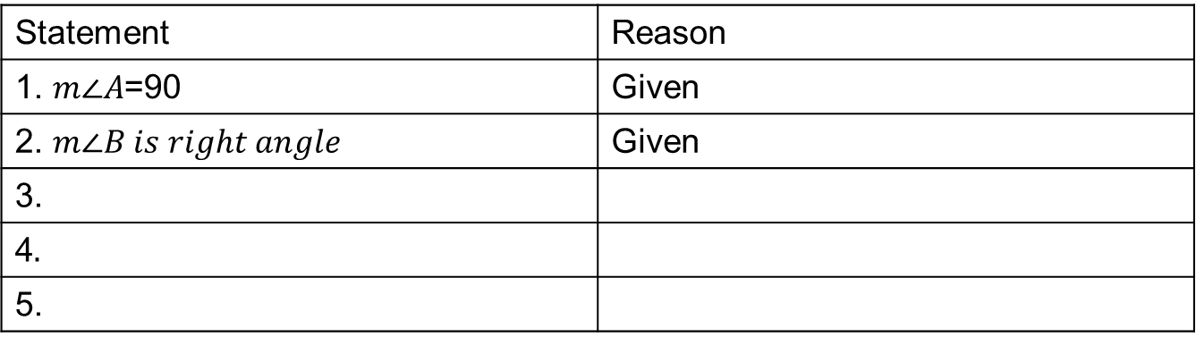



Given: $m∠A$=90 ,
$m∠B is right angle$
Prove:$∠A=∠B$
$$A$$
$$B$$
Statement | Reason
1. $m∠A$=90 | Given
2. $m∠B is right angle$ | Given
3.
4$.$
5.
$$QED$$

Slide 39

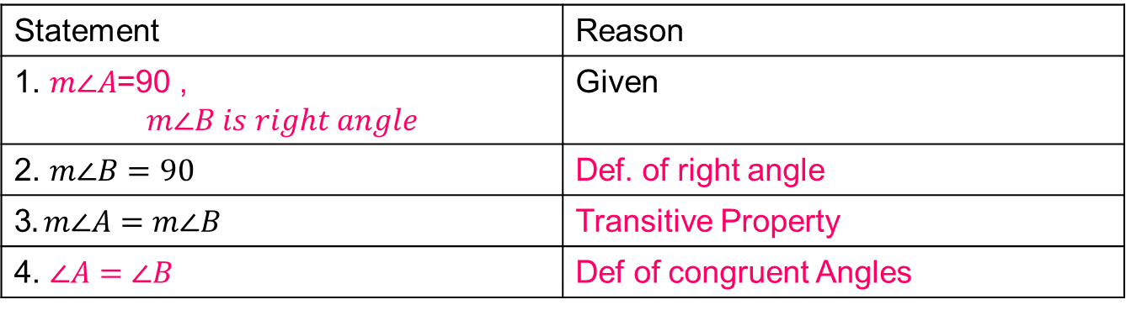

Given: $m∠A$=90 , $. m∠B is right angle$
Prove:$∠A=∠B$
$$A$$
$$B$$
Statement | Reason
1. $m∠A$=90 , | Given
2. $m∠B=90$ | Def. of right angle
3$. m∠A=m∠B$ | Transitive Property
4. $∠A=∠B$ | Def of congruent Angles
$$QED$$

Slide 40



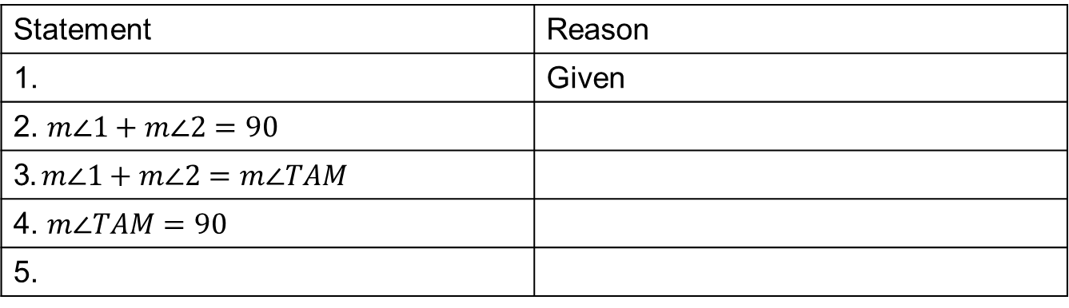





$$T$$
Given: $m∠1 and m∠2$ are complementary
Prove: $AT⊥AM$
$$1$$
$$2$$
$$A$$
$$M$$
Statement | Reason
1. | Given
2. $m∠1+m∠2=90$
3$. m∠1+m∠2=m∠TAM$
4. $m∠TAM=90$
5.
$$QED$$

Slide 41
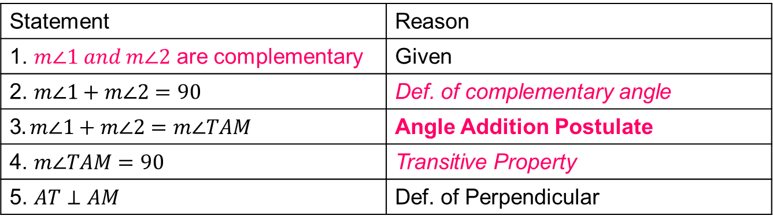
$$T$$
Given: $m∠1 and m∠2$ are complementary
Prove: $AT⊥AM$
$$1$$
$$2$$
$$A$$
$$M$$
Statement | Reason
1. $m∠1 and m∠2$ are complementary | Given
2. $m∠1+m∠2=90$ | Def. of complementary angle
3$. m∠1+m∠2=m∠TAM$ | Angle Addition Postulate
4. $m∠TAM=90$ | Transitive Property
5. $AT⊥AM$ | Def. of Perpendicular

Slide 42
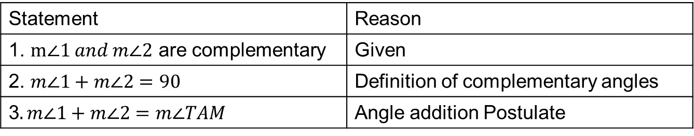
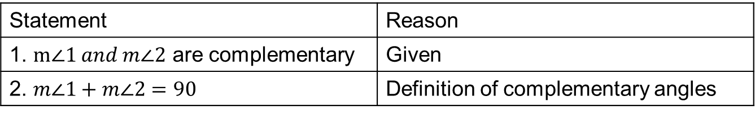
How to answer the Proof table
Statement | Reason
1. $m∠1 and m∠2$ are complementary | Given
2. $m∠1+m∠2=90$ | Definition of complementary angles
If
then
reason
Statement | Reason
1. $m∠1 and m∠2$ are complementary | Given
2. $m∠1+m∠2=90$ | Definition of complementary angles
3$. m∠1+m∠2=m∠TAM$ | Angle addition Postulate
New If
New then
new reason
Statement | Reason
Write here the If part
Write here the then part | Write here the Def/Postulate/Properties or theorem used for if-then part.

Slide 43

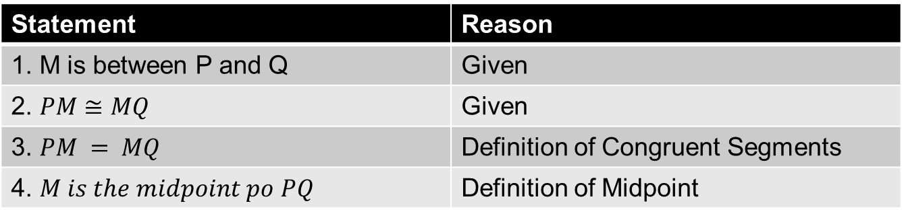


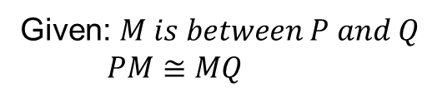

Given: $M is between P and Q$
$PM≅MQ$
$$P$$
$$M$$
$$Q$$
Prove: $M is the midpoint of PQ$
Statement | Reason
1. M is between P and Q | Given
2. $PM≅MQ$ | Given
3. $PM = MQ$ | Definition of Congruent Segments
4. $M is the midpoint po PQ$ | Definition of Midpoint

Slide 44
Angles Postulates and Theorems

Slide 45
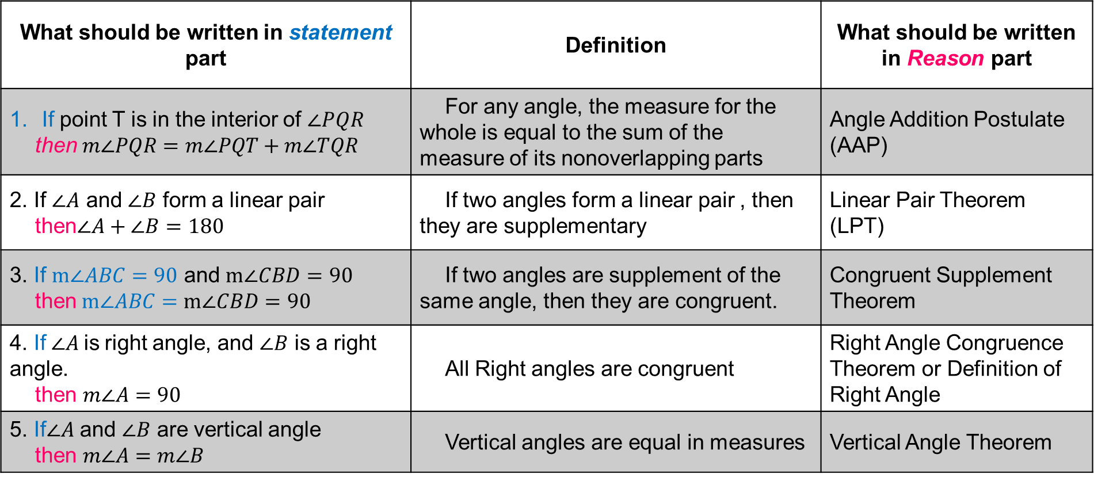
What should be written in statement part | Definition | What should be written in Reason part
If point T is in the interior of $∠PQR$ then$m∠PQR=m∠PQT+m∠TQR$ | For any angle, the measure for the whole is equal to the sum of the measure of its nonoverlapping parts | Angle Addition Postulate (AAP)
2. If $∠A$ and $∠B$ form a linear pair then$∠A+∠B=180$ | If two angles form a linear pair , then they are supplementary | Linear Pair Theorem (LPT)
3. If $m∠ABC=90$ and $m∠CBD=90$ then$m∠ABC=m∠CBD=90$ | If two angles are supplement of the same angle, then they are congruent. | Congruent Supplement Theorem
4. If$∠A$is right angle, and $∠B$ is a right angle. then $m∠A=90$ | All Right angles are congruent | Right Angle Congruence Theorem or Definition of Right Angle
5. If$∠A$ and $∠B$ are vertical angle then $m∠A=m∠B$ | Vertical angles are equal in measures | Vertical Angle Theorem

Slide 46
Line Postulates and Theorems

Slide 47
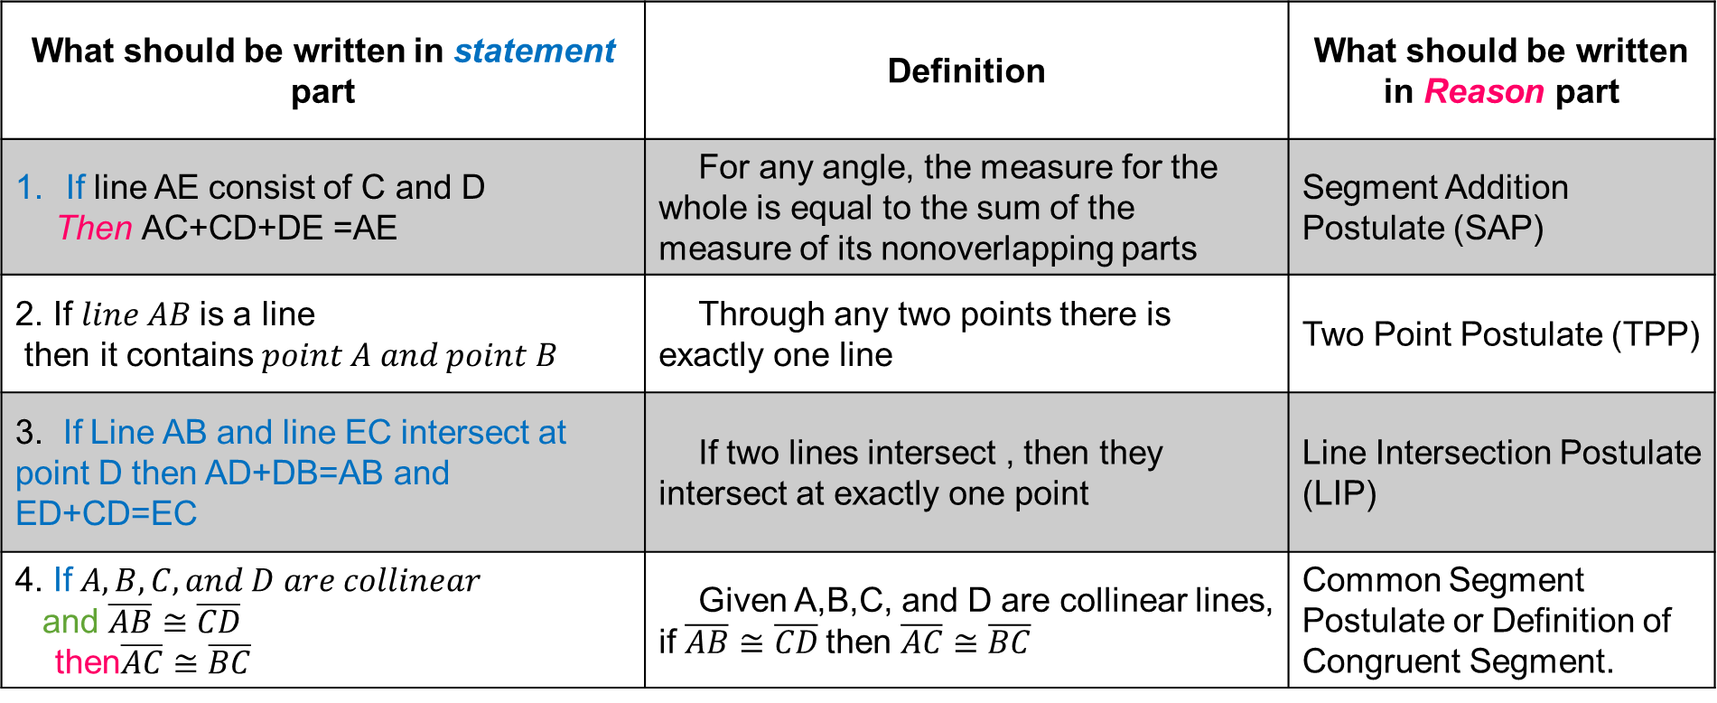
What should be written in statement part | Definition | What should be written in Reason part
If line AE consist of C and D Then AC+CD+DE =AE | For any angle, the measure for the whole is equal to the sum of the measure of its nonoverlapping parts | Segment Addition Postulate (SAP)
2. If $line AB$is a line then it contains $point A and point B$ | Through any two points there is exactly one line | Two Point Postulate (TPP)
3. If Line AB and line EC intersect at point D then AD+DB=AB and ED+CD=EC | If two lines intersect , then they intersect at exactly one point | Line Intersection Postulate (LIP)
4. If$A,B,C, and D are collinear$ and $\overline{AB}≅\overline{CD}$ then$\overline{AC}≅\overline{BC}$ | Given A,B,C, and D are collinear lines, if $\overline{AB}≅\overline{CD}$then $\overline{AC}≅\overline{BC}$ | Common Segment Postulate or Definition of Congruent Segment.

Slide 48
Proving Angles and Lines

Slide 49
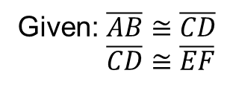
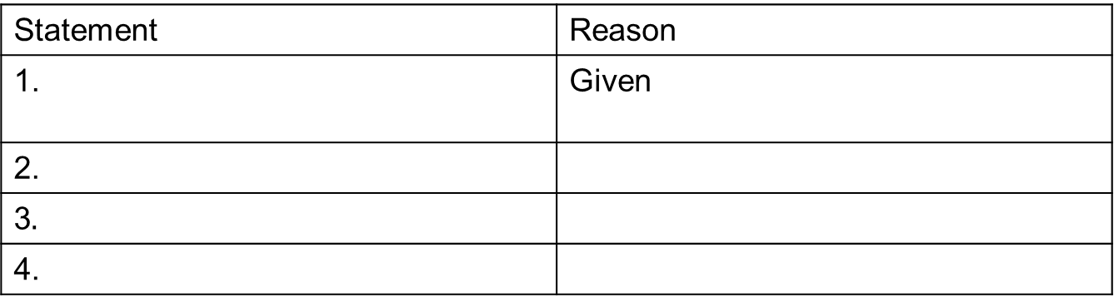

Given: $\overline{AB}≅\overline{CD}$
$\overline{CD}≅\overline{EF}$
Prove:$\overline{AB}≅\overline{EF}$
Statement | Reason
1. | Given
2.
3$.$
4.

Slide 50
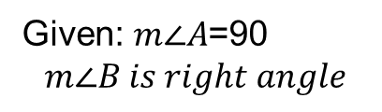
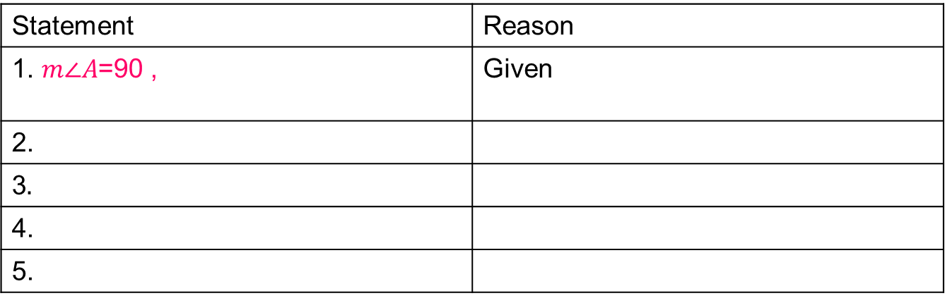

Given: $m∠A$=90
$$m∠B is right angle$$
Prove:$∠A=∠B$
$$A$$
$$B$$
Statement | Reason
1. $m∠A$=90 , | Given
2.
3$.$
4.
5.

Slide 51










$$R$$
Given: $m∠RST=50$
$m∠TSV=40$
$m∠Q is a right angle$
$$T$$
$$50$$
$$40$$
$$Q$$
Prove:$∠RSV=∠Q$
$$S$$
$$V$$
Statement | Reason
1 | Given
2.
3$.$
4.
5.
6.
7.
8.
9.

Slide 52








Given: $\overline{QS}≅\overline{RT}$
$$Q$$
$$R$$
$$S$$
$$T$$
Prove:$\overline{QR}≅\overline{ST}$
Statement | Reason
1 | Given
2.
3$.$
4.
5.
6.
7.
$$QED$$

Slide 53







Given: $\overline{QS}≅\overline{RT}$
$$A$$
$$B$$
$$C$$
$$D$$
Prove:$\overline{AC}≅\overline{BD}$
Statement | Reason
1 | Given
2.
3$.$
4.
5.
6.
7.
$$QED$$

Slide 54






Given:$∠1$ and $∠3$ are vertical angles
$$4$$
$$1$$
$$3$$
$$2$$
Prove:$∠1≅∠3$
Statement | Reason
1 | Given
2.
3$.$
4.
5.
6.
7.
$$QED$$

Slide 55







Given:$∠4$ $≅ ∠3$
$$1$$
$$2$$
$$3$$
$$4$$
Prove:$∠1≅∠2$
Statement | Reason
1. | Given
2.
3$.$
4.
5.
6.
7.
8.
$$QED$$

Slide 56
Student Group Work
LEADER NAME:
MEMBER NAMES:

Slide 57
Group Work
Each Member must Participate
Open Google Slide in one tab.
Leader must present in the Break Room
Discussed what must be written in the tables
  You can simultaneously type in the G-Slide
  You can dictate in the chat box
Finalize your answer
Present 1 Geometric Proof
PS. You can add/insert tables below if you need.
Use : COLOR of FONT PINK

Slide 58
Group

Slide 59


Student Work Group 1
Given: $\overline{AC}≅\overline{BD}$
$$A$$
$$B$$
$$C$$
$$D$$
Prove:$\overline{AB}≅\overline{CD}$
Statement | Reason
1 | Given
2.
3$.$
4.
5.
6.
7.
Use : COLOR of FONT PINK

Slide 60






Student Work Group 2
Given:$∠A$ $is a supplement of ∠B$
$∠C$ $is a supplement of ∠B$
$$A$$
$$C$$
$$B$$
Prove:$m∠A≅m∠C$
Statement | Reason
1. | Given
2.
3$.$
4.
5.
6.
$$QED$$
Use : COLOR of FONT PINK

Slide 61










Student Work Group 3
$$N$$
Given: $m∠CON=90$
$∠1≅∠3$
$$3$$
$$1$$
$$2$$
$$C$$
$$O$$
Prove:$∠1 and ∠2 are complementary angles$
Statement | Reason
1.
2. | Given
3. $m∠CON=m∠2+m∠3$ | Angle Addition Postulate
3$.$ $m∠2+m∠3=90$
4. $m∠1=m∠3$
5. $m∠2+m∠1=90$
6.
$$QED$$
Use : COLOR of FONT PINK

Slide 62






Student Work Group 4
Given: $m∠A is a Right Angle$
$m∠B is a Right Angle$
$∠B≅∠A$
$$A$$
$$B$$
Prove:$∠B≅∠A$
Statement | Reason
1. | Given
2.
3$.$
4.
$$QED$$
Use : COLOR of FONT PINK

Slide 63







Student Work Group 5
$$D$$
$$C$$
Given: $m∠DAB is a Right Angle$
$m∠ABC is a Right Angle$
Prove:$∠DAB≅∠BCD$
$$A$$
$$B$$
Statement | Reason
1. | Given
2.
3$.$
4.
5.
Use : COLOR of FONT PINK
$$QED$$

Slide 64


Q.E.D. or QED is an initialism of the Latin phrase "quod erat demonstrandum", literally meaning "what was to be shown”Traditionally, the abbreviation is placed at the end of a mathematical proof or philosophical argument in print publications to indicate that the proof or the argument is complete, and hence is used with the meaning "thus it has been demonstrated"
Euclid – the Founder of geometry
$$QED$$

