Slide 1
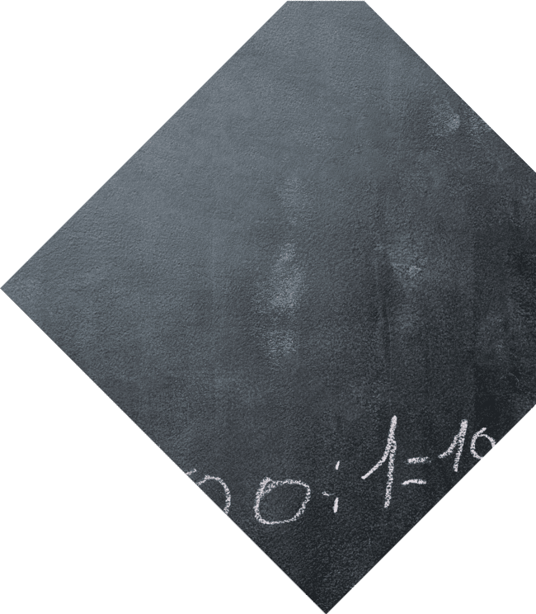
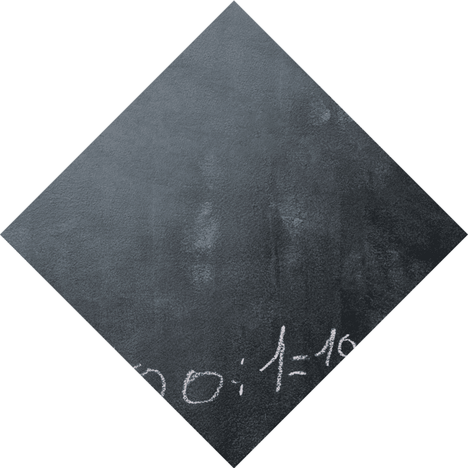
Unlocking the Secrets of the Quadratic Formula: Your Key to Solving Parabolic Mysteries!

Slide 2
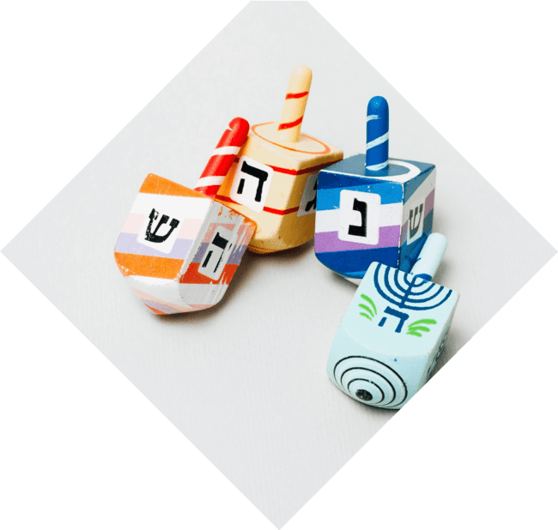





Introduction to Quadratics
Welcome to the world of
! In this presentation, we will explore the behind the
and how it serves as your to
solving parabolic challenges. Get ready to unlock the secrets of this powerful mathematical tool!

Slide 3





What is a Quadratic Equation?
A is any equation
that can be expressed in the form
. Here, , , and are constants, with not equal to zero.
Understanding this form is crucial for applying the
effectively.

Slide 4


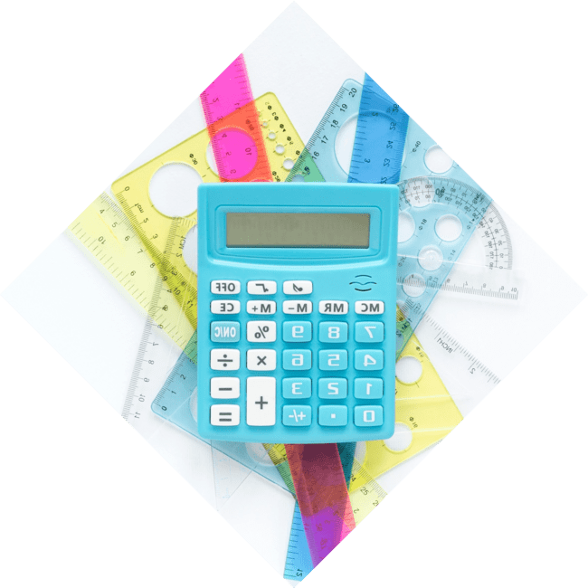

The Quadratic Formula
The
is given by
. This formula allows us to find the of any quadratic equation, revealing where the parabola intersects the x-axis.
It’s like having a magic wand for
solving quadratics!

Slide 5
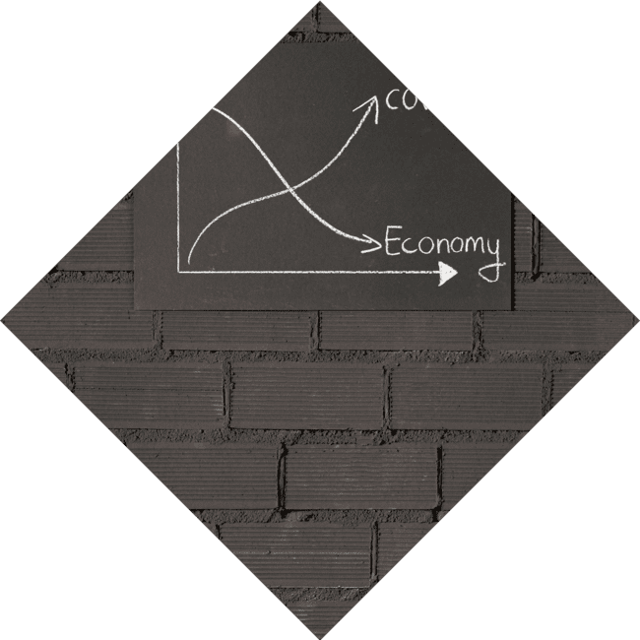



Discriminant Dilemma
The (D = b² - 4ac) determines the nature of the roots. If
, there are two distinct real
roots. If , there is one real root (a ). If , the roots are
. Understanding this helps in
predicting the shape of the parabola!

Slide 6




Graphing Quadratics
Graphing a quadratic function reveals its . The vertex, axis of symmetry, and intercepts are key
features. By using the
, we can find these points and sketch the graph accurately, enhancing our understanding of its
behavior.

Slide 7



Real-World Applications
Quadratic equations are not just abstract concepts; they have
! From physics to finance,
understanding how to solve quadratics can
help in optimizing solutions, modeling projectile motion, and even in architecture. The possibilities are endless!

Slide 8



Tips for Mastery
To master the ,
practice is essential. Familiarize yourself with different types of problems, and don’t forget to check
your work! Use as a visual aid to reinforce your understanding
of the solutions you find.

Slide 9

Conclusion: Unlock Your Potential
Congratulations! You have now unlocked the secrets of the . With this knowledge, you can tackle parabolic mysteries with confidence. Remember, practice makes perfect, and every problem solved is a step towards mastering mathematics!

Slide 10
Thanks!
Do you have any questions?
youremail@email.com
+91 620 000 838
www.yourwebsite.com @yourusername

