Slide 1
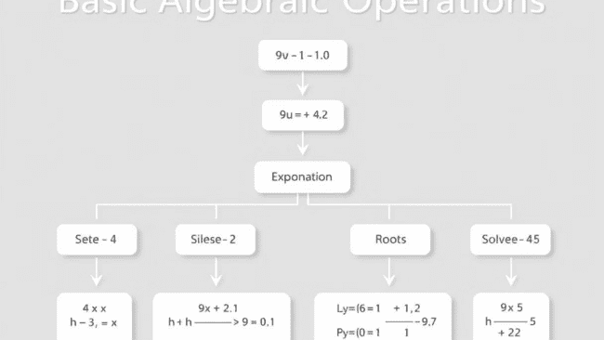
Basic Algebraic Operations
This document provides a comprehensive overview of basic algebraic operations, covering essential concepts and techniques. We'll explore fundamental operations like addition, subtraction, multiplication, and division, then delve into more advanced topics like exponents, roots, factoring, solving linear equations, systems of equations, and real-world applications. This guide is designed to enhance your understanding and proficiency in algebra.
by Rejoice Onwurah
RO

Slide 2
Addition and Subtraction
Addition and subtraction are the most fundamental operations in algebra. Addition involves combining two or more quantities, while subtraction involves finding the difference between two quantities. These operations are governed by specific properties that simplify calculations.
The commutative property of addition states that the order of addition doesn't affect the sum (e.g., 3 + 4 = 4 + 3). The associative property states that the grouping of terms doesn't affect the sum (e.g., (3 + 4) + 5 = 3 + (4 + 5)). The identity property states that adding zero to any number results in the original number (e.g., 5 + 0 = 5).
Subtraction is the inverse operation of addition. The difference between two numbers can be expressed as the sum of the first number and the negative of the second number (e.g., 7 - 3 = 7 + (-3)). These properties are essential for manipulating expressions and solving equations.

Slide 3
Multiplication and Division
Multiplication and division are key operations in algebra, closely related to addition and subtraction. Multiplication is a form of repeated addition, while division is the inverse operation of multiplication.
The commutative property of multiplication states that the order of multiplication doesn't affect the product (e.g., 2 x 5 = 5 x 2). The associative property states that the grouping of factors doesn't affect the product (e.g., (2 x 5) x 3 = 2 x (5 x 3)). The identity property states that multiplying any number by one results in the original number (e.g., 7 x 1 = 7).
Division is the inverse of multiplication, and it's used to determine how many times one quantity fits into another quantity. The quotient of two numbers is the result of dividing the first number by the second number. For example, 12 ÷ 3 = 4, meaning that 3 fits into 12 four times.

Slide 4
Exponents and Roots
Exponents represent repeated multiplication. They are used to express a base number raised to a power. For example, 2 raised to the power of 3 (written as 23) represents 2 multiplied by itself three times (2 x 2 x 2 = 8).
Roots are the inverse of exponents. They indicate the number that, when multiplied by itself a certain number of times, equals a given number. For example, the square root of 9 is 3, because 3 multiplied by itself equals 9.
There are various rules governing exponents and roots that simplify calculations and make them more efficient. For example, when multiplying powers with the same base, you add the exponents (e.g., x2 x x3 = x5). When dividing powers with the same base, you subtract the exponents (e.g., x6 ÷ x2 = x4). Understanding these rules is crucial for manipulating expressions and solving equations that involve exponents and roots.

Slide 5
Factoring
Factoring is the process of breaking down an expression into simpler expressions that, when multiplied together, equal the original expression. Factoring is a fundamental technique used in solving equations, simplifying expressions, and understanding the properties of polynomials.
Several methods are commonly used for factoring, including factoring by grouping, difference of squares, sum and difference of cubes, and factoring quadratic expressions. Factoring by grouping involves rearranging terms and extracting common factors. The difference of squares factorization applies to expressions where two perfect squares are subtracted (e.g., a2 - b2 = (a + b)(a - b)). Sum and difference of cubes factorization applies to expressions where two perfect cubes are added or subtracted. Factoring quadratic expressions involves finding two numbers that multiply to the constant term and add up to the coefficient of the middle term.
Factoring can be applied to a wide variety of expressions, making it a powerful tool in algebra.

Slide 6
Solving Linear Equations
A linear equation is an equation where the highest power of the variable is 1. Solving a linear equation means finding the value of the variable that makes the equation true.
The goal of solving a linear equation is to isolate the variable on one side of the equation. This is achieved by applying algebraic operations to both sides of the equation, ensuring that the equation remains balanced.
These operations include adding or subtracting the same quantity to both sides, multiplying or dividing both sides by the same non-zero quantity, and simplifying expressions. For example, to solve the equation 2x + 3 = 9, you would subtract 3 from both sides, resulting in 2x = 6. Then, you would divide both sides by 2, yielding x = 3. This solution indicates that x = 3 makes the original equation true.

Slide 7
Solving Systems of Equations
A system of equations consists of two or more equations that share the same variables. Solving a system of equations involves finding values for the variables that satisfy all the equations simultaneously. This means that the values of the variables must make all the equations true.
Several methods are used to solve systems of equations, including substitution, elimination, and graphing. The substitution method involves solving one equation for one variable in terms of the other variable and then substituting that expression into the other equation. The elimination method involves manipulating the equations to eliminate one variable and then solving for the remaining variable. The graphing method involves plotting the equations on a graph and finding the point of intersection, which represents the solution.
Systems of equations are used to model real-world problems with multiple variables. The solution represents a set of values that satisfies all the constraints of the problem.

Slide 8
Applications and Problem Solving
Algebra is a powerful tool used to model and solve real-world problems across various fields. Algebraic concepts and techniques are applied to solve problems in finance, engineering, physics, computer science, and many other disciplines.
For example, algebra can be used to calculate interest on investments, determine the optimal production quantities in a manufacturing process, analyze the motion of objects, and design algorithms. Algebraic equations and inequalities can be used to represent relationships between variables and to solve for unknown quantities.
The ability to translate real-world problems into mathematical language and solve them using algebraic methods is a valuable skill in many professional and personal endeavors.

