Slide 1
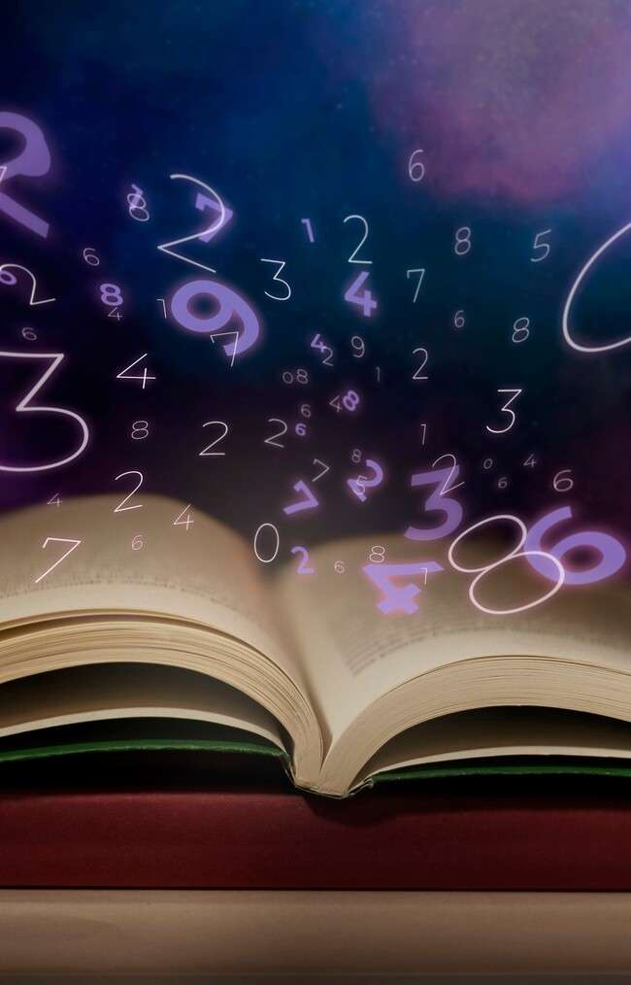
Unlocking the Secrets of the Complex Plane: A Journey Through De Moivre's Theorem

Slide 2





Introduction to the Complex Plane
the secrets of the
is an adventure in mathematics.
We will explore the fascinating world of complex numbers, their representation, and how they relate to
. Join us as we
embark on this
through mathematical beauty!

Slide 3





What is the Complex
Plane?
The is a two-
dimensional space where each point represents a . It
consists of a real axis and an imaginary axis. This framework allows us to visualize and manipulate complex numbers, enhancing our
understanding of their
and
.

Slide 4
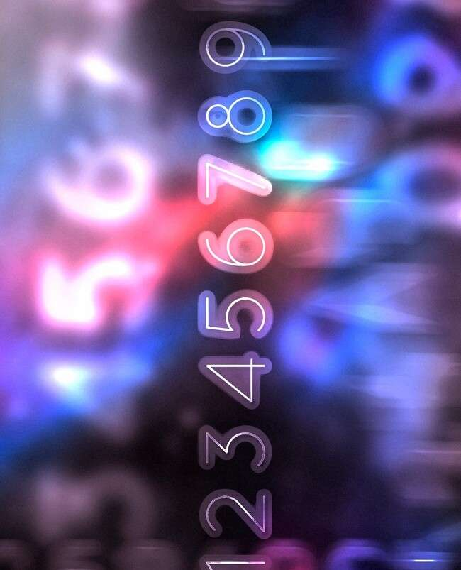




Understanding Complex Numbers
A is expressed in the form , where is the real part and is the imaginary part. This unique structure enables us to perform various and uncover deeper mathematical relationships. Let's delve into the beauty of these numbers!

Slide 5
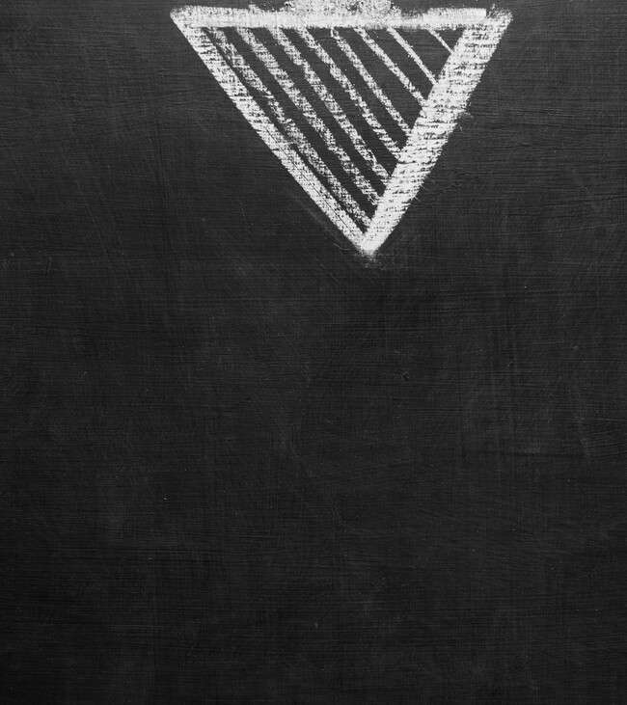





De Moivre's Theorem Unveiled
states that for any complex number in polar form,
θ θ θ
θ . This theorem bridges the
gap between
and
, revealing the
power of complex exponentiation. Let's explore its implications!

Slide 6






Applications of De Moivre's Theorem
De Moivre's Theorem ﬁnds applications
in various ﬁelds such as
, and
,
. It
simpliﬁes the computation of powers and roots of complex numbers, aiding in the analysis of and . Discover how this theorem impacts
real-world scenarios!

Slide 7
Visualizing Complex Numbers
Visual representation of complex numbers can enhance our understanding. By plotting numbers on the , we can observe their and . This visualization aids in grasping the geometric interpretation of operations like addition and multiplication. Let's see the magic unfold!

Slide 8
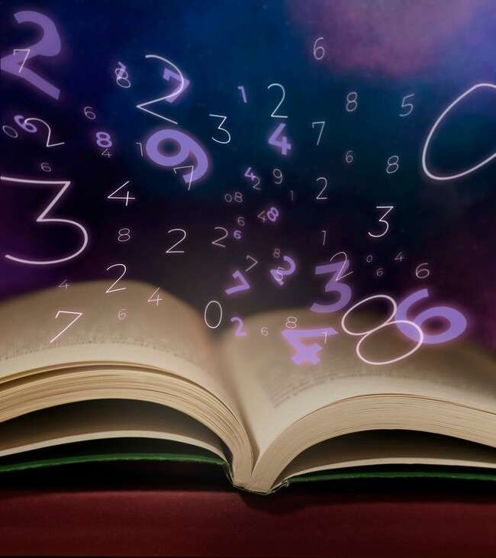


Exploring Further: Beyond Basics
Once we grasp De Moivre's Theorem, we can explore advanced
concepts like
and
. These topics
expand our knowledge and application of complex numbers, leading to new discoveries in
and its
.

Slide 9

Conclusion: The Journey Continues
In conclusion, and the
offer a rich landscape for exploration and discovery. We have only scratched the surface of this fascinating topic. Continue your journey into the world of complex numbers and uncover their !

Slide 10
Thanks!
Do you have any questions? youremail@email.com
+91 620 000 838
www.yourwebsite.com @yourusername

