Slide 1


Unraveling the Curves: A Journey Through Polynomial Graphing

Slide 2






Introduction to Polynomial Graphing
Welcome to our journey of the curves of polynomial graphing! Here, we will explore the beauty and intricacies of
, their , and how they
can represent various . Get ready to dive into the world of mathematical
!

Slide 3






What are Polynomials?
Polynomials are
consisting of variables and coefficients, combined using
, , and
. They can take various forms, such as linear, quadratic, cubic, and more. Understanding their structure is crucial for effective
.

Slide 4





The Degree Matters!
The of a polynomial significantly influences its and behavior. Higher degrees can create more complex curves. For example, a quadratic polynomial will form a
, while a cubic polynomial can have multiple . Let's explore these effects!

Slide 5
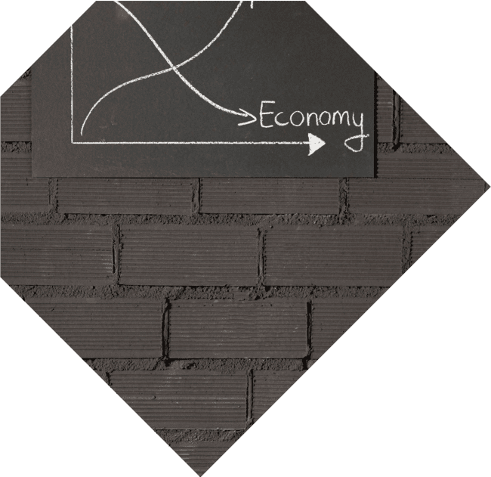




Roots and Intercepts
Roots or of a polynomial are the points where the graph the x- axis. These points provide insight into the polynomial's . Understanding how to find and interpret these roots is essential for accurate graphing.

Slide 6



Graphing Techniques
To effectively graph polynomials, we can use techniques such as
, , and the
. These methods help us identify key features like intercepts, turning points, and end behavior, leading to a more accurate representation.

Slide 7
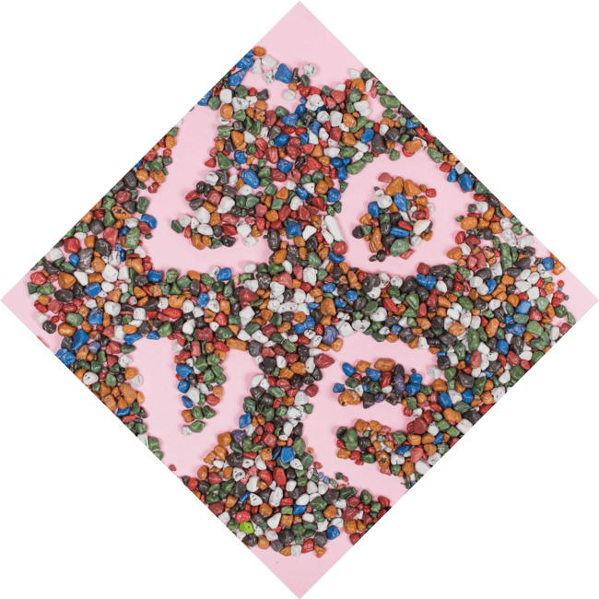




The Beauty of Curves
Polynomial graphs can exhibit a wide range of and , from simple parabolas to intricate loops. Each curve tells a unique story about the polynomial's . Let's celebrate the of these mathematical forms!

Slide 8
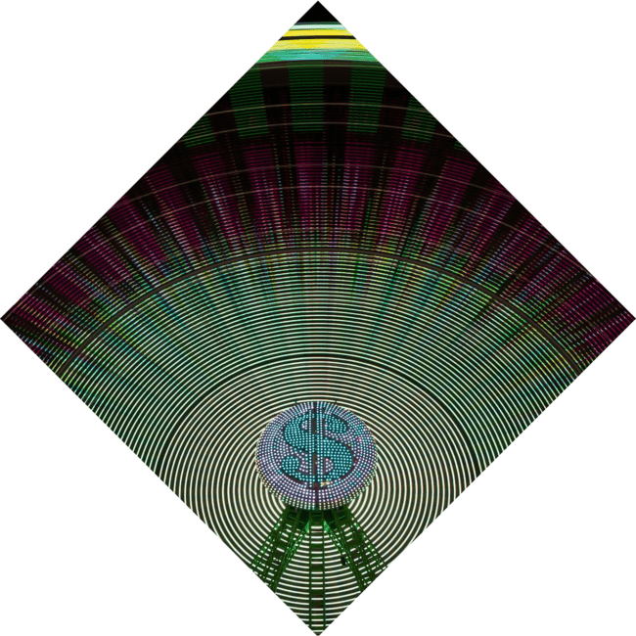


Applications of Polynomial
Graphing
Polynomial graphing is not just theoretical; it has real-world applications! From to
, understanding these
curves can help us model and predict various phenomena. The ability to interpret these graphs is a valuable
skill in many fields.

Slide 9


Conclusion: Embrace the Curves
In conclusion, polynomial graphing is a fascinating blend of and . By understanding the properties and behaviors of polynomials, we can unlock the secrets behind their beautiful curves. Let's continue to explore and appreciate this wonderful journey!

Slide 10
Thanks!
Do you have any questions?
youremail@email.com
+91 620 421 838
www.yourwebsite.com @yourusername

