Slide 1


Symmetry in Motion: The Dance of Even and Odd Functions

Slide 2





Introduction to
Symmetry
In mathematics, plays a pivotal role in understanding functions. This presentation
explores the between
and , revealing their unique properties and how they interact with each other in the realm
of mathematics.

Slide 3
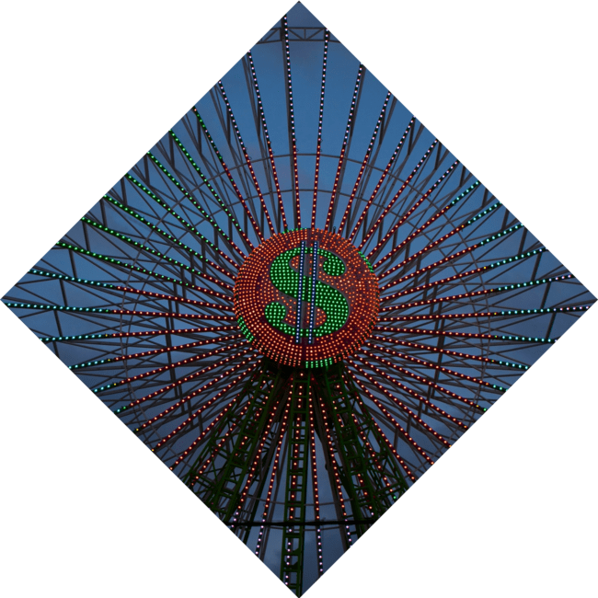


What are Even Functions?
are defined by the property f(x) = f(-x). This symmetry about the creates a beautiful balance, making them visually appealing and mathematically significant. Examples include polynomial functions like f(x) = x².

Slide 4

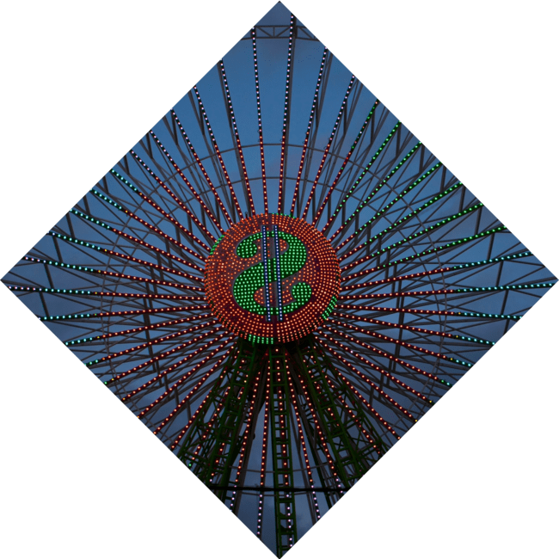

What are Odd Functions?
exhibit a different kind of symmetry, defined by f(x) = - f(-x). This symmetry about the
gives them a unique twist, often resulting in fascinating patterns. A classic example is f(x) = x³.

Slide 5



Visualizing Symmetry
The interplay between even and odd functions creates a stunning
visual tapestry.
reveal how these functions complement each other, showcasing their unique characteristics through vibrant
curves and shapes.

Slide 6





Applications of Even Functions
find applications in various fields, including physics and engineering.
They often simplify complex problems,
allowing for easier calculations and clearer interpretations of data, particularly in
and .

Slide 7
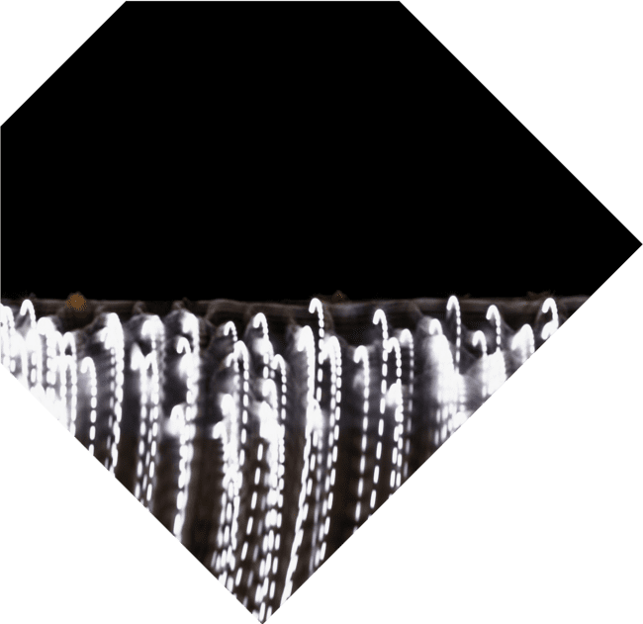




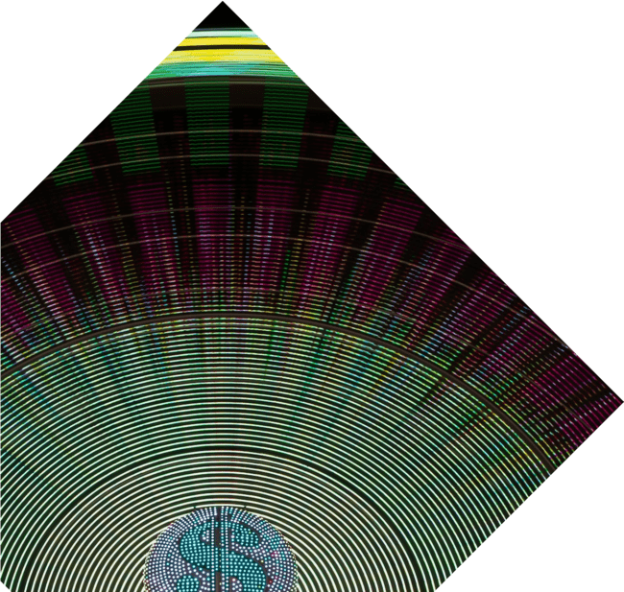
Applications of Odd Functions
In contrast, are crucial in
areas like and
. Their unique properties allow for the decomposition of signals into
simpler components, enhancing our understanding of complex systems.

Slide 8


The Harmony of Functions
The relationship between even and odd functions is not just mathematical; it's a
. Together, they create a
rich landscape of possibilities, showcasing
the beauty of symmetry and its profound impact on mathematical concepts.

Slide 9

Conclusion: Embracing Symmetry
Understanding the
enriches our appreciation of mathematics. Their not
only simplify calculations but also inspire
creativity, reminding us of the beauty inherent in mathematical structures.

Slide 10
Thanks!
Do you have any questions?
youremail@email.com
+91 620 000 838
www.yourwebsite.com @yourusername

