Slide 1
OPERATION OF FUNCTIONS

Slide 2


RECALL:
Note: in adding/subtracting similar terms, simply add/subtract the number and then copy the variable.
Ex.
1. $x+2x=3x$
2. $3x^{2}+{2x}^{2}={5x}^{2}$
3. $3x^{3}−{2x}^{3}=$ $x^{3}$
Rule (addition and subtraction of polynomials)
$$a+\left(+b\right)=a+b$$
$$a+\left(−b\right)=a−b$$
$$a−\left(+b\right)=a−b$$
$$a−\left(−b\right)=a+b$$
Example:
1. Add 3x+4 and 7x-8
Sol’n
$$3x+4+7x−8=3x+7x+4−8$$
$$=10x−4$$
2. Subtract ${35x}^{2} +4 and {30x}^{2}−2$
Sol’n
$${35x}^{2}+4−\left({30x}^{2}−2\right)={35x}^{2}+4−{30x}^{2}+2$$
$={5x}^{2}+6$

Slide 3

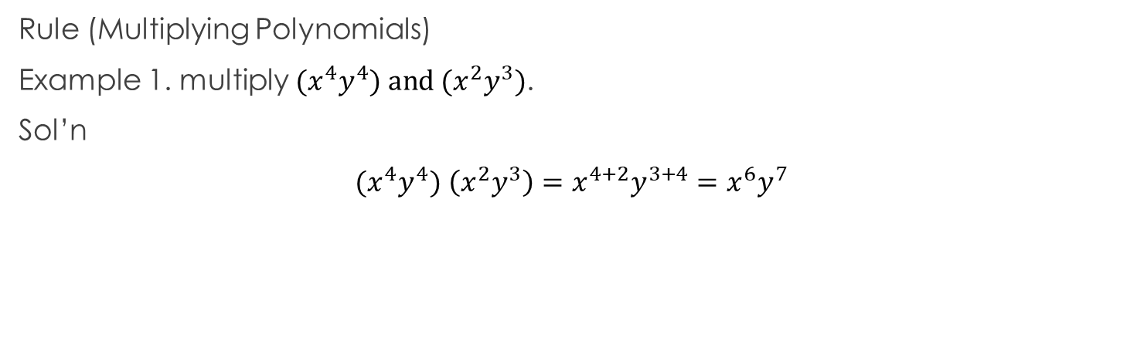
Recall:
Law of Exponent
Product rule for Exponents: ${(x}^{m}){(x}^{n})=x^{m+n}$
(Keep the base just add the exponent)
2. Power rule for Exponents: ${(x^{m})}^{n}=x^{mn}$
(keep the base just multiply the exponent)
3. Power of a product Rule:$({xy)}^{n}=$ $x^{n}y^{n}$
(Keep the base just multiply the exponent each of the base)
Rule (Multiplying Polynomials)
Example 1. multiply ${(x}^{4}y^{4}) and (x^{2}y^{3})$.
Sol’n
${(x}^{4}y^{4})$ $\left(x^{2}y^{3}\right)=x^{4+2}y^{3+4}=x^{6}y^{7}$

Slide 4


Recall:
Distributive property
$$a\left(x+b\right)=ax+ab$$
Rule (multiply polynomials by monomials)
Example: Multiply $5x$ by $x+4$
$$5x(x+4)=5x(x)+5x(4)$$
$={5x}^{2}+20x$

Slide 5
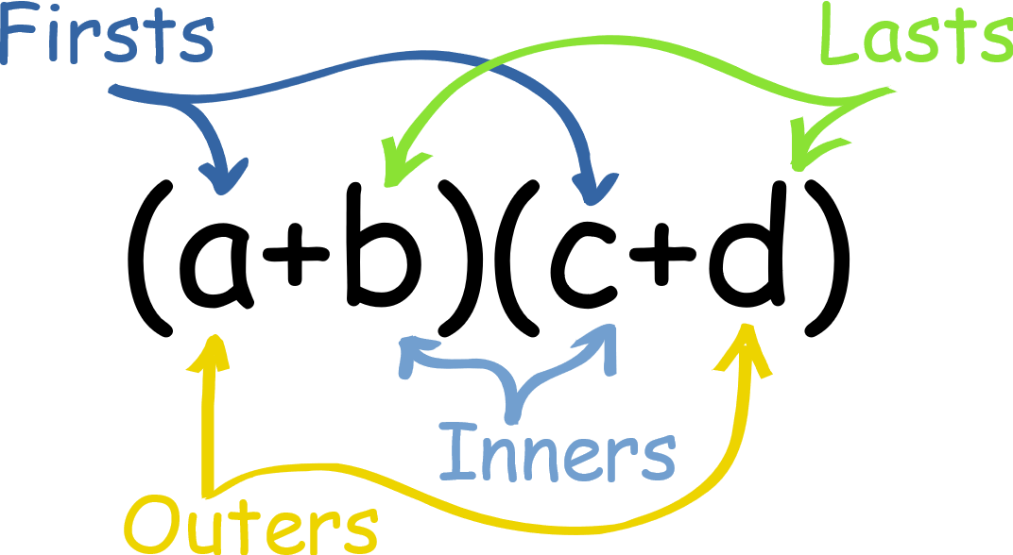

Recall:
Foil Method (First, Out, In, Last)
Rule (Multiply polynomials by polynomials)
Example: Multiply $(2x+3) by (x+4)$
$$\left(2x+3\right)\left(x+4\right)=2x\left(x\right)+2x\left(4\right)+3x\left(x\right)+3\left(4\right)$$
$$={2x}^{2}+8x+3x+12$$
$={2x}^{2}+11x+12$

Slide 6

Recall
Square of a Binomial
$${(x+y)}^{2}=x^{2}+2xy+y^{2}$$
$${(x−y)}^{2}=x^{2}−2xy+y^{2}$$
Example:
${(4x+y)}^{2}=$ ${16x}^{2}+8xy+y^{2}$
${(2x+3y)}^{2}=$ ${4x}^{2}+12xy+{9y}^{2}$
Cube of a Binomial
$${(x+y)}^{3}=x^{3}+{3x}^{2}y+3xy^{2}+y^{3}$$
Example:
$${(2x+y)}^{3}={8x}^{3}+{6x}^{2}y+6xy^{2}+y^{3}$$

Slide 7

Recall
Square of Trinomial
${(x+y+z)}^{2}=$ $x^{2}+y^{2}+z^{2}+2xy+2xz+2yz$
Example:
$${(2x+3y+4z)}^{2} ={(2x)}^{2}+(3{y)}^{2}+{\left(4z\right)}^{2}+2\left(2x\right)\left(3y\right)+2\left(2x\right)\left(4z\right)+2\left(3y\right)\left(4z\right)$$
$$={4x}^{2}+{9y}^{2}+{16z}^{2}+12xy+16xz+24yz$$

Slide 8


Recall
Law of exponent (Division)
$$\frac{x^{m}}{x^{n}}=x^{m−n}, m>0$$
$$\frac{x^{m}}{x^{n}}=\frac{1}{x^{m−n}}, m<0$$
Rule (dividing polynomials)
Example: Divide $\frac{x^{5}}{x^{3}}$
$$\frac{x^{5}}{x^{3}}=x^{5−2}=x^{3}$$

Slide 9

Definition
Sum, Difference, Product and Quotient of function
Let ‘f’ and ‘g’ be any two function. Then,
$(f+g)(x)=f(x)+g(x)$
$(f−g)(x)=f(x)−g(x)$
$(fg)(x)=f(x)g(x)$
$\left(\frac{f}{g}\right)\left(x\right)=\frac{f(x)}{g(x)}$, where $g(x)≠0$

Slide 10

Example
If $f(x)=(x−3)$ and $g\left(x\right)=x^{2}−6x+9$, Find
$\left(f+g\right)\left(x\right)$
$\left(f−g\right)\left(x\right)$
$\left(fg\right)\left(x\right)$
$(\frac{f}{g})(x)$

Slide 11
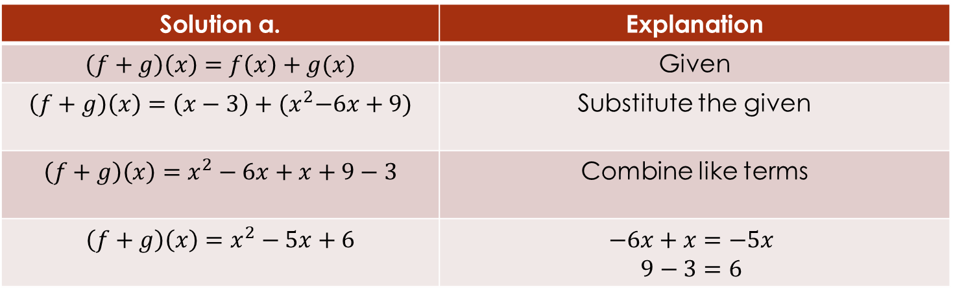

If $f(x)=(x−3)$ and $g\left(x\right)=x^{2}−6x+9$, Find
$\left(f+g\right)\left(x\right)$
$$\left(f+g\right)\left(x\right)=x^{2}−5x+6$$
Solution a. | Explanation
$$\left(f+g\right)\left(x\right)=f\left(x\right)+g(x)$$ | Given
$$\left(f+g\right)\left(x\right)=\left(x−3\right)+{(x}^{2}−6x+9)$$ | Substitute the given
$$\left(f+g\right)\left(x\right)=x^{2}−6x+x+9−3$$ | Combine like terms
$$\left(f+g\right)\left(x\right)=x^{2}−5x+6$$ | $$−6x+x=−5x$$ $$9−3=6$$

Slide 12
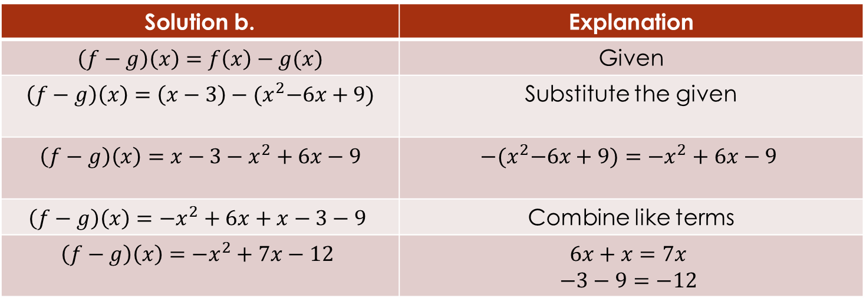

If $f(x)=(x−3)$ and $g\left(x\right)=x^{2}−6x+9$, Find
$\left(f−g\right)\left(x\right)$
$$\left(f−g\right)\left(x\right)=−x^{2}+7x−12$$
Solution b. | Explanation
$$\left(f−g\right)\left(x\right)=f\left(x\right)−g(x)$$ | Given
$$\left(f−g\right)\left(x\right)=\left(x−3\right)−{(x}^{2}−6x+9)$$ | Substitute the given
$$\left(f−g\right)\left(x\right)=x−3−x^{2}+6x−9$$ | $$−{(x}^{2}−6x+9)=−x^{2}+6x−9$$
$$\left(f−g\right)\left(x\right)=−x^{2}+6x+x−3−9$$ | Combine like terms
$$\left(f−g\right)\left(x\right)=−x^{2}+7x−12$$ | $$6x+x=7x$$ $$−3−9=−12$$

Slide 13
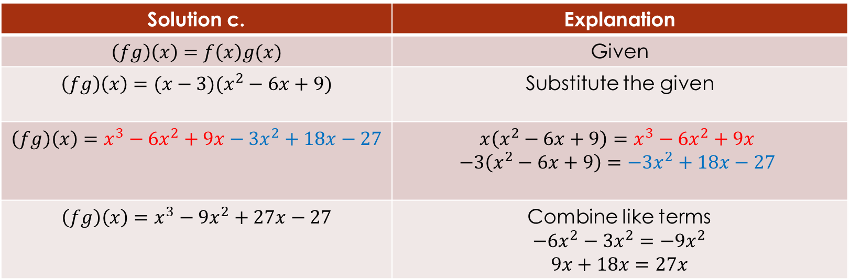

If $f(x)=(x−3)$ and $g\left(x\right)=x^{2}−6x+9$, Find
$\left(fg\right)\left(x\right)$
$$\left(fg\right)\left(x\right)=x^{3}−9x^{2}+27x−27$$
Solution c. | Explanation
$$\left(fg\right)\left(x\right)=f\left(x\right)g(x)$$ | Given
$$\left(fg\right)\left(x\right)=(x−3)(x^{2}−6x+9)$$ | Substitute the given
$$\left(fg\right)\left(x\right)=x^{3}−6x^{2}+9x−3x^{2}+18x−27$$ | $$x\left(x^{2}−6x+9\right)=x^{3}−6x^{2}+9x$$ $$−3\left(x^{2}−6x+9\right)=−3x^{2}+18x−27$$
$$\left(fg\right)\left(x\right)=x^{3}−9x^{2}+27x−27$$ | Combine like terms $$−6x^{2}−3x^{2}=−9x^{2}$$ $$9x+18x=27x$$

Slide 14
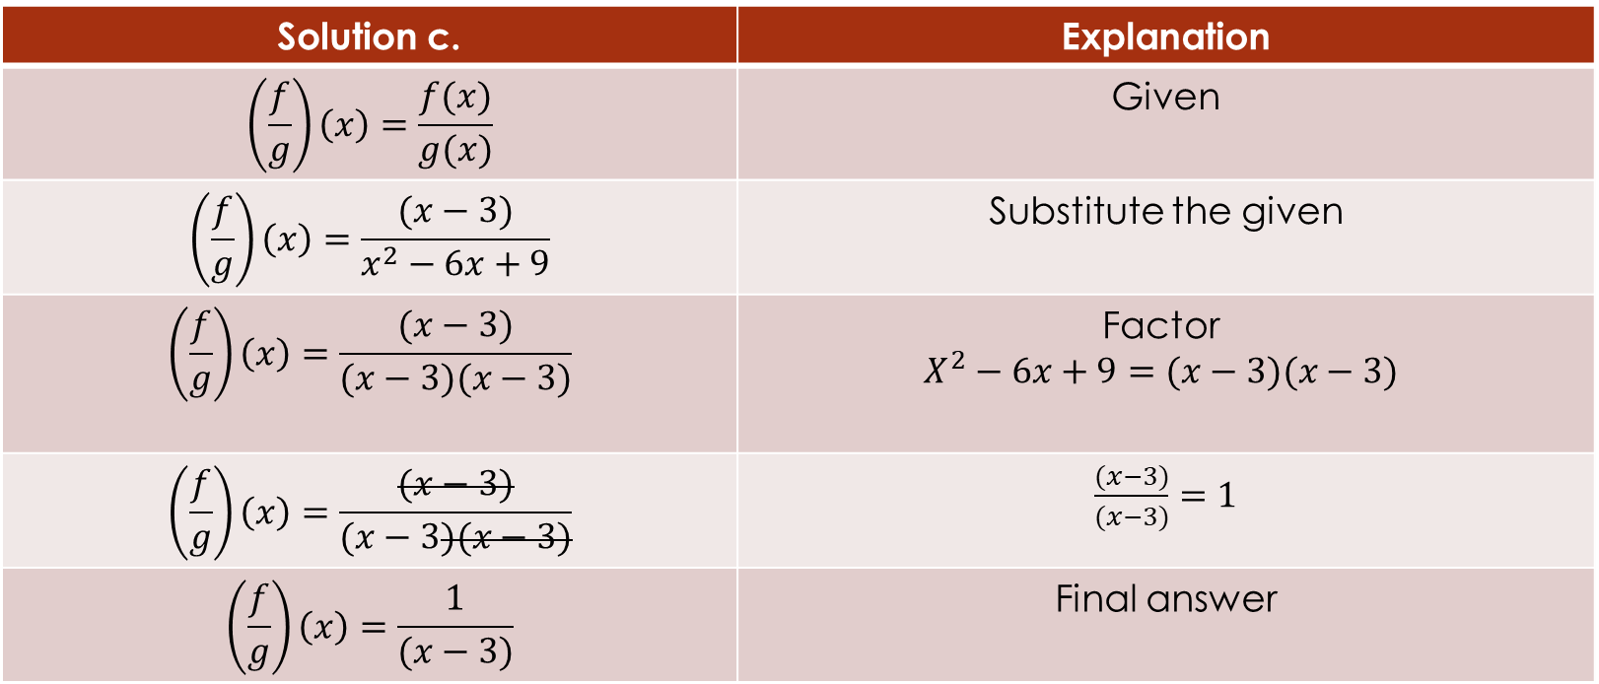

If $f(x)=(x−3)$ and $g\left(x\right)=x^{2}−6x+9$, Find
$(\frac{f}{g})(x)$
Solution c. | Explanation
$$\left(\frac{f}{g}\right)\left(x\right)=\frac{f(x)}{g(x)}$$ | Given
$$\left(\frac{f}{g}\right)\left(x\right)=\frac{(x−3)}{x^{2}−6x+9}$$ | Substitute the given
$$\left(\frac{f}{g}\right)\left(x\right)=\frac{(x−3)}{(x−3)(x−3)}$$ | Factor $$X^{2}−6x+9=(x−3)(x−3)$$
$$\left(\frac{f}{g}\right)\left(x\right)=\frac{(x−3)}{(x−3)(x−3)}$$ | $\frac{(x−3)}{(x−3)}=1$
$$\left(\frac{f}{g}\right)\left(x\right)=\frac{1}{(x−3)}$$ | Final answer

