Slide 1

Complex Numbers
Complex numbers are a fundamental concept in mathematics, extending the real number system to include numbers with both real and imaginary components. They have a wide range of applications in fields such as physics, engineering, and computer science.
OI
by ONYEDIKA IK

Slide 2
Introduction to Complex Numbers
Real Numbers
Imaginary Numbers
Real numbers represent quantities that can be measured or counted, such as the length of a line or the number of objects in a set. They are represented on a number line and can be positive, negative, or zero.
Imaginary numbers arise when we take the square root of a negative number. The imaginary unit "i" is defined as the square root of -1. Imaginary numbers are not directly measurable in the real world but have important applications in mathematics.

Slide 3
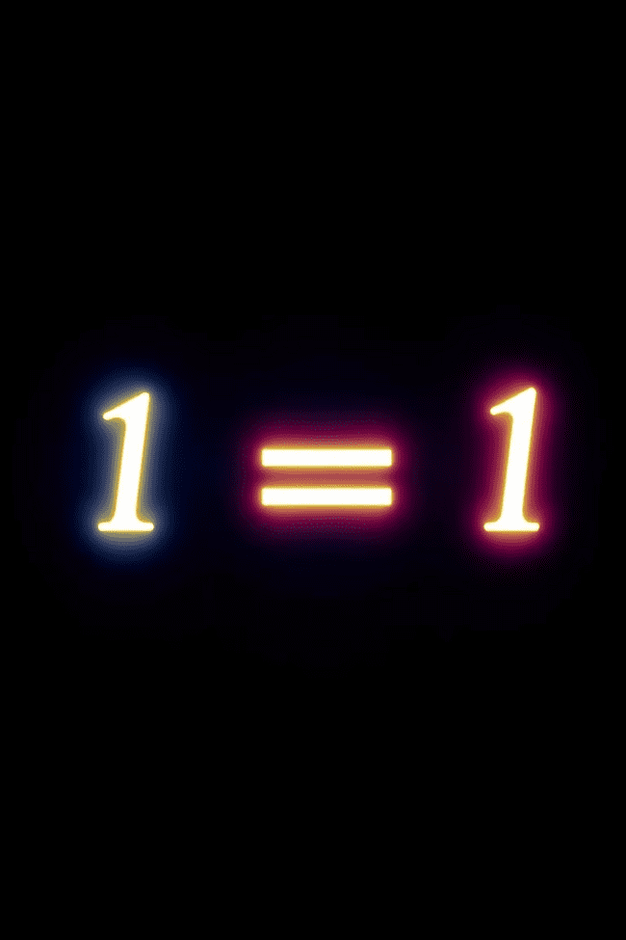
Imaginary Unit (i)
Definition
Properties
The imaginary unit "i" is defined as the square root of -1. This means that i2 = -1.
The imaginary unit "i" has several important properties, such as: i3 = -i, i4 = 1, and so on. These properties are used in calculations involving complex numbers.

Slide 4
Representation of Complex Numbers
Standard Form
Geometric Representation
A complex number is typically represented in the standard form "a + bi," where "a" and "b" are real numbers, and "i" is the imaginary unit.
Complex numbers can be visualized as points in the complex plane, where the horizontal axis represents the real part ("a") and the vertical axis represents the imaginary part ("b").

Slide 5
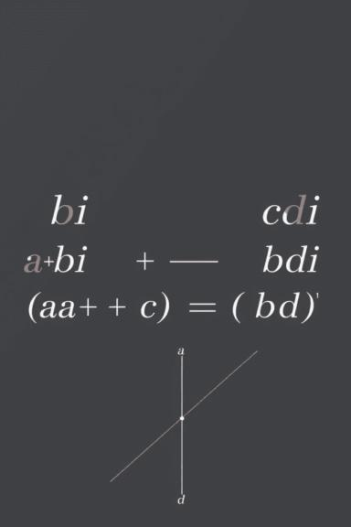
Addition and Subtraction of Complex Numbers
Addition
Subtraction
To add two complex numbers, we simply add their real and imaginary parts separately. (a + bi) + (c + di) = (a + c) + (b + d)i
To subtract two complex numbers, we subtract their real and imaginary parts separately. (a + bi) - (c + di) = (a - c) + (b - d)i

Slide 6
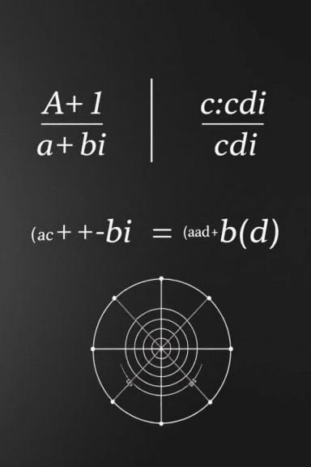


Multiplication of Complex Numbers
Distributive Property
Simplifying
Multiplication of complex numbers follows the distributive property. (a + bi) * (c + di) = ac + adi + bci + bdi2
Since i2 = -1, we can simplify the result to (ac - bd) + (ad + bc)i

Slide 7
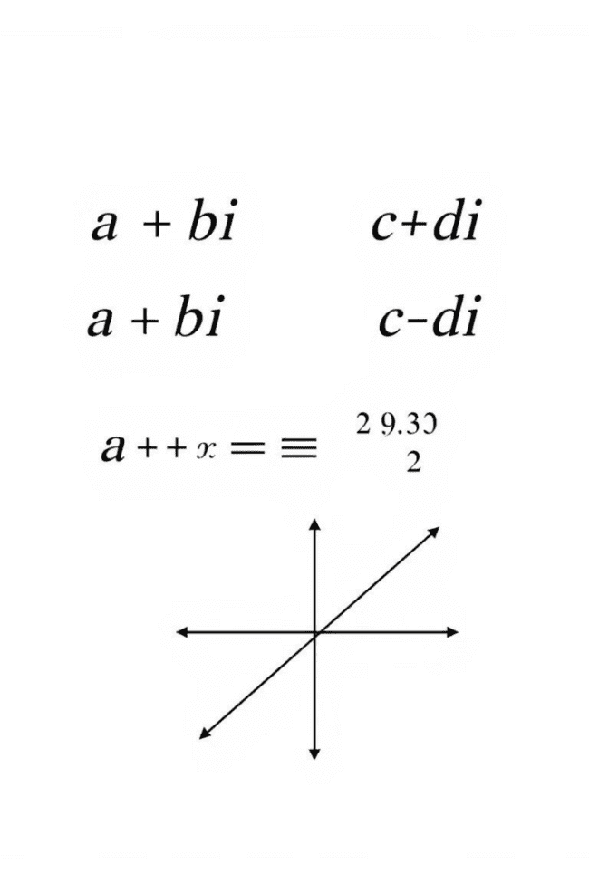


Division of Complex Numbers
Multiply by Conjugate
To divide two complex numbers, we multiply both the numerator and denominator by the complex conjugate of the denominator.
Simplify
The result simplifies to a complex number with a real number in the denominator. (a + bi) / (c + di) = [(a + bi) * (c - di)] / [(c + di) * (c - di)]

Slide 8



Complex Conjugate
Definition
1
The complex conjugate of a complex number "a + bi" is "a - bi."
Properties
2
The product of a complex number and its conjugate is always a real number.
Applications
3
Complex conjugates are used in various mathematical operations, such as division of complex numbers, finding the modulus and argument, and solving equations.

Slide 9
Modulus and Argument of Complex Numbers
Modulus
1
The modulus of a complex number is its distance from the origin in the complex plane. It is represented by |z|.
Argument
The argument of a complex number is the angle between the positive real axis and the line connecting the origin to the complex number in the complex plane. It is represented by arg(z).
2

Slide 10
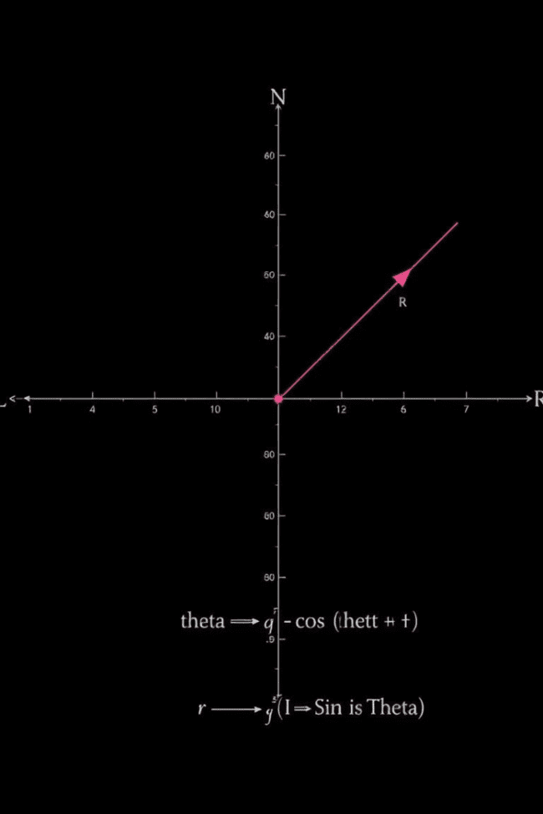
Polar Form of Complex Numbers
1
2
Polar Coordinates
Conversion
Instead of using the rectangular coordinates (a, b), we can represent a complex number using polar coordinates (r, θ).
We can convert between rectangular and polar forms using the relationships: r = |z| and θ = arg(z).

