Slide 1



Area of Shapes
Explore the fascinating world of geometric shapes and learn how to calculate their areas, from the basics of rectangles and triangles to the intricacies of irregular shapes. Uncover the practical applications of shape area knowledge and gain a deeper understanding of the mathematical principles that govern the physical world around us.
by Onwurah Onyedikachi

Slide 2
Introduction to Geometric Shapes
Fundamental Shapes
Real-World Applications
Mathematical Principles
The building blocks of geometry include rectangles, triangles, circles, and other basic shapes. Each shape has unique properties and formulas for calculating its area.
Geometric shapes are found everywhere in our daily lives, from the rectangular layout of buildings to the circular design of wheels. Understanding their areas is crucial in fields like construction, engineering, and even art.
The area of a shape is determined by its dimensions, such as length, width, and radius. Mastering the formulas and techniques for calculating these areas is essential for problem-solving and analytical thinking.

Slide 3
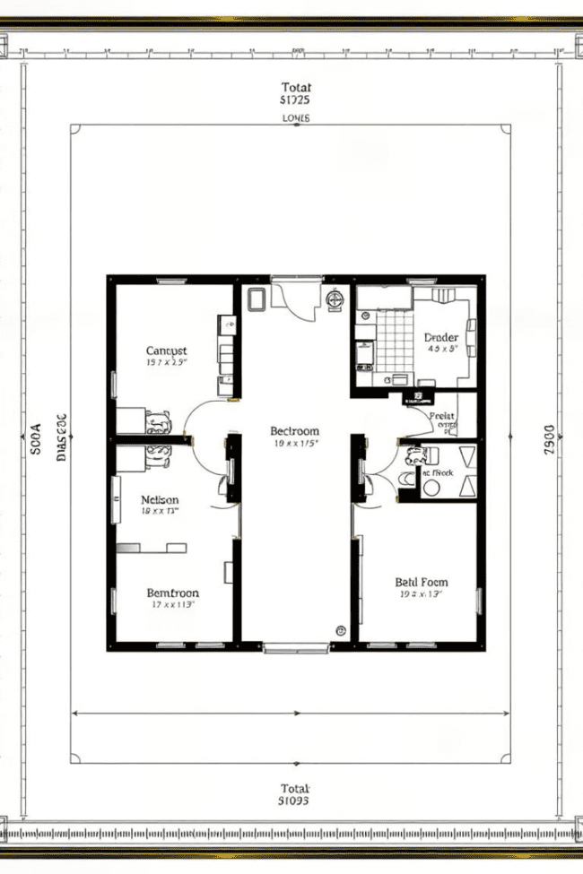
Calculating the Area of Rectangles
1
Step 1
Identify the length and width of the rectangle.
2
Step 2
Multiply the length and width to find the area.
3
Step 3
Express the area in the appropriate units (e.g., square meters, square feet).

Slide 4
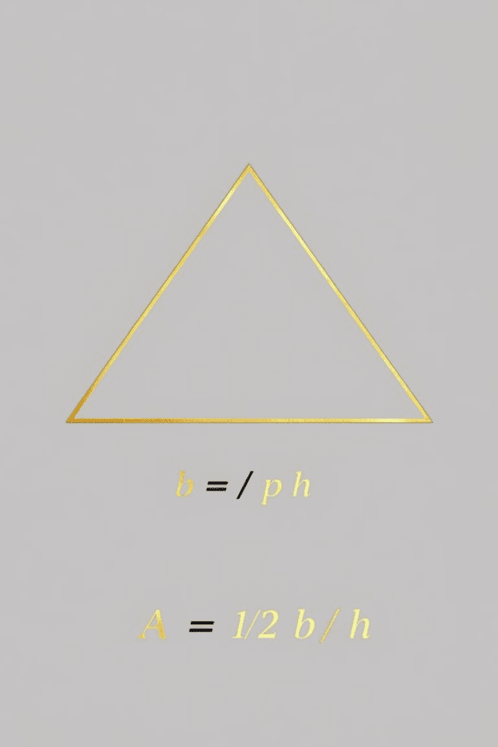
Calculating the Area of Triangles
1
Base and Height
2
Alternate Formulas
The area of a triangle is determined by its base and height. The formula is: Area = 1/2 × base × height.
For triangles with known side lengths, you can use the formula: Area = √(s(s-a)(s-b)(s-c)), where s is the semi-perimeter and a, b, c are the side lengths.
3
Special Triangles
The area of isosceles and equilateral triangles can be calculated using simplified formulas based on their unique properties.

Slide 5
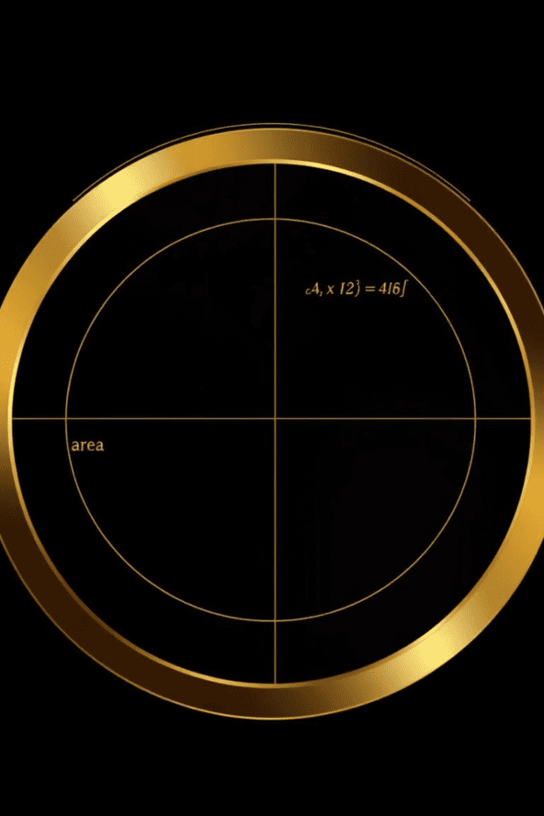
Calculating the Area of Circles
Formula
Diameter and Circumference
The area of a circle is calculated using the formula: Area = π × r^2, where r is the radius of the circle.
The diameter and circumference of a circle can also be used to derive the area formula: Area = (π × d^2) / 4, where d is the diameter.
Real-World Applications
Circular shapes are ubiquitous in architecture, engineering, and design, making the ability to calculate their areas essential for various projects and applications.

Slide 6
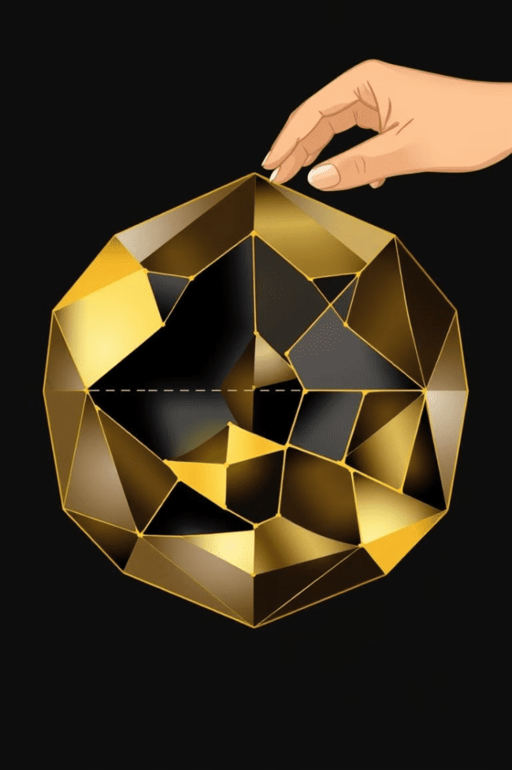



Calculating the Area of Irregular Shapes
Decompose
Break down the irregular shape into smaller, simpler geometric shapes that are easier to measure and calculate.
Calculate Parts
Determine the area of each individual component using the appropriate formulas for rectangles, triangles, or other shapes.
Sum the Areas
Add up the areas of all the components to find the total area of the irregular shape.

Slide 7





Practical Applications of Shape Area
Construction
Manufacturing
Landscape Design
Art and Design
Calculating the area of building components, such as floors, walls, and roofs, is essential for estimating materials, budgeting, and project planning.
Knowing the area of parts and products is crucial for efficient production, packaging, and resource allocation in various industries.
Calculating the area of gardens, lawns, and outdoor spaces helps designers plan landscaping elements, irrigation systems, and material requirements.
Understanding the area of canvases, frames, and other art surfaces is important for artists and designers to properly scale their work.

Slide 8

Conclusion and Key Takeaways
Mastering Formulas
Develop a deep understanding of the formulas and techniques for calculating the areas of various geometric shapes.
Practical Applications
Recognize the widespread use of shape area knowledge in fields like construction, engineering, and design, and apply these principles to real-world situations.
Problem-Solving Skills
Enhance your analytical thinking and problem-solving abilities by using shape area calculations to tackle complex challenges.
Appreciate Geometry
Gain a deeper appreciation for the mathematical principles and patterns that govern the physical world around us.

