Slide 1
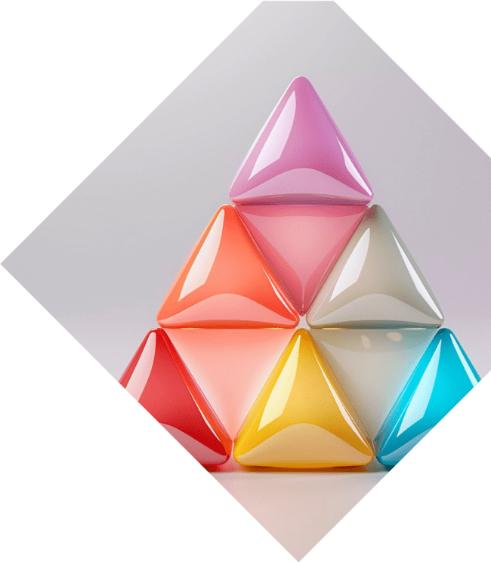

Unlocking the Secrets of Trigonometry: A Journey Through Identities

Slide 2




Introduction to Trigonometry
is a fascinating branch of mathematics that explores the relationships between the angles and sides of triangles. This journey will unlock the
behind trigonometric and their applications, revealing the beauty and utility of this mathematical field.

Slide 3






The Basics of Angles
Understanding is crucial in trigonometry. We will explore and
, the two primary units of
measuring angles. Each unit has its unique
applications, making it essential to grasp their and how they relate to trigonometric functions.

Slide 4





Sine, Cosine, and Tangent
The trigonometric functions—
, , and —are the building blocks of trigonometry. These functions relate the angles of a triangle to the ratios
of its sides, providing a foundation for solving complex problems in mathematics and physics.

Slide 5





Exploring Trigonometric
Identities
Trigonometric are equations that hold true for all values of the variables involved. They are essential tools for simplifying expressions and solving equations.
We'll delve into key identities,
including the ,
,
identities.
and

Slide 6
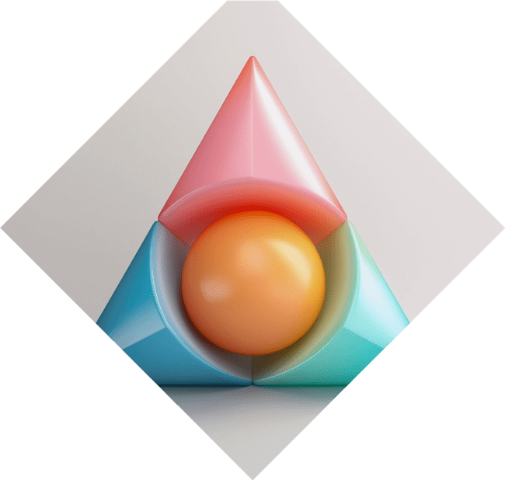

The Unit Circle Unveiled
The is a powerful concept in trigonometry that helps visualize the relationships between angles and coordinates. By understanding the unit circle, we can easily derive the values of trigonometric functions for common angles, enhancing our problem-solving skills.

Slide 7
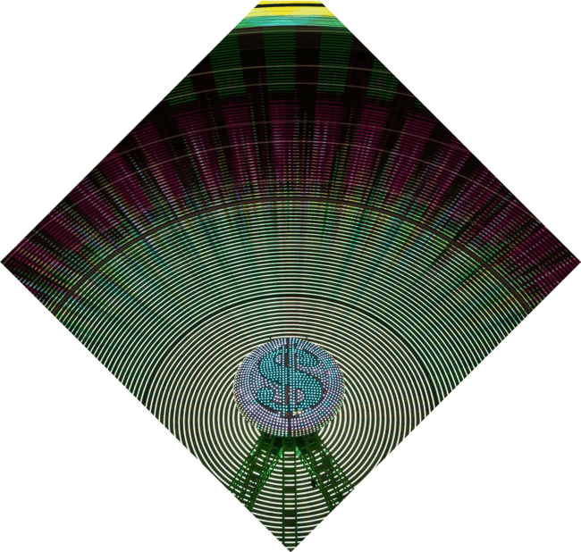



Applications of Trigonometry
Trigonometry has various fields, including
in
,
, and . From calculating distances to modeling waves, the principles of trigonometry are vital in solving practical problems and advancing technology.

Slide 8
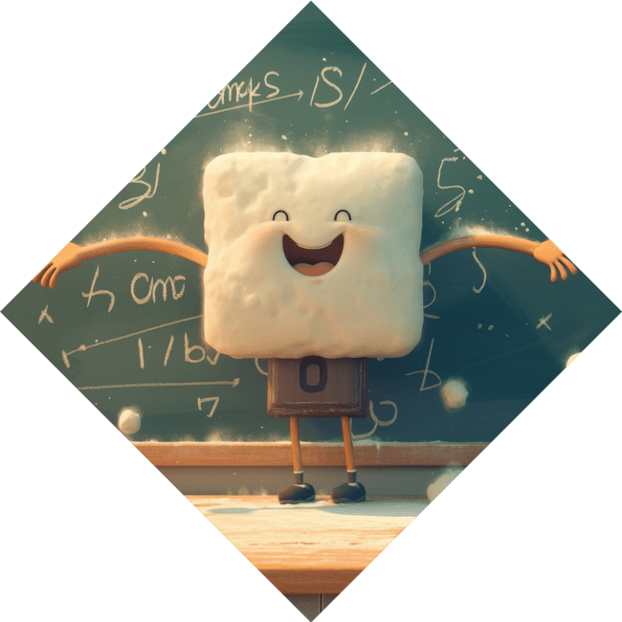


Common Misconceptions
Many students struggle with due to misconceptions.
It's essential to clarify common
misunderstandings, such as
confusing with their trigonometric ratios or misapplying identities. Addressing these issues can lead to a clearer understanding
of the subject.

Slide 9

Conclusion: The Journey Continues
As we conclude our exploration of trigonometry, remember that this is just the beginning. The
of trigonometric identities will aid you in advanced mathematics and beyond. Keep
practicing, and let your curiosity guide you on this mathematical journey!

Slide 10
Thanks!
Do you have any questions?
youremail@email.com
+91 620 000 838
www.yourwebsite.com @yourusername

