Slide 1


Data Handling: An Essential Skill for the Digital Age
In our rapidly evolving digital landscape, the ability to effectively manage, analyze, and extract insights from data has become a critical skill for individuals and organizations alike. Data handling encompasses a wide range of techniques and tools that empower us to navigate the vast ocean of information at our fingertips, transforming raw data into valuable knowledge that drives informed decision-making and fuels innovation.
by Onyedikachi Onwurah

Slide 2

Introduction to Data Handling
1
Understanding Data
2
Data-Driven Mindset
Data handling involves the process of collecting, organizing, and interpreting various types of information, ranging from structured datasets to unstructured text, images, and multimedia.
Embracing a data-driven mindset enables individuals and organizations to make informed decisions, identify patterns, and uncover hidden insights that can lead to improved outcomes and competitive advantages.
3
Practical Applications
The skills acquired through data handling can be applied across a wide array of industries and disciplines, from business and finance to healthcare, education, and scientific research.

Slide 3
Types of Data: Structured vs. Unstructured
Structured Data
Unstructured Data
Combining Data Types
Structured data refers to information that is organized in a predefined format, such as spreadsheets, databases, and tables. This type of data is often easier to manage, analyze, and query, making it a valuable resource for decision-making and reporting.
Unstructured data encompasses a wide range of information that does not adhere to a specific format, including text documents, emails, social media posts, images, and multimedia files. Handling unstructured data requires more advanced techniques, such as natural language processing and machine learning.
Effective data handling often involves integrating both structured and unstructured data to gain a comprehensive understanding of a given problem or scenario, leading to more robust and insightful analysis.

Slide 4
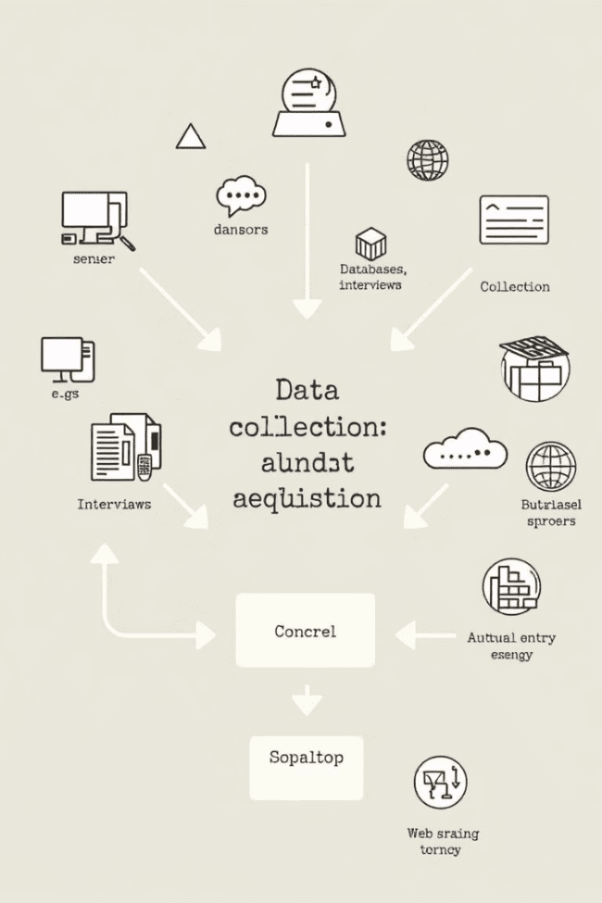
Data Collection and Acquisition
1
Identify Data Sources
The first step in data handling is to identify the relevant sources of information, which can include internal databases, external datasets, online resources, and real-time data streams.
2
Data Acquisition
Once the data sources have been identified, the next step is to acquire the data, which can involve web scraping, API integrations, or manual data entry, depending on the format and accessibility of the information.
3
Data Verification
Before proceeding with data analysis, it is crucial to verify the accuracy, completeness, and reliability of the collected data to ensure the integrity and validity of the insights derived from it.

Slide 5
Data Cleaning and Preprocessing
Data Cleaning
Data Transformation
Data cleaning involves identifying and addressing issues such as missing values, duplicate entries, inconsistencies, and outliers within the dataset, ensuring that the information is accurate, complete, and ready for analysis.
Preprocessing data often requires transforming the information into a standardized format, such as converting text to numerical values or normalizing data ranges, to enable effective analysis and comparison across different datasets.
Feature Engineering
Data Enrichment
Feature engineering is the process of creating new variables or attributes from the existing data, which can uncover hidden patterns, relationships, and insights that may not be immediately apparent in the raw information.
Data enrichment involves supplementing the existing dataset with additional information from external sources, such as demographic data, market trends, or geospatial information, to provide a more comprehensive and context-rich view of the problem at hand.

Slide 6





Exploratory Data Analysis
Identifying Patterns
Statistical Analysis
Exploratory data analysis involves examining the dataset to identify patterns, trends, and relationships that can provide valuable insights and inform the next steps in the data handling process.
Utilizing statistical techniques, such as calculating measures of central tendency, dispersion, and correlation, can help uncover the underlying structure and characteristics of the data.
Visualizing Insights
Generating Hypotheses
Data visualization tools, such as scatter plots, histograms, and heat maps, can help researchers and decision-makers quickly identify and communicate key insights hidden within the data.
Exploratory data analysis can also inform the formulation of hypotheses, which can then be tested and validated through more rigorous statistical analysis or targeted data collection efforts.

Slide 7
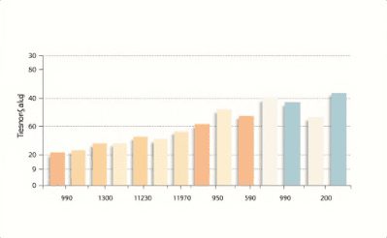
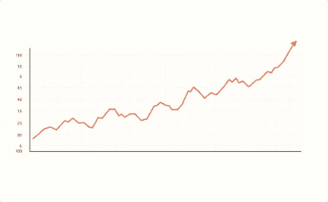
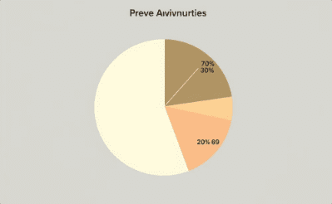
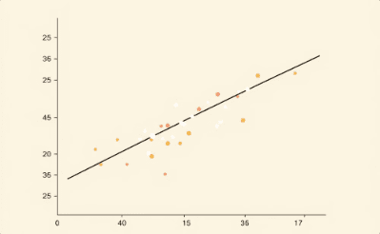
Data Visualization Techniques
Bar Charts
Line Graphs
Pie Charts
Scatter Plots
Bar charts are effective for comparing and contrasting different categories or values, making them a useful tool for visualizing trends, performance metrics, and other quantitative data.
Line graphs are particularly well-suited for displaying changes over time, such as stock prices, growth rates, or other time-series data, allowing users to easily identify patterns and trends.
Pie charts are a classic data visualization technique used to showcase the proportional composition of a whole, making them ideal for representing the relative sizes of different categories or segments within a dataset.
Scatter plots are used to visualize the relationship between two variables, allowing users to identify patterns, outliers, and potential correlations within the data.

Slide 8




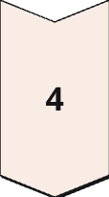
Data Storage and Management
Database Systems
Relational database management systems (RDBMS) and NoSQL databases provide robust and scalable solutions for storing, organizing, and managing structured and unstructured data.
Data Warehousing
Data warehouses serve as centralized repositories for integrating and consolidating data from multiple sources, enabling comprehensive analysis and reporting.
Cloud-Based Storage
Cloud-based storage and computing platforms offer scalable, flexible, and cost-effective solutions for data storage, processing, and management, allowing for easy access and collaboration.
Data Governance
Effective data governance policies and procedures ensure the security, privacy, and integrity of data, while also facilitating efficient data management and utilization.

Slide 9

Practical Applications and Case Studies
Industry
Application
Key Benefits
Healthcare
Predictive modeling for disease outbreaks
Early detection and prevention of epidemics
Finance
Fraud detection and risk analysis
Improved financial security and compliance
Retail
Personalized product recommendations
Enhanced customer experience and increased sales
Transportation
Route optimization and logistics planning
Reduced costs, improved efficiency, and lower emissions

Slide 10
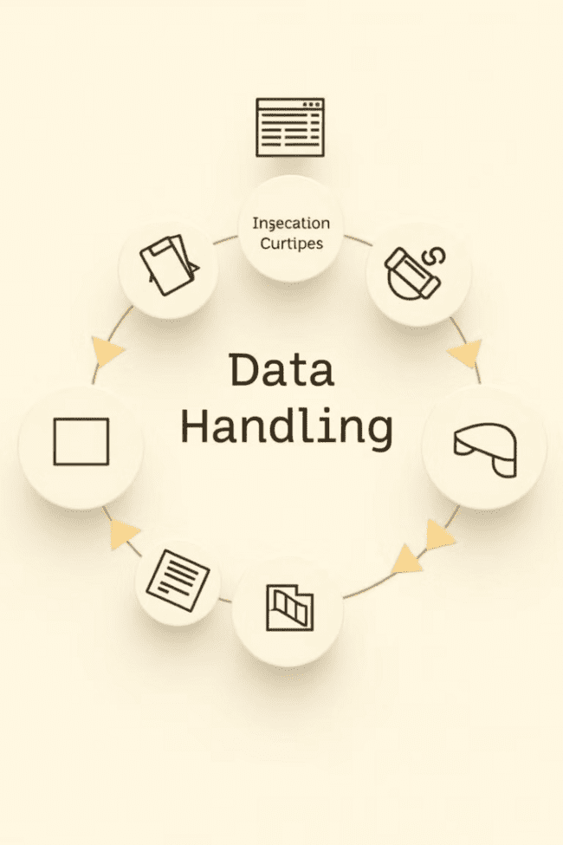
Conclusion and Key Takeaways
1
Data Handling: A Crucial Skill
2
Systematic Approach
Successful data handling requires a systematic approach, encompassing data collection, cleaning, preprocessing, analysis, visualization, and storage, to ensure the integrity and reliability of the insights generated.
The ability to effectively manage, analyze, and derive insights from data has become a critical skill in the digital age, driving innovation, improving decision-making, and delivering tangible benefits across various industries.
3
Continuous Learning
As the data landscape continues to evolve, staying current with emerging technologies, tools, and best practices is essential for individuals and organizations to maintain a competitive edge and capitalize on the vast potential of data-driven decision-making.

