Slide 1


Unlocking the Secrets of Polynomials: The Magic of the Rational Root Theorem

Slide 2


Introduction to Polynomials
are fundamental expressions in algebra that consist of variables and coefficients. Understanding their properties can unlock many mathematical mysteries. In this presentation, we will explore the and
how it helps us find roots of polynomial equations creatively.

Slide 3


What Are Polynomials?
A is an expression made up of variables raised to non-negative integer powers and multiplied by coefficients. They can be simple like x
+ 2 or complex like 3x^3 - 2x^2 + x - 5. Understanding their structure is key
to mastering algebra.

Slide 4
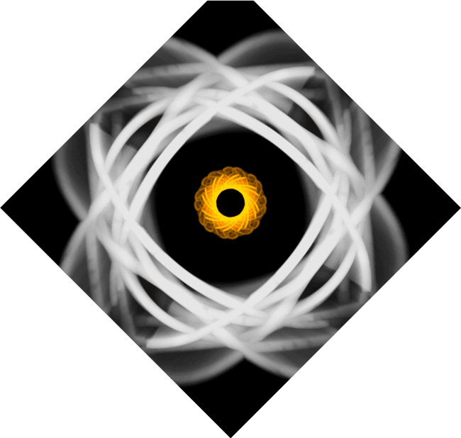

Roots and Their Importance
The of a polynomial are the values of x that make the polynomial equal to zero.
Finding these roots is crucial for graphing
the polynomial and understanding its
behavior. Let's dive into how we can find these roots efficiently.

Slide 5

Introducing the Rational
Root Theorem
The
provides a method to identify potential rational roots of a polynomial. It
states that any rational solution, expressed as a fraction p/q, has p as a factor of the constant term and q as a factor of the leading coefficient.
Let's break this down!

Slide 6




Finding Potential Roots
To find potential roots using the
, first list all factors of the constant term and the leading coefficient. Then, create all possible fractions p/q.
These candidates are your starting point for testing roots in the polynomial.

Slide 7


Testing the Roots
Once you have your potential roots, it's time to them! Substitute each candidate into the polynomial. If it equals zero, congratulations! You've found a root. This process helps us simplify polynomials and uncover
their mysteries.

Slide 8

Applications of the
Theorem
The is not just
a theoretical tool; it has practical applications in engineering, physics, and computer science. By efficiently
finding roots, we can solve real-world problems and optimize solutions in
various fields.

Slide 9
Conclusion: The Magic Unveiled
In conclusion, the is a
powerful tool that simplifies the process of
finding polynomial roots. By understanding and applying this theorem, we unlock the secrets of polynomials, making complex problems easier to solve. Embrace the magic of mathematics!

Slide 10
Thanks!
Do you have any questions?
youremail@email.com
+91 620 000 838
www.yourwebsite.com @yourusername

