Slide 1

Arithmetic Sequences: A Deep Dive
This presentation explores the fascinating world of arithmetic sequences, delving into their fundamental properties, applications, and problem-solving techniques. Join us as we uncover the patterns, formulas, and real-world scenarios that make arithmetic sequences a compelling topic in mathematics.
IO
by IKENNA ONYI

Slide 2
Definition of an Arithmetic Sequence
Definition
Example
An arithmetic sequence is a series of numbers where the difference between any two consecutive terms is constant. This constant difference is known as the common difference. In other words, each term is obtained by adding the common difference to the previous term.
The sequence 2, 5, 8, 11, 14... is an arithmetic sequence because the common difference is 3. Each term is obtained by adding 3 to the previous term.

Slide 3
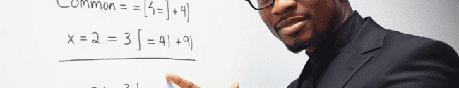
Common Difference
1
Importance
2
Calculation
3
Notation
The common difference is the defining characteristic of an arithmetic sequence. It determines the pattern and allows us to predict future terms in the sequence.
To find the common difference, simply subtract any term from the term that follows it. For example, in the sequence 2, 5, 8, 11, 14..., the common difference is 5 - 2 = 3.
The common difference is often denoted by the letter 'd'. In our example, d = 3.

Slide 4
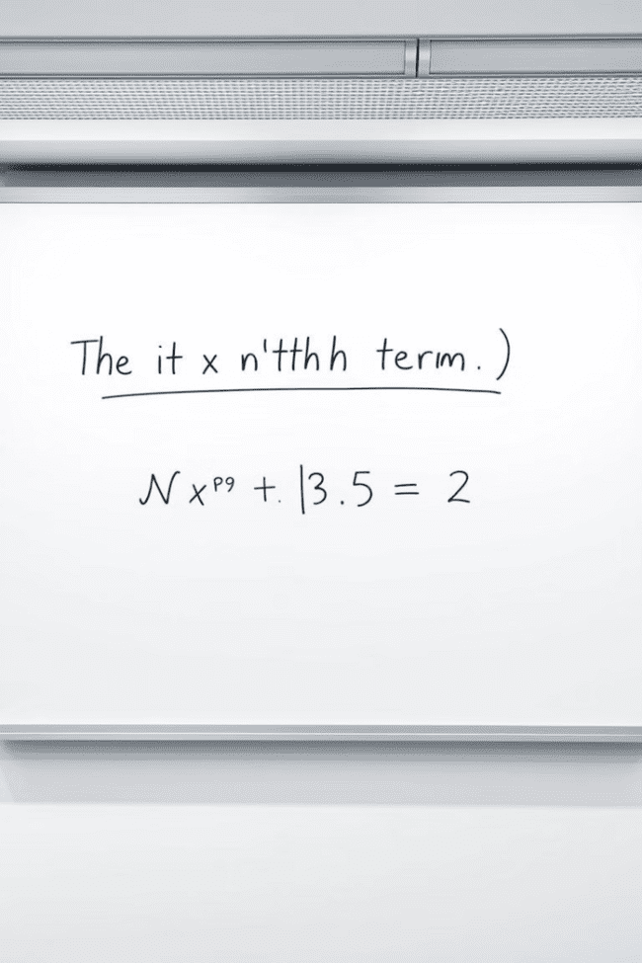


Explicit Formula for the nth Term
Formula
The explicit formula for the nth term of an arithmetic sequence is given by: an = a1 + (n - 1)d, where a1 is the first term, d is the common difference, and n is the term number.
Example
For the sequence 2, 5, 8, 11, 14..., a1 = 2 and d = 3. To find the 10th term, we use the formula: a10 = 2 + (10 - 1)3 = 29.

Slide 5
Recursive Formula for the nth Term
Formula
1
The recursive formula expresses the nth term in terms of the previous term: an = an-1 + d, where d is the common difference. This formula highlights the iterative nature of arithmetic sequences.
Example
2
In the sequence 2, 5, 8, 11, 14..., to find the 5th term (a5), we use the formula: a5 = a4 + d = 11 + 3 = 14. This formula demonstrates that each term is built upon the previous one.

Slide 6


Sum of the First n Terms
Formula
The sum of the first n terms of an arithmetic sequence is given by: Sn = (n/2)(a1 + an), where a1 is the first term, an is the nth term, and n is the number of terms.
1
Example
2
To find the sum of the first 10 terms of the sequence 2, 5, 8, 11, 14..., we use the formula: S10 = (10/2)(2 + 29) = 155.

Slide 7

Properties of Arithmetic Sequences
Constant Difference
Linear Relationship
The key characteristic of an arithmetic sequence is the constant difference between consecutive terms, allowing for predictable growth or decline.
The terms of an arithmetic sequence form a linear relationship when plotted on a graph, exhibiting a constant rate of change.
Explicit Formula
Recursive Formula
The nth term can be directly calculated using the explicit formula, providing a convenient method for finding specific terms.
The recursive formula expresses each term in relation to the previous one, highlighting the iterative nature of the sequence.

Slide 8




Applications of Arithmetic Sequences
Financial Planning
Arithmetic sequences are used to model compound interest, loan repayments, and investment growth, providing insights into financial planning.
Data Analysis
Arithmetic sequences help analyze trends in data, identify patterns, and predict future values in various fields, such as economics and statistics.
Construction
Arithmetic sequences are employed in construction projects to calculate the number of bricks, tiles, or other materials needed for building structures.

Slide 9
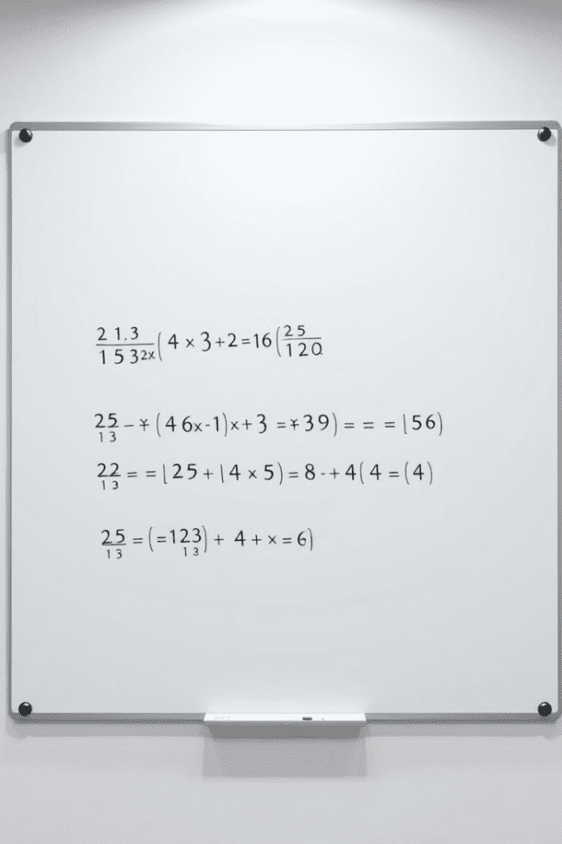
Solving Problems with Arithmetic Sequences
1
2
Identify the pattern
Apply the formula
Determine the common difference and the first term to define the sequence.
Use the explicit or recursive formula to calculate the nth term or the sum of the first n terms.
3
4
Solve for unknowns
Interpret the results
Manipulate the formulas to solve for unknown variables, such as the first term, common difference, or the term number.
Apply the calculated values to answer the original problem in a meaningful way.

Slide 10

Review and Practice Problems
We have explored the fundamental concepts of arithmetic sequences, including their definition, formulas, properties, and applications. Now, let's solidify our understanding through practice problems and interactive exercises.

