Slide 1

Unraveling the Mysteries: A Journey Through Non-Homogeneous Differential Equations

Slide 2


Introduction to Non-Homogeneous DEs
are
fundamental in understanding various phenomena in engineering and science. This
presentation will guide you through their intricacies, exploring solutions and applications.
Prepare to embark on a journey that unveils the
behind these equations!

Slide 3



Understanding the Basics
To grasp
, we ﬁrst need
. These
to understand the equations consist of a
homogeneous part and a non- homogeneous part. The solutions to these equations reveal much about the systems they represent.

Slide 4



Types of Non-Homogeneous DEs
There are various of Non-Homogeneous Differential Equations, including linear and nonlinear forms. Each type presents unique challenges and solutions. Understanding these distinctions is crucial for tackling real-world
effectively.

Slide 5



Methods of Solution
Several exist for solving Non- Homogeneous Differential Equations, such as the method of undetermined coefﬁcients and variation of parameters. Each method has its own advantages and is suitable for different types of .

Slide 6
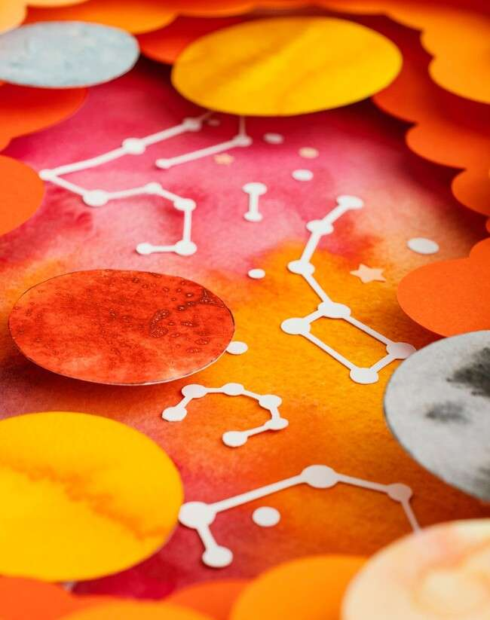


Applications in Real Life
Non-Homogeneous Differential Equations have
applications, from physics to economics. They model everything from
population growth to electrical circuits, showcasing their importance in understanding
systems.

Slide 7



Challenges and Pitfalls
While solving Non-Homogeneous Differential Equations can be rewarding, it also presents various
. Common pitfalls include misidentifying the type of equation or applying the wrong solution method. Awareness of these issues can enhance .

Slide 8



Future Directions
The study of Non-Homogeneous Differential Equations is evolving, with new and applications being developed. As technology advances, the potential for innovative solutions in diverse ﬁelds becomes more .

Slide 9

Conclusion: The Journey Continues
In conclusion, our exploration of Non-Homogeneous Differential Equations reveals their and signiﬁcance. As we continue to unravel these mathematical mysteries, we open doors to discoveries and innovations in various ﬁelds.

Slide 10
Thanks!
Do you have any questions? youremail@email.com
+91 620 000 838
www.yourwebsite.com @yourusername

