Slide 1
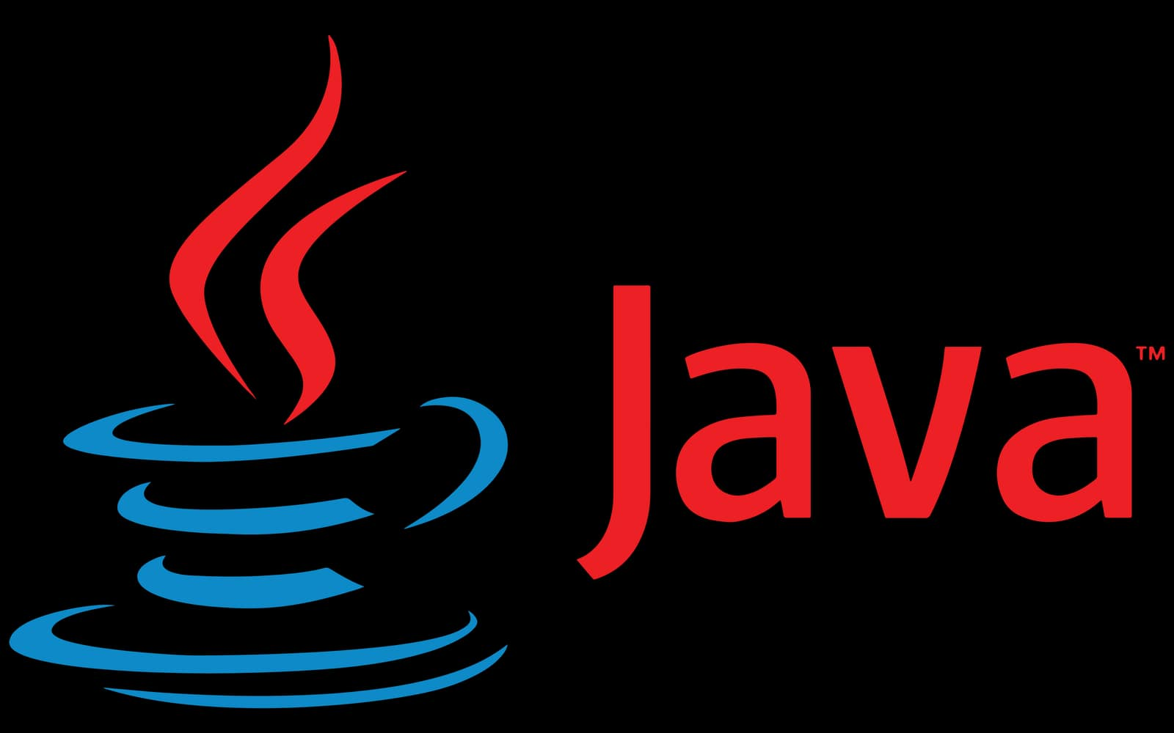
CHAPTER 1
INTRODUCTION TO JAVA PROGRAMMING
IT-PF01 – OBJECT-ORIENTED PROGRAMMING 1

Slide 2
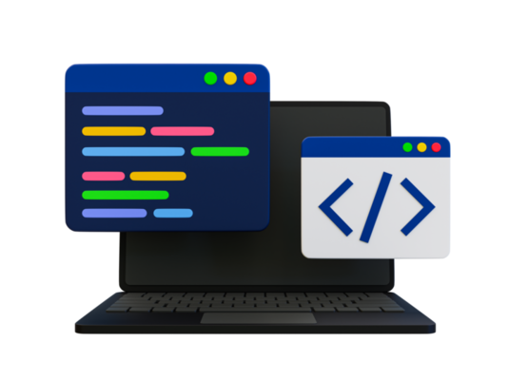
Understanding programming and computer porgrams
The term PROGRAMMING pertains to the method of writing scripts or code. Programs or software is the by-product of programming. Each computer program is done through point-by-point procedures called process.
COMPUTER PROGRAMS are series of commands you write to inform your machine what it should perform. It is possible through the use of programming language which refers to the series of syntax used to implement algorithms.
Programmers use programming languages to write code(programming), create computer programs, and develop software.

Slide 3
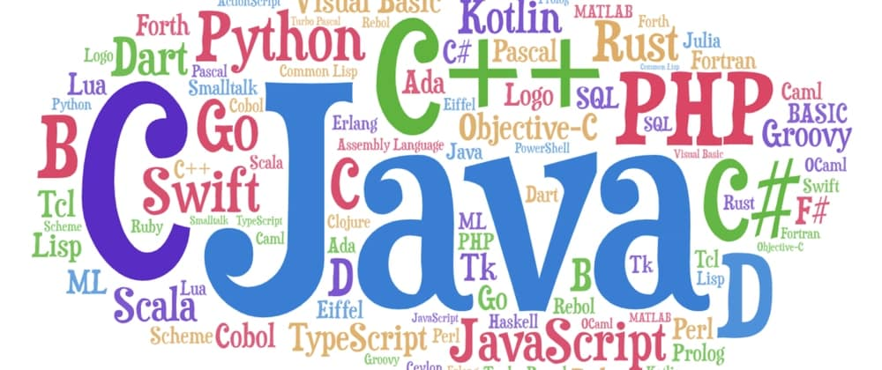
Different types of programming language
Algorithm for the Analytical Engine (1843) – First programming Language
Assembly Language (1949)

Slide 4
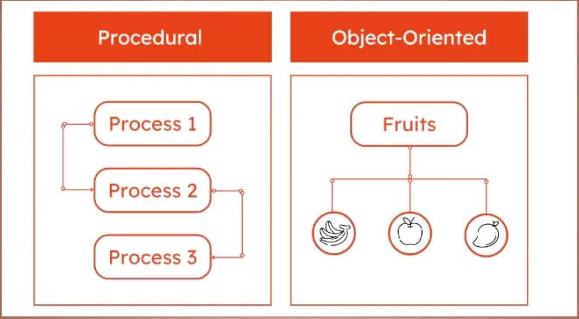
Comparing the concepts of procedural vs oBject-oriented programming
Procedural programming is a programming style in which action is executed one series after the other. It encompasses using your programming skills to create software. To make it simple, each operation is clustered into logical units commonly referred to as procedure, modules methods, functions, and subroutines.
Object-Oriented Programming (OOP) is an expansion of procedural programming that allows you to take a somewhat alternative approach to computer program writing. Is a programming paradigm based on the concept of "objects", which can contain data and code.

Slide 5

History of
In 1991, a group called the Green Team at Sun Microsystems started a project focused on creating technology for interactive television. At that time, this was quite an advanced concept. However, the technology they were developing turned out to be more suited for internet programming.
Later on, Java technology was incorporated by Netscape, one of the earliest and most popular web browsers. This allowed Java programs, known as applets, to run directly in web browsers, bringing richer interactivity to web pages.
It’s first name was Oak derived from oak trees that stood outside Gosling’s Office, also went by the name Green and ended up later being renamed as Java, from the list of random words.
Java is the popular programming language, developed by James Gosling at Sun Microsystems in 1995. In 2010 the Sun Microsystem purchased by Oracle, and more than 9 million developers used Java to create application or everything from smart cards and smart phones to enterprise servers and the cloud.

Slide 6
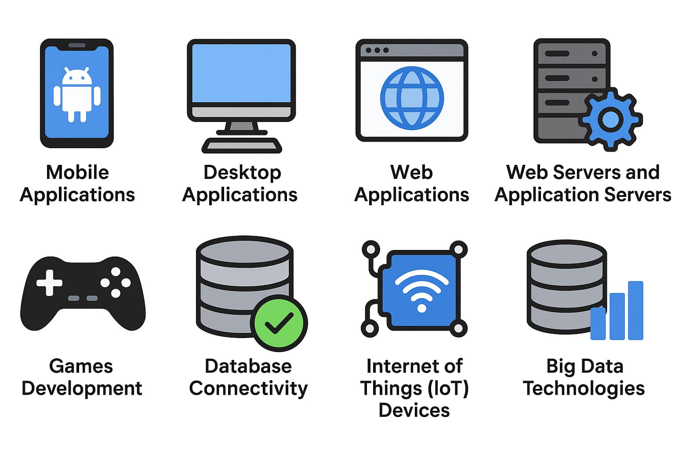
Java it is used for:
Mobile applications (especially Android apps)
Desktop applications
Web applications
Web servers and application servers
Games Development
Database Connectivity
Internet of Things (IoT) Devices
Big Data Technologies

Slide 7
Java Version
There are many java versions that has been released:
1. JDK Alpha and Beta (1995) 14. Java SE 13 (17th Sep, 2019)
2. JDK 1.0 (23rd Jan, 1996) 12. Java SE 14 (17th March, 2020)
3. JDK 1.1 (19th Feb, 1997) 13. Java SE 15 (16th Sep, 2020)
4. J2SE 1.2 (8th Dec, 1998) 14. Java SE 16 (16th March, 2021)
5. J2SE 1.3 (8th May, 2000) 15. Java SE 17 (14th Sep, 2021)
6. J2SE 1.4 (6th Feb, 2002) 16. Java SE 18 (22th March, 2022)
7. J2SE 1.5 (30th Sep,2004) 17. Java SE 19 (20th Sep, 2022)
8. Java SE 6 (11th Dec,2006) 18. Java SE 20 (21th March, 2023)
9. Java SE 7 (28th July, 2011) 19. Java SE 21 (19th Sep, 2023)
10. Java SE 8 (18th March,2014) 20. Java SE 22 (19th March, 2024)
11. Java SE 9 (21st Sep, 2017) 21. Java SE 23 (Sep, 2024)
12. Java SE 10 (20th March, 2018) 22. Java SE 24 (March, 2025)
13. Java SE 11 (25th Sep, 2018) 23. Java SE 25 (Sep, 2025)
14. Java SE 12 (19th March, 2019) 24. Java SE 26 (March, 2026)

Slide 8
WHY JAVA?
Today, many applications and programs are written in Java. It is a popular programming language used to write different kinds of applications. As a result, the demand for Java developers continue to increase in today’s digital era. Since Java becomes a universal if not, common programming language, it is straightforward, uncomplicated to understand, and analyze, allowing more and more opportunities come to in for those who engage and devote time and effort in learning the language. Java enables user to build up and install applications on the internet for computer servers, desktop computers, and smart phones. The advent of internet-of-things allows more and more Java applications to be developed and utilized.

Slide 9
WHY USE JAVA?
Java works on different platforms (Windows, Mac, Linux, Raspberry Pi, etc.)
It is one of the most popular programming language in the world
It has a large demand in the current job market
It is easy to learn and simple to use
It is open-source and free
It is secure, fast and powerful
It has a huge community support (tens of millions of developers)
Java is an object-oriented language which gives a clear structure to programs and allows code to be reused
As Java is close to C++ and C#, it makes it easy for programmers to switch to Java or vice versa

Slide 10
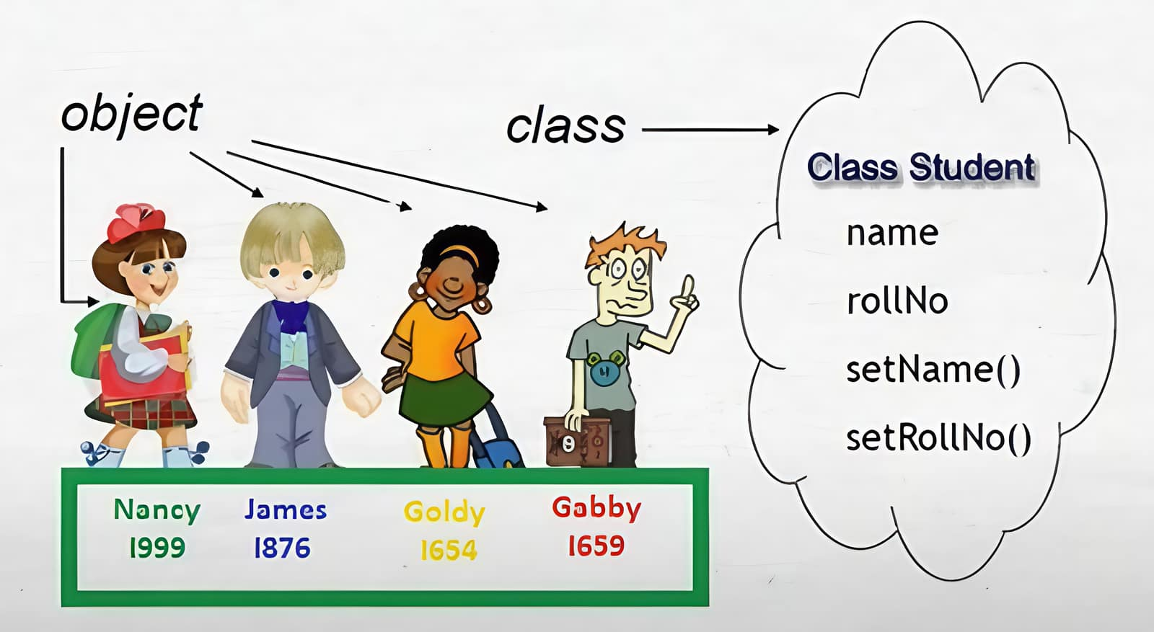
CLASSES
Classes it will act as blueprint of an object. It is a concept defining a set of objects with same properties. A class definition defines what characteristic the objects should have (attributes), and what those objects can do (methods).
  Attribute refers to the characteristic that describes an object.
  Method is a group of code that performs a specific task.

Slide 11
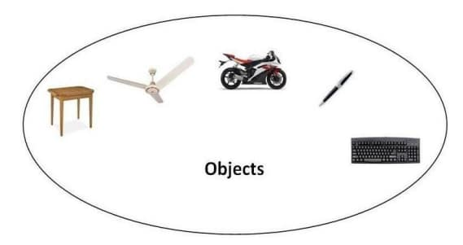
OBJECTS
Objects are anything we see and hold. It is constructed by a attributes and method.
In Java programming, objects are specific things or instances created from classes. They have attributes (characteristics) and methods (actions) that define what they are and what they can do.
  As an analogy, we can say that a class shirt shows what shirt objects looks like. It has properties such as size, color and cut. Each shirt may have the 2 same attribute, but we cannot say that it contains the same value for each attribute. A shirt may be for male, female or both. This analogy applies to all objects we can think of.

Slide 12
Most Popular Java IDE
NetBeans
Developed by Apache (originally started in 1996), NetBeans is a free and open-source Java IDE. It supports Java SE, Java EE, and JavaFX development, and includes a built-in GUI builder, making it ideal for beginners.
Eclipse
Created by IBM in 2001, Eclipse is a powerful, open-source, and free Java IDE. It is highly extensible through plugins and widely used in academic and enterprise environments.
IntelliJ IDEA
Developed by JetBrains, IntelliJ IDEA is a modern, feature-rich Java IDE known for its intelligent code completion, powerful refactoring tools, and seamless integration with build tools and frameworks like Maven, Gradle, and Spring. It comes in two versions: a free Community Edition and a paid Ultimate Edition with additional features for enterprise development.

Slide 13
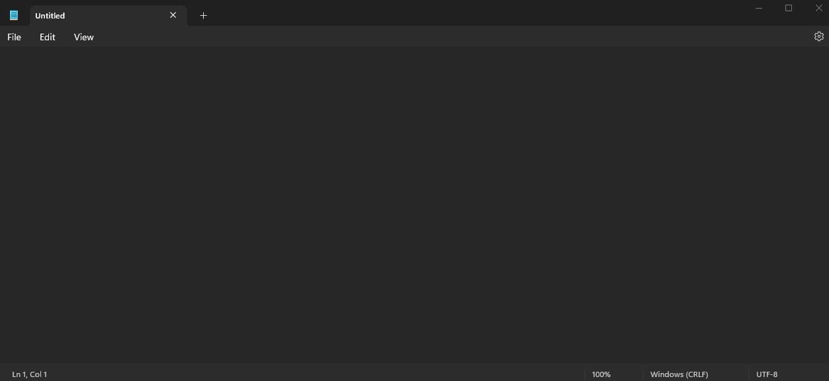
WHAT APPLICATION SHOULD I USE?
1. Text Editors (Notepad, Notepad++, VS Code, Sublime, Atom, Brackets, etc.)

Slide 14
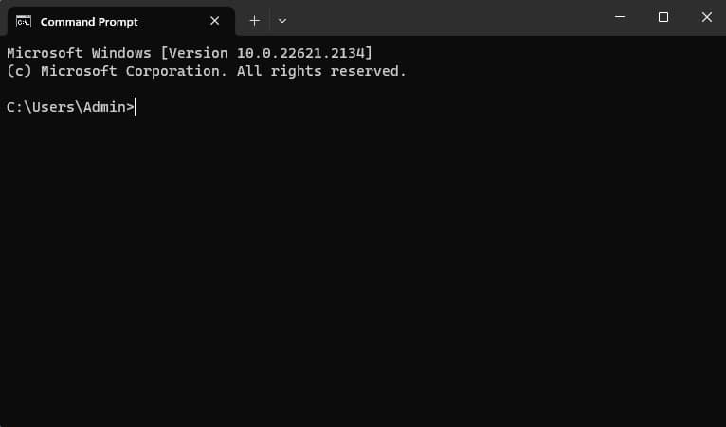
2. Command Prompt (cmd.exe) - A built-in terminal on Windows used to compile and run Java programs manually using commands like javac and java.

Slide 15

Java Install
Some PCs might have Java already installed. To check if you have Java installed on a Windows PC, search in the start bar for Java or type the following in Command Prompt (cmd.exe):
If Java is installed, you will see something like this (depending on version):
If you do not have Java installed on your computer, you can download it for free at https://www.oracle.com/ph/java/technologies/downloads/

Slide 16
PROGRAMMING BASICS
Like any other language, you should understand that in programming, you are to perform an action or task through operations that a computer can do—the input, process and output. These operations are performed in order to achieve a quality output. This concept is known as sequential processing, where each instruction is done in pattern. In developing an application in Java, there are three essential steps to take, namely;
  Writing code;
  Compiling code
  Executing application
In Writing Code, we can encode our scripts (called source code) in a text file. You can use any text editor such as Notepad, Notepad++, Wordpad, etc. It is necessary to save it using the .java extension.

Slide 17


After writing your source code, the next step is to compile. In compiling, Java will create a class file that includes the byte-code and will soon be translated by the JVM into instructions that the machine understands. We use the command javac followed by the file name of your .java file to compile our program. For example:
This will compile your code. If there are no errors in the code, the command prompt will take you to the next line. Now, you can execute the file using:

Slide 18
SOURCE CODE COMPILING
The programs written using a high-level programming language is commonly known as a source program. A source program is translated to a machine language to become an object program using a compiler. These object programs are linked and executed on the machine. It is important to note that programs written using high-level programming language must go through a compiler to ensure its correctness and readiness before it can be converted as object programs.

Slide 19
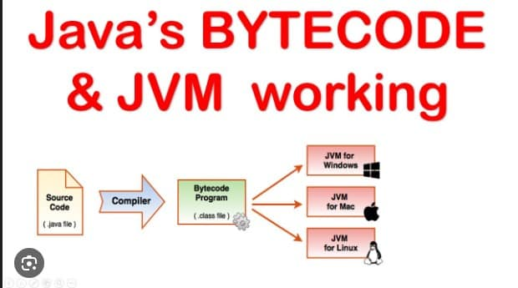
How Source Code Works on JVM

Slide 20
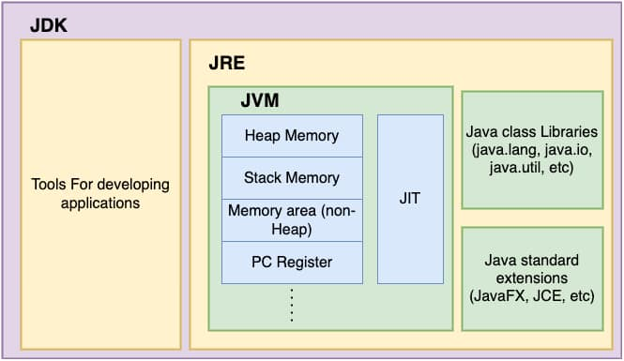
Java environment
Three main components of the Java Environment:
  Java Development Kit (JDK) – It is a software development environment that provides all the tools, libraries, and components needed to write, compile, debug, and run Java applications.
  Java Runtime Environment (JRE) – It is the part of the Java platform that allows you to run Java programs on your computer but does not let you develop or compile them.
  Java Virtual Machine (JVM ) – is a virtual processor that runs Java programs by executing their platform-independent bytecode. It lets Java programs run on any device with a compatible JVM, enabling the “Write Once, Run Anywhere (WORA)” capability. JVM also handles memory management and security to ensure programs run safely and efficiently.
How it works together:
  You write Java source code (.java) using a text editor or IDE.
  The JDK compiler converts the source code into bytecode (.class files).
  The JVM inside the JRE reads and executes this bytecode.
  This makes Java platform-independent, meaning the same .class files can run anywhere there is a compatible JVM.

Slide 21
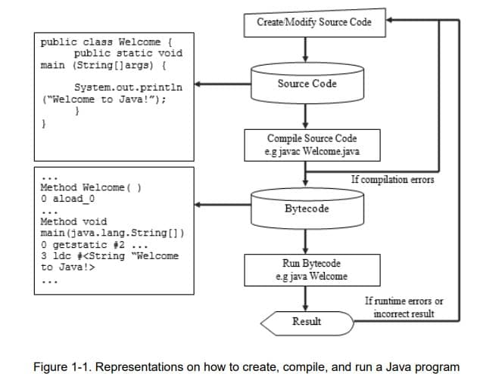
PROCESS TO CREATE, COMPILE, AND RUN A JAVA PROGRAM

Slide 22


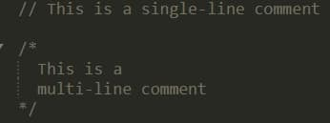

Parts of java program
Class Declaration
  Every java program must have at least one class
  It defines the blueprint or template of for an object
Main Method
  The entry point of any java application.
  The program starts executing from the main method.
Statements
  Instruction inside the main method or other methods.
  They perform action like printing text, calculation, etc.
Comments
  Notes inside the code ignored by the compiler.
  Used to explain or annotate code.
Import Statements (optional)
  Used to bring in Java libraries/classes needed for the program.

Slide 23
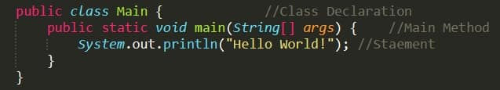
Basic SYNTAX OF JAVA
Example of a simple Java program putting it all together:
Every line of code that runs in Java must be inside a class. In our example, we named the class Main. A class should always start with an uppercase first letter.
NOTE: Java is case-sensitive: “Main" and “main" has different meaning.
The name of the java file must match the class name. When saving the file, save it using the class name and add ".java" to the end of the filename. To run the example above on your computer, make sure that Java is properly installed.
The main() method is required and will see in every java program. Any code inside main() method will be executed.

Slide 24
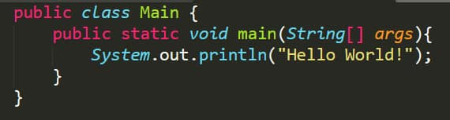
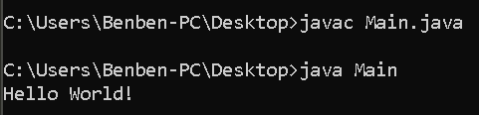
Sample Code of java: Print text
Sample Question: Write a java program to print a Hello World!
NOTE: The curly brace {} marks the beginning and end of a block of code.
System is a built-in java class that holds a collection of methods and variables such as out, which is short for “output”
Inside the main() method, we can use the println() to print a line of text to the screen.
You should also note that each code statement must end with semicolon (;)

Slide 25
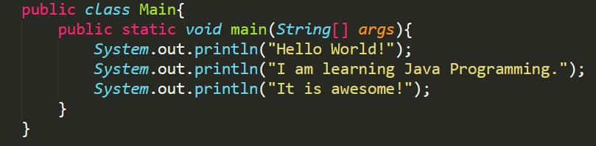
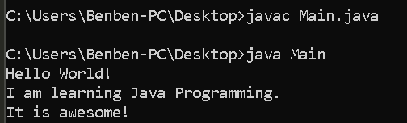
Sample Code of java
Sample Question: Write a java program that print the following output:
Hello Word!
I am learning Java Programming
It is awesome!

Slide 26
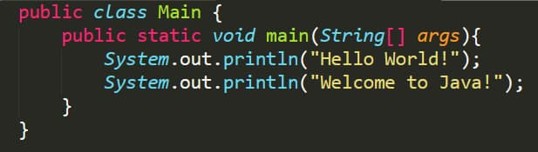
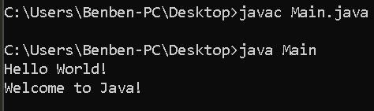
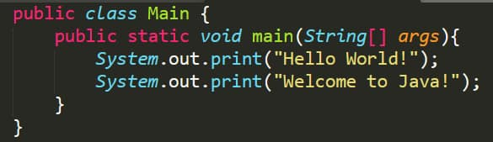
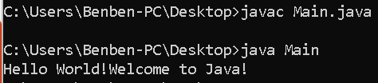
JAVA PRINT METHOD
System.out.println();
System.out.print();

Slide 27

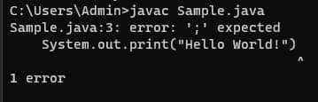
Locating and Correcting Errors
Locating and Correcting Errors in Java
Finding errors in Java is obviously easy. When the compiler detects an error in your source code, the compilation will fail, and the program will not run until the error is fixed.
The compiler will:
    Display the error message describing the problem.
    Indicate the exact line number where the issue occurred.
    Show the caret symbol (^) pointing to the exact (or very close) location in the code where the compiler detected the problem

Slide 28
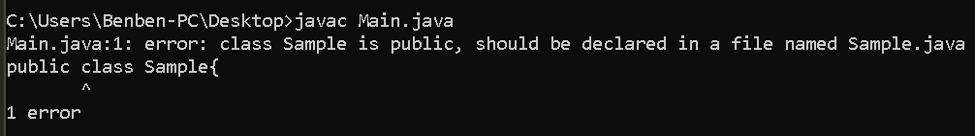
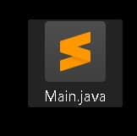
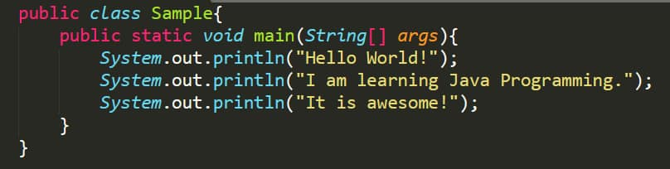
Locating and Correcting Errors
  The compiler informs that 1 error in line 1 has an error.

Slide 29
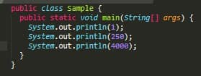




Print Numbers
However, unlike text, we don't put numbers inside double quotes:
You can also perform mathematical calculations.

Slide 30
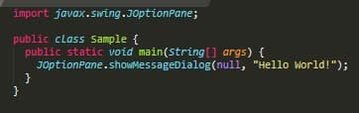
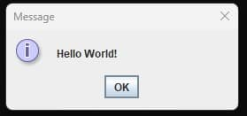
JaVA GUI
The examples above is a Java application that uses console. On the other hand, we can also create a Java Application that produces a GUI Output—known as windowed.
In Line 1, an import statement is written. It is an access to a given Java class that is included in the classes called package where JOptionPane (the class that creates GUI like dialog boxes) belongs to.
In line5, the JOptionPane class has been called to create a GUI in the form of a dialog box. In the example shown, a Message Dialog Box has been used through the method showMessageDialog. It is followed by a set of parentheses which requires two arguments, the null—which sets the dialog box at the center of the screen and the String that will be displayed inside the dialog box.

