Slide 1

Unraveling the Secrets of First- Order Differential Equations: A Journey into Mathematical Dynamics

Slide 2







Introduction to Dynamics
Welcome to our exploration of
!
This presentation will guide you
through the
and of these equations,
revealing their in modeling dynamic systems. Prepare for a journey that intertwines
and
.

Slide 3






What are Differential Equations?
are mathematical statements that relate a function to its
They describe how a quantity
.
changes over time, making them essential for modeling
in physics, biology, and engineering. Understanding them
opens doors to
.

Slide 4




First-Order Differential Equations
A involves only
the ﬁrst derivative of a function. It can often be expressed in the form . These
equations are foundational, as they help us
understand the
and of
various systems.

Slide 5




Solving Techniques
To solve ﬁrst-order differential equations, we utilize several techniques such as ,
, and .
Each method provides unique insights into the of solutions, allowing us to grasp the underlying dynamics.

Slide 6
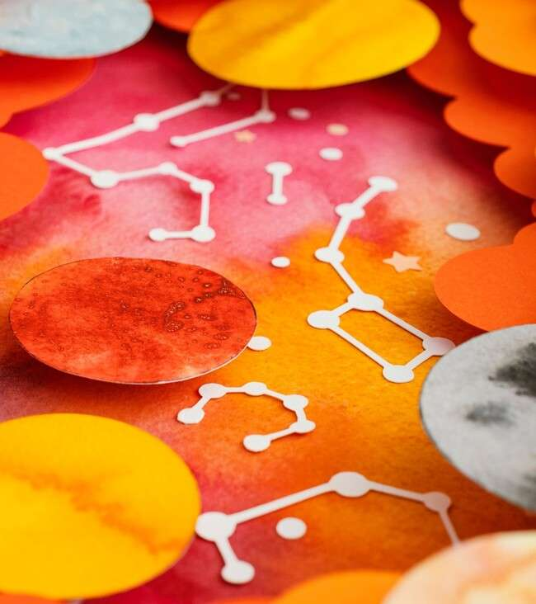




Real-World Applications
First-order differential equations are pivotal in various ﬁelds like
, , and . They model phenomena such as population growth, , and even ,
showcasing their versatility and importance in understanding our
world.

Slide 7





Graphical Interpretation
Visualizing solutions to ﬁrst-order differential equations can provide deeper insights. and
illustrate how solutions evolve over time, helping us comprehend the and
of dynamical systems.

Slide 8

Challenges and Complexities
While ﬁrst-order differential equations are foundational, they can present challenges, especially in non-linear cases. Understanding these complexities is crucial for advancing in
and tackling effectively.

Slide 9



Conclusion: The Journey Continues
In summary, ﬁrst-order differential equations are a gateway to understanding the dynamics of the world around us. As we continue our exploration of , let’s embrace the
and these equations present in our journey.

Slide 10
Thanks!
Do you have any questions? youremail@email.com
+91 620 421 838
www.yourwebsite.com @yourusername

