Slide 1

Unraveling the Mysteries: Key Properties of Parallelograms

Slide 2





Introduction to Parallelograms
are fascinating quadrilaterals characterized by opposite sides that are both and in length. Understanding their properties is essential in geometry. This presentation will explore the
that deﬁne parallelograms and their signiﬁcance in various
mathematical contexts.

Slide 3
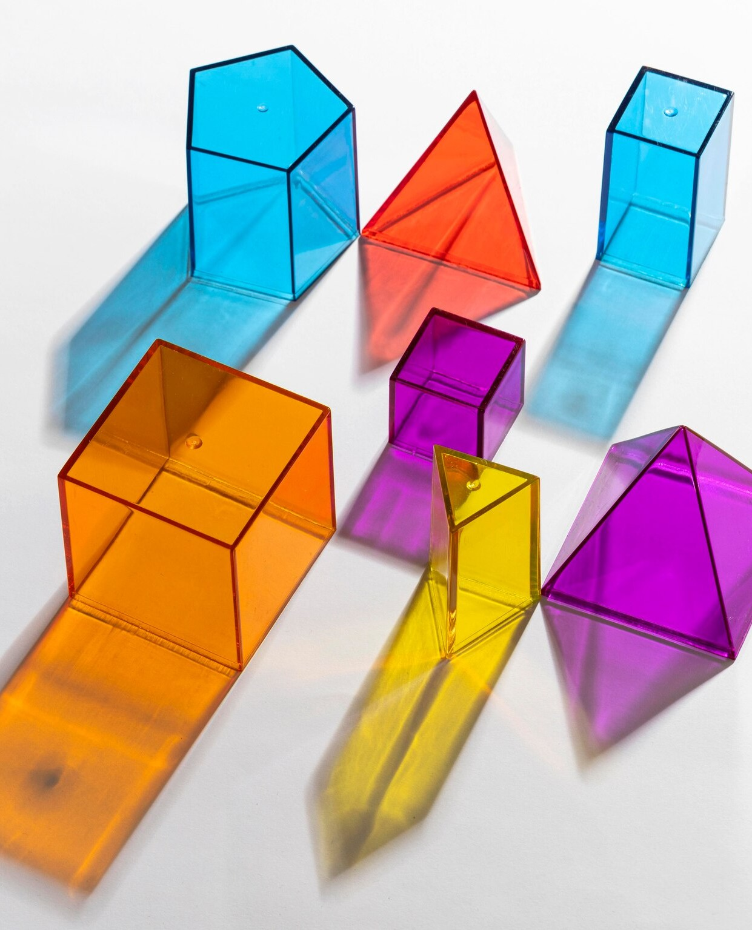


Deﬁnition of Parallelogram
A is a four-sided ﬁgure where each pair of opposite sides is
. This unique property leads to several other important characteristics, such as equal opposite angles and the ability to bisect each other. Understanding this deﬁnition is foundational for further exploration.

Slide 4




Properties of Opposite Sides
In a
are not only
, the
but also in
length. This means that if one side measures 5 units, the opposite side will also measure 5 units. This property is crucial for solving many geometric problems involving parallelograms.

Slide 5




Properties of Opposite Angles
Another important property of parallelograms is that the
are . For example, if one angle measures 60 degrees, the angle directly across from it will also measure 60 degrees. This symmetry plays a vital role in various geometric applications.

Slide 6




Consecutive Angles
In parallelograms,
are ,
meaning they add up to 180 degrees. This property can be used to ﬁnd unknown angles when given one angle's measure.
Understanding this relationship enhances our grasp of angle
properties in polygons.

Slide 7


Diagonals of Parallelograms
The of a parallelogram bisect each other, meaning they cut each other into two equal parts. This property is vital for various geometric proofs and constructions, providing insights into the structure of the shape and its symmetry.

Slide 8
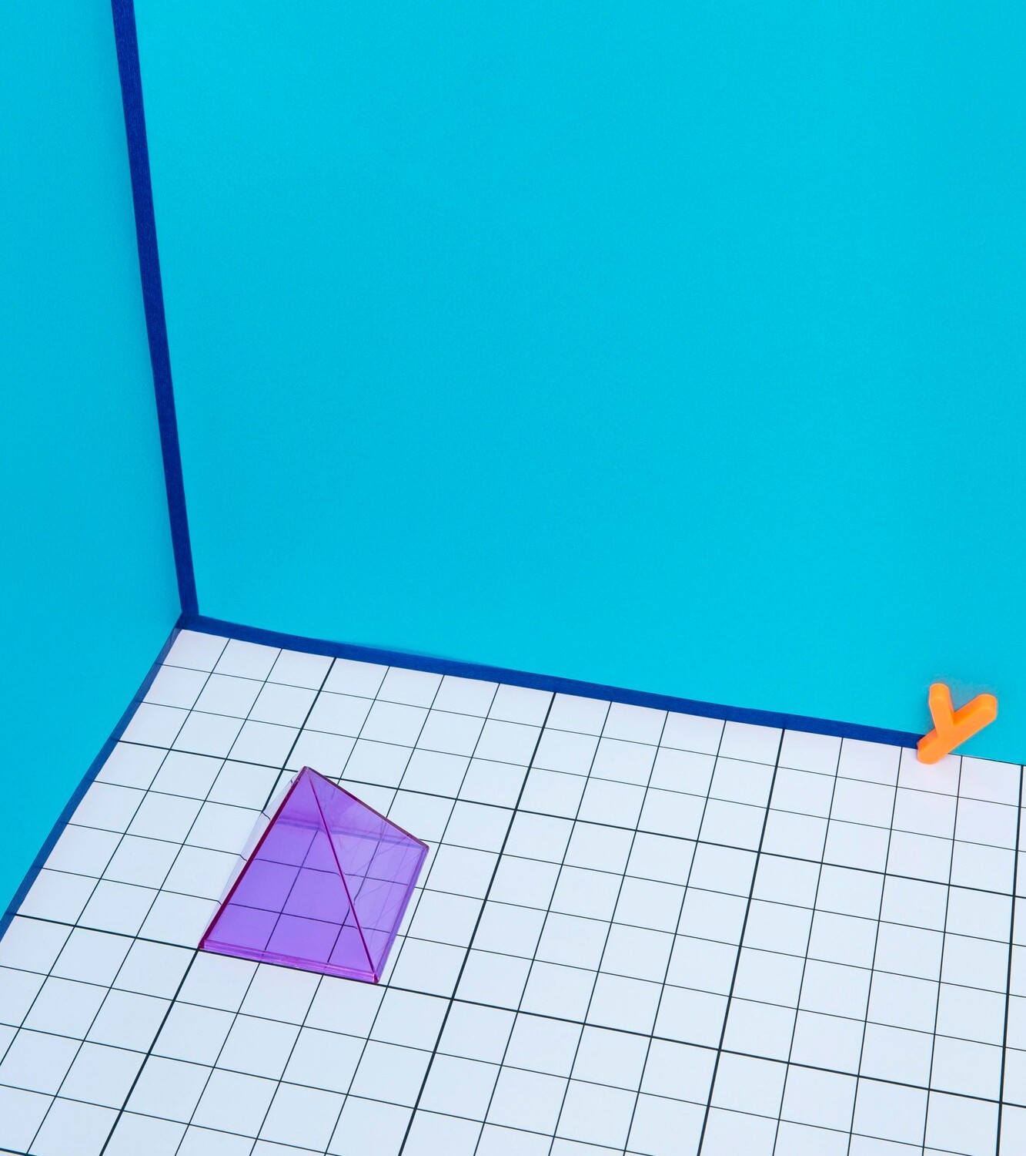



Area of Parallelograms
The of a parallelogram can be calculated using the formula:
. This formula highlights the importance of both the base length and the height, which is the perpendicular distance from the base to the opposite side.
Knowing how to calculate area is essential in geometry.

Slide 9

Conclusion:
Understanding
In conclusion, the study of
re eals se eral key
properties, including equal opposite sides, angles, and the
behavior of diagonals. These characteristics not only enhance
Parallelograms
our understanding of geometry but also have practical
applications in various ﬁelds, including architecture and
engineering.

Slide 10
Thanks!
Do you have any questions? youremail@email.com
+91 620 000 838
www.yourwebsite.com @yourusername

