Slide 1


Perimeter of Shapes
Understanding the concept of perimeter is a fundamental aspect of geometry. Perimeter refers to the total distance around the boundary of a 2D shape, and it is an essential tool for measuring and calculating the size of various objects and spaces. This presentation will explore the perimeter of different shapes, from simple rectangles and triangles to more complex irregular shapes, and discuss the practical applications of this important geometric principle.
by Onwurah Onyedikachi

Slide 2

Introduction to Perimeter
What is Perimeter?
How to Calculate Perimeter
Perimeter is the total distance around the boundary of a 2D shape. It is a fundamental concept in geometry that is used to measure and calculate the size of various objects and spaces.
The formula for calculating the perimeter of a shape depends on the type of shape. For basic shapes like rectangles and triangles, the perimeter can be calculated by adding up the lengths of all the sides.
1
2
3
Why is Perimeter Important?
Perimeter is essential for a variety of practical applications, such as calculating the amount of fencing or edging needed for a garden, determining the length of a floor or wall covering, and even estimating the area of a property.

Slide 3
Perimeter of Rectangles
Formula for Rectangle Perimeter
Example Calculation
Practical Applications
Let's say a rectangle has a length of 5 units and a width of 3 units. The perimeter would be: Perimeter = 2 × (5 + 3) = 2 × 8 = 16 units.
Knowing the perimeter of a rectangle is useful for calculating the amount of fencing, trim, or other materials needed to enclose a space, such as a garden, room, or property.
The perimeter of a rectangle is calculated by adding up the lengths of all four sides. The formula is: Perimeter = 2 × (length + width)

Slide 4

Perimeter of Triangles
1
Formula for Triangle Perimeter
2
Types of Triangles
3
Practical Applications
There are several types of triangles, including equilateral, isosceles, and scalene, each with its own unique properties and perimeter calculations.
Knowing the perimeter of a triangle is useful for calculating the amount of fencing, edging, or other materials needed to enclose a triangular-shaped space, such as a garden bed or a roof overhang.
The perimeter of a triangle is calculated by adding up the lengths of all three sides. The formula is: Perimeter = side 1 + side 2 + side 3

Slide 5
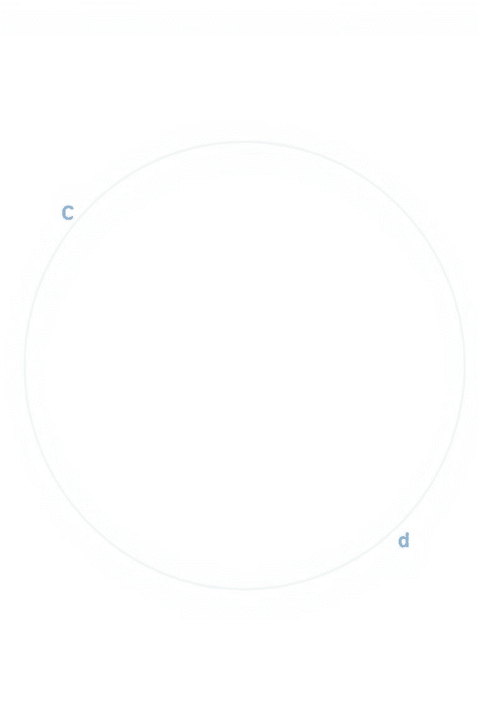
Perimeter of Circles
Formula for Circle Perimeter
Practical Applications
Knowing the circumference of a circle is useful for calculating the amount of material needed for things like fencing, edging, or wrapping around a cylindrical object, such as a tree trunk or a column.
The perimeter of a circle, also known as the circumference, is calculated using the formula: Circumference = π × diameter, where π is the constant approximately equal to 3.14.
Limitations of Perimeter
While perimeter is a useful measurement, it doesn't provide information about the area or volume of a shape. For a more complete understanding, it's important to also consider the concept of area.

Slide 6
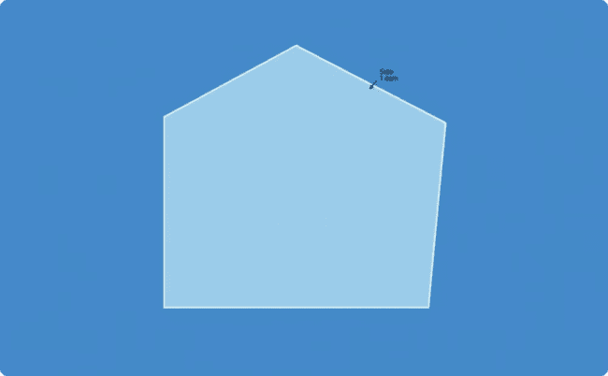
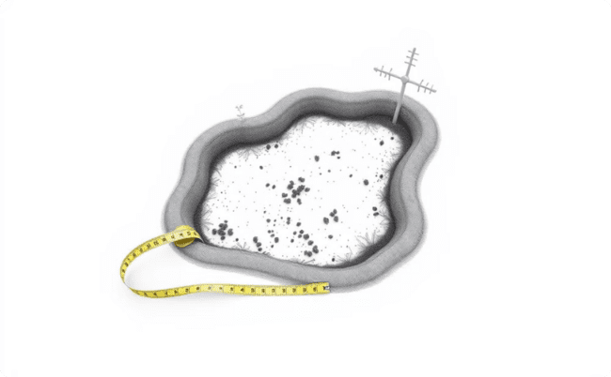
Perimeter of Irregular Shapes
Calculating Perimeter
Practical Applications
For irregular shapes, the perimeter is calculated by adding up the lengths of all the sides. This may require measuring each side individually and then summing the measurements.
Knowing the perimeter of an irregular shape is useful for calculating the amount of fencing, edging, or other materials needed to enclose an area with an unusual or complex shape, such as a garden plot or a building footprint.

Slide 7





Practical Applications of Perimeter
Fencing and Edging
Flooring and Carpeting
Calculating the perimeter of a space is essential for determining the amount of fencing, edging, or other materials needed to enclose an area, such as a garden, property, or building.
Knowing the perimeter of a room or building is necessary for estimating the amount of flooring, carpeting, or other floor coverings required to cover the entire space.
Wall Coverings
Property Measurement
Perimeter calculations are also important for determining the quantity of wall coverings, such as paint, wallpaper, or trim, needed to finish a room or building.
The perimeter of a property or land parcel is a crucial measurement for real estate transactions, property taxes, and land-use planning.

Slide 8



Conclusion and Key Takeaways
Understand Perimeter
Calculate Perimeter
Apply Perimeter Knowledge
Perimeter is the total distance around the boundary of a 2D shape, and it is an essential concept in geometry with numerous practical applications.
The formula for calculating perimeter varies depending on the shape, but it typically involves adding up the lengths of the sides.
Knowing how to calculate perimeter is useful for a wide range of tasks, from estimating material needs to measuring property boundaries.
In conclusion, understanding the concept of perimeter and how to calculate it is a fundamental skill in geometry with numerous practical applications. By mastering this important geometric principle, you'll be better equipped to measure and calculate the size of various objects and spaces, from gardens and buildings to properties and land parcels.

