Slide 1

Linear Inequalities: A Comprehensive Guide
Welcome! Today, we'll delve into the world of linear inequalities. We'll explore their definitions, how to graph and solve them, and how they apply to real-world scenarios. Join us as we unravel the intricacies of these powerful mathematical tools.
IO
by IKENNA ONYI

Slide 2
Defining Linear Inequalities
Introduction
Examples
Linear inequalities are mathematical statements comparing two expressions, using inequality signs (>, <, ≥, ≤) instead of an equal sign. These expressions involve variables and constants, forming a linear relationship between them.
Examples include 2x + 3 > 5, y ≤ x - 2, and 4 - z ≥ 0. They express relationships where one side is not necessarily equal to the other, but rather greater than, less than, greater than or equal to, or less than or equal to.

Slide 3
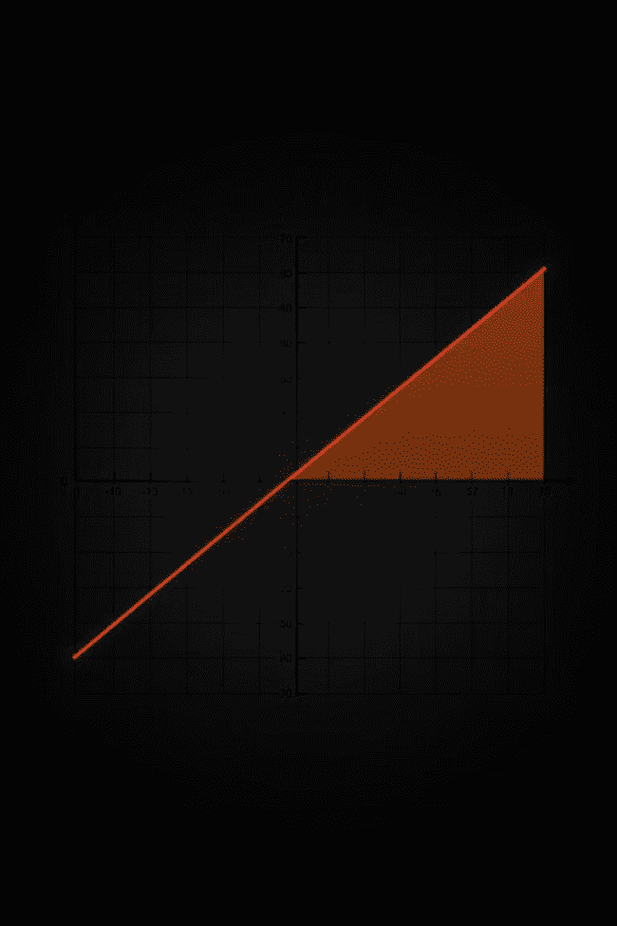



Graphing Linear Inequalities
1. Graph the Boundary Line
Treat the inequality as an equation and graph it as a line. Use a solid line for ≥ or ≤, and a dashed line for > or <.
2. Test a Point
Choose a point not on the line and substitute its coordinates into the original inequality. If the inequality holds true, shade the side of the line containing the point; otherwise, shade the other side.
3. Interpret the Solution
The shaded region represents all points satisfying the inequality. This visual representation provides a clear understanding of the solution set.

Slide 4
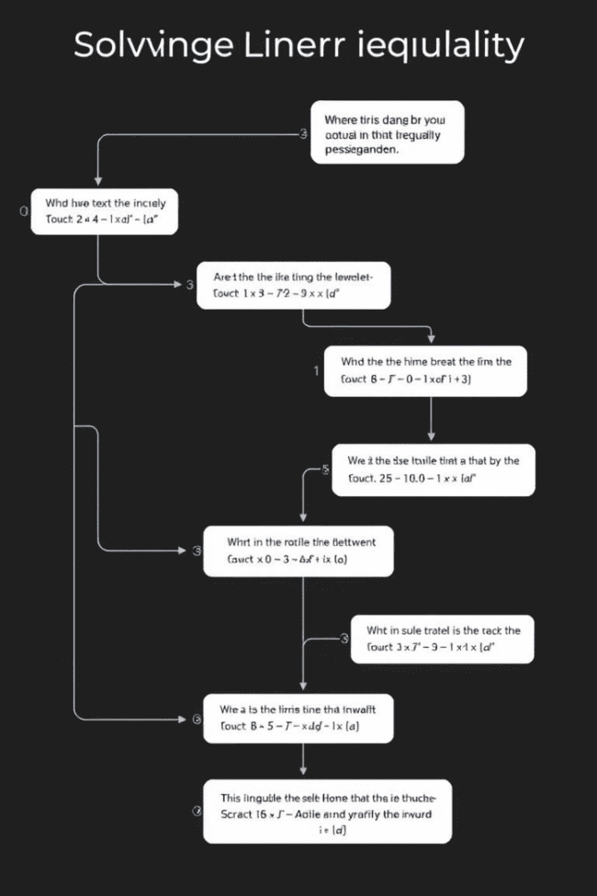
Solving Linear Inequalities
1. Simplify
2. Isolate the Variable
Use algebraic operations to simplify both sides of the inequality, combining like terms and isolating the variable.
Apply inverse operations to isolate the variable on one side of the inequality, ensuring the sign remains consistent.
3. Express the Solution
Write the solution in interval notation or set-builder notation, indicating the range of values that satisfy the inequality.

Slide 5



Compound Inequalities
Definition
1
Compound inequalities involve two or more inequalities combined with the words "and" or "or," creating a more complex set of conditions.
And
2
The solution set includes values that satisfy *both* inequalities simultaneously.
Or
3
The solution set includes values that satisfy *at least one* of the inequalities.

Slide 6
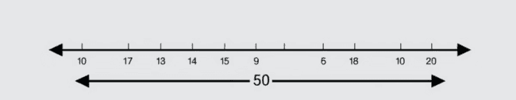
Absolute Value Inequalities
1
2
3
Definition
Solving
Solution
Absolute value inequalities involve an expression with an absolute value sign, representing the distance of a number from zero.
To solve, consider both positive and negative cases of the expression inside the absolute value sign, solving each separately.
Combine the solutions from both cases to obtain the complete solution set for the absolute value inequality.

Slide 7
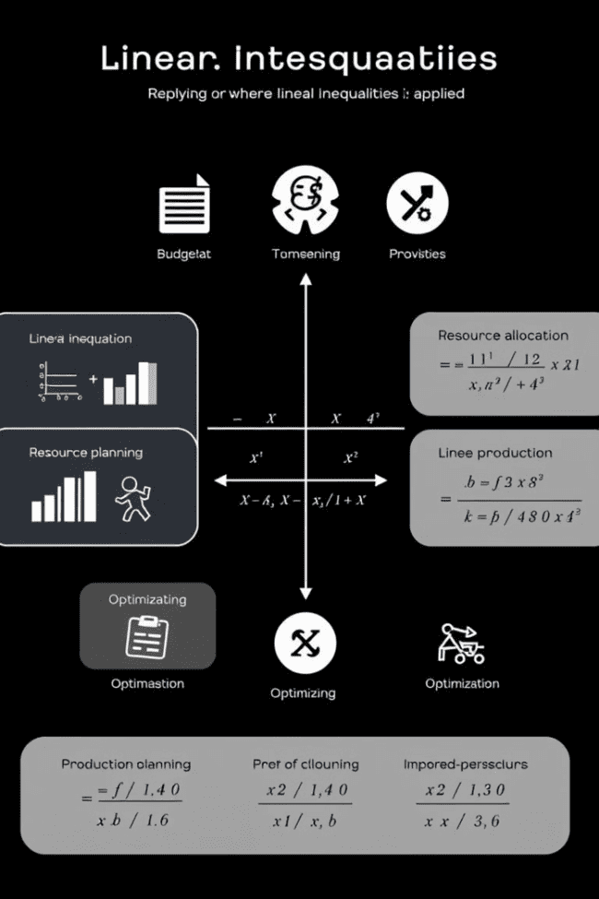



Applications of Linear Inequalities
Budgeting
Linear inequalities can help manage finances, ensuring spending stays within a budget constraint.
Resource Allocation
They assist in allocating limited resources effectively, optimizing efficiency and meeting production goals.
Production Planning
Linear inequalities help plan production schedules and quantities, ensuring optimal output while adhering to resource constraints.

Slide 8
Solving Systems of Linear Inequalities
Definition
1
Systems of linear inequalities involve multiple inequalities considered simultaneously. The solution set comprises points satisfying all inequalities in the system.
Graphing Method
2
Graph each inequality individually, shading the corresponding solution region. The region where all shaded regions overlap represents the solution for the system.
Algebraic Method
3
Solve each inequality separately and then combine the individual solutions to find the points satisfying all conditions.

Slide 9


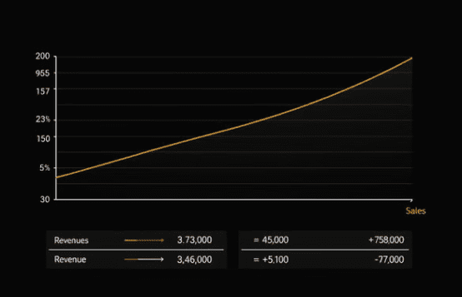
Optimization Problems with Linear Inequalities

Slide 10
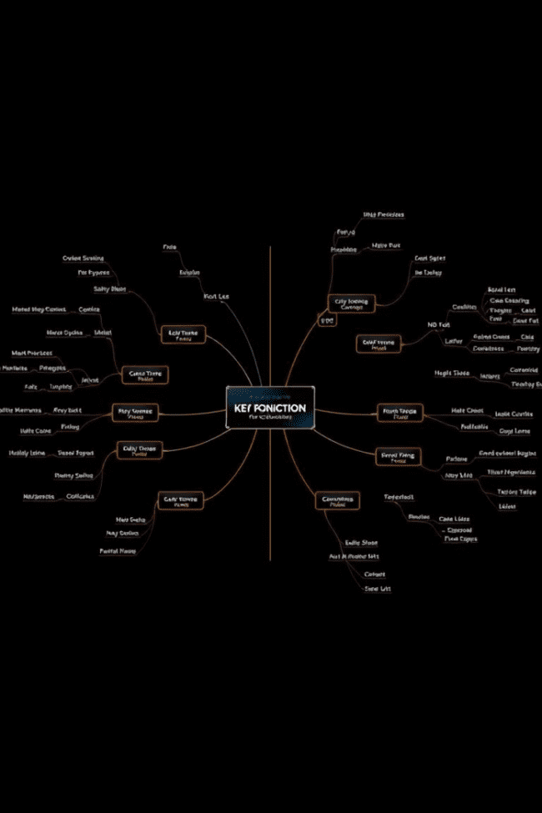
Key Takeaways and Review
We've explored the fundamentals of linear inequalities, from defining them to applying them to real-world scenarios. We've learned how to graph, solve, and interpret these mathematical statements, including compound inequalities and absolute value inequalities. We've also seen how systems of linear inequalities can be used to optimize problems with multiple constraints. This knowledge equips us to understand and utilize linear inequalities in a wide range of applications.

