Slide 1

Rational Functions
This presentation will delve into the world of rational functions, exploring their properties, graphs, and applications.
oi
by onyi ik

Slide 2
Introduction to Rational Functions
Rational functions are defined as functions that can be expressed as the ratio of two polynomials. The denominator of a rational function cannot be zero, as division by zero is undefined. This is a key concept to remember when dealing with rational functions.
For example, the function f(x) = (x + 2) / (x - 3) is a rational function. The numerator is the polynomial x + 2, and the denominator is the polynomial x - 3. This function is undefined for x = 3 because the denominator becomes zero at that point.

Slide 3
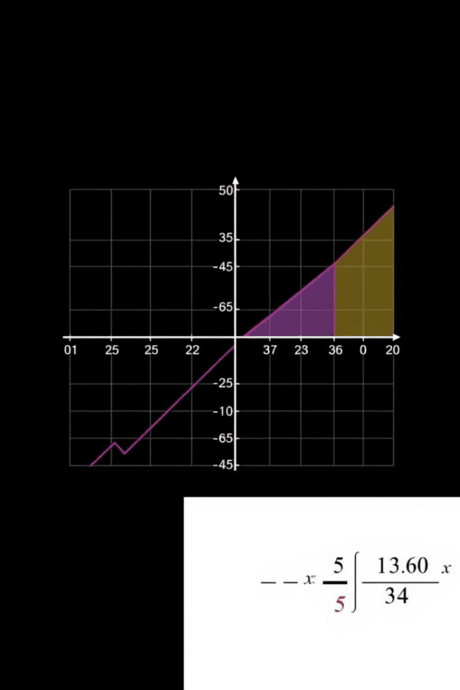
Domain and Range of Rational Functions
Domain
Range
The domain of a rational function is the set of all real numbers where the function is defined. This means we need to exclude values that make the denominator zero. Finding the domain involves setting the denominator equal to zero and solving for x. These excluded values are called vertical asymptotes.
The range of a rational function is the set of all possible output values. To find the range, we need to consider the behavior of the function as x approaches positive and negative infinity. This involves analyzing horizontal asymptotes.

Slide 4
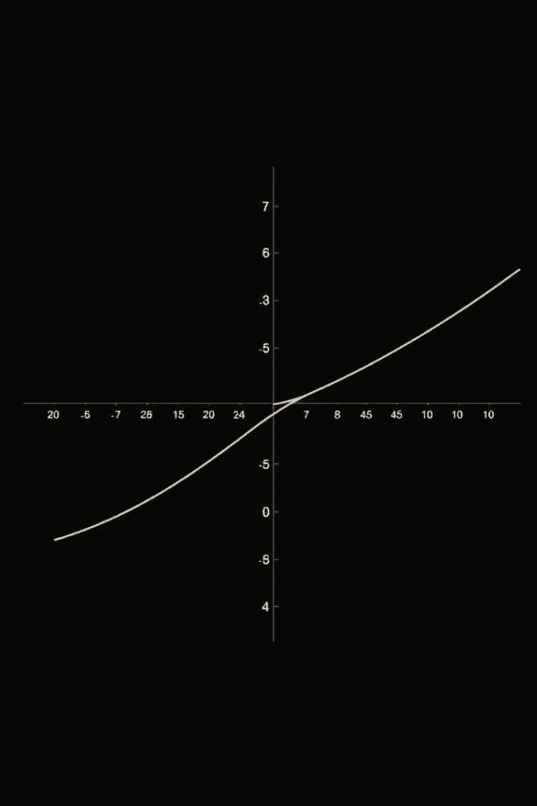


Asymptotes of Rational Functions
Vertical Asymptotes
Horizontal Asymptotes
Vertical asymptotes occur at values of x that make the denominator zero. They represent a vertical line where the function approaches infinity.
Horizontal asymptotes occur when the function approaches a specific value as x approaches infinity or negative infinity. They indicate the behavior of the function at the extremes.

Slide 5
Graphing Rational Functions
Identify the vertical asymptotes by setting the denominator equal to zero and solving for x.
1
2
Determine the horizontal asymptote by comparing the degrees of the numerator and denominator.
Find the x-intercepts by setting the numerator equal to zero and solving for x.
3
4
Find the y-intercept by setting x equal to zero and solving for y.
Plot the intercepts, asymptotes, and a few additional points to get a clear picture of the function's graph.
5

Slide 6
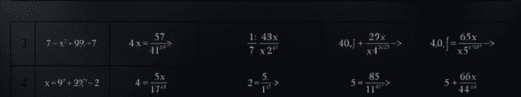
Operations with Rational Functions
1
2
3
Addition & Subtraction
Multiplication
Division
To add or subtract rational functions, they must have a common denominator. If not, we need to find the least common multiple (LCM) and rewrite the functions to have the same denominator.
Multiplying rational functions is straightforward. We multiply the numerators and the denominators.
Dividing rational functions involves flipping the second function (the divisor) and then multiplying.

Slide 7


Simplifying Rational Expressions
Factoring
1
Factor the numerator and the denominator completely. This will help identify common factors that can be canceled.
Cancellation
2
Cancel any common factors between the numerator and the denominator. Make sure the cancelled factors are not zero, as that would make the expression undefined.

Slide 8
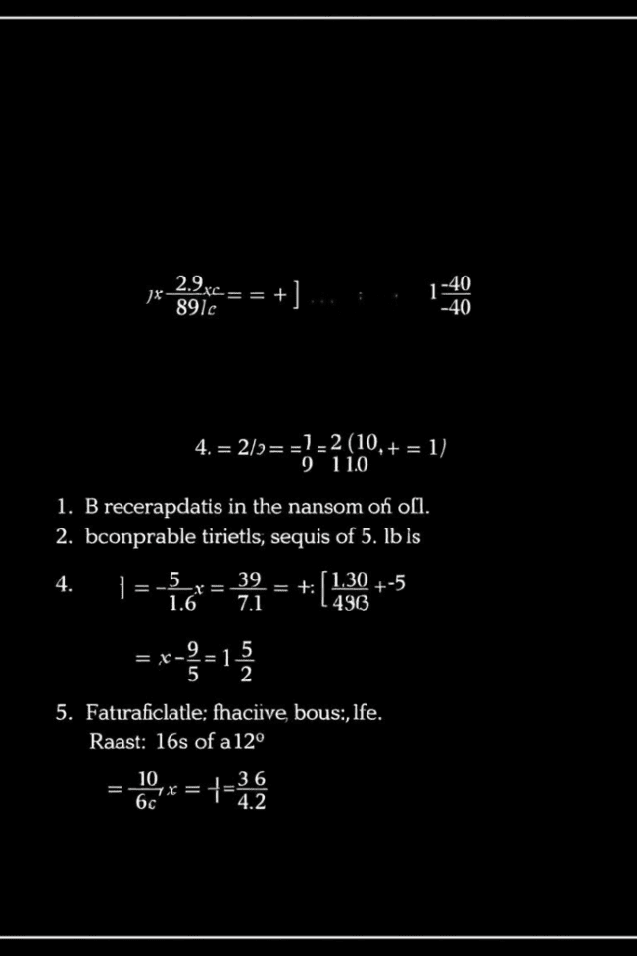



Solving Rational Equations
Finding the LCD
Find the least common denominator (LCD) of all the rational expressions in the equation.
Eliminating Fractions
Multiply both sides of the equation by the LCD. This will eliminate the fractions.
Solving the Equation
Solve the resulting equation for the variable. Be sure to check your solutions to ensure they do not make any denominators zero.

Slide 9
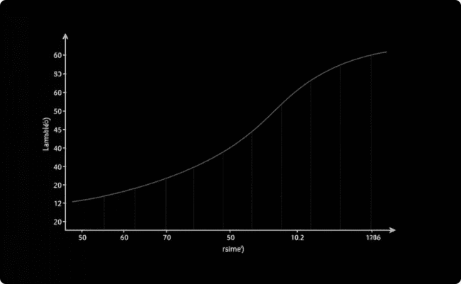
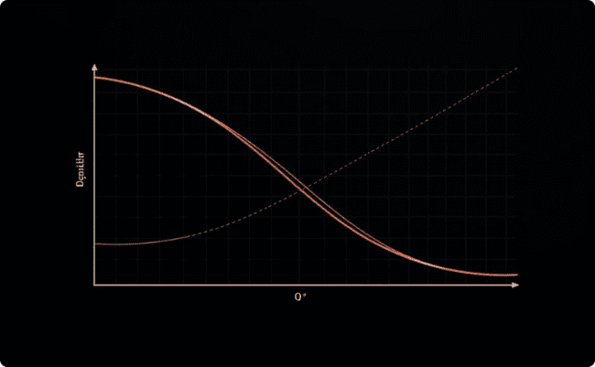
Applications of Rational Functions
Population Growth
Economics
Rational functions can be used to model population growth. They can account for factors like limited resources and carrying capacity.
Rational functions can be applied in economics to analyze supply and demand, as well as to model financial growth and investment strategies.

Slide 10
Common Mistakes and Misconceptions
Not Defining the Domain
1
Failing to exclude values that make the denominator zero can lead to incorrect results.
Incorrectly Canceling Terms
2
Only factors that are common to both the numerator and the denominator can be canceled.
Misunderstanding Asymptotes
3
Knowing the difference between vertical and horizontal asymptotes and their role in the graph is essential.

