Slide 1


Differential Calculus: Unlocking the Secrets of Change
Welcome to a journey into the fascinating world of differential calculus, a branch of mathematics that unlocks the power to analyze and understand rates of change. We'll explore fundamental concepts like derivatives, delve into powerful rules that govern their calculation, and discover their wide-ranging applications in various fields. This journey will equip you with the tools to analyze real-world phenomena, from optimizing business strategies to predicting the motion of objects.
by Onyedikachi Ikenna Onwurah

Slide 2
Introduction to Derivatives
The Essence of Change
Measuring Change
At its core, differential calculus is about understanding how things change. Derivatives are the mathematical tools that quantify these changes, providing us with the instantaneous rate of change at any given point.
Imagine a car speeding down a highway. Its speedometer tells us its speed, but what if we want to know how quickly its speed is changing at a specific moment? Derivatives allow us to answer this question, revealing the acceleration of the car.

Slide 3
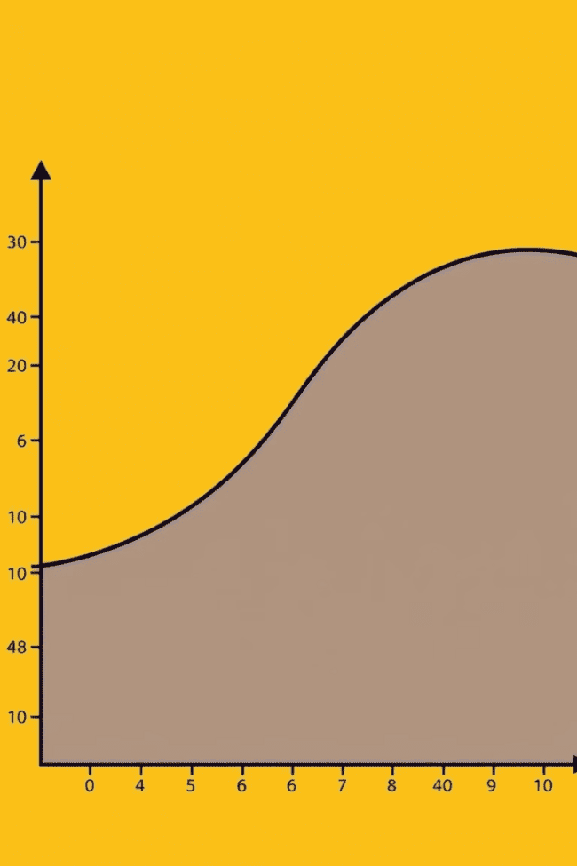
The Derivative as a Slope
1
Visualizing the Rate
2
Tangent Line's Significance
A derivative is essentially the slope of the line tangent to a curve at a particular point. This slope represents the instantaneous rate of change of the function at that specific point.
The tangent line's slope provides us with an accurate approximation of the function's behavior in the immediate vicinity of that point, making it a crucial tool for understanding local change.

Slide 4



The Power Rule
Simplifying Differentiation
1
Power Rule Basics
2
The power rule is a simple yet powerful formula that allows us to find the derivatives of functions involving powers. It states that the derivative of xn is nxn-1.
Examples and Applications
3
For example, the derivative of x^2 is 2x. The power rule makes finding derivatives of polynomial functions much easier, significantly speeding up our calculations.

Slide 5
The Product Rule and Quotient Rule
Derivatives of Products
1
The product rule allows us to find the derivative of a function that is the product of two other functions. The rule states that the derivative of f(x)g(x) is f'(x)g(x) + f(x)g'(x).
Derivatives of Quotients
The quotient rule helps us find the derivative of a function that is the quotient of two other functions. The rule states that the derivative of f(x)/g(x) is [g(x)f'(x) - f(x)g'(x)] / [g(x)]^2.
2

Slide 6
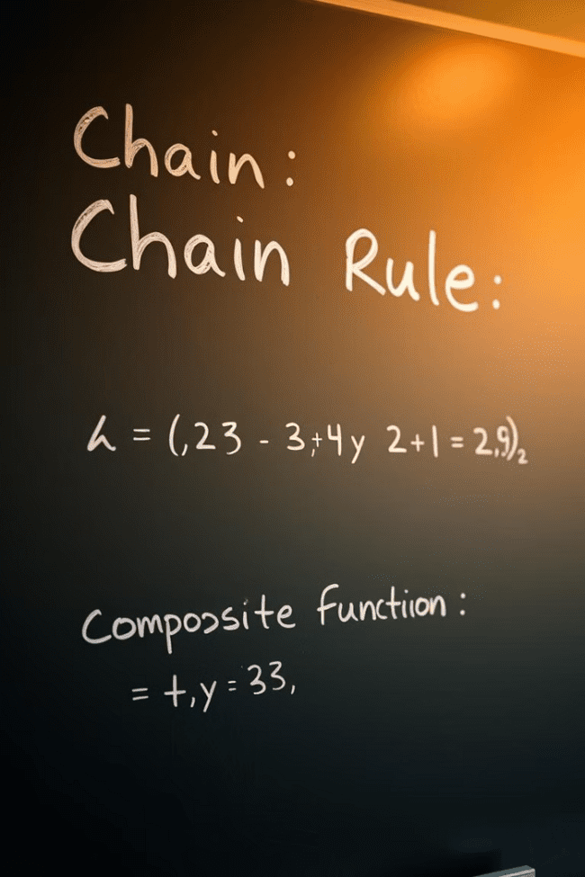


The Chain Rule
Composition of Functions
Chain Rule Formula
The chain rule states that the derivative of f(g(x)) is f'(g(x)) * g'(x). This rule is crucial for differentiating complex functions involving multiple layers.
The chain rule is used when dealing with composite functions, where one function is nested inside another. It helps us find the derivative of such functions.

Slide 7
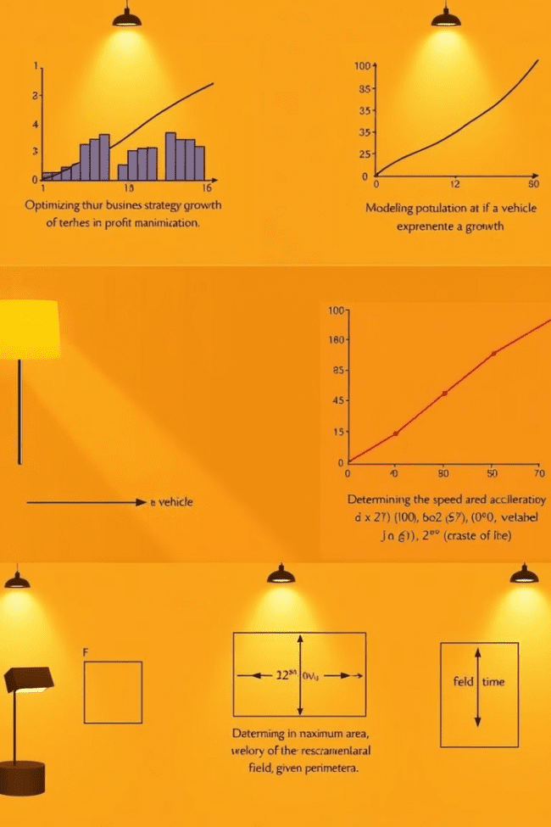
Applications of Derivatives
1
Optimization
Derivatives are essential for finding maximum and minimum values of functions, which is crucial in optimizing various real-world processes, such as maximizing profits or minimizing costs.
2
Physics
Differential calculus plays a fundamental role in understanding motion and forces. Derivatives are used to calculate velocity, acceleration, and other key quantities in physics.
3
Economics
Derivatives are used in analyzing marginal cost, marginal revenue, and other economic concepts, providing insights into market dynamics and consumer behavior.

Slide 8
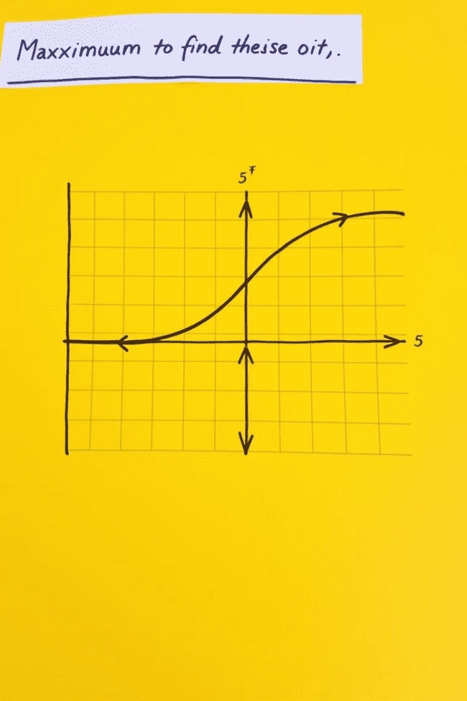



Optimization Problems
Finding the Extreme Values
Optimization problems involve finding the maximum or minimum values of a function within a given interval or subject to certain constraints.
Using Derivatives
Derivatives are powerful tools for solving these problems. By setting the derivative of the function equal to zero, we can find critical points where the function may attain extreme values.
Real-World Applications
Optimization problems arise in various fields, including engineering, finance, and manufacturing, allowing us to optimize designs, allocate resources, and maximize efficiency.

Slide 9
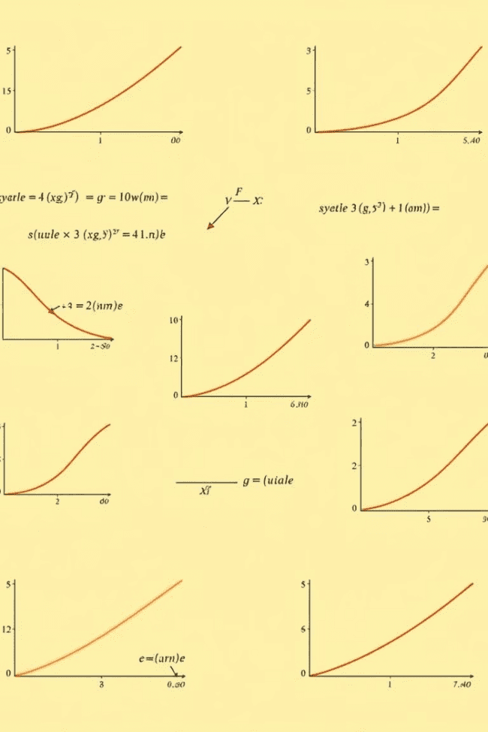
Conclusion and Key Takeaways
Differential calculus is a powerful tool that provides a framework for understanding change and analyzing rates of change. From its basic concept of derivatives to its diverse applications in various fields, differential calculus offers a profound understanding of the world around us. This journey has equipped you with the foundational knowledge to confidently analyze real-world phenomena, solve complex optimization problems, and unlock the secrets of change.

