Slide 1


Exploring the World of Sequences and Series
Welcome to our exploration of sequences and series! These fundamental concepts in mathematics have wide applications across various fields, from finance and engineering to computer science and physics. This presentation will delve into the fascinating world of sequences and series, providing you with a comprehensive understanding of their definitions, properties, and applications.
by ONYEDIKACHI ONWURAH

Slide 2

Defining Sequences and Series
Sequences
Series
A sequence is an ordered list of numbers, where each number is called a term. Each term is related to the previous one according to a specific rule. Examples include arithmetic sequences with a common difference and geometric sequences with a common ratio.
A series is the sum of the terms of a sequence. It is represented by a sigma notation, where we sum all the terms of the sequence from a starting index to an ending index. Series can be finite or infinite, depending on the number of terms involved.

Slide 3
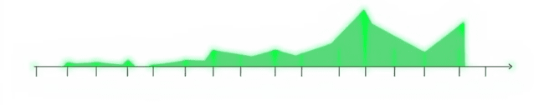
Arithmetic Sequences
1
Definition
2
Formula
3
Examples
In an arithmetic sequence, each term is found by adding a constant value, called the common difference, to the previous term.
The general formula for an arithmetic sequence is an = a1 + (n-1)d, where an is the nth term, a1 is the first term, and d is the common difference.
The sequence 2, 5, 8, 11, 14... is an arithmetic sequence with a common difference of 3. The sequence -5, -1, 3, 7, 11... is also an arithmetic sequence with a common difference of 4.

Slide 4
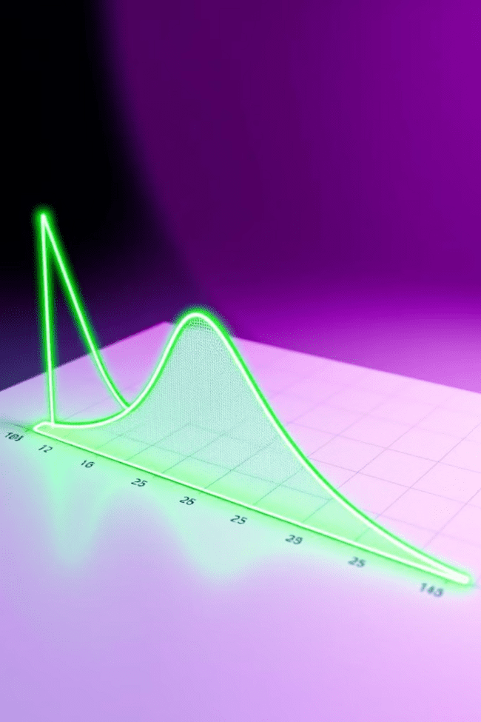
Geometric Sequences
Definition
Formula
A geometric sequence is one where each term is obtained by multiplying the previous term by a constant value, known as the common ratio.
The general formula for a geometric sequence is an = a1 * r(n-1), where an is the nth term, a1 is the first term, and r is the common ratio.
Examples
The sequence 1, 2, 4, 8, 16... is a geometric sequence with a common ratio of 2. The sequence 100, 50, 25, 12.5, 6.25... is a geometric sequence with a common ratio of 0.5.

Slide 5
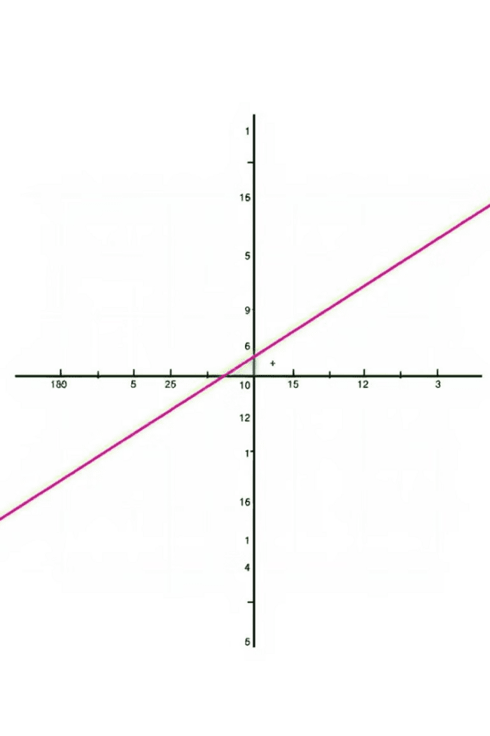


Convergence and Divergence
Divergent Series
Convergent Series
A divergent series is one where the sum of its terms does not approach a finite value. The terms of the series either increase infinitely or oscillate without settling. For example, the harmonic series (1 + 1/2 + 1/3 + 1/4 + ...) diverges.
A convergent series is one where the sum of its terms approaches a finite value as the number of terms increases. For example, the geometric series with a common ratio less than 1 converges.

Slide 6

Sum of Infinite Series
1
Geometric Series
For a geometric series with a common ratio less than 1, the sum of the infinite series can be calculated using the formula S = a1 / (1 - r), where a1 is the first term and r is the common ratio.
2
Other Series
For other types of infinite series, various convergence tests like the ratio test, integral test, and comparison test can be used to determine whether the series converges or diverges, and to calculate its sum if it converges.

Slide 7




Applications of Sequences and Series
Financial Modeling
1
Sequences and series are used to model financial growth, such as compound interest, annuities, and mortgages.
Engineering
2
They are used in analyzing and predicting the behavior of systems over time, such as in signal processing, control systems, and structural analysis.
3
Computer Science
They are used in algorithms for data compression, image processing, and artificial intelligence.
Physics
4
Sequences and series are used in describing periodic phenomena, such as waves and oscillations, as well as in modeling radioactive decay and other processes.

Slide 8

Conclusion and Key Takeaways
Sequences and series are fundamental concepts in mathematics with far-reaching applications. We have explored the definitions, properties, and convergence of sequences and series. We also saw how these concepts are used in various fields to model and analyze complex phenomena. Understanding sequences and series not only enhances mathematical understanding but also provides valuable insights into the world around us.

