Slide 1
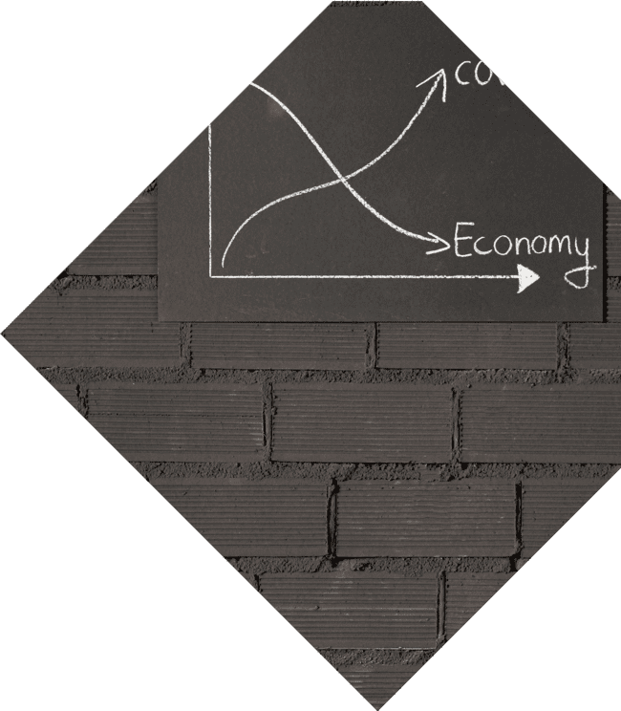
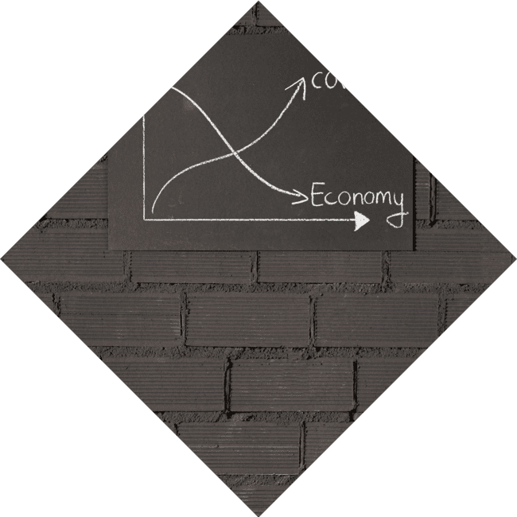
Unlocking the Parabola: A Journey Through Quadratic Graphs

Slide 2


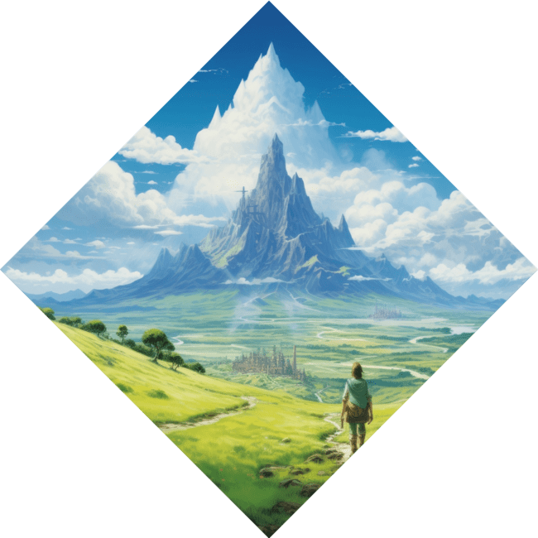
Unlocking the Parabola
to our journey through
! In this presentation, we will explore the beauty and intricacies of parabolas, uncovering their properties, transformations, and real-world applications. Get ready to embrace
the
that lies within these curves!

Slide 3


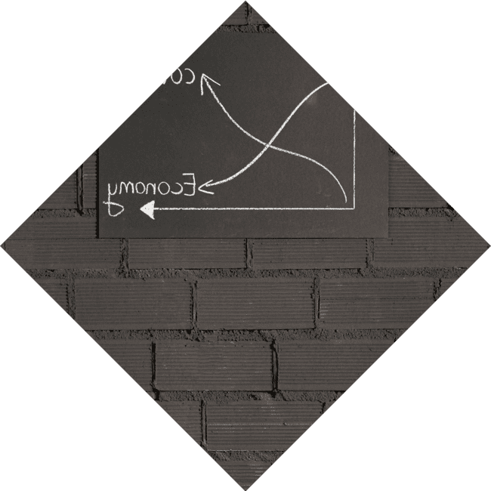



What is a Parabola?
A
is a symmetric curve
defined by a . It
can open upwards or downwards, creating a unique shape that is both
and functional.
Understanding parabolas helps us grasp the concept of
and their significance in
mathematics.

Slide 4
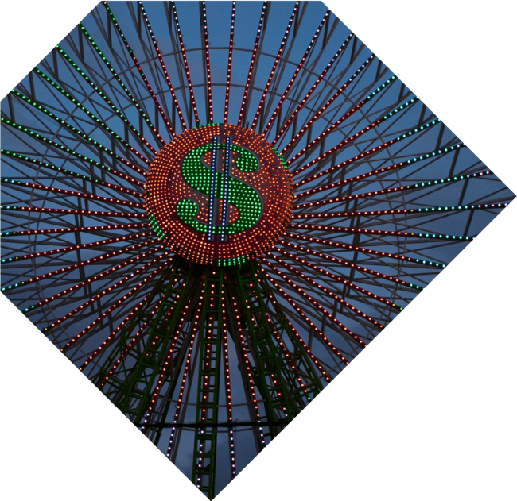




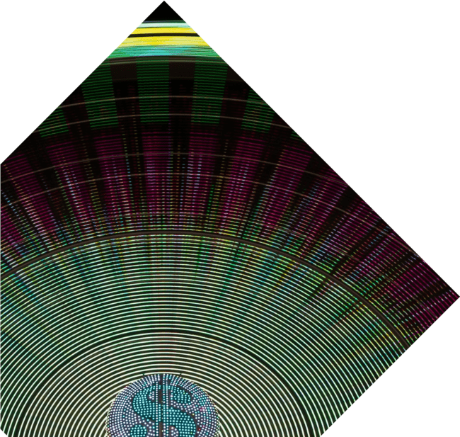
Key Features of Parabolas
Parabolas have distinct features such as the , , and . The vertex represents the highest or lowest point, while the axis of symmetry divides the parabola into two halves. These features are crucial for analyzing and graphing quadratic functions.

Slide 5
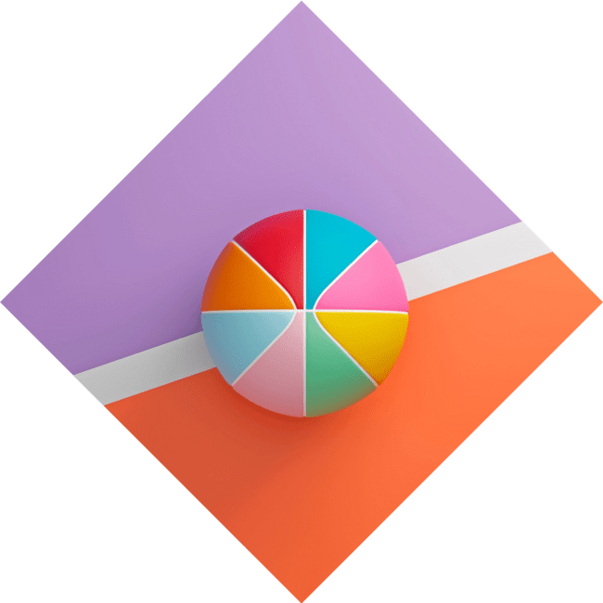

Transforming Parabolas
Parabolas can be
through shifts, stretches, and reflections. By altering the coefficients in the quadratic
equation, we can move the graph left, right, up, or down. This flexibility allows for a rich variety of shapes and positions, making parabolas fascinating to study.

Slide 6
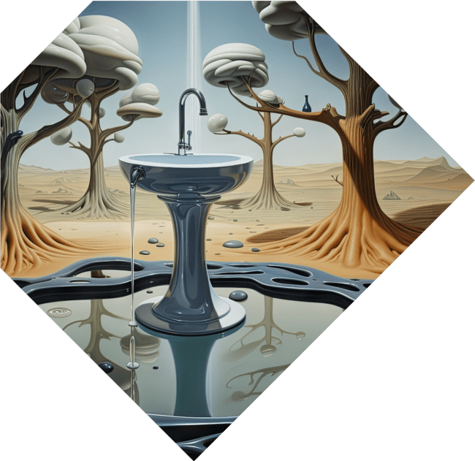



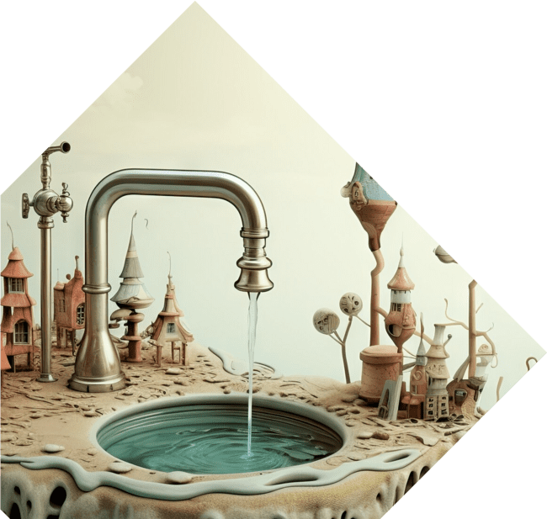
Real-World Applications
Parabolas are not just theoretical; they appear in the ! From the trajectory of a thrown ball to the design of satellite dishes, understanding parabolic shapes is essential in fields like ,
, and even . Let's explore how these curves impact our lives.

Slide 7
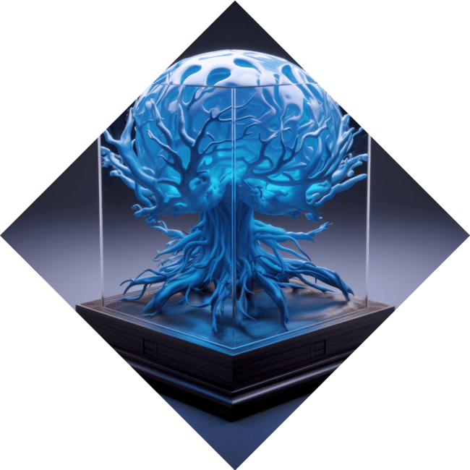



The Quadratic Formula
The is a powerful
tool for finding the roots of quadratic equations. Given by
, it reveals the x-intercepts
of a parabola. Understanding this formula unlocks the potential to solve complex problems involving parabolic functions.

Slide 8
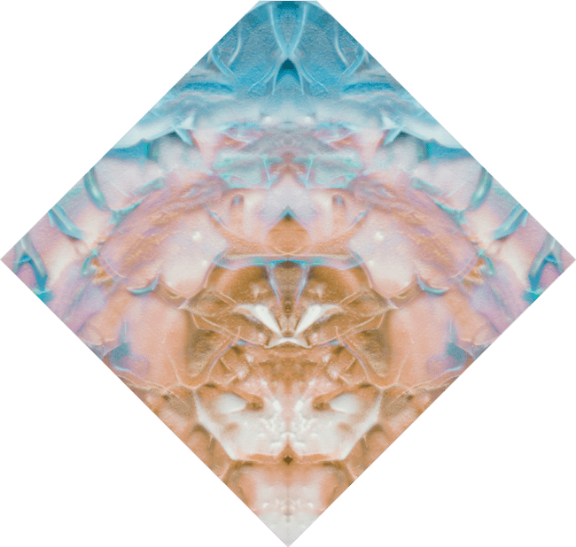



Exploring Parabolic Patterns
Parabolas exhibit beautiful in nature and art. From the
to the design of bridges, these curves
inspire creativity and innovation. By
studying their properties, we can appreciate the between mathematics and the world around us.

Slide 9


Conclusion: The Beauty of Parabolas
In conclusion, parabolas are more than just mathematical concepts; they are a to understanding the world. By unlocking their secrets, we gain insight into various fields and appreciate the of mathematics. Thank you for joining this creative journey through quadratic graphs!

Slide 10
Thanks!
Do you have any questions?
youremail@email.com
+91 620 000 838
www.yourwebsite.com @yourusername

