Slide 1
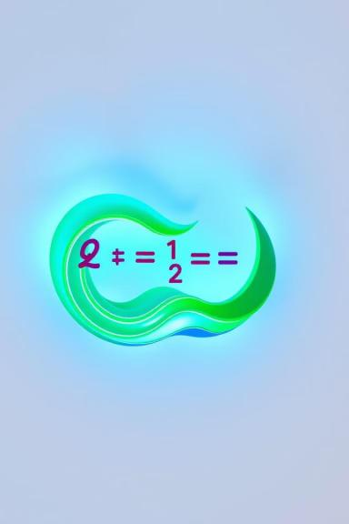


Quadratic Equation
The quadratic equation is a mathematical formula that describes a parabola, a U-shaped curve. It is a powerful tool used in various fields, including physics, engineering, and economics, to model and solve problems involving curved paths, projectile motion, and optimization.
by onyedikachi Ikenna

Slide 2
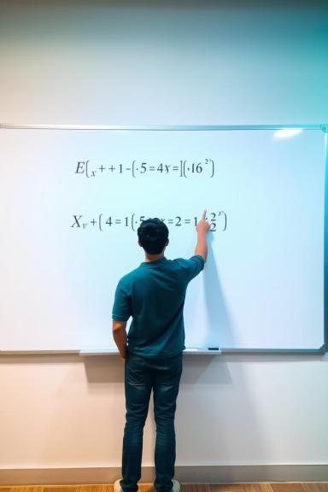
Introduction to Quadratic Equations
A quadratic equation is an equation where the highest power of the variable is 2. It can be written in the standard form ax² + bx + c = 0, where a, b, and c are constants and a ≠ 0. Quadratic equations are fundamental to understanding and solving problems in many different areas of mathematics and science. They are used to model a wide range of phenomena, from the trajectory of a projectile to the growth of a population.
1
Example of a Quadratic Equation
2
Key Characteristics
A quadratic equation has at most two solutions, also called roots. These roots represent the points where the graph of the equation intersects the x-axis.
2x² + 5x - 3 = 0

Slide 3

Standard Form and Vertex Form
The standard form of a quadratic equation is ax² + bx + c = 0, where a, b, and c are constants. This form is useful for finding the roots of the equation and for performing algebraic manipulations. The vertex form of a quadratic equation is a(x - h)² + k = 0, where (h, k) represents the vertex of the parabola. This form provides easy identification of the vertex and the direction of the parabola.
Standard Form
Vertex Form
ax² + bx + c = 0
a(x - h)² + k = 0

Slide 4

Solving Quadratic Equations
Solving a quadratic equation involves finding the values of the variable (x) that satisfy the equation. There are several methods to solve quadratic equations, each with its own advantages and disadvantages. These methods include factoring, completing the square, and using the quadratic formula.
1
2
3
Factoring
Completing the Square
Quadratic Formula
This method involves rewriting the quadratic equation as a product of two linear expressions. Factoring is only applicable when the quadratic equation can be expressed as a product of linear factors.
This method involves manipulating the equation to create a perfect square trinomial. It is a versatile method that works for all quadratic equations.
The quadratic formula provides a direct solution to any quadratic equation. It can be applied regardless of whether the equation can be factored or not.

Slide 5
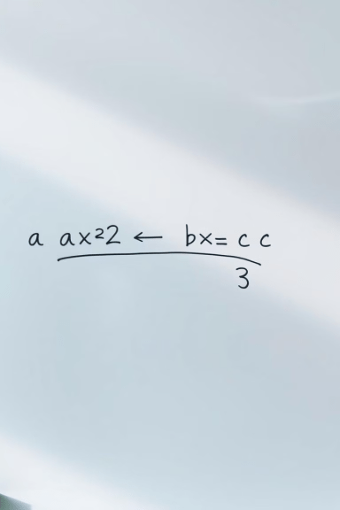
Factoring Quadratic Equations
Factoring a quadratic equation involves rewriting it as a product of two linear expressions. This method is only applicable if the equation can be factored into two linear expressions. It is a straightforward method when it is possible. Factoring is a useful technique for solving quadratic equations because it often leads to simpler expressions that can be easily solved.
Equation
Factored Form
x² + 5x + 6 = 0
(x + 2)(x + 3) = 0
2x² - 7x + 3 = 0
(2x - 1)(x - 3) = 0

Slide 6





Completing the Square
Completing the square is a method used to solve quadratic equations by manipulating the equation to create a perfect square trinomial. It is a versatile method that can be used to solve any quadratic equation, including those that cannot be factored. This method is also helpful in deriving the quadratic formula.
Step 1
Rewrite the equation by moving the constant term to the right side.
Step 2
Divide both sides of the equation by the coefficient of the x² term (a).
Step 3
Take half of the coefficient of the x term (b/2), square it, and add it to both sides of the equation.
Step 4
Factor the left side of the equation as a perfect square trinomial.
Step 5
Solve for x by taking the square root of both sides and isolating x.

Slide 7
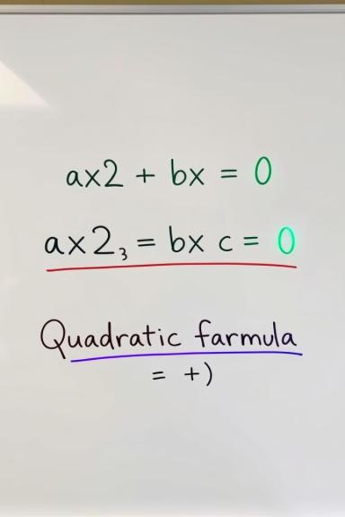
The Quadratic Formula
The quadratic formula is a general solution for quadratic equations. It provides a direct way to find the roots of any quadratic equation, regardless of whether the equation can be factored or not. It is a fundamental concept in algebra and is widely used in various fields.
The quadratic formula is given by:
x = (-b ± √(b² - 4ac)) / 2a
Where a, b, and c are the coefficients of the quadratic equation ax² + bx + c = 0.

Slide 8



Graphing Quadratic Equations
The graph of a quadratic equation is a parabola. It is a U-shaped curve that opens upwards if the coefficient of the x² term (a) is positive and opens downwards if a is negative. The vertex of the parabola is the point where the curve changes direction, and it is determined by the values of h and k in the vertex form of the equation.
X-Intercepts
Vertex
Axis of Symmetry
The x-intercepts are the points where the parabola intersects the x-axis. These points correspond to the solutions of the quadratic equation.
The vertex is the point where the parabola changes direction. It is the highest or lowest point on the graph, depending on the direction of the parabola.
The axis of symmetry is a vertical line that divides the parabola into two symmetrical halves. It passes through the vertex.

Slide 9

Applications of Quadratic Equations
Quadratic equations have numerous applications in various fields. They are used to model real-world phenomena, solve problems, and make predictions. Some common applications include:
Physics
Engineering
Modeling projectile motion, calculating the trajectory of a ball thrown in the air, and analyzing the motion of a spring.
Designing structures, calculating the strength of materials, and analyzing the behavior of electrical circuits.
Economics
Modeling market trends, analyzing supply and demand, and optimizing production processes.

