Slide 1
Teacher Ali
FK1832961
Plookpanya School, Nakhon Ratchasima, Thailand

Slide 2
HABITAT
A habitat is a place within an ecosystem that provides food, water, and other biotic and abiotic factors an organism needs to survive and reproduce

Slide 3
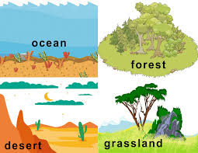
Habitat types
Organisms have a variety of habitats

Slide 4
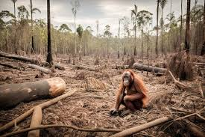
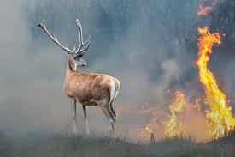
Habitat loss
When biotic and abiotic factors in an ecosystem change, habitat can change or disappear

Slide 5
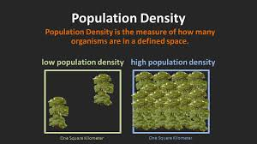
Population density
When population density is high, organisms live close together
They might not be able to obtain all the resources needed for life

Slide 6
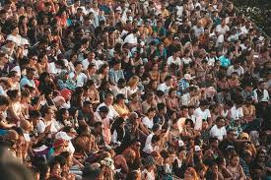
High population density
Diseases spread more easily when organisms live close together

Slide 7
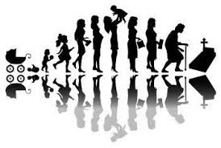
Population size
Production of offspring increases the size of population
The death of individuals reduces the population size.
When the birth rate is high and the death rate is low, the population increases.

Slide 8
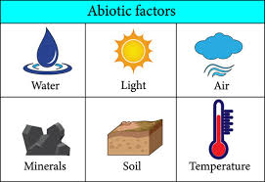
Abiotic Factors
A nonliving things in an ecosystem

Slide 9
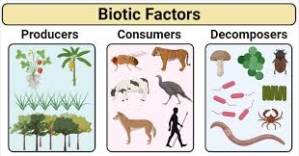
Biotic factors
A living thing in an ecosystem

Slide 10
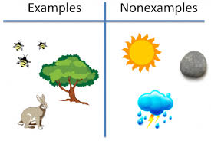
Biotic & Abiotic factors

Slide 11


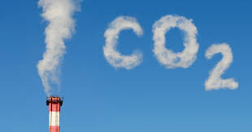
Earth Gases
The gases in Earth’s atmosphere include Nitrogen, Oxygen, and Carbon dioxide

Slide 12
Importance of gases
1- Oxygen is needed by most organisms for cellular respiration
2- Carbon dioxide is needed for plant growth and photosynthesis
3-Nitrogen is needed for plants to make protein

Slide 13
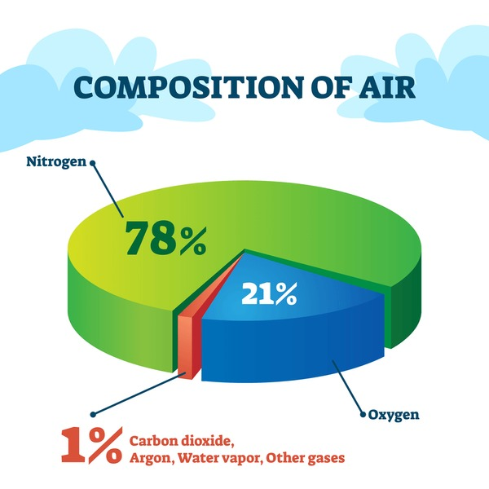
Comparison of gases

Slide 14
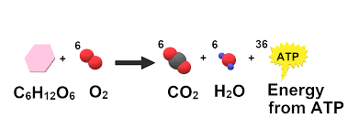
Oxygen usage

Slide 15
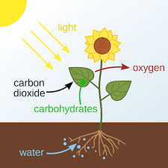
Carbon dioxide usage

Slide 16
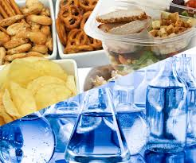
Nitrogen usage

Slide 17
Importance of WATER
Water is required for all life processes such as
1-Cellular respiration
2-Digestion
3-Photosynthesis

Slide 18
Soil composition
Soil contains a mixture of living and nonliving things
The biotic part of soil is HUMUS which consists of decayed remains of plants, animals, bacteria, and other organisms.
The abiotic factors include minerals, rock, sand, and clay

Slide 19

The Language of Algebra
Write Mathematical Expressions for Verbale Expressions
The Language of Algebra

Slide 20
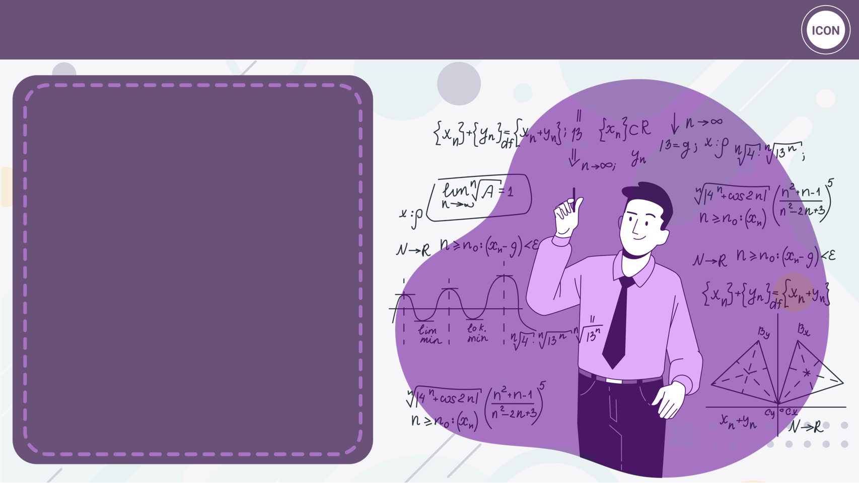
Write Mathematical Expressions for Verbale Expressions
Key Concepts
1. Write Mathematical Expressions for Verbale Expressions

Slide 21
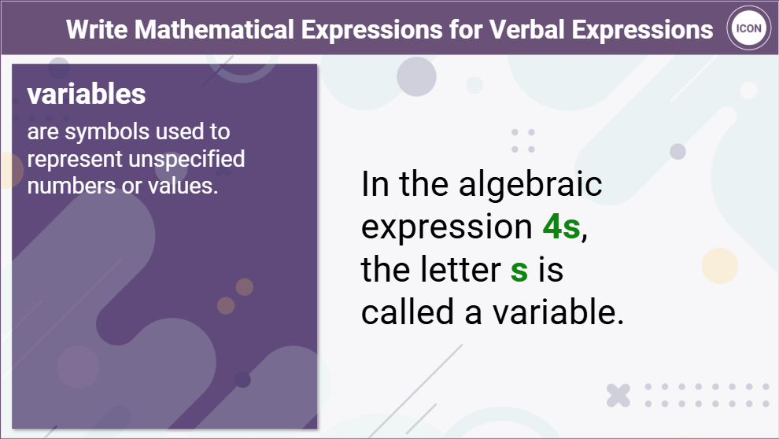

Slide 22
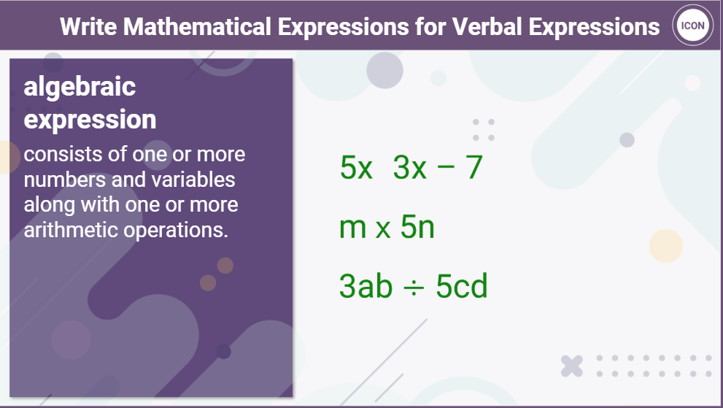

Slide 23
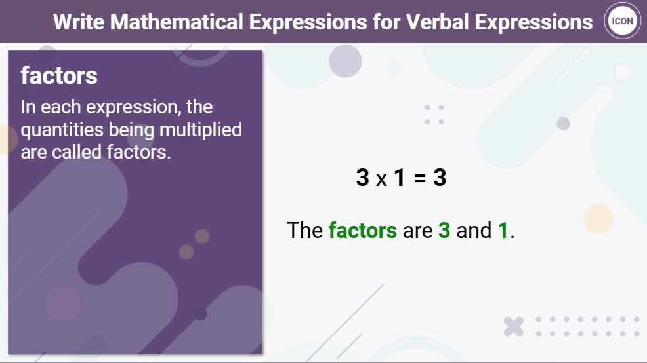

Slide 24
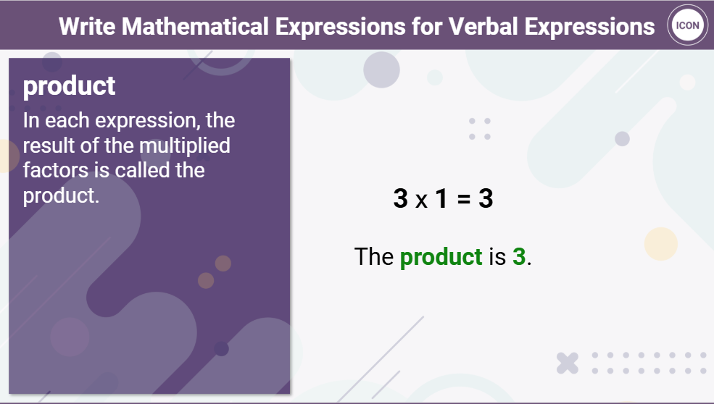

Slide 25
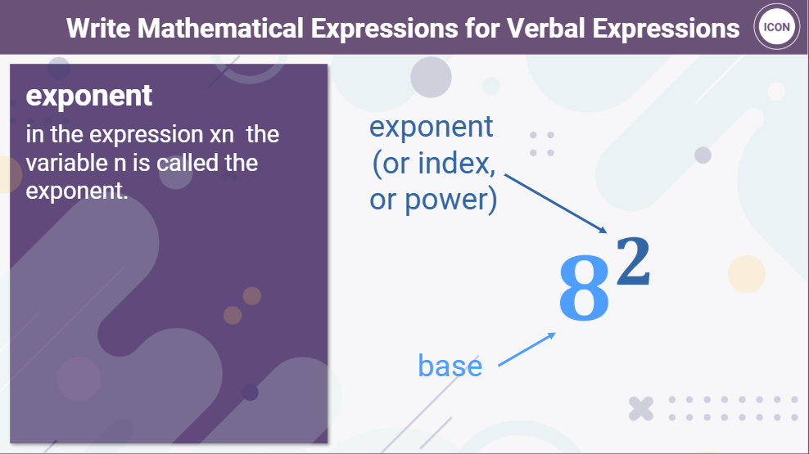

Slide 26


Slide 27
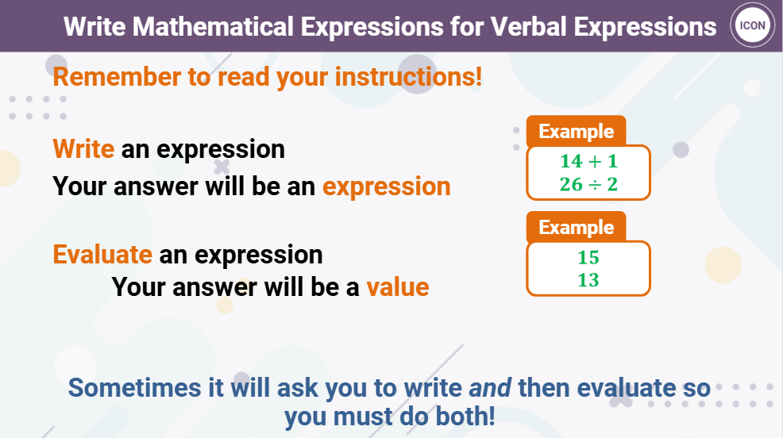

Slide 28
Thank You

