Slide 1


Trigonometry: The Language of Angles
Welcome to our journey into the fascinating world of trigonometry! This presentation will explore the fundamental concepts of trigonometry, its applications, and its impact on various fields. We'll start by understanding the basics of trigonometric functions and their relationships. Then we'll delve into the power of the unit circle and right triangle trigonometry. Finally, we'll explore the practical applications of trigonometry in fields like surveying, navigation, and engineering.
by Onyedikachi Ikenna Onwurah

Slide 2

Defining Trigonometric Functions: Sine, Cosine, and Tangent
Sine
Cosine
Tangent
Sine is the ratio of the side opposite an angle to the hypotenuse. It is represented by the abbreviation sin.
Cosine is the ratio of the side adjacent to an angle to the hypotenuse. It is represented by the abbreviation cos.
Tangent is the ratio of the side opposite an angle to the side adjacent to the angle. It is represented by the abbreviation tan.

Slide 3

The Unit Circle: Understanding Radian Measure
1
Understanding Radian Measure
2
Unit Circle as a Reference
3
Connecting Angles and Coordinates
The unit circle is a powerful tool for visualizing trigonometric functions and their values across different angles. It allows us to understand the cyclical nature of these functions.
Radian measure represents angles as the ratio of arc length to radius. It's crucial for understanding trigonometric functions in their entirety.
The unit circle enables us to connect angles in radians with corresponding coordinates on the circle, offering a visual representation of the relationship between angles and trigonometric functions.

Slide 4
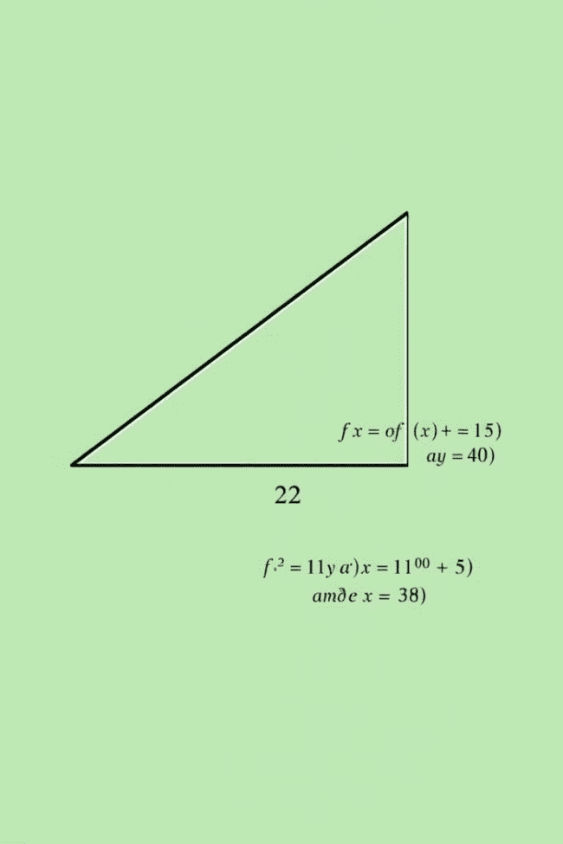



Right Triangle Trigonometry: Solving for Sides and Angles
SOH CAH TOA
Remember the acronym SOH CAH TOA to easily recall the relationships between sides and angles in a right triangle. It represents Sine, Opposite, Hypotenuse; Cosine, Adjacent, Hypotenuse; and Tangent, Opposite, Adjacent.
Finding Unknown Sides
Using trigonometric functions, we can solve for the lengths of unknown sides in a right triangle when we know one side and one angle. The known angle and side determine the trigonometric function to use.
Determining Unknown Angles
Inverse trigonometric functions, such as arcsine, arccosine, and arctangent, allow us to determine the measure of an unknown angle when two sides of a right triangle are known.

Slide 5
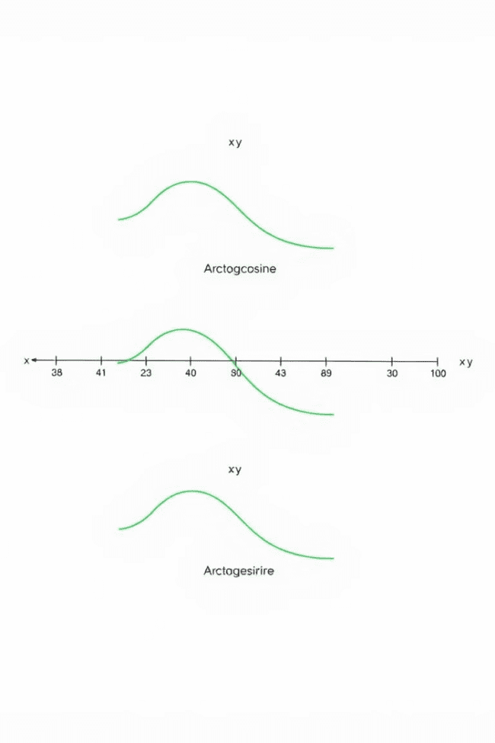



Inverse Trigonometric Functions: Arcsine, Arccosine, and Arctangent
Arcsine (sin⁻¹)
Arcsine is used to find the angle whose sine is a given value. For example, arcsin(0.5) equals 30 degrees, as the sine of 30 degrees is 0.5.
Arccosine (cos⁻¹)
Arccosine is used to find the angle whose cosine is a given value. For example, arccos(0.866) equals 30 degrees, as the cosine of 30 degrees is 0.866.
Arctangent (tan⁻¹)
Arctangent is used to find the angle whose tangent is a given value. For example, arctan(1) equals 45 degrees, as the tangent of 45 degrees is 1.

Slide 6
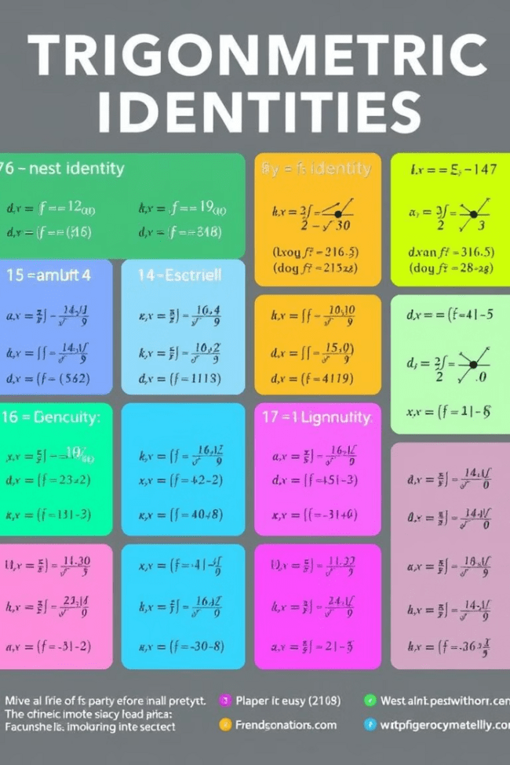
Trigonometric Identities: Foundational Relationships
Pythagorean Identity
Quotient Identities
sin²θ + cos²θ = 1. This identity is based on the Pythagorean theorem and holds true for any angle θ.
tanθ = sinθ/cosθ, cotθ = cosθ/sinθ. These identities relate the tangent and cotangent functions to sine and cosine.
Reciprocal Identities
cscθ = 1/sinθ, secθ = 1/cosθ, cotθ = 1/tanθ. These identities define the cosecant, secant, and cotangent functions as reciprocals of sine, cosine, and tangent, respectively.

Slide 7

Applications of Trigonometry: From Surveying to Navigation
1
Surveying
Trigonometry is crucial in surveying to determine distances, elevations, and angles. Surveyors use trigonometric functions and measurements to create accurate maps and plans.
2
Navigation
Navigators rely on trigonometry to calculate courses, distances, and positions. From sailing ships to guiding aircraft, trigonometry plays a vital role in navigation.
3
Engineering
Trigonometry is essential in engineering to design and analyze structures, bridges, and other constructions. It helps determine forces, angles, and stresses in these structures.

Slide 8

Trigonometry in the Modern World: Exploring Relevant Use Cases
3D Modeling
3D Modeling
Trigonometry is used in 3D modeling to create realistic and accurate representations of objects and scenes. It helps in defining the position and orientation of objects in space.
Audio Processing
Audio Processing
Trigonometry plays a crucial role in audio processing by manipulating sound waves and signals. It's used for tasks such as filtering, equalization, and effects processing.
Image Processing
Image Processing
Trigonometry is utilized in image processing for tasks like image resizing, rotation, and geometric transformations. It helps manipulate and analyze pixel data in images.

