Slide 1

Functions: Domain and Range
Welcome to this presentation exploring the fundamental concepts of functions, specifically focusing on domain and range. We'll dive into the definition and significance of these concepts, discover how to determine them for various functions, and understand their practical applications.
oi
by onyi ik

Slide 2
What is a Function?
Definition
Example
A function is a special relationship between inputs and outputs. For each input, there is exactly one output. Imagine a vending machine: you put in a specific amount of money (input), and it gives you a particular snack (output). Each input has only one associated output.
Consider the function f(x) = x + 2. If you input 3 (x = 3), the output is 5 (f(3) = 5). Each input value maps to a unique output value.

Slide 3
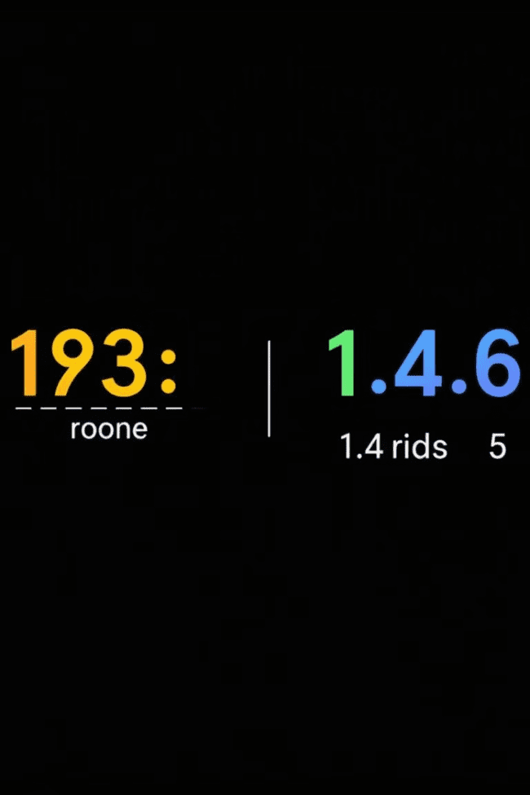
Definition of Domain
The domain of a function is the set of all possible input values that the function can accept. Think of it as the "allowed" values you can put into the function. The domain can be restricted based on certain rules or conditions.

Slide 4
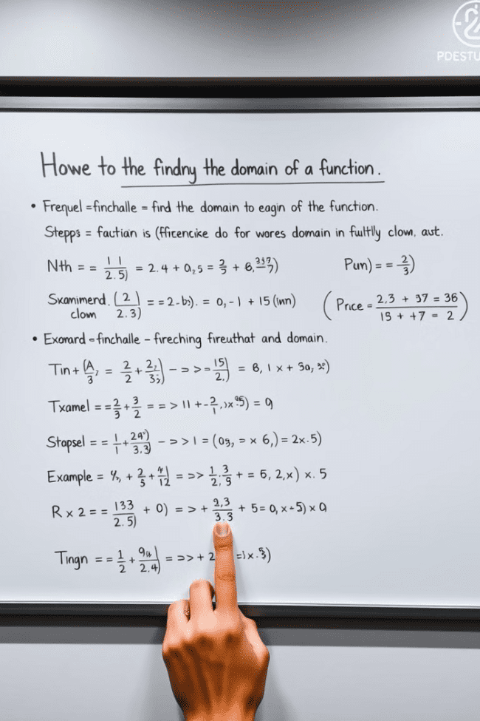
Finding the Domain of a Function
1
1. Restrictions
2
2. Examples
Look for any restrictions on the input values, such as: - Division by zero. You cannot divide by zero, so exclude values that would make the denominator zero. - Square roots. The square root of a negative number is undefined, so exclude values that would result in taking the square root of a negative number.
- f(x) = 1/x: The domain is all real numbers except for x = 0. - f(x) = √x: The domain is all non-negative real numbers (x ≥ 0).

Slide 5
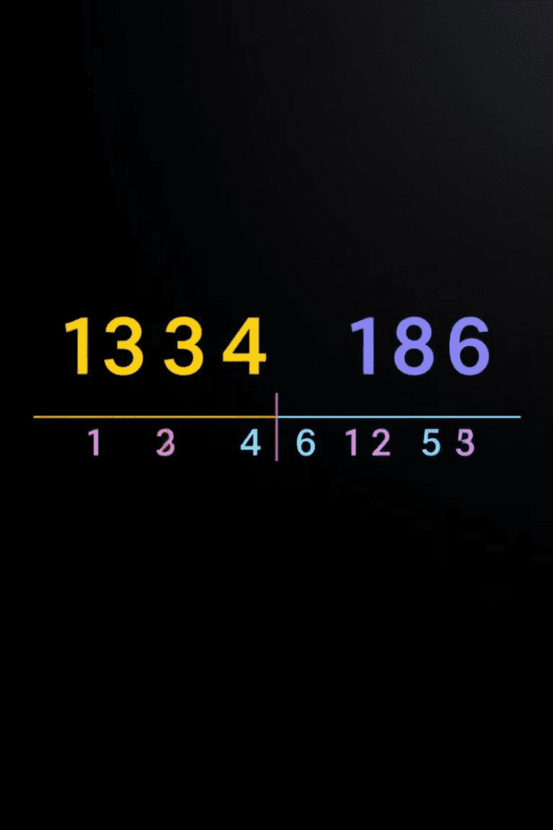
Definition of Range
The range of a function is the set of all possible output values that the function can produce. It's the set of all values you can get as a result of applying the function to its domain.

Slide 6
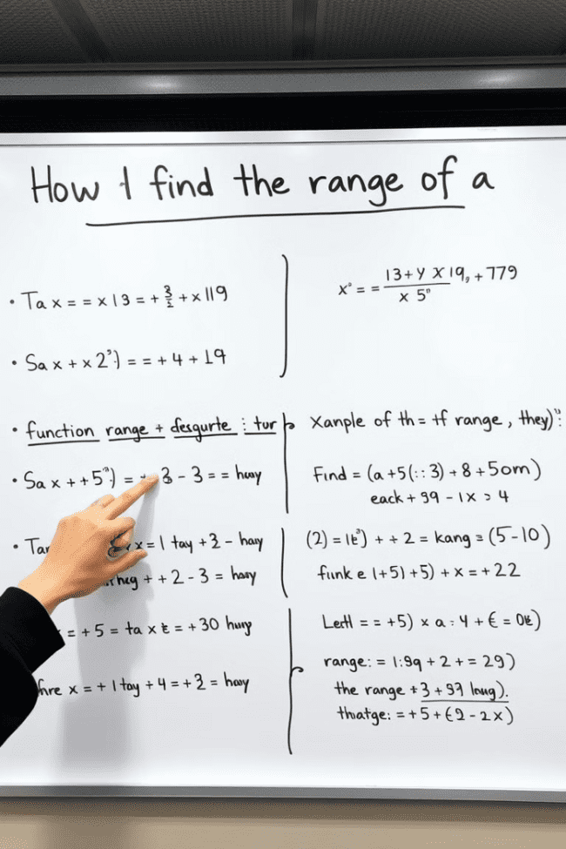
Finding the Range of a Function
1
1. Analyze
2
2. Techniques
Examine the function and its behavior to understand how the output values are generated. For example, does it always produce positive outputs, negative outputs, or both? Does it have any limitations on the output values?
- Graphing: Plot the function and observe the y-values (output values). - Algebraic manipulation: Solve the equation for the output variable and analyze the resulting expression.

Slide 7
Graphing Functions and Identifying Domain & Range
Domain
Range
Look at the x-axis (horizontal axis) and identify the set of all x-values that the graph covers. This represents the domain.
Look at the y-axis (vertical axis) and identify the set of all y-values that the graph covers. This represents the range.

Slide 8
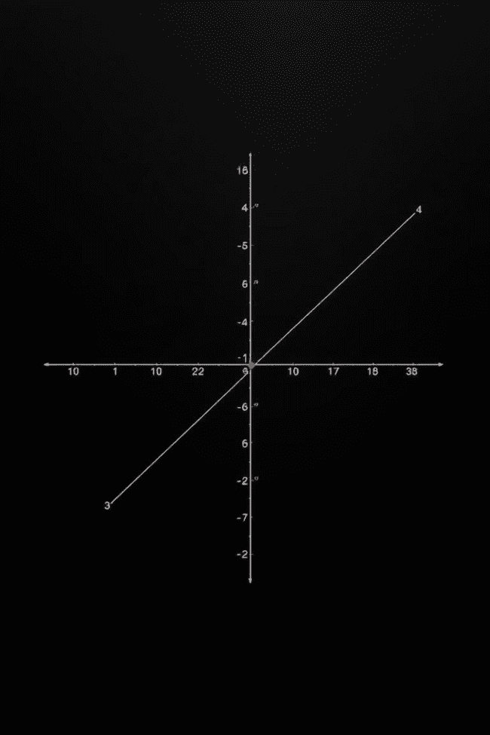
Vertical Line Test
The vertical line test is a simple visual way to determine if a graph represents a function. If any vertical line intersects the graph at more than one point, then the graph does not represent a function. This is because a function cannot have multiple outputs for a single input.

Slide 9
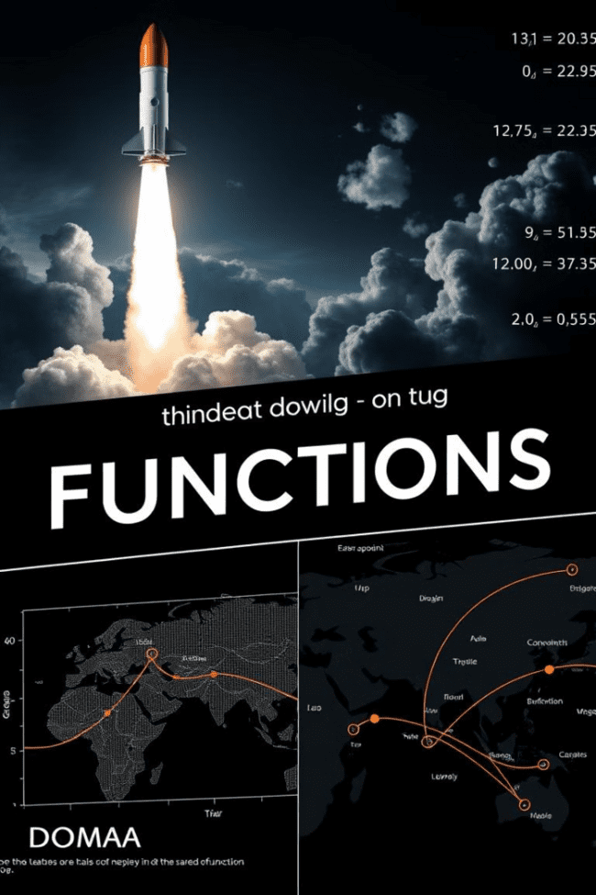
Practical Applications of Domain & Range
Rocket Launch
Stock Prices
The domain of a function modeling a rocket launch might be the time during the ascent. The range could be the rocket's altitude or velocity.
The domain of a function representing stock prices might be the time period (e.g., trading days). The range would be the actual stock prices.
Travel Routes
The domain of a function describing a travel route could be the distance traveled. The range could be the total travel time or the final destination.

Slide 10
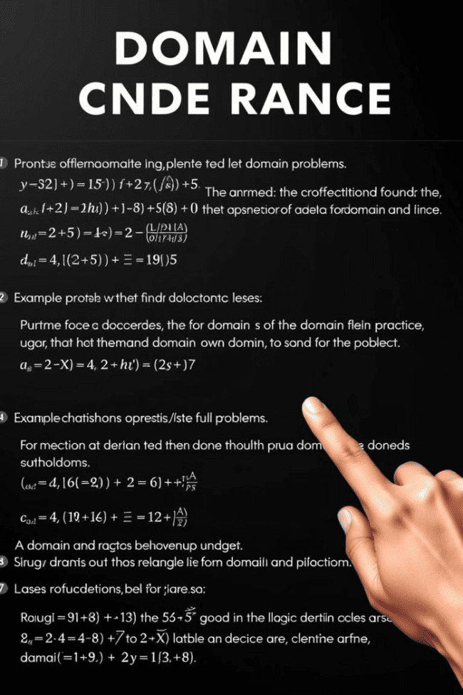
Exercises and Examples
To solidify your understanding of domain and range, let's work through some examples and practice problems. We'll explore various types of functions and determine their domain and range using the techniques we learned.

