Slide 1

Geometric Sequences
Dive into the fascinating world of geometric sequences, exploring their definition, properties, real-world applications, and the powerful formulas used to analyze them.
IO
by IKENNA ONYI

Slide 2
What is a Geometric Sequence?
Definition
Example
A geometric sequence is a sequence of numbers where each term is found by multiplying the previous term by a constant factor called the common ratio.
Consider the sequence 2, 4, 8, 16, 32. Each term is twice the previous one, making the common ratio 2.

Slide 3
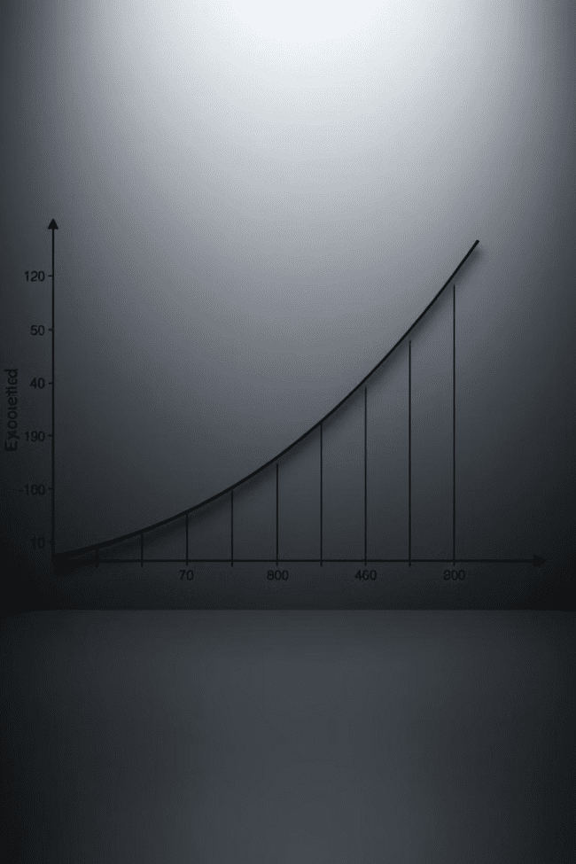
Common Ratio
1
Key Concept
2
Symbol
The common ratio is the constant factor by which each term in a geometric sequence is multiplied to get the next term.
The common ratio is typically represented by the letter 'r'.
3
Calculation
To find the common ratio, divide any term by the term that precedes it.

Slide 4
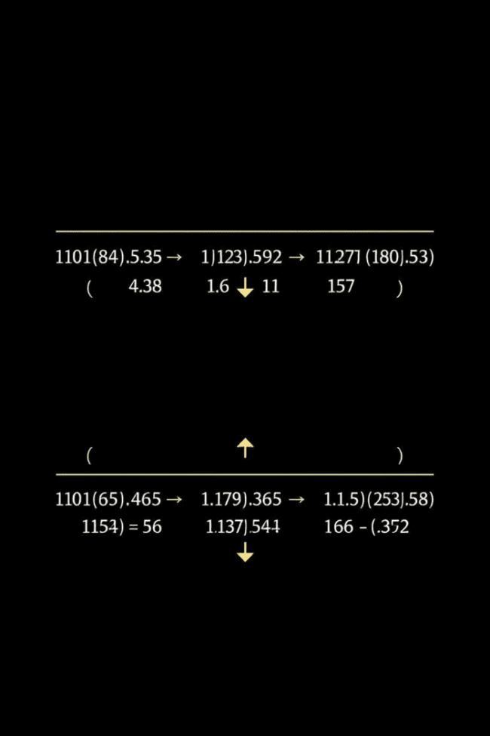


Recursive Formula
Definition
The recursive formula defines a geometric sequence by expressing each term as a function of the previous term and the common ratio.
Formula
an = an-1 * r, where an is the nth term, an-1 is the (n-1)th term, and r is the common ratio.

Slide 5
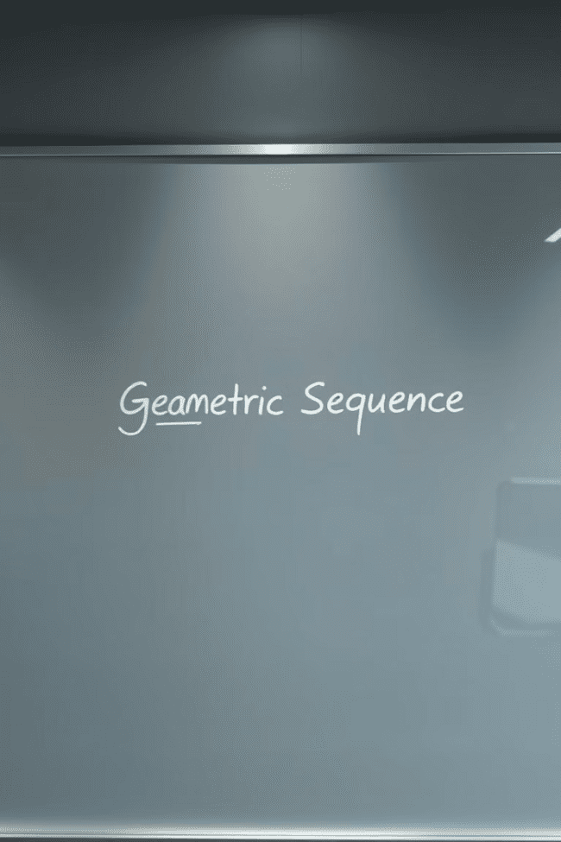
Explicit Formula
Definition
Formula
The explicit formula directly calculates any term in a geometric sequence without having to calculate the preceding terms.
an = a1 * rn-1, where an is the nth term, a1 is the first term, r is the common ratio, and n is the term number.

Slide 6




Geometric Sequences in Real Life
Architecture
Population Growth
Compound Interest
Geometric sequences can be observed in the heights of buildings in a city, where each building is a specific ratio larger than the previous one.
In some scenarios, population growth can be modeled using a geometric sequence, where the population increases by a fixed percentage each year.
Compound interest, where interest is earned on both the principal amount and accumulated interest, can be calculated using a geometric sequence.

Slide 7

Applications of Geometric Sequences
1
Biology
Geometric sequences are used to model bacterial growth and decay in biological experiments.
2
Physics
They are employed in understanding radioactive decay and the behavior of oscillating systems.
3
Finance
Geometric sequences are crucial in analyzing financial investments, particularly those with compound interest.

Slide 8



Convergence and Divergence
1
Convergence
2
Divergence
3
Common Ratio
Geometric sequences exhibit two distinct behaviors: convergence and divergence. Convergence occurs when the common ratio is less than 1, causing the terms to approach zero as the sequence progresses. Divergence happens when the common ratio is greater than 1, causing the terms to increase infinitely.

Slide 9
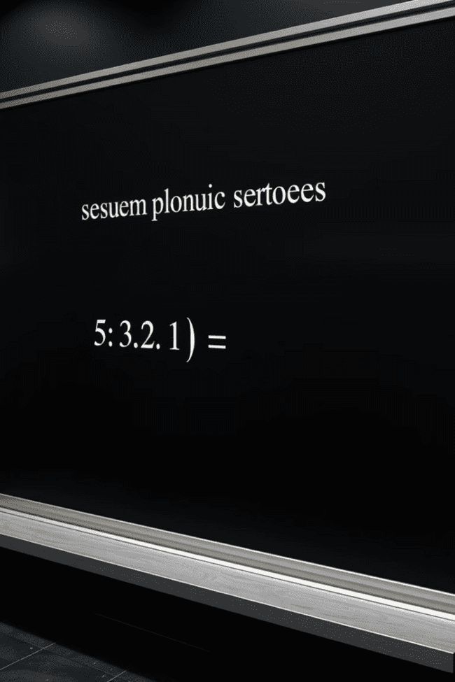
Sum of a Geometric Series
S
Sum
The sum of an infinite geometric series can be calculated using a specific formula.
a<sub>1</sub>
First Term
This formula requires the first term of the sequence.
r
Common Ratio
The formula also depends on the common ratio of the sequence.

Slide 10
Practice Problems
Problem 1
1
Find the common ratio and the 10th term of the geometric sequence 3, 6, 12, 24...
Problem 2
2
Determine whether the geometric series 1 + 1/2 + 1/4 + 1/8 + ... converges or diverges.
Problem 3
3
Calculate the sum of the infinite geometric series 2 - 1 + 1/2 - 1/4 + ...

