Slide 1
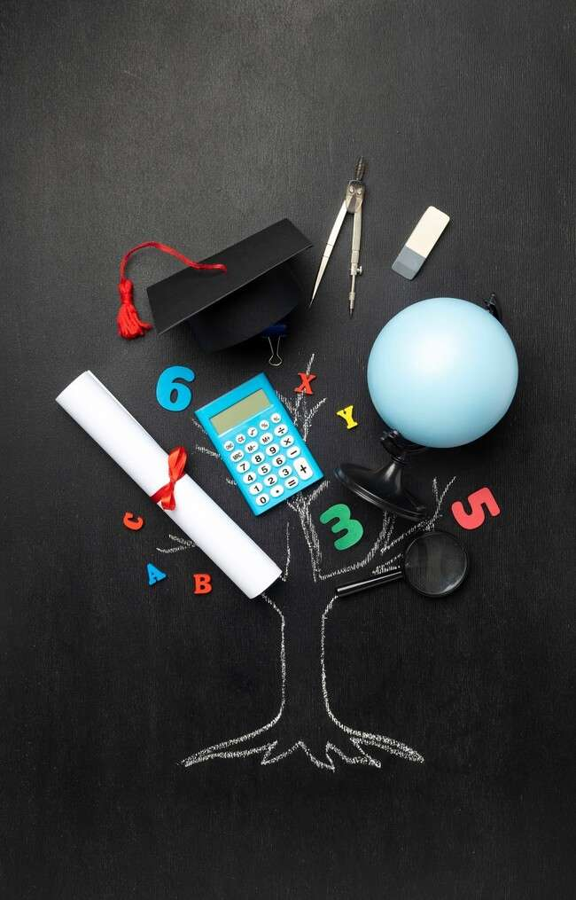
Unveiling Truth: The Art of Direct Proofs in Mathematics

Slide 2
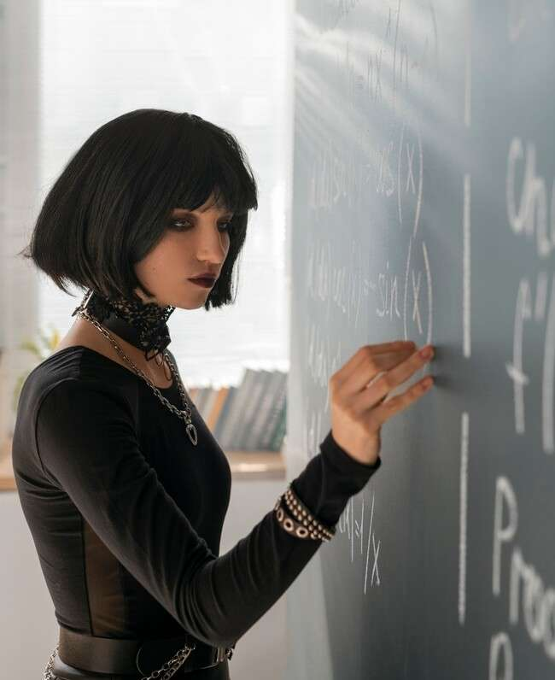




Introduction to Direct Proofs
In the realm of ,
serve as a fundamental tool for establishing truths. They rely on logical
reasoning and established to demonstrate the validity of statements. This presentation will explore the of direct proofs and their signiﬁcance in mathematical discourse.

Slide 3
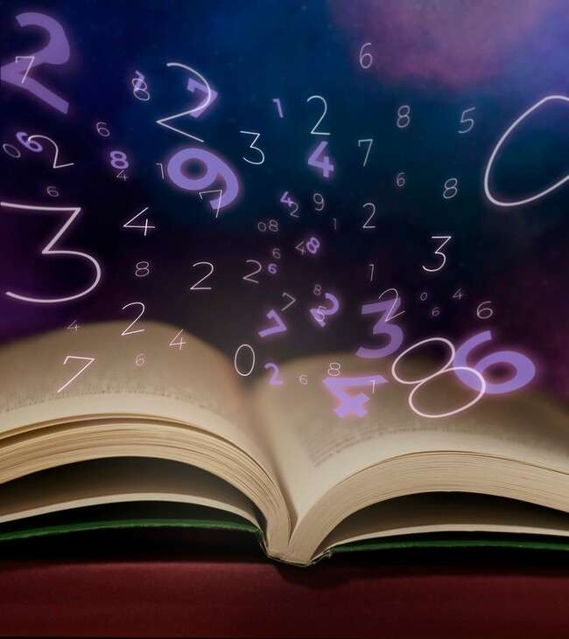


What is a Direct Proof?
A is a method of proving a statement by a straightforward chain of logical deductions. It starts from known and applies logical reasoning to
arrive at the conclusion. This approach is essential for building a solid foundation in .

Slide 4
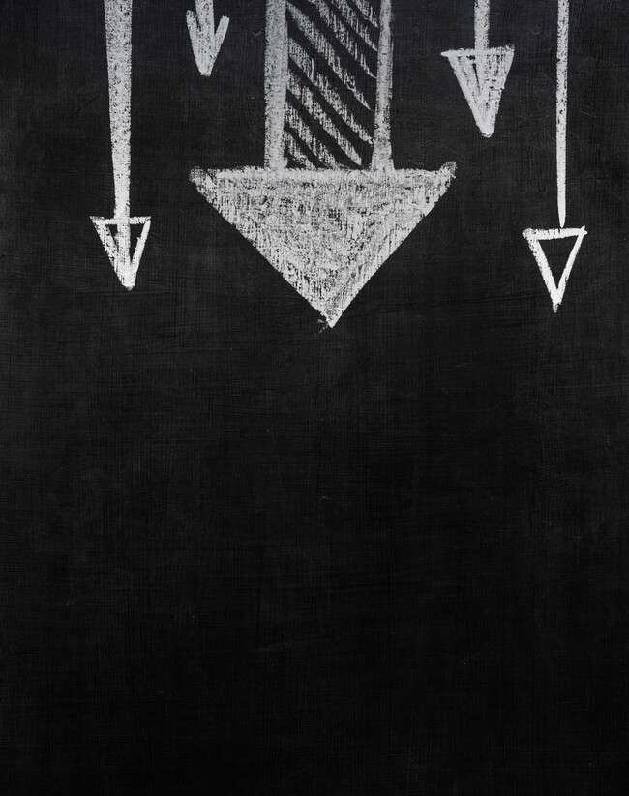




The Structure of Direct Proofs
The structure of a direct proof typically includes
an
, a series of logical steps, and a
. Each step must be clearly articulated,
leading the reader through the reasoning process. This clarity is what makes direct proofs both and .

Slide 5
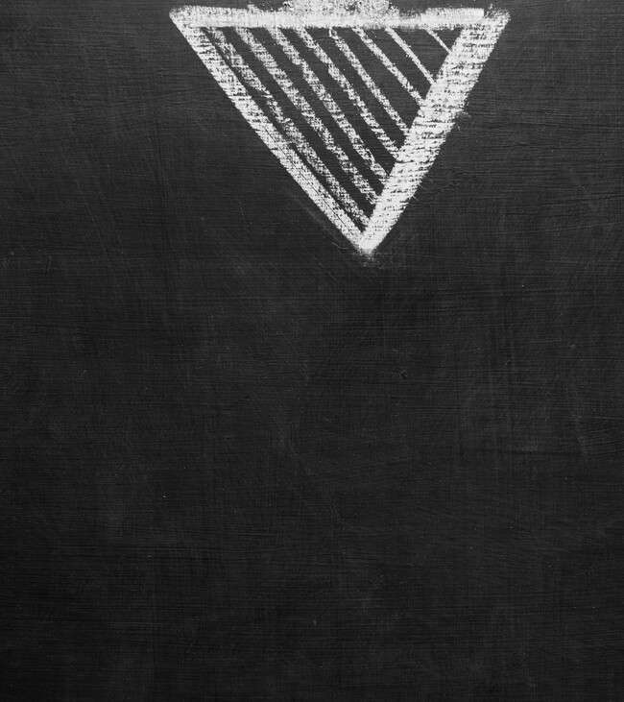


Examples of Direct Proofs
Consider the statement: 'If n is an integer, then n² is also even.' A
direct proof can be constructed by letting n = 2k for some integer k, and showing that n² = 4k², which is clearly even. This example highlights the of direct proofs.

Slide 6



Common Mistakes in Direct Proofs
While crafting direct proofs, it’s easy to make errors or assumptions that lead to incorrect conclusions.
Common pitfalls include skipping steps or failing to justify each claim. Recognizing these mistakes is crucial for developing proof-writing skills.

Slide 7





Applications of Direct
Proofs
Direct proofs are not just academic exercises; they have practical
applications in ﬁelds such as
, engineering, and economics. Understanding how to construct and analyze direct proofs can enhance
problem-solving skills and foster
.

Slide 8



The Beauty of Logical Reasoning
At the heart of direct proofs lies the beauty of . Each
proof is a journey from assumptions to conclusions, showcasing the elegance of mathematical thought. Embracing this art form enriches our understanding of and its profound implications.

Slide 9


Conclusion: Embrace the Art
In conclusion, mastering direct proofs is essential for anyone wishing to delve deeper into . By honing this skill, we not only enhance our problem-solving abilities but also appreciate the involved in logical reasoning and proof construction.

Slide 10
Thanks!

