Slide 1


Word Problems: The Key to Unlocking Math Mastery
Word problems are an essential tool for developing a deeper understanding of mathematical concepts and their real-world applications. By engaging students in contextual problem-solving, word problems challenge them to translate verbal information into mathematical representations, fostering critical thinking and problem-solving skills that are invaluable both in and out of the classroom.
by Onyedikachi Onwurah

Slide 2
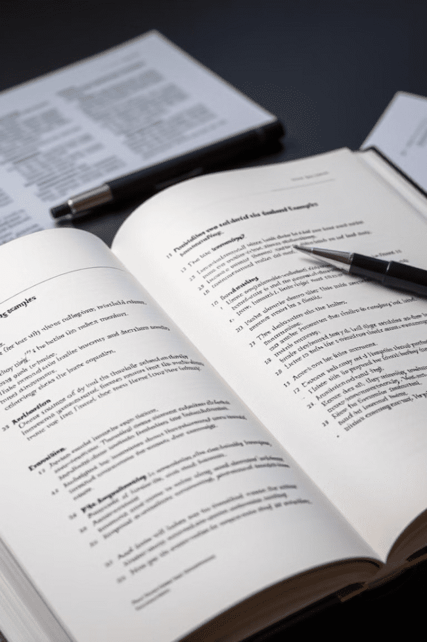
What are Word Problems?
1
Contextual Math Problems
2
Verbal Representation
Instead of straightforward numerical equations, word problems convey the problem statement in a written, verbal format, challenging students to translate the information into a mathematical model.
Word problems present mathematical concepts within real-world scenarios, requiring students to understand the context and determine the appropriate operations to solve the problem.
3
Critical Thinking
Solving word problems requires analytical skills, such as identifying relevant information, recognizing patterns, and applying appropriate mathematical strategies to arrive at the correct solution.

Slide 3

The Importance of Word Problems
Conceptual Understanding
Problem-Solving Skills
Relevance and Motivation
Word problems help students move beyond rote memorization of formulas and procedures, fostering a deeper comprehension of mathematical concepts and their real-world applications.
Solving word problems develops critical thinking, analytical reasoning, and problem-solving abilities, which are essential skills for success in various academic and professional domains.
By presenting math in a relatable, context-driven format, word problems help students understand the relevance of mathematical knowledge, increasing their engagement and motivation to learn.

Slide 4
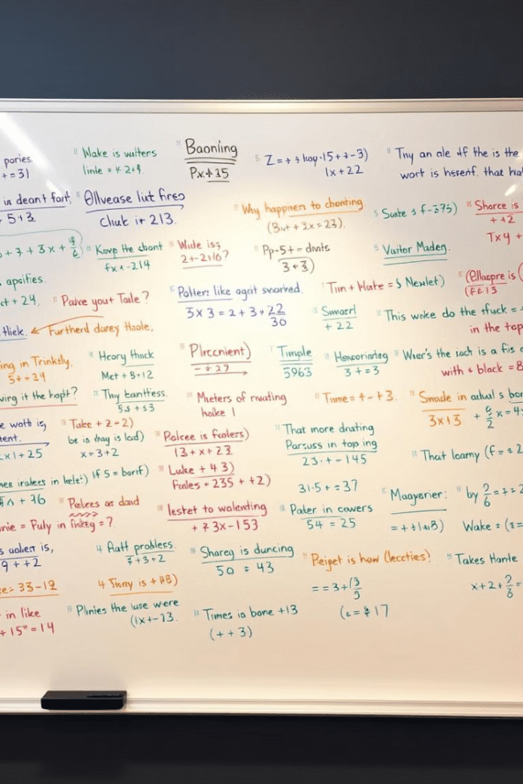
Common Types of Word Problems
1
Arithmetic
Word problems involving basic operations such as addition, subtraction, multiplication, and division, often set in real-world scenarios.
2
Algebra
Problems that require the use of algebraic concepts, such as solving for unknown variables, interpreting and manipulating equations.
3
Geometry
Word problems that involve the application of geometric principles, such as calculating area, volume, or determining the properties of shapes.

Slide 5

Strategies for Solving Word Problems
Understand the Problem
Translate to Math
Carefully read the problem statement, identify the key information, and determine the goal or the question being asked.
Represent the problem using mathematical expressions, equations, or diagrams, based on the information provided.
Develop a Plan
Execute the Plan
Devise a step-by-step strategy to solve the problem, considering the appropriate mathematical operations and concepts to apply.
Carefully carry out the steps of the solution, showing all the necessary work and ensuring the accuracy of the calculations.

Slide 6





Step-by-Step Approach to Solving Word Problems
Read and Understand
Carefully read the problem statement, identify the key information, and determine the goal or the question being asked.
Identify the Relevant Information
Analyze the problem and extract the necessary data, such as quantities, units, and relationships between the given information.
Develop a Plan
Determine the appropriate mathematical operations and concepts to apply, and outline the steps to solve the problem.
Carry Out the Solution
Carefully execute the planned steps, showing all the necessary work and ensuring the accuracy of the calculations.
Verify the Solution
Check the final answer to ensure it makes sense within the context of the problem and aligns with the original question.

Slide 7





Real-World Applications of Word Problems
Personal Finance
Construction
Word problems related to budgeting, savings, and financial decision-making.
Problems involving measurements, materials, and cost calculations for construction projects.
Healthcare
Manufacturing
Word problems that deal with medication dosages, patient data, and resource allocation.
Problems related to production, inventory, and efficiency in industrial settings.

Slide 8

Overcoming Challenges in Solving Word Problems
1
Comprehending the Problem
Ensuring students fully understand the problem statement, the relevant information, and the goal of the problem.
2
Translating to Math
Helping students bridge the gap between the verbal description and the appropriate mathematical representation.
3
Applying Strategies
Providing guidance and practice in employing effective problem-solving strategies, such as drawing diagrams or breaking problems into steps.
By addressing these challenges through targeted instruction, practice, and feedback, educators can empower students to develop the skills and confidence needed to excel at solving word problems and unlock their full potential in mathematics.

