Slide 1
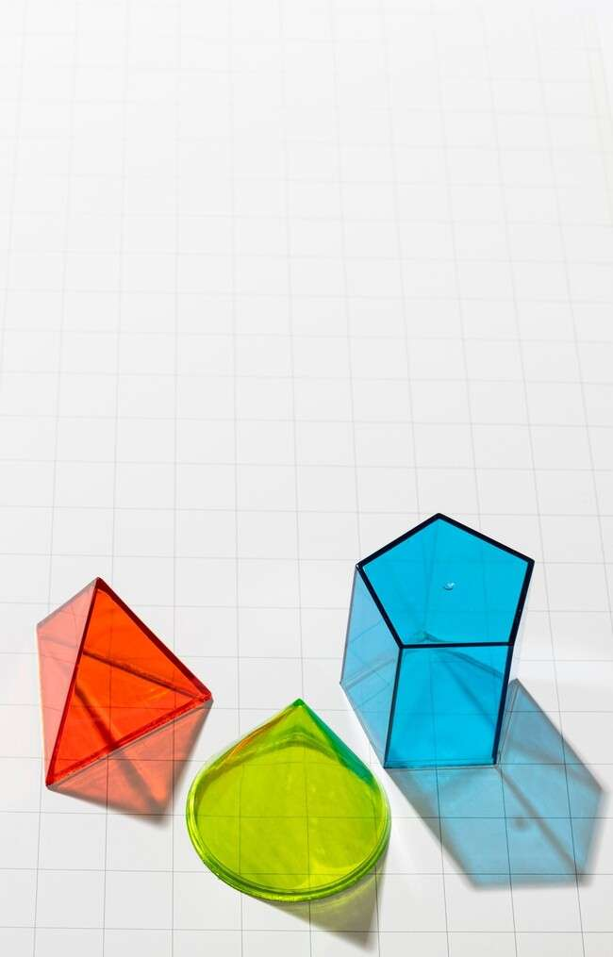
Unlocking the Mysteries of Triangles: The Enigmatic Law of Cosines

Slide 2
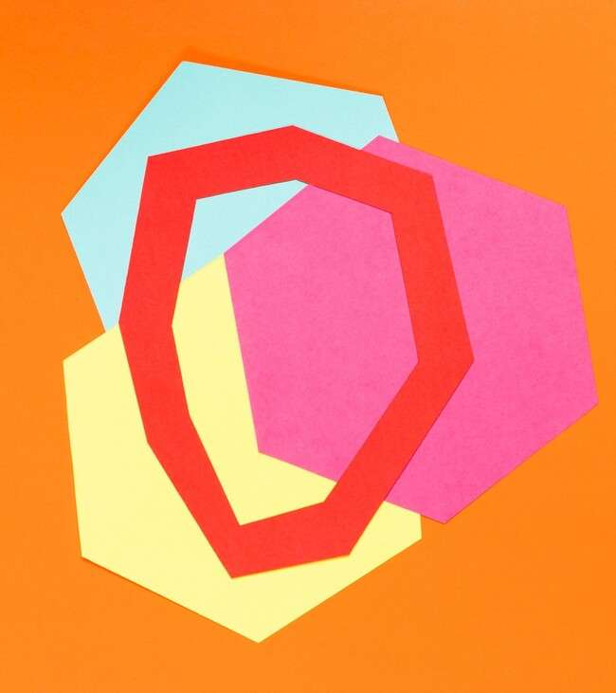


Unlocking the Mysteries
Welcome to our exploration of
and the . This
presentation will uncover the secrets
behind this mathematical principle, showcasing its signiﬁcance in geometry and real-world applications. Prepare to embark on a creative journey through angles and sides!

Slide 3
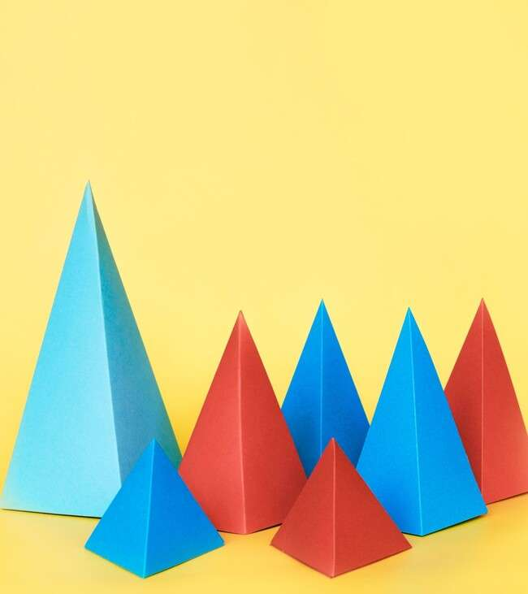

What is a Triangle?
A is a polygon with three edges and vertices. It is the simplest form of a polygon and serves as the foundation for many geometric principles.
Understanding triangles is crucial for grasping more complex shapes and theorems in mathematics.

Slide 4
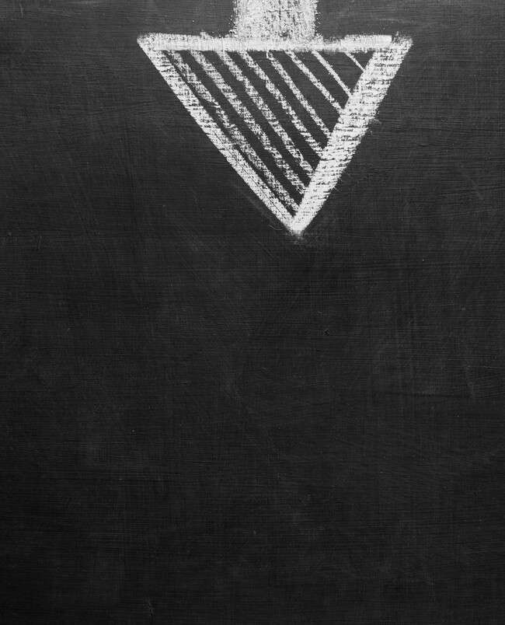

The Law of Cosines
The relates the lengths of the sides of a triangle to the cosine of one of its angles. It is expressed as
. This formula is essential for solving triangles when we know two sides and the included angle.

Slide 5




Applications in Real Life
The is not just theory; it has practical applications! From to
, this law helps in calculating distances
and angles in various ﬁelds. Understanding its applications can enhance our problem-solving skills in everyday scenarios.

Slide 6


Visualizing the Law
Visual aids can enhance our
understanding of the
By drawing triangles and labeling their sides and angles, we can better grasp how the formula operates.
Visualization is key to unlocking the mysteries hidden within this mathematical law.
.

Slide 7
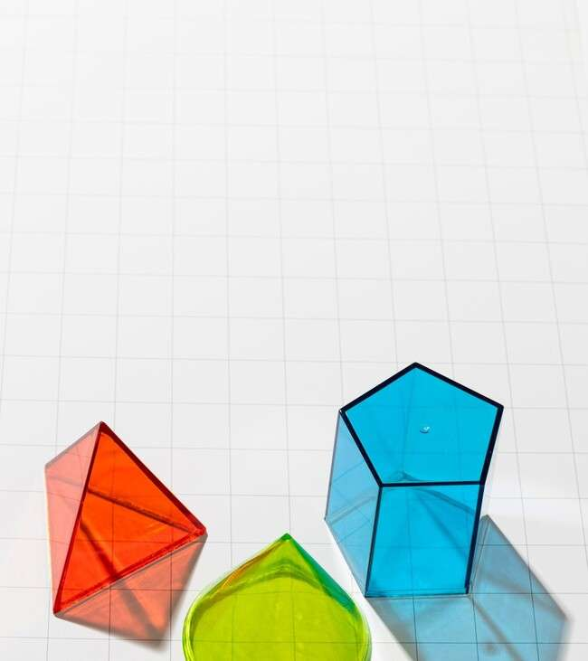

Common Misconceptions
Many students struggle with the
due to misconceptions. One common error is confusing it with the
. Remember, the Law of Cosines applies to non- right triangles, while the Pythagorean theorem is speciﬁc to
right triangles.

Slide 8
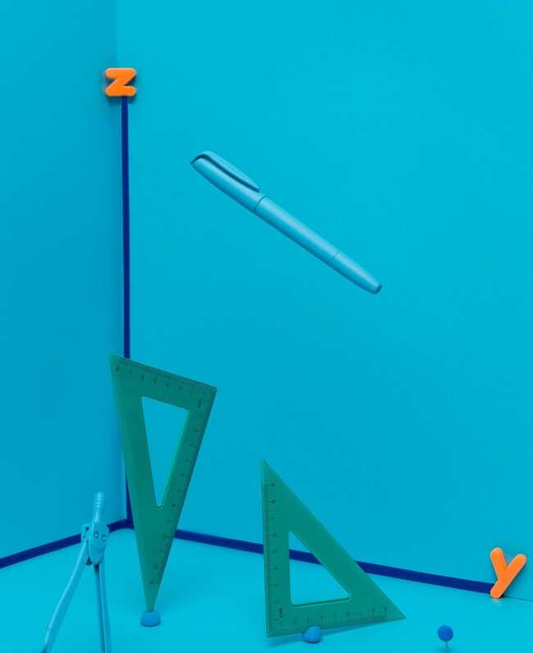

Practice Problems
Engaging with the
through practice problems is vital for mastery. Start with simple triangles and
gradually increase complexity. Solving these problems will solidify your understanding and make you more conﬁdent in applying this law.

Slide 9
Conclusion: Embrace the Mystery
In conclusion, the is a powerful tool in understanding triangles. By embracing its concepts and applications, we can unlock the mysteries of geometry. Keep exploring, practicing, and applying these principles in your mathematical journey!

Slide 10
Thanks!
Do you have any questions? youremail@email.com
+91 620 000 838
www.yourwebsite.com @yourusername

