Slide 1


Unlocking the Mysteries of Inverse Trigonometric Functions: A Journey Beyond Angles

Slide 2
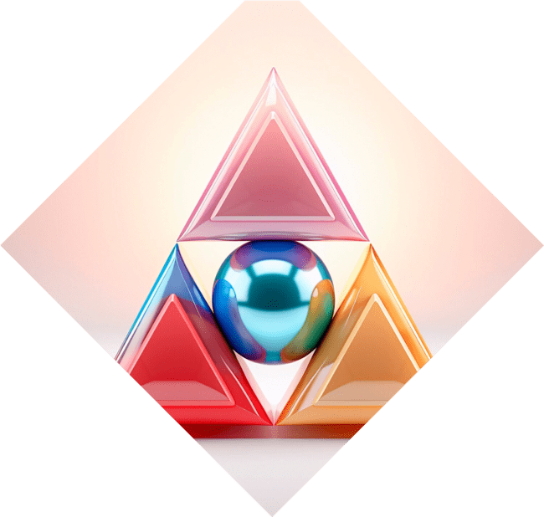


Introduction to Inverse Trigonometric Functions
Welcome to our exploration of
! These fascinating concepts allow us to reverse the typical relationships between angles and sides in
triangles. Join us as we embark on a journey that transcends mere angles and dives into the behind these functions.

Slide 3
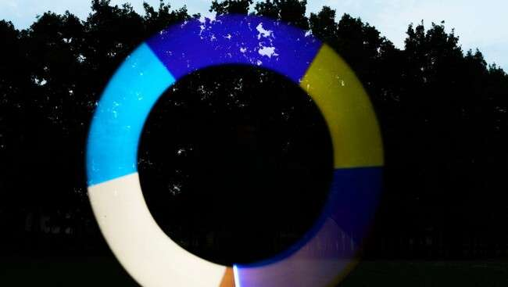





What Are Inverse Trigonometric Functions?
are the reverse of standard trigonometric functions. They help us find angles when given ratios of sides. The primary functions include ,
, and , each unlocking unique insights into the
.

Slide 4




The Importance of Domain and Range
Understanding the and
of these functions is crucial. For instance, arcsin has a range of
, while arccos spans . This
knowledge helps us navigate the
of angle solutions
effectively.

Slide 5
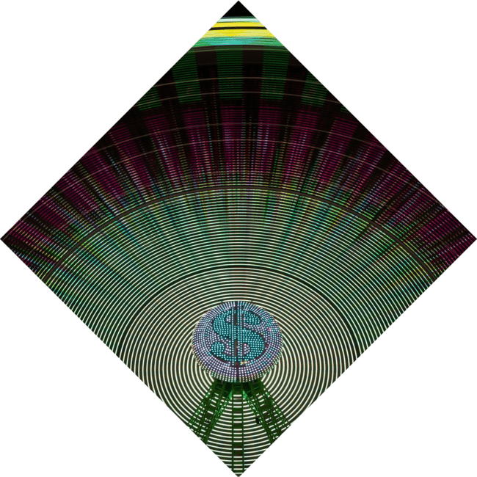



Graphing Inverse Functions
Graphing
reveals their unique shapes. Each graph is a reflection of its corresponding trigonometric
function over the line . This visual connection deepens our understanding of their .

Slide 6
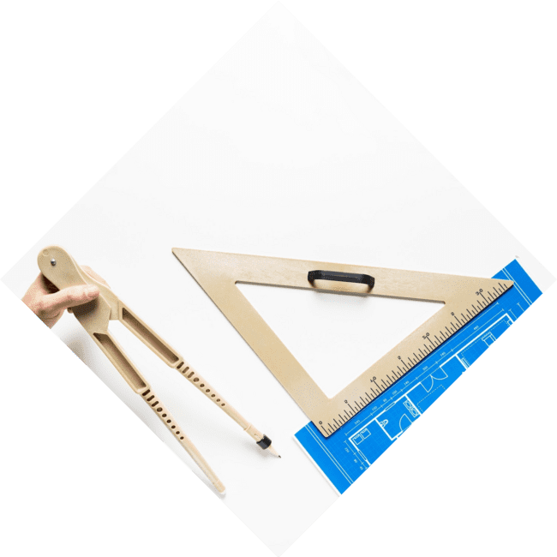


Real-Life Applications
Inverse trigonometric functions are not just theoretical; they have real- world applications! From
to , these
functions help solve practical problems involving angles and distances, making them invaluable
tools in various fields.

Slide 7





Common Mistakes to
Avoid
Many students struggle with
due to misconceptions. Common mistakes include confusing the functions' outputs
and neglecting their
. Being aware of these pitfalls can enhance your understanding and application of
these functions.

Slide 8
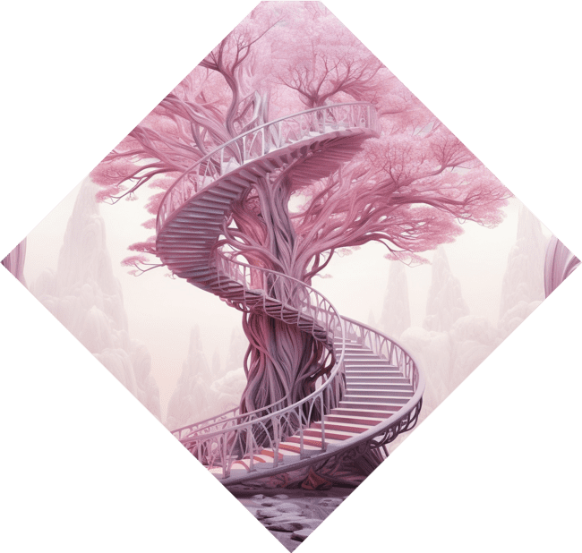
Exploring Beyond Angles
The journey doesn't end with angles! By mastering inverse trigonometric functions, we unlock pathways to more complex
. This knowledge
serves as a foundation for calculus, physics, and beyond, enriching our mathematical journey.

Slide 9

Conclusion: Embrace the Mysteries
In conclusion,
are more than mere calculations; they are keys
to understanding the of angles and their applications. Embrace these concepts, and let them guide you through the fascinating world of mathematics!

Slide 10
Thanks!
Do you have any questions?
youremail@email.com
+91 620 000 838
www.yourwebsite.com @yourusername

