Slide 1

Unlocking the Power Within: A Journey Through Eigenvalues and Eigenvectors

Slide 2






Unlocking the Power Within
Welcome to our journey through
and ! Together, we will explore their signiﬁcance in
linear transformations and how they can hidden potentials in various applications. Prepare to dive deep into a world where meets
.

Slide 3
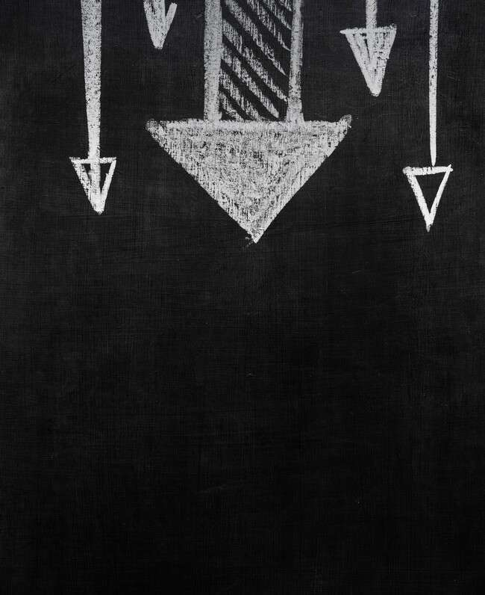



What Are Eigenvalues?
Eigenvalues are associated with a linear transformation. They represent the factor by which an eigenvector is
or .
Understanding eigenvalues is crucial for simplifying complex systems and revealing their intrinsic properties. Let's discover their role in linear algebra!

Slide 4





The Magic of Eigenvectors
Eigenvectors are the in which a transformation acts by merely . They provide insights into the structure of linear transformations, making them essential in areas like
and
Let's explore how they guide us through complex problems.
.

Slide 5









Real-World Applications
From
to
, eigenvalues and eigenvectors
play a pivotal role. They help in
,
even in understanding
, and
. Join me as we unveil the practical uses of these mathematical tools in our daily lives.

Slide 6


Finding Eigenvalues and Eigenvectors
The process involves solving the
. By ﬁnding the roots of this polynomial, we can derive
eigenvalues and subsequently compute their corresponding eigenvectors. This method is not just a procedure; it's a
to deeper understanding in linear algebra!

Slide 7

Eigenvalues in Action
Consider the (Principal Component Analysis) technique in statistics, which utilizes eigenvalues to reduce dimensionality. By identifying the most signiﬁcant directions in data, we can enhance our understanding and visualization of complex datasets.
Let's see how this unfolds!

Slide 8



Creative Perspectives
Eigenvalues and eigenvectors are not just numbers; they represent
and
various ﬁelds. By embracing creativity, we can visualize and
in
interpret these concepts in unique ways, making them relatable and engaging for everyone. Let your imagination soar!

Slide 9

Conclusion: The Journey Continues
As we conclude our exploration of eigenvalues and eigenvectors, remember that these concepts are
tools in mathematics and beyond. They help us unlock potential in numerous applications. Keep exploring, stay curious, and let the journey of discovery continue!

Slide 10
Thanks!
Do you have any questions? youremail@email.com
+91 620 000 838
www.yourwebsite.com @yourusername

