Slide 1
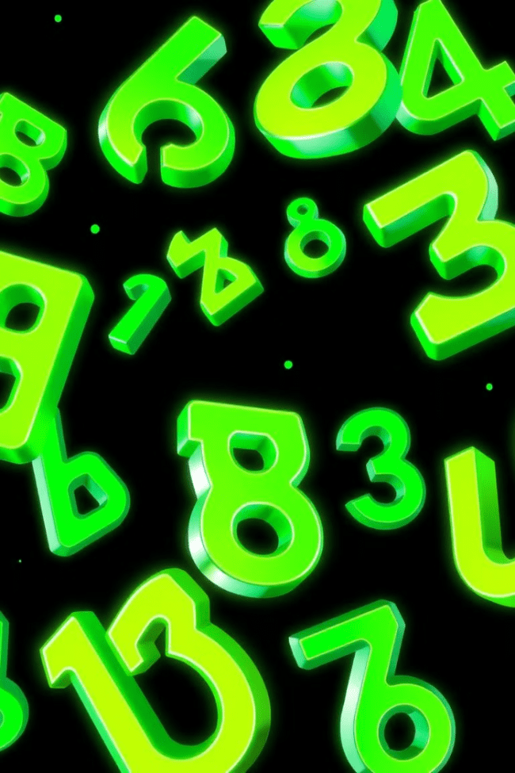


Exploring the World of Numbers: Rational vs. Irrational
Welcome to this journey into the fascinating world of numbers! Today, we'll delve into the difference between two fundamental types of numbers: rational and irrational. We'll explore their definitions, properties, and real-world applications. So, get ready to unravel the mysteries behind these intriguing numerical concepts.
by ONYEDIKACHI ONWURAH

Slide 2
What are Rational Numbers?
Definition
Examples
Rational numbers are numbers that can be expressed as a ratio of two integers, where the denominator is not zero. These numbers can be represented as fractions or decimals that terminate or repeat.
Examples include 3/4, 2, -5, 0.5, and 1.333... Any number that can be written as a fraction, even if it's a whole number or a repeating decimal, is a rational number.

Slide 3

Characteristics of Rational Numbers
1
Closure
2
Order
3
Density
Rational numbers are closed under addition, subtraction, multiplication, and division, meaning that performing these operations on two rational numbers always results in another rational number.
Rational numbers can be ordered, meaning that we can determine which number is greater or less than another. This allows us to compare rational numbers and arrange them in a specific sequence.
Rational numbers are dense, meaning that between any two rational numbers, there exists another rational number. This property implies that rational numbers are infinitely close to each other, filling the number line completely.

Slide 4
What are Irrational Numbers?
Definition
Examples
Irrational numbers are numbers that cannot be expressed as a ratio of two integers. Their decimal representations are infinite and non-repeating, making them impossible to write as a simple fraction.
Famous examples include pi (π), the square root of 2 (√2), and Euler's number (e). These numbers are essential in various fields, including geometry, calculus, and physics.

Slide 5
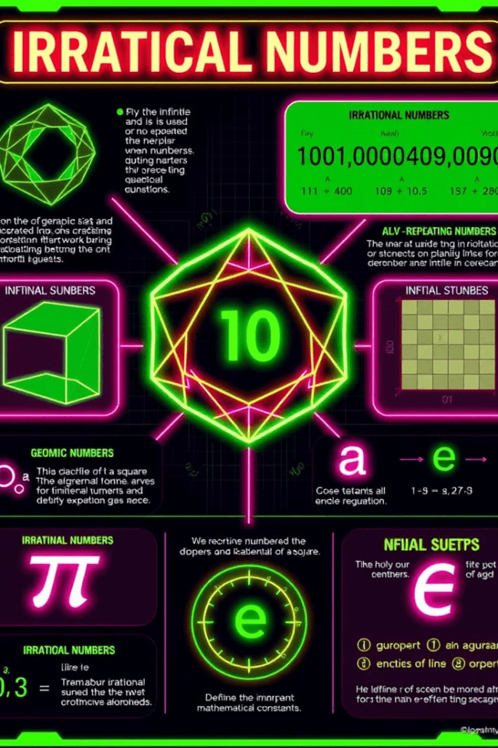
Characteristics of Irrational Numbers
Infinite Decimals
No Ratio Form
Irrational numbers have decimal representations that continue infinitely without any repeating patterns. This means that the decimal representation never terminates, making it impossible to express them as fractions.
Irrational numbers cannot be written as a ratio of two integers. Unlike rational numbers, where we can always find a fraction representing them, irrational numbers are inherently different.
Geometric Importance
Irrational numbers play a critical role in geometry. For instance, the diagonal of a square with side length 1 has a length of √2, a classic example of an irrational number. They also appear in the calculations of circles' circumferences and areas.

Slide 6
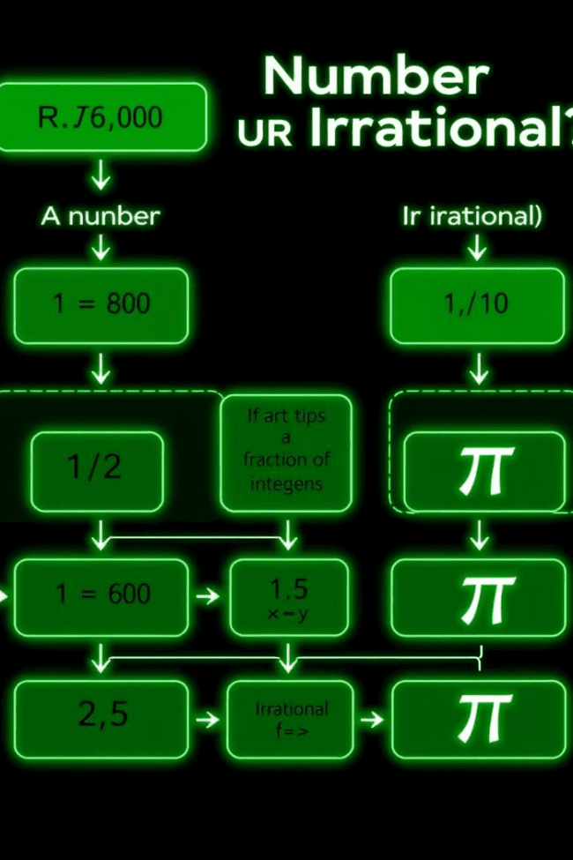



Identifying Rational and Irrational Numbers
Decimal Representation
If the decimal representation of a number terminates or repeats, it's rational. If it continues infinitely without repeating, it's irrational.
Fraction Form
If a number can be expressed as a ratio of two integers, it's rational. If it cannot be written in this form, it's irrational.
Square Roots
The square root of a perfect square is rational (e.g., √9 = 3). If a number has a square root that cannot be simplified to an integer, it's irrational (e.g., √2).

Slide 7
Comparing Rational and Irrational Numbers
Order on the Number Line
Both rational and irrational numbers can be ordered on the number line. However, rational numbers are densely packed, meaning that between any two rational numbers, there will always be another rational number. Irrational numbers, on the other hand, are distinct and occupy unique positions on the line.
Operations
Adding, subtracting, multiplying, and dividing rational numbers always results in another rational number. However, performing these operations on irrational numbers may lead to another irrational number, depending on the specific numbers involved.
1
2
3
Comparisons
Comparing rational numbers is generally straightforward, as we can convert them to a common denominator or decimal form. Comparing irrational numbers can be more challenging, as we often rely on approximations and understanding their relative magnitudes.

Slide 8
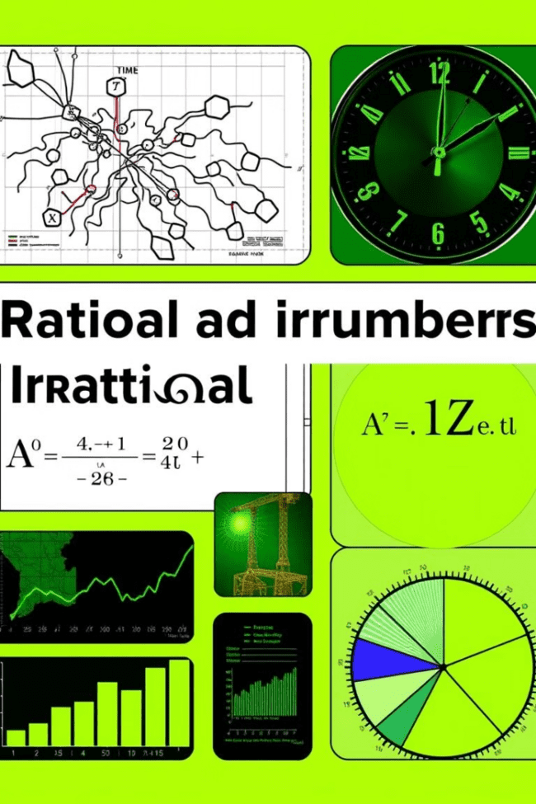



Real-world Applications of Rational and Irrational Numbers
Measurement and Construction
Rational numbers are essential in everyday measurements and construction. We use fractions and decimals to express lengths, weights, volumes, and other quantities accurately. Irrational numbers also play a role in advanced calculations and engineering designs.
Time and Finance
Rational numbers are used extensively in timekeeping and financial calculations. We use fractions and decimals to represent time intervals, interest rates, and financial ratios. Irrational numbers can also be applied in financial modeling and risk analysis.
Science and Technology
Irrational numbers are fundamental to many scientific and technological fields. Pi (π) is used in calculations involving circles and spheres, while other irrational numbers are crucial in physics, engineering, and computer science.

Slide 9

Conclusion and Key Takeaways
Understanding the distinction between rational and irrational numbers is crucial for navigating various mathematical and real-world concepts. Rational numbers are those that can be expressed as a ratio of two integers, while irrational numbers have infinite, non-repeating decimal representations. We've explored their properties, applications, and how to distinguish between them. This knowledge provides a foundation for further exploration of the complex and fascinating world of mathematics.

