Slide 1
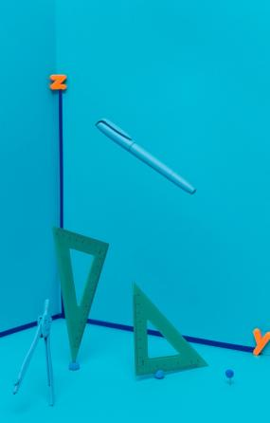
Exploring the World of Quadrilaterals: Shapes, Properties, and Applications

Slide 2




Introduction to Quadrilaterals
In this presentation, we will explore the fascinating world of . These four-sided shapes are not just basic ﬁgures; they have unique
and numerous
in various ﬁelds. Let's delve into their characteristics and signiﬁcance.

Slide 3
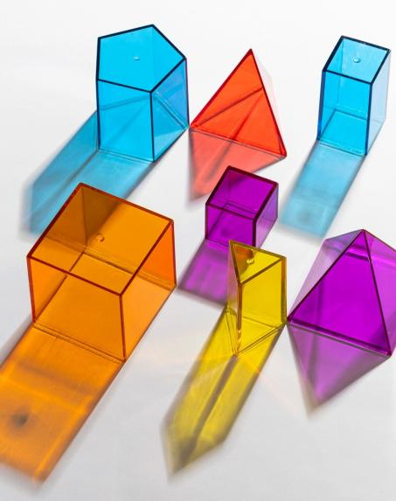






Types of Quadrilaterals
Quadrilaterals can be classiﬁed into several types
such as
, , ,
, and
. Each type has that set them apart, such as
distinct
equal sides or angles, and parallel sides.
Understanding these types is essential for geometry.

Slide 4
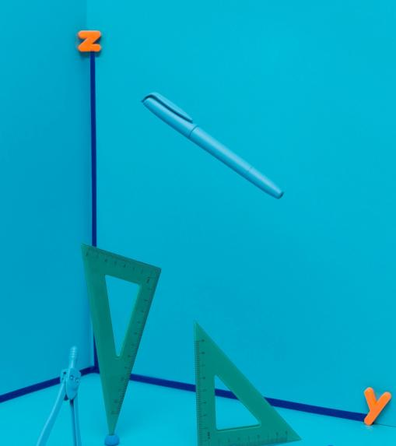


Properties of Quadrilaterals
Each quadrilateral possesses unique that deﬁne its shape. For example, the sum of interior angles in any quadrilateral is always . Additionally, some quadrilaterals have equal sides or angles, which contributes to their classiﬁcation.

Slide 5
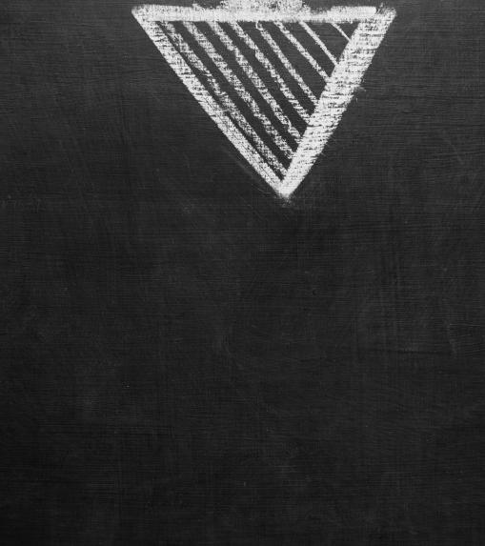




Perimeter and Area Formulas
Calculating the and of quadrilaterals is crucial in
geometry. The formulas vary based on the type: for example, the area of a rectangle is calculated as
, while a square's area is . Understanding these formulas aids in practical
applications.

Slide 6
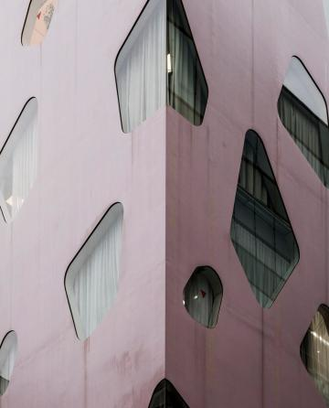

Real-World Applications
Quadrilaterals are not just theoretical shapes; they have real-world
in architecture, engineering, and design. For instance, many buildings utilize rectangular and square shapes for structural integrity. Understanding quadrilaterals helps in practical
problem-solving.

Slide 7
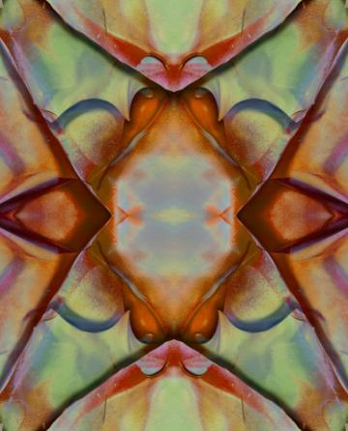

Quadrilaterals in Art
Artists often use to create visually appealing compositions. From paintings to sculptures, these shapes contribute to balance and harmony in art.
Recognizing the role of quadrilaterals can enhance our appreciation for artistic designs.

Slide 8

Common Misconceptions
There are several
about quadrilaterals, such as assuming all four-sided ﬁgures are squares. In reality, quadrilaterals encompass a wide variety of shapes, each with distinct characteristics. Clarifying these misconceptions is key to
understanding geometry.

Slide 9


Conclusion and Summary
In conclusion, quadrilaterals are essential shapes with diverse and . From geometry to art,
understanding these four-sided ﬁgures enriches our knowledge and practical skills. We hope this exploration has deepened your appreciation for quadrilaterals.

Slide 10
Thanks!
Do you have any questions? youremail@email.com
+91 620 000 838
www.yourwebsite.com @yourusername

