Slide 1
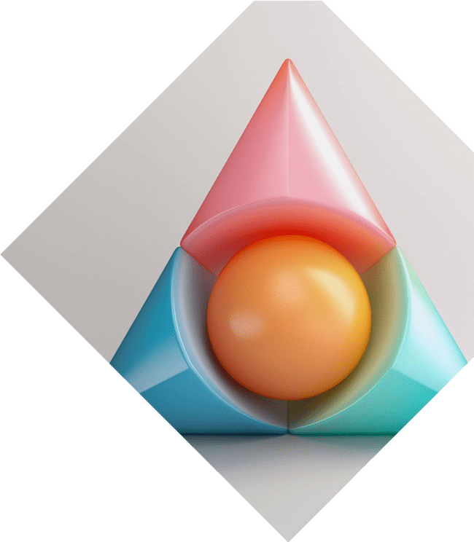

Graphical Metamorphosis: Unveiling the Art of Transformations

Slide 2




Introduction to Transformations
explores the enchanting world of
in art. This presentation will unveil the techniques and creativity behind transforming simple shapes into complex designs. Join us on this
artistic journey where
meets .

Slide 3





Understanding Transformations
Transformations are the of shapes in a plane.
The primary types include
, , and . Each transformation alters the shape's position, orientation, or size, creating a new visual experience that captivates the
viewer.

Slide 4
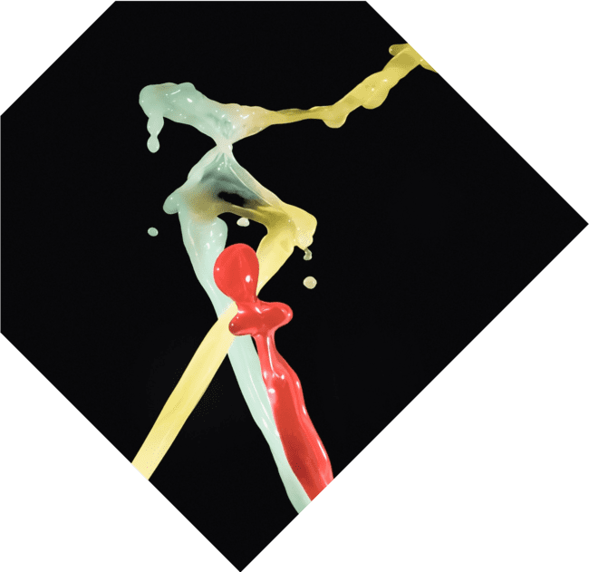



The Power of Translation
involves sliding a shape from one location to another without altering its orientation or size. This technique emphasizes and can create dynamic compositions that draw the viewer's eye across the artwork.

Slide 5





Captivating Rotations
Through , shapes can be turned around a point, creating a sense of and depth. This technique can evoke feelings of energy or serene , depending on the context and execution in the artwork.

Slide 6




Scaling for Impact
Scaling alters the size of a shape while maintaining its proportions. This transformation can create a
effect, emphasizing certain elements within
a composition. It allows artists to play with and .

Slide 7



Combining Transformations
Artists often transformations to create intricate
designs. By layering translations,
rotations, and scalings, they can
produce stunning visual effects that challenge the viewer's perception and enhance the overall .

Slide 8





Applications in Art and
Design
Transformations are not just mathematical concepts; they are essential in ,
, and .
Understanding these techniques allows artists to convey messages
effectively and create
visuals that resonate with
audiences.

Slide 9

Conclusion: The Art of Change
In summary, reveals
the artistry behind transformations. By
mastering techniques like translation, rotation, and scaling, artists can create compelling visuals that engage and inspire. Embrace the of transformation in your own creative journey!

Slide 10
Thanks!
Do you have any questions?
youremail@email.com
+91 620 000 838
www.yourwebsite.com @yourusername

