Slide 1


Permutations and Combinations: A Comprehensive Guide
Welcome to this presentation on permutations and combinations, a fundamental aspect of mathematics that plays a crucial role in fields like probability, statistics, and computer science. We'll explore the core concepts, delve into practical applications, and guide you through the process of calculating permutations and combinations.
by Onyedikachi Ikenna Onwurah

Slide 2
Introduction to Permutations and Combinations
Permutations
Combinations
Permutations deal with the number of ways to arrange a set of objects in a specific order. Think of it as arranging items in a line, where the order matters.
Combinations focus on the number of ways to select a group of objects from a larger set, where the order of selection doesn't matter. It's like choosing a team, where the order you pick the players is irrelevant.

Slide 3
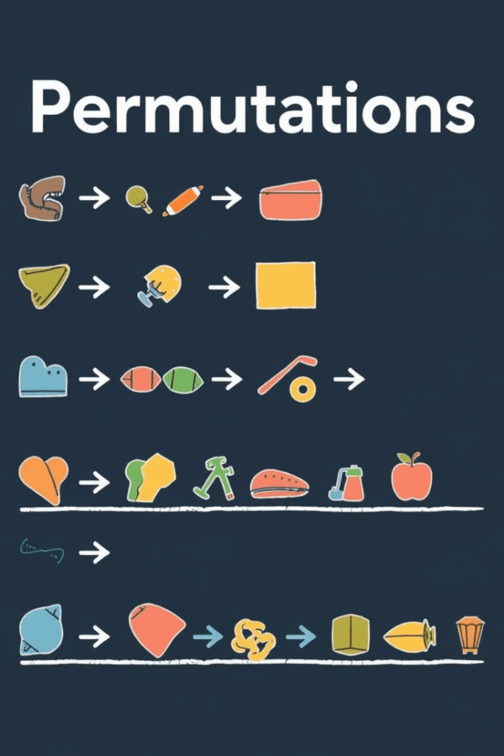
Fundamentals of Permutations
1
Factorial
2
Repetitions
The factorial function (denoted by '!') plays a key role in permutations. It calculates the product of all positive integers less than or equal to a given integer. For example, 5! = 5 * 4 * 3 * 2 * 1 = 120.
When dealing with permutations, consider whether repetition is allowed. If repetition is allowed, you can use the same object multiple times. If repetition is not allowed, each object can only be used once.
3
Order
Remember, permutations are about order. Switching the positions of objects creates a different permutation. The order in which you arrange things matters.

Slide 4
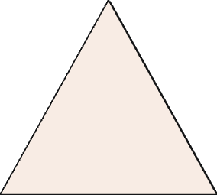
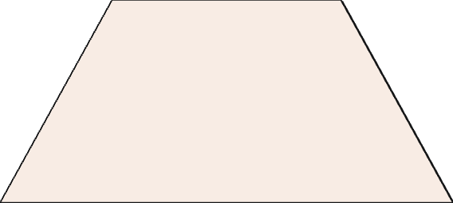
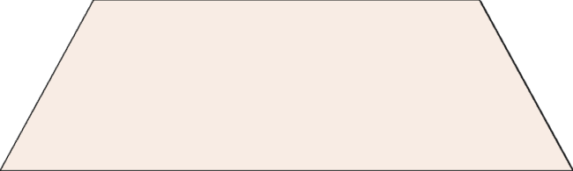
Calculating Permutations
Formula
1
The formula for calculating permutations is: nPr = n! / (n-r)!, where n is the total number of objects and r is the number of objects being selected.
Example
2
Let's say you have 5 books and want to arrange 3 of them on a shelf. The number of permutations is 5P3 = 5! / (5-3)! = 60.
Applications
3
Permutations are used in a wide range of applications, including password combinations, arranging teams, and scheduling events.

Slide 5




Fundamentals of Combinations
Selection
No Repetition
Order Doesn't Matter
Combinations are about selecting a group of objects without regard to order. You're focused on which items are chosen, not the order they're chosen in.
In general, combinations don't allow repetition. Each object can be chosen only once when forming a combination.
The order in which you select the objects doesn't affect the combination. Selecting A then B is the same as selecting B then A in a combination.

Slide 6
Calculating Combinations
Formula
1
The formula for calculating combinations is: nCr = n! / (r! * (n-r)!), where n is the total number of objects and r is the number of objects being selected.
Example
2
Let's say you have 7 fruits and want to choose 3 for a fruit salad. The number of combinations is 7C3 = 7! / (3! * (7-3)!) = 35.
Real-World Applications
3
Combinations are used in probability, statistics, and many other areas, from lottery drawings to selecting committees.

Slide 7
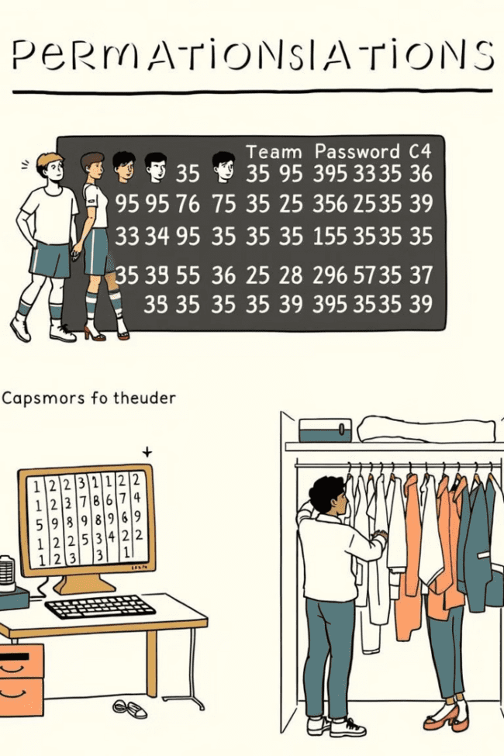
Applications of Permutations and Combinations
10
25
Password Security
Lottery Odds
Understanding permutations helps calculate the number of possible passwords, which is crucial for password security.
Combinations help determine the probability of winning a lottery by calculating the total number of possible winning combinations.
35
40
Game Design
Data Analysis
Combinations are vital for game designers, who use them to create diverse and engaging gameplay experiences.
Permutations and combinations are crucial for analyzing data and making statistical inferences.

Slide 8

Conclusion and Q&A
Understanding permutations and combinations equips you with powerful tools to tackle various mathematical challenges. These concepts have wide-ranging applications in diverse fields, making them essential for both theoretical exploration and practical problem-solving. We're now open to questions and further discussion. Let's explore permutations and combinations together!

