Slide 1
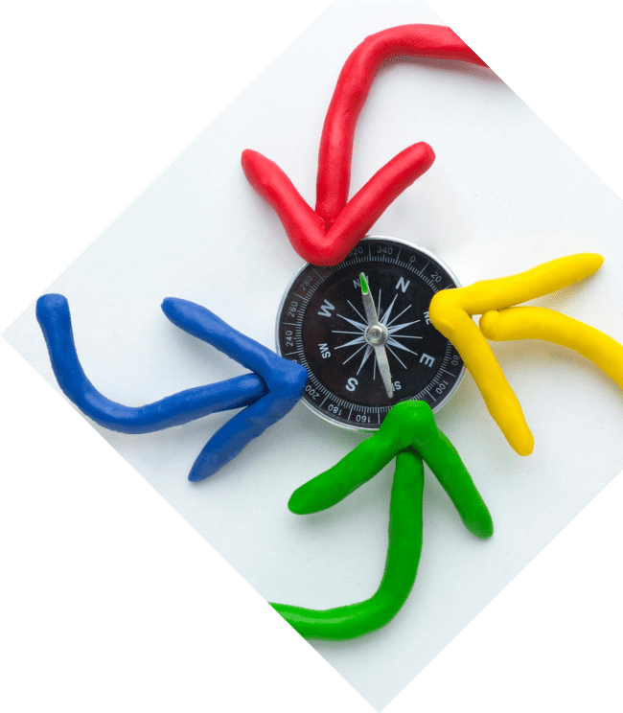
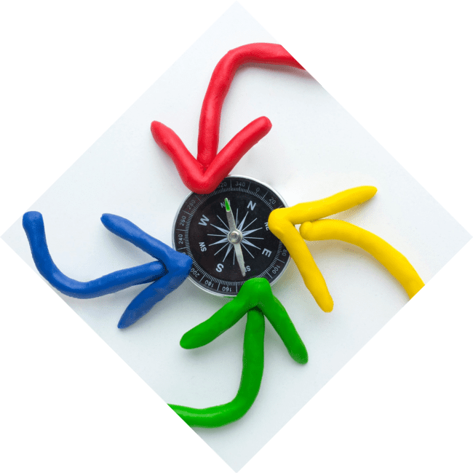
Unlocking the Parabola: The Art and Science of Quadratic Functions

Slide 2
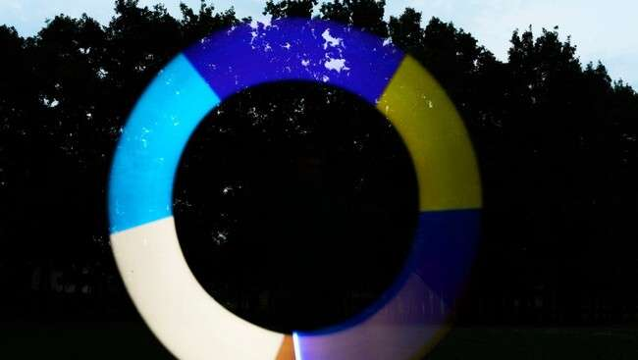



Introduction to Quadratics
Welcome to !
In this presentation, we will explore the and of
. Discover how these
elegant curves play a vital role in mathematics and the world around us, from architecture to physics.

Slide 3
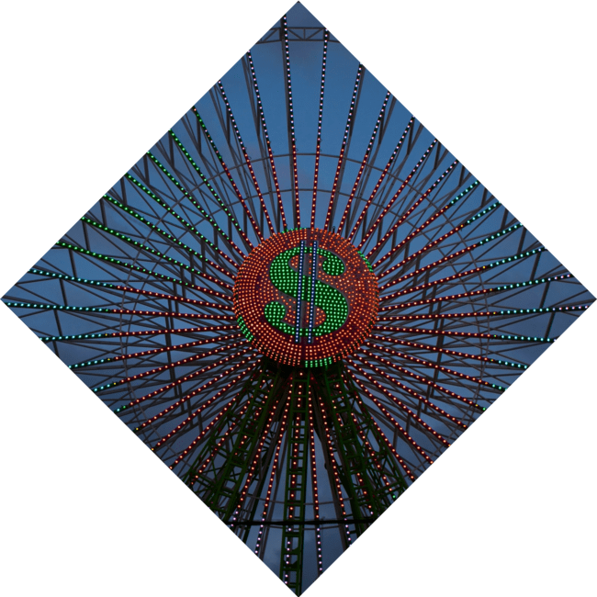



What is a Quadratic Function?
A is a polynomial
of degree two, typically written in the form . These
functions create a distinctive
called a parabola, which can open upwards or downwards depending on the
coefficient of x².

Slide 4



The Vertex: A Key Point
The of a parabola is its highest or lowest point, serving as a crucial feature in understanding its shape. The vertex can be found using the formula , revealing insights into the function's behavior
and symmetry.

Slide 5
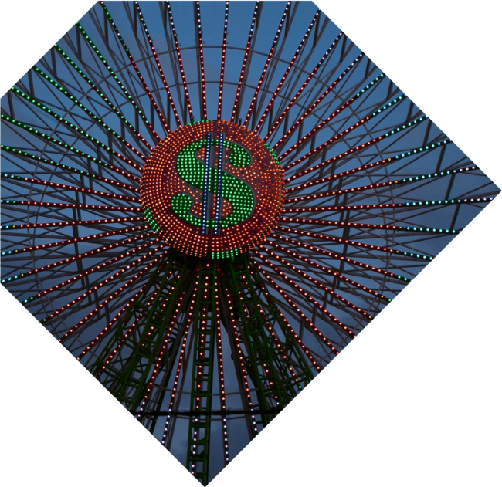



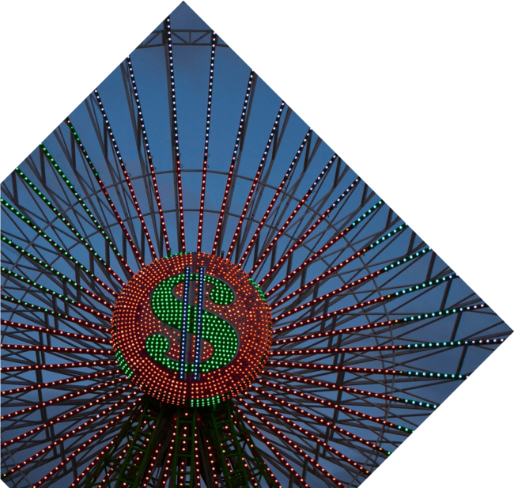
Roots and Intercepts
The of a quadratic function are the x- values where the graph intersects the x- axis. Finding these roots can be done using the :
. These points are essential for understanding the function's solutions.

Slide 6
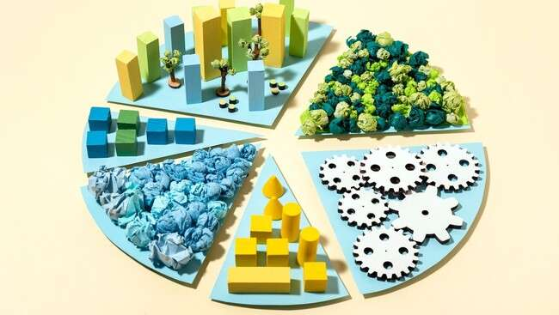



Applications in Real Life
Quadratic functions are not just theoretical! They are used in
to model projectile motion, in
to determine profit
maximization, and even in for designing arches.
Their applications are as diverse as
they are fascinating!

Slide 7
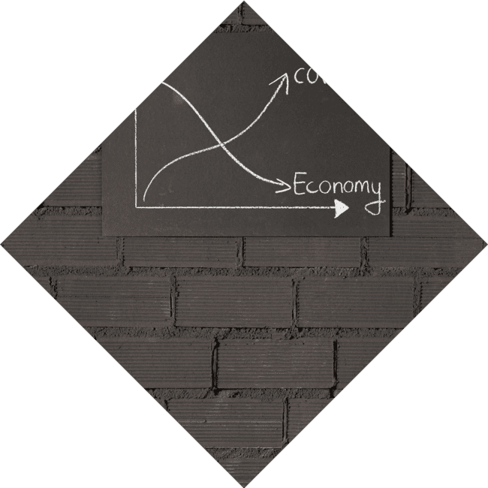



Graphing Techniques
Graphing a quadratic function involves identifying key features: the
, , and
. By plotting these points,
we can create a precise representation of the parabola, making it easier to analyze its
properties visually.

Slide 8



Transformations of Parabolas
Quadratic functions can be transformed through , , and
. Understanding these
transformations helps us predict how
changes in the equation affect the graph, allowing for creative manipulation of parabolic shapes.

Slide 9

Conclusion: The Beauty of Quadratics
In conclusion, quadratic functions are a blend of and . Their unique properties and
applications make them a captivating subject in mathematics. Embrace the beauty of parabolas and explore their endless possibilities in your own work!

Slide 10
Thanks!
Do you have any questions?
youremail@email.com
+91 620 421 838
www.yourwebsite.com @yourusername

