Slide 1


Advanced Trigonometry: Exploring the World of Angles and Ratios
Welcome to the fascinating world of advanced trigonometry. This presentation will guide you through key concepts, applications, and problem-solving strategies. We'll explore the rich relationships between angles, ratios, and functions that underlie many aspects of our world. Get ready to dive into a world of triangles, circles, and fascinating mathematical patterns.
by Onyedikachi Ikenna Onwurah

Slide 2
Angles and their Measurement
Angles: The Foundation
Measurement Matters
Angles are fundamental in trigonometry. They represent the amount of rotation between two lines or rays. We measure angles using units such as degrees, radians, and gradians. Understanding angle types like acute, obtuse, right, straight, and reflex angles is crucial for trigonometric analysis.
Each unit of angle measurement has its unique advantages and applications. Degrees are commonly used for everyday purposes. Radians are favored in calculus and higher-level mathematics. Understanding conversions between these units is essential for working with trigonometric functions.

Slide 3
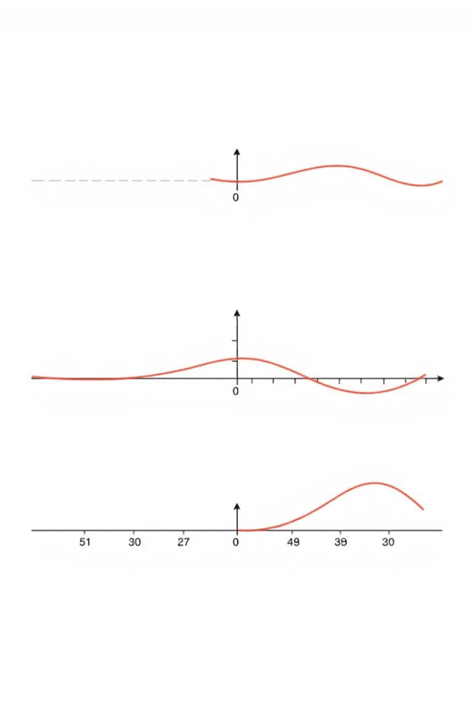
Trigonometric Functions
1
Sine
2
Cosine
The sine function (sin) represents the ratio of the opposite side to the hypotenuse in a right triangle. It's a periodic function, oscillating between -1 and 1.
The cosine function (cos) represents the ratio of the adjacent side to the hypotenuse. It's also periodic and oscillates between -1 and 1.
3
Tangent
4
Other Trigonometric Functions
The tangent function (tan) represents the ratio of the opposite side to the adjacent side. It's a periodic function with vertical asymptotes.
Beyond sine, cosine, and tangent, there are other important trigonometric functions: cotangent, secant, and cosecant. They are reciprocals of the primary functions and play vital roles in advanced calculations.

Slide 4
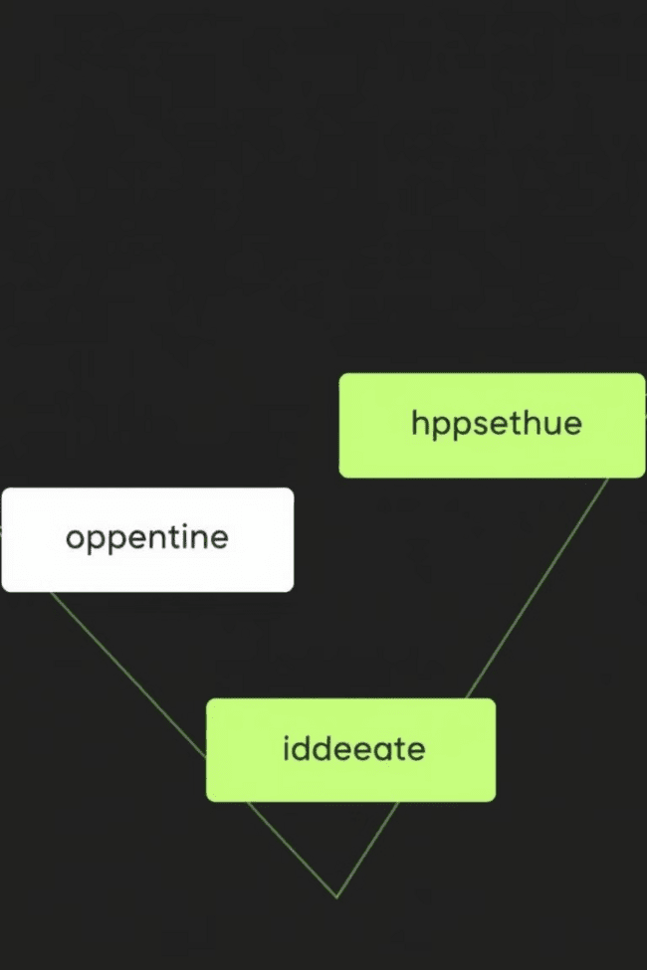



Right Triangle Trigonometry
SOH CAH TOA
This mnemonic helps remember the relationships between trigonometric functions and sides of a right triangle: Sine = Opposite/Hypotenuse, Cosine = Adjacent/Hypotenuse, Tangent = Opposite/Adjacent.
Solving for Sides and Angles
Trigonometric ratios allow us to solve for unknown sides and angles in right triangles. We use trigonometric functions like sine, cosine, and tangent along with inverse trigonometric functions to find these values.
Applications in Real-World Problems
Right triangle trigonometry has numerous applications in fields like engineering, surveying, navigation, and physics. We can calculate distances, heights, angles, and other essential parameters.

Slide 5




Trigonometric Identities
Fundamental Identities
1
These identities express relationships between trigonometric functions. Examples include sin^2(x) + cos^2(x) = 1 and tan(x) = sin(x)/cos(x).
Sum and Difference Identities
2
These identities relate the trigonometric functions of the sum or difference of two angles. For example, cos(a + b) = cos(a)cos(b) - sin(a)sin(b).
Double and Half Angle Identities
3
These identities help calculate trigonometric functions of double or half angles. For example, sin(2x) = 2sin(x)cos(x).
Product-to-Sum and Sum-to-Product Identities
4
These identities allow us to express products or sums of trigonometric functions as sums or products of other trigonometric functions. They are useful for simplifying expressions and solving equations.

Slide 6
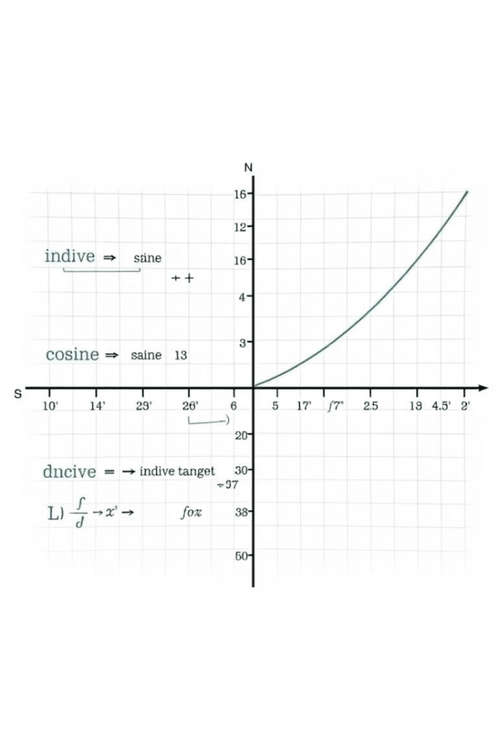
Inverse Trigonometric Functions
1
Finding Angles
Inverse trigonometric functions, denoted as arcsine (sin^-1), arccosine (cos^-1), and arctangent (tan^-1), are used to find the angle corresponding to a given trigonometric ratio.
2
Domains and Ranges
Inverse trigonometric functions have restricted domains and ranges to ensure a unique output for each input. Understanding these restrictions is essential for accurate calculations.
3
Solving Equations
Inverse trigonometric functions are crucial for solving trigonometric equations where the unknown is an angle. They allow us to isolate the angle and find its value.

Slide 7
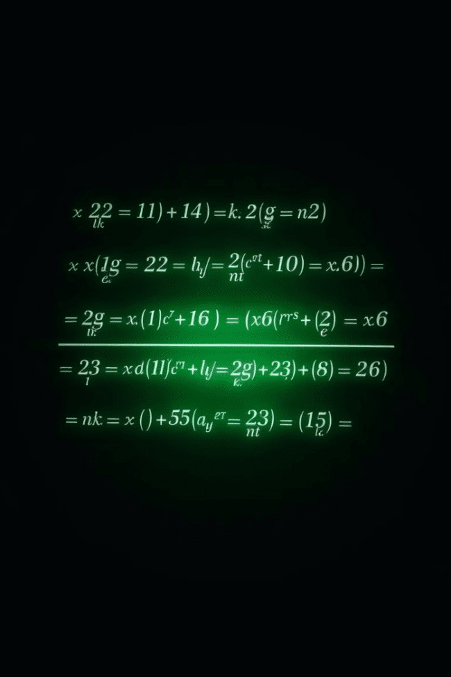




Solving Trigonometric Equations
Basic Equations
Simple equations involving trigonometric functions can be solved by using algebraic methods and basic trigonometric identities.
Advanced Equations
More complex trigonometric equations may require the use of quadratic formulas, factorization, or trigonometric identities to simplify and solve.
Solutions in Specific Intervals
We often need to find solutions to trigonometric equations within specific intervals, such as [0, 2π), which represents one complete cycle of a trigonometric function.
Multiple Solutions
Trigonometric equations often have multiple solutions due to the periodic nature of trigonometric functions. It's important to find all solutions within a specified interval.

Slide 8

Applications of Advanced Trigonometry
1
2
Engineering
Surveying
Trigonometry is essential in structural engineering, where calculations involving angles and forces are critical for building bridges, buildings, and other structures.
Surveyors use trigonometry to measure distances, angles, and elevations for land mapping and construction projects.
3
4
Navigation
Physics
Trigonometry is fundamental for navigation systems used in ships, aircraft, and satellites, where angles and distances are used to determine position and direction.
Trigonometry plays a vital role in physics, where it is used to analyze forces, motion, waves, and other physical phenomena.

